Slide 1
Module 8: Managing Recipient Objects and Resources

Slide 2
Module Agenda
Exchange Recipients
Creating and Managing Exchange Recipients
Lab 7-Exercise 1 – Create Exchange Recipients
Lab 7-Exercise 2 – Create Groups
Managing Email Addresses, Lists, and Resources

Slide 3
Lesson 1: Exchange Recipients

Slide 4
Lesson introduction
Importance of Exchange administrators in creating and configuring email recipients
After this lesson, you will be able to:
Describe the different recipient objects in Exchange
Describe resource mailboxes
Describe shared mailboxes
Describe linked mailboxes and site mailboxes
Describe groups

Slide 5
Recipient types overview
Mailboxes
Microsoft 365 groups
Shared Mailboxes
Mail contacts
Room mailboxes
Mail users
Equipment mailboxes
Mail-enabled Public Folders
Distribution groups
Site Mailboxes
Security groups
Linked mailboxes
Dynamic distribution groups
Remote mailboxes

Slide 6
Introduction to user mailboxes and resource mailboxes
User mailboxes
Resource mailboxes
Room mailboxes
Equipment mailboxes

Slide 7
Introduction to shared mailboxes
Shared mailboxes provide:
A generic
email address
A way for teams
to provide
centralized
services
Support for
multiple users
to monitor
and reply

Slide 8
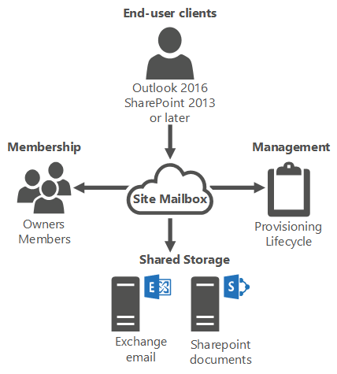
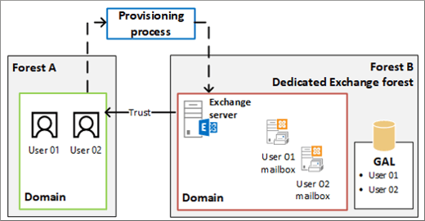
Overview of linked and site mailboxes
Linked mailbox architecture
Site mailbox architecture

Slide 9
Introduction to groups
Groups that can be used for Exchange to address a group of recipients
Types of groups that can be created and managed in the EAC portal:
Distribution lists (distribution groups)
Mail-enabled security groups
Dynamic distribution lists
Microsoft 365 groups

Slide 10
Lesson 2: Creating and Managing Exchange Recipients

Slide 11
Lesson introduction
After completing this lesson, you will be able to create and manage the following Exchange objects:
Mailbox settings
Resource mailboxes
Shared mailboxes
Mail contacts and mail users
Recipient permissions
Groups

Slide 12
Creating and managing user mailboxes
Create the user mailbox:
Create in Exchange Server or through the Exchange Management Shell
Configure user mailbox properties
Manage the user mailbox:
Various mailbox configuration options
Enable archive mailbox
Note mailbox size limits
Delete the user mailbox:
Disable or delete, depending on user’s need

Slide 13
Creating and managing resource mailboxes
Create the resource mailbox:
Create in Exchange Server or through the Exchange Management Shell
Manage the resource mailbox:
Configure how the mailbox will respond to meeting requests

Slide 14
Creating and managing shared mailboxes
Create the shared mailbox:
Single-step process performed by using the Exchange Admin Center or Exchange PowerShell
Grant users Full Access and Send As mailbox permissions upon creation
Manage the shared mailbox:
Manage delegate permissions (Full Access, Send As, Send on Behalf of)

Slide 15
Creating and managing mail contacts and mail users
Mail contacts:
Do not have a user account in Active Directory (AD) or Microsoft 365
Appear in Global Address List (GAL) throughout the organization
Add optional fields to contact or configure MailTip
Mail users:
Can log into AD or Microsoft 365 and access OneDrive, SharePoint Online
Have an external email address to Microsoft 365
Can have a secondary email address for the default <tenantname>.onmicrosoft.com domain

Slide 16
Managing permissions for recipients
Following permissions are used to access mailboxes or send messages on behalf of mailboxes or groups:
Full Access
Send As
Send on Behalf of
Procedures for assigning permissions

Slide 17
Creating and managing exchange groups
Manage Microsoft 365 groups
Manage security and distribution groups
Migrate distribution lists to Microsoft 365 groups:
Use either the EAC or Windows PowerShell

Slide 18
Lesson 3: Lab 7 – Exercises 1 and 2

Slide 19
Lab exercises
Exercise 1: Create Exchange Recipients
Task 1
Create a Cloud Recipient
Exercise 2: Create Groups
Task 1
Create an On-Premises Distribution Group
Task 2
Create a Cloud Distribution Group
Task 3
Create an Office 365 Group

Slide 20
Lesson 4: Managing Email Addresses, Lists, and Resources

Slide 21
Lesson introduction
Address lists simplify the process of finding recipients in an organization.
Address book policies (ABPs) allow for user segmentation and provide custom views of the GAL.
After this lesson, you will be able to:
Describe address lists
Explain how to configure address lists
Describe address book policies
Explain how to configure offline address books
Describe email address policies

Slide 22
Address lists overview
Address lists are used to:
Group recipient objects based on a LDAP query for specific user attributes
Sort the GAL into multiple views for locating recipients
Types of recipient filters:
Pre-canned
Custom
How address lists can be used:
Custom address lists
Hierarchical address lists

Slide 23
Creating and managing address lists
The most common address list management tasks performed by Messaging Administrators include:
Creating
address lists
Modifying
address lists
Deleting
address lists
Hiding
mailboxes from
address lists
Updating
address list
membership

Slide 24
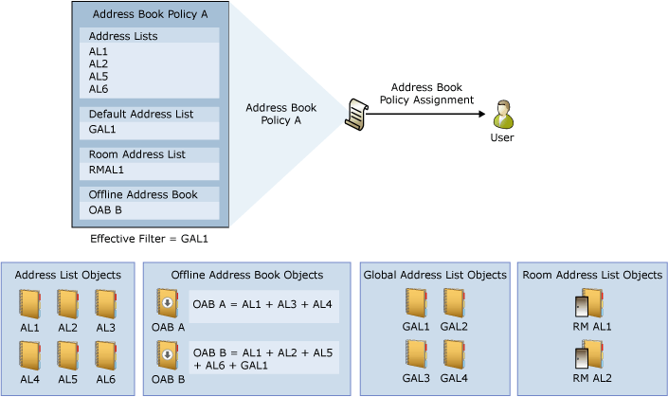
Address book policies
Used to limit the information users see in the GAL
Address book policy (ABP) components
  One GAL
  One OAB
  One room list
  One or more address lists

Slide 25
Configuring offline address books
Offline address books (OABs):
Downloadable copies of the address lists used by Outlook clients
Used when they are configured in cached mode and are not connected to Exchange
OAB generated on a Mailbox server every 8 hours (by default)
The most common OAB tasks include:
Create or remove an OAB
Add or remove an address list to or
from an OAB
Change the default OAB
Assign OAB to a user
Assign ABP to a user

Slide 26
Email address policies
Creating an email-address policy
Using Email Address
Policy Wizard, choose
from default set of
recipient scope filters
Configure a rule
that filters the
recipients to which
the policy applies
Choose from
default SMTP email
address or custom
SMTP email address

Slide 27
Lesson 5: Module Review

Slide 28

Discussion – Module review
What are your key takeaways from this module, and why?
What are the key features discussed in this module that you foresee implementing at your organization?

Slide 29
Closing Slide

