Slide 1

Module 11: Performing Mailbox Migrations

Slide 2
Module Agenda
Planning Mailbox Migrations
Performing IMAP Migrations
Performing Cutover and Staged Migrations
Performing Advanced Migrations
Exercise – Planning a Mail Migration to Microsoft 365

Slide 3
Lesson 1: Planning Mailbox Migrations

Slide 4

Lesson introduction
The importance of deciding the best migration option for your environment
After completing this lesson, you will be
able to:
Describe the migration and coexistence strategies with Exchange Online
Use FastTrack to move mailboxes

Slide 5
Overview of migration options to Exchange Online
Migration Approaches
Cutover Migrations
IMAP Migration
Staged Migration
PST Migrations
Minimal Hybrid Configuration/ Express Migration
Third-Party Migration
Full Hybrid Configuration

Slide 6
Determining which migration option to use
Exchange Online Migration Decision Matrix
What is the current email system
Which Exchange Server Version?
Is there any need for long term mail co-existence
Rich
Exchange
Server
Exchange 2003
or later
Yes
Hybrid Exchange/
Minimal Hybrid
Exchange 2000
or earlier
Exchange 2010
2013 or 2016
Third-party
No
How do clients connect
Is thee any need for long-term mail coexistence
How many users are there?
2,000
or over
Coexistence
IMAP
Yes
EX Version
Cross-Premises Coexistence
POP3 or
proprietary
No
Under
2,000
Simple
Can it be configured for IMAP?
How many users are there?
2,000
or over
Exchange 2003
2013 or 2007
Yes
Want more than just email folders
Under
2,000
No
Staged Exchange or
IMAP migration
Migration
Temporary
PST migration or 3rd party migration tool
IMAP migration
Cutover Exchange migration

Slide 7
Changing the DNS MX records during a Microsoft 365 migration
Migration options
Cutover
Migration
Staged
Migration
Full or
Minimal Hybrid
Configuration
IMAP
Migration

Slide 8

Using FastTrack center to move mailboxes to Exchange Online
FastTrack process
1
Purchase eligible plan
2
Initiate FastTrack Center Benefit
User adoption services for eligible products
Core onboarding
Service onboarding and data migration*
Exchange Online
Data
migration*
SharePoint Online
OneDrive for Business
Skype for Business Online
Microsoft Teams
Power BI
Project Online
Yammer Enterprise
Office 356 ProPlus
Microsoft StaffHub
Outlook for iOS and Android

Slide 9
Lesson 2: Performing IMAP Migrations

Slide 10
Lesson introduction
Considering the importance of the IMAP Protocol and how it affects the migration process to Exchange Online
After completing this lesson, you will be
able to:
  Describe the requirements for an IMAP migration and how it’s carried out
  Move mailbox data using an IMAP migration

Slide 11
Performing an IMAP migration
Administrator tasks
in the IMAP email system
Administrator tasks
in Microsoft 365
Administrator tasks
in domain registrar
Add users and assign licenses
1
Prepare your server and get the
information you need to migrate
Prepare: Verify your domain
2
2
Communicate changes to users
3
Set up admin credentials or get
or reset user email passwords
Create list of mailboxes to
migrate (CSV file)
4
5
Connect Microsoft 365 to
email system
6
Migrate mailboxes, then
verify the migration
7
Optimize email settings
(optional)
Configure domain to begin
routing email to Microsoft 365
8
9
Verify routing, then stop
email synchronization
10
Send a welcome letter
to users
11

Slide 12
Moving mailboxes using IMAP migration
Planning your IMAP migration
Steps for running your IMAP migration

Slide 13
Lesson 3: Performing Cutover and Staged Migrations

Slide 14
Lesson introduction
After completing this lesson, you will be
able to:
  Describe the requirements for both cutover and staged migrations
  Perform a migration and move mailboxes either with a cutover or staged migration

Slide 15
Planning a cutover migration
If your organization has Exchange Server 2007 or later and fewer than 2000 users, you should implement a cutover Exchange migration
The entire on-premises Exchange organization is migrated to Exchange Online in a single migration batch
Cutover migration is the ideal migration solution for up to 150 mailboxes
  When planning a cutover migration, key considerations include:
  Your current Exchange environment must run Exchange 2007 or later
  Directory synchronization (Azure AD Connect) must be disabled on your Microsoft 365 tenant
  A cutover migration only moves mailboxes, mail users, mail contacts, and mail-enabled groups; it does NOT migrate security groups and system mailboxes
  You must either migrate all messages from all mailboxes, or remove the items that you don’t want to migrate before you start the migration process
On-premises accounts will be automatically created and matched with the corresponding objects in Exchange Online
If there is already an object with the same name, the migration process for this user or mailbox will fail

Slide 16
Performing a cutover migration
Administrator tasks
in Exchange Server on-premises
Administrator tasks
in Microsoft 365
Administrator tasks
in domain registrar
Communicate changes to users
Prepare: Verify your domain
1
1
Prepare your servers
Create empty mail-enabled
security group in Microsoft 365
2
2
Connect Microsoft 365 to
on-premises email system
3
Migrate mailboxes (including
email, contacts, and calendar),
then verify the migration
Configure domain to begin
routing email to Microsoft 365
4
5
Verify routing, then delete
the cutover migration batch
6
Decommission Exchange
servers (Optional)
Complete post-migration tasks
7
7
Send a welcome letter to users
8

Slide 17
Planning a staged migration
While a Cutover migration migrates all the user’s mailboxes in 1 step, Staged Migration includes minimal coexistence
A Staged Migration is performed in either the EAC or PowerShell

Slide 18
Performing a staged migration
Administrator tasks
in Exchange Server on-premises
Administrator tasks
in Microsoft 365
Result for users
Administrator runs
synchronization
Synchronization creates users
in Microsoft 365
1
1
1
Administrator creates CSV file
that lists user to be migrated
Administrator runs staged
migration batch
2
3
Migration report sent to admin
4
All email, contacts, and calendar
items are migrated
5
Administrator converts
mailboxes
Users in initial batch can connect to Exchange Online from Outlook
6
7
Administrator creates new
CSV files for additional batches
of users
Administrator runs staged migra-
tion batches for additional users
8
9
Administrator resolve any issues
All users can connect to Exchange Online from Outlook
10
11
Administrator performs
post-migration tasks
Administrator performs
post-migration tasks
13
12

Slide 19
Moving mailboxes using cutover and staged migrations
Spend enough time planning your Cutover or Staged Migrations!
Creating a Migration Endpoint for Cutover or Staged Migration:
Moving mailboxes
  Performing a Migration Batch:
  Moving mailboxes (Staged)
  CSV file is created

Slide 20
Lesson 4: Performing Advanced Migrations

Slide 21
Lesson introduction
The focus of this lesson will be on migrating a PST file and the considerations for a Public Folder migration
After completing this lesson, you will be
able to:
  Import PST Files to Exchange Online mailboxes
  Migrate Public Folders to Exchange Online

Slide 22
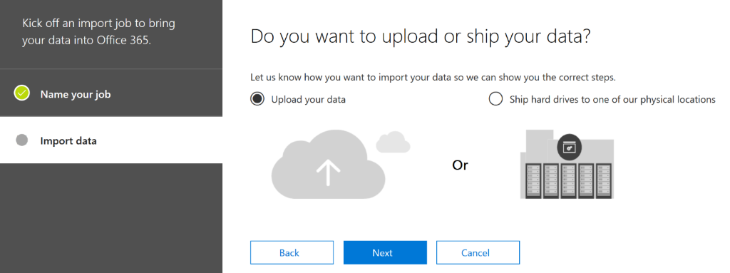
Planning a PST migration

Slide 23
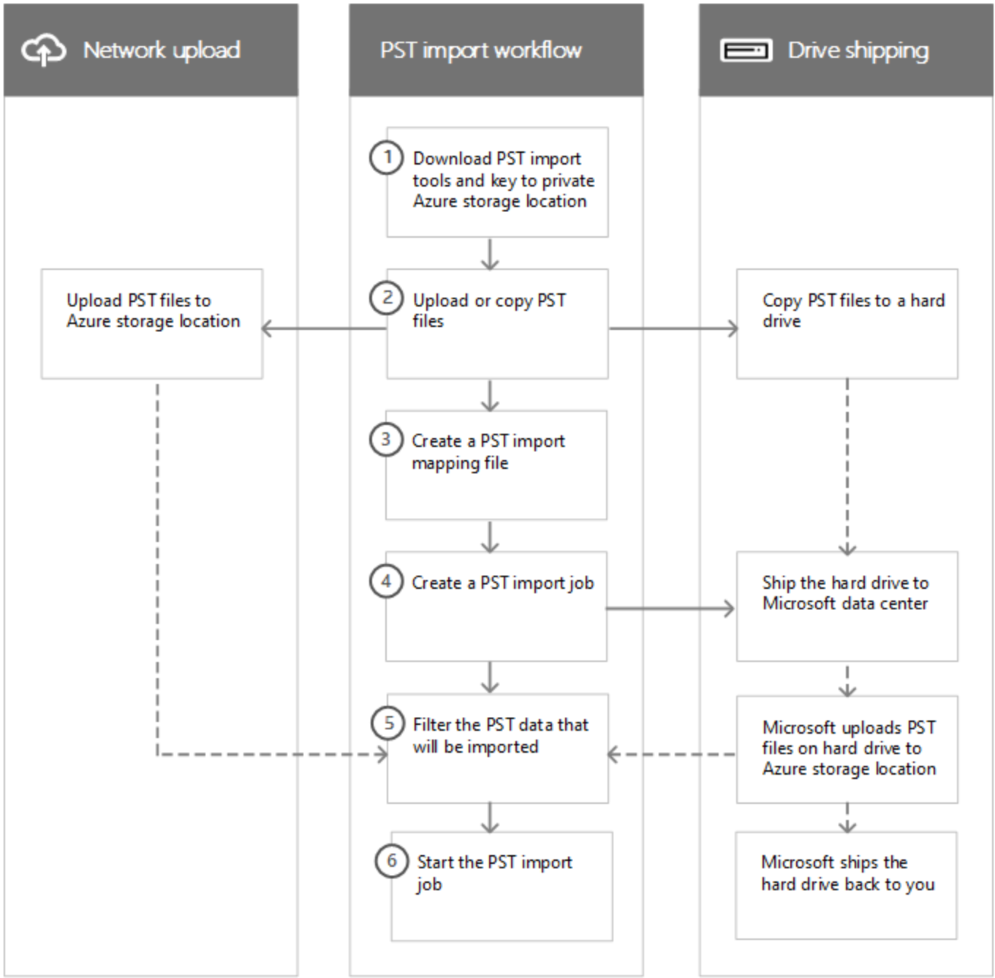
Performing a PST migration

Slide 24
Performing a public folder migration
Planning your Public Folder Migration
Two types of Public Folders
Migrations Process is Different for Each Public Folder Type
Migrating Legacy Public Folders to Exchange Online
Migrating Modern Public Folders to Exchange Online
Migrating Public Folders to Microsoft 365 Groups

Slide 25
Lesson 5: Exercise – Planning a Mail Migration to Microsoft 365

Slide 26
Paper-based lab exercise
Planning a Mail Migration to Microsoft 365
Fabrikam, Inc. is moving to Microsoft 365 as its cloud solution. The Enterprise Administrator has requested that you review the company’s footprint and then develop a plan for migrating a group of on-premises mailboxes to Microsoft 365 as part of its mail migration pilot project. As part of that analysis, he has asked that you address some specific issues that concern him.
Download the planning document from the site listed in your student manual
Step 1
Each student should review the information provided and answer the questions in the document
Step 2
After completing the assessment, exchange it with one of your fellow students and review each other’s assessment. Identify the key differences between your
two proposals
Step 3
Review your assessments with the class and come to a final solution
for Fabrikam
Notes:
A copy of the planning document is available in the MCT DLC for this course. The document has suggested solutions for each question. Use these suggested answers to help drive the discussion. You should allot approximately 1 hour for this exercise.

Slide 27
Lesson 6: Module Review

Slide 28

Discussion – Module review
What are your key takeaways from this module, and why?
What are the key features discussed in this module that you foresee implementing at your organization?

Slide 29
Closing Slide

