Slide 1
Module 12: Deploying and Troubleshooting a Hybrid Environment

Slide 2
Module Agenda
Deploying and Managing an Edge Transport Server
Configuring a Hybrid Deployment using the HWC
Implementing Advanced Hybrid Functionality
Lab 10-Exercise 1 – Configure your Hybrid Deployment
Troubleshooting Hybrid Deployments
Lab 10-Exercise 2 – Test your Hybrid Deployment
Lab 10-Exercise 3 – Final Assessment – Troubleshooting your Hybrid Deployment

Slide 3
Lesson 1: Deploying and Managing an Edge Transport Server

Slide 4
Lesson introduction
After this lesson, you will be able to:
Describe the Edge Transport servers
Explain Infrastructure requirements for Edge Transport server
Describe EdgeSync
Plan for message flow with an
Edge Transport server

Slide 5
Overview of the Edge Transport Server
The Edge Transport server provides a secure SMTP gateway for all incoming and outgoing Internet email in an organization
The Edge Transport server was developed primarily for the medium-to-large business market to replace an existing SMTP gateway or smart host
The Edge Transport server in Exchange Server 2019 does not provide
a graphical management interface
Edge Transport server Functionality

Slide 6
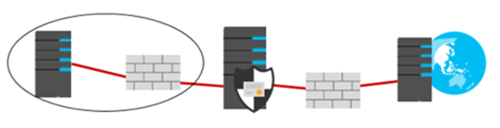
Infrastructure requirements for the Edge Transport Server
The Edge Transport server role
Cannot be deployed with any other Exchange server role
Should not be a member of the internal AD DS
Must be configured with an FQDN
Should be deployed in a perimeter network
Requires a minimal number of ports opened on the internal and external firewalls
Must be configured with the IP addresses for DNS servers that can resolve DNS names on the internet

Slide 7


Overview of EdgeSync
EdgeSync replicates AD DS information to AD LDS on Edge Transport servers
EdgeSync:
Includes configuration and recipient information
Synchronizes only changes to the Edge Transport server
Is always initiated by internal Exchange servers
EdgeSync
AD DS database
AD LDS database

Slide 8
Message Flow with an Edge Transport Server
On-premises Exchange organization
Microsoft 365 for enterprise
EOP
1
Internet
Internal Exchange server
3
2
Perimeter network
4
Exchange Edge Transport
Exchange Online organization

Slide 9
Lesson 2: Configuring a Hybrid Deployment using the HWC

Slide 10
Lesson overview
After this lesson, you will be able to:
Describe the prerequisites to run the Office 365 Hybrid Configuration Wizard
Explain best practices for implementing a hybrid deployment

Slide 11

Preparing to run the HCW
Hybrid deployment requirements
Hybrid deployment prerequisites

Slide 12
Best practices for implementing a Hybrid Deployment
Use the Hybrid Configuration Wizard (HCW) app
Understand the requirements of Minimal Hybrid, Exchange Classic, and Exchange
Modern Hybrid
Understand why your organization wants to implement a hybrid deployment
Start slowly, and then speed up when everything works
Do not change the MX resource record at first
Use multiple MRS Proxy endpoints where possible

Slide 13
Lesson 3: Implementing Advanced Hybrid Functionality

Slide 14
Lesson overview
After this lesson, you will be able to:
Manage a hybrid deployment
Describe when you must configure Public Folder coexistence with Microsoft 365
Explain how to configure Oauth for a mixed Exchange environment
Describe how to configure OneDrive for Business attachments for on-premises mailboxes

Slide 15
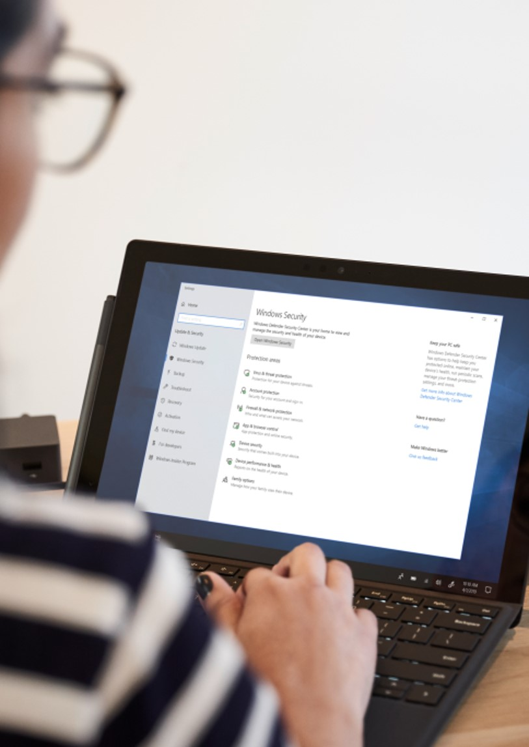
Managing a Hybrid Deployment
Monitoring a Hybrid Deployment
Updating a Hybrid Deployment

Slide 16
Configuring Public Folder Coexistence with Microsoft 365
How Public Folder coexistence works
Public Folder coexistence requirements
Planning legacy Public Folder coexistence
Public Folder co-existence pre-requisites
Configuration steps for Public Folder coexistence
Synchronize mail-enabled Public Folders

Slide 17
Configuring OAuth for a Mixed Exchange Environment
OAuth is required for some Exchange-related features, such as cross-premises discovery and automatic archive retention
Manually configuring OAuth for your Exchange organization

Slide 18
Configuring OneDrive for business access for on-premises mailboxes
This functionality requires the following prerequisites:
The user’s mailbox must be located on an Exchange 2016/19 server
Your on-premises Exchange environment must be configured as a hybrid deployment
OAuth must be configured between your on-premises Exchange environment and Exchange Online

Slide 19
Lesson 4: Lab 10 – Exercise 1

Slide 20
Lab exercises
Exercise 1: Configure your Hybrid Deployment
Task 1
Create Adatum’s hybrid Exchange deployment
Task 2
Configure Mail Flow settings
Task 3
Create on-premises user mailboxes for testing
Task 4
Create a new Outbound Connector

Slide 21
Lesson 5: Troubleshooting Hybrid Deployments

Slide 22
Lesson overview
After this lesson, you will be able to troubleshoot:
Directory synchronization
Pass-Through Authentication and Single Sign-On
Transport with Exchange Online
Client Access in Coexistence
Mailbox Replication Service

Slide 23
Troubleshooting directory synchronization
Sync fails completely
Single user object does not sync

Slide 24
Troubleshooting pass-through authentication and single sign-on
Pass-through authentication troubleshooting
Single sign-on
The Remote Connectivity Analyzer Microsoft 365 Single Sign-On Test is a tool to help you troubleshoot SSO

Slide 25
Troubleshooting transport with Exchange Online
Mail flow
Connectivity
configuration
DNS
Third-party
hardware and
software

Slide 26
Troubleshooting mailbox replication service
When you move mailboxes or public folders, the backend process that handles the data move is the Mailbox Replication Service (MRS)
Some indirect troubleshooting of MRS is often beneficial as well, such as collecting statistics to find information about move requests

Slide 27
Lesson 6: Lab 10 – Exercises 2 and 3

Slide 28
Lab exercises (continued)
Exercise 2: Test your Hybrid Deployment
Task 1
Test the Hybrid Topology
Task 2
Migrate an On-Premises Mailbox to test your connectors
STOP! See note below
Task 3
Test the newly migrated mailbox
Exercise 3: Final Assessment
IMPORTANT: Migrating an on-premises mailbox to Microsoft 365 in Exercise 2, Task 2 can take up to an hour to complete. You cannot test the newly migrated mailbox in Task 3 until the migration is complete.
To avoid sitting around for an hour, once you finish Task 2 perform the Final Assessment in Exercise 3 while the migration runs. Once the class has finished the Final Assessment, return to Exercise 2, Task 3 to test the newly migrated mailbox.
Task 1
Troubleshooting your
Hybrid Deployment
Return to Exercise 2,
Task 3

Slide 29
Lesson 7: Module Review

Slide 30
Discussion – Module review
What are your key takeaways from this module, and why?
What are the key features discussed in this module that you foresee implementing at your organization?

Slide 31
Closing Slide

