Slide 1
Module 2
Managing Entra ID users
and groups
Notes:
Presentation: 75 minutes
Lab: 95 minutes
After completing this module, students will be able to:
Manage user accounts and licenses by using the Microsoft 365 admin center.
Manage passwords and authentication.
Manage security and distribution groups by using the Microsoft 365 admin center.
Manage Entra ID users and groups by using Windows PowerShell.
Configure administrative access.
Required materials
To teach this module, you need the Microsoft PowerPoint file 20347B_02.pptx.
Preparation tasks
To prepare for this module, you should:
Read all of this module’s materials.
Practice performing the demonstrations and labs.
Work through the Module Review and Takeaways section to determine how you will use the information to reinforce student learning and promote knowledge transfer to on-the-job performance.
As you prepare for this class, it is imperative that you complete the labs yourself. This gives you an understanding of how the labs work and the concepts that each covers, so that you can provide meaningful hints to students who might have issues. Furthermore, it will help guide your lecture to ensure that you discuss the concepts that the labs cover.
20347B
2: Managing Entra ID users and groups

Slide 2
Module Overview
Managing user accounts and licenses
Managing passwords and authentication
Managing security groups in Entra ID
Managing Entra ID users and groups with Windows PowerShell
Configuring administrative access
Notes:
Briefly introduce the module lessons to students.
20347B
2: Managing Entra ID users and groups

Slide 3
Lesson 1: Managing user accounts and licenses
User account types
Creating user accounts
Managing user licenses
Managing user accounts
Deleting and recovering user accounts
Notes:
Briefly introduce the lesson topics to students.
Question
What types of user accounts are available in Entra ID?
Answer
The following types of user accounts are available in Entra ID:
Cloud identities—when using these, you create and manage users in Entra ID only.
Synchronized identities by using an on-premises directory service to synchronize with Entra ID.
Federated identities by using Active Directory Federation Services (AD FS).
20347B
2: Managing Entra ID users and groups

Slide 4
User account types
Cloud identities:
  Exist only in Entra ID
  Are suitable only for small organizations
Synchronized identities:
  Exist in AD DS and Entra ID
  Can synchronize passwords
  Are managed in AD DS
  You can implement pass-through authentication as an alternative to AD FS
Federated identities:
  Add SSO for synchronized identities
  Require AD FS
Notes:
Briefly describe the concept of cloud, synchronized, and federated identities. Mention that synchronized and federated identities are covered in detail later in the course.
20347B
2: Managing Entra ID users and groups

Slide 5
Creating user accounts
User provisioning options include:
  Microsoft 365 admin center
  Import multiple users
  Windows PowerShell
  Directory synchronization
Notes:
Describe how to create user accounts by using Microsoft 365 admin center and with bulk import.
20347B
2: Managing Entra ID users and groups

Slide 6
Managing user licenses
While assigning Entra ID service licenses to users, you can:
  Replace existing licenses
  Add to existing licenses
You can view license information such as:
  Unlicensed users
  Number of used licenses
Notes:
Describe how to assign licenses to users and the implications of choosing different license subscriptions.
20347B
2: Managing Entra ID users and groups

Slide 7
Managing user accounts
In the Microsoft 365 admin center, you can modify the user settings in the following categories:
Account
Devices
Licenses and Apps
Mail
OneDrive
Notes:
Describe how to modify user accounts after creation, including managing multiple recipients.
20347B
2: Managing Entra ID users and groups

Slide 8
Deleting and recovering user accounts
Delete single or multiple users with:
  Microsoft 365 admin center
  The Remove-MsolUser command in the Microsoft Online module for
  Windows PowerShell
Deleted users are inactive for 30 days
Restore deleted users before the 30-day grace period with Microsoft 365 admin center:
  The Restore-MsolUser command in the MSOnline module for Windows PowerShell
Notes:
Describe how to delete and restore user accounts and how this affects users.
20347B
2: Managing Entra ID users and groups

Slide 9
Lesson 2: Managing passwords and authentication
Password policy options
Self-service password management
Multi-factor authentication
Planning password policies and authentication
Notes:
Briefly introduce the lesson topics to students.
Question
What password policy options are available in Entra ID?
Answer
The following password policy options are available in Entra ID:
Password expiration policy:
Specify the number of days until the password expires.
Specify the number of days for the user notification warning about the password expiration.
Resetting user passwords:
Create a new temporary password for users.
Resetting admin passwords:
You can ask another administrator to reset it for you.
Reset it yourself.
20347B
2: Managing Entra ID users and groups
(More notes on the next slide)

Slide 10
Notes:
Question
How can you enable multi-factor authentication in Entra ID and what multi-authentication options are available?
Answer
An administrator enables multi-factor authentication on a per-user basis. Multi-factor authentication options in Entra ID include:
Call my mobile phone
Text code to my mobile phone
Call my office phone
Notify me through app
Show one-time code in app
20347B
2: Managing Entra ID users and groups

Slide 11
Password policy options
Password policy:
  Specify the number of days for password expiration
  Specify the number of days for the password expiration warning
  Disable password expiration
Resetting user passwords:
  Create a new temporary password for users
Resetting admin passwords:
  Ask another administrator to reset it for you
  Reset it yourself on the sign in screen
Notes:
Describe the options for configuring password policies and managing passwords.
20347B
2: Managing Entra ID users and groups

Slide 12
Self-service password management
Subscription | User type | Password reset
Entra ID only | Cloud | Self-service password reset
 | Synchronized or federated | Contact administrator
Entra ID Premium P1 or P2 | Cloud, synchronized, or federated | Self-service password reset
Self-service password reset authentication methods:
Email
Mobile phone
Office phone
Security questions
Notes:
Use the table on the slide to describe self-service password reset requirements.
20347B
2: Managing Entra ID users and groups

Slide 13
Multi-factor authentication
The tenant administrator enables multi-factor authentication
Enable multi-factor authentication for each user
Multi-factor authentication options in Entra ID include:
  Call to phone
  Text message to phone
  Notification through mobile app
  Verification code from mobile app
Notes:
Describe how to enable multi-factor authentication and describe the multi-factor authentication options.
20347B
2: Managing Entra ID users and groups

Slide 14
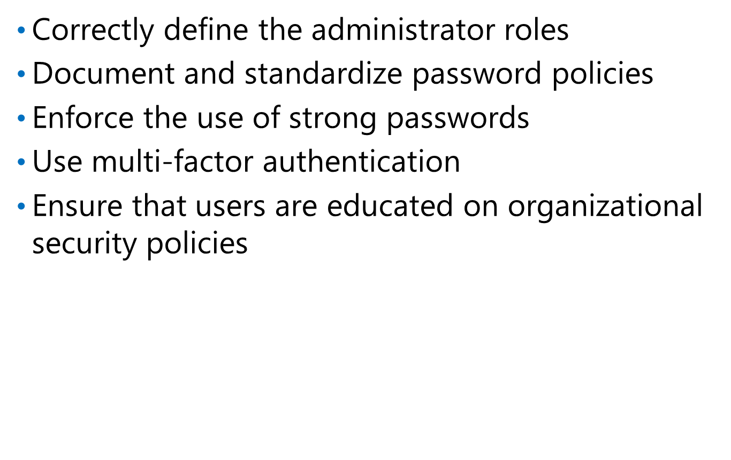
Planning password policies and authentication
Notes:
Describe the best practices for managing passwords and authentication.
20347B
2: Managing Entra ID users and groups

Slide 15
Lab A: Managing Entra ID users and passwords
Exercise 1: Managing Entra ID users and licenses by using the Microsoft 365 admin center
Exercise 2: Managing Entra ID password policies
Logon Information
Virtual machine: 20347B-LON-DC1
20347B-LON-CL1
User names: Adatum\Administrator
Adatum\Beth
Password: Pa55w.rd
Estimated Time: 35 minutes
Notes:
Exercise 1: Managing Entra ID users and licenses by using the Microsoft 365 admin center
The Entra ID tenant for Adatum is now configured, and you need to start creating Entra ID users and then managing the user licenses.
Exercise 2: Managing Entra ID password policies
Your organization has configured a password policy for on-premises users that requires a complex password, and it requires users to change their passwords every 60 days. You need to ensure that the password policy for the pilot users on Entra ID matches the policy for on-premises users, and you need to report any settings that you cannot configure to match.
20347B
2: Managing Entra ID users and groups

Slide 16
Lab Scenario
After configuring an Entra ID tenant and preparing it for pilot deployment, you are now ready to start creating user and group accounts in Entra ID. You and your team need to be familiar with how to configure these accounts by using the Microsoft 365 admin center because this will be your primary tool for managing the environment after the deployment is fully functional. Additionally, you need to make sure that the password policy for Entra ID users matches the password policy for on-premises users.
Notes:
20347B
2: Managing Entra ID users and groups

Slide 17
Lab Review
After creating a user account, what account settings are available for you to edit in the Active users window of the Microsoft 365 admin center?
What password policy settings are available in Entra ID?
Notes:
Question
After creating a user account, what account settings are available for you to edit in the Active users window of the Microsoft 365 admin center?
Answer
In the Active users window of the Microsoft 365 admin center, an administrator can edit the following settings for a user account:
User name
Email aliases
Product licenses
Group membership
Sign-in status
Office installations
Roles
Contact information
Mail settings
OneDrive settings
20347B
2: Managing Entra ID users and groups
(More notes on the next slide)

Slide 18
Notes:
Question
What password policy settings are available in Entra ID?
Answer
In Entra ID, the following password policy settings are available:
Set passwords to never expire
Number of days before passwords expire
Days before a user is notified that their password will expire
20347B
2: Managing Entra ID users and groups

Slide 19
Lesson 3: Managing security groups in Entra ID
Overview of groups in Entra ID
Creating and configuring groups
Deleting groups
Notes:
Briefly introduce the lesson topics to students.
Question
List the three types of mail-enabled groups in Exchange Online in Entra ID.
Answer
The three types of mail-enabled groups in Exchange Online in Entra ID are:
Distribution groups. Use these groups only to distribute messages to a set of recipients.
Security groups. Use these groups to distribute messages and to provide access to resources.
Dynamic distribution groups. These groups do not have a predefined member list, because they use recipient filters and conditions that you define to determine membership dynamically at the time that messages are sent.
20347B
2: Managing Entra ID users and groups

Slide 20
Overview of groups in Entra ID
Group types in Microsoft 365 admin center:
  Microsoft 365 group
  Distribution list
  Mail-enabled security group
  Security group
Group types in Exchange admin center:
  Distribution group
  Security group (mail-enabled)
  Dynamic distribution group
SharePoint Online groups can contain security groups
Notes:
Describe the function of groups in Entra ID. Compare Microsoft Exchange Online distribution groups, Microsoft SharePoint Online security groups, and Entra ID groups.
20347B
2: Managing Entra ID users and groups

Slide 21
Creating and configuring groups
Security groups are not mail-enabled, but you can create mail-enabled security groups
Use security groups to grant permissions to SharePoint Online sites
Create groups by using the Microsoft 365 admin center or the New-MsolGroup cmdlet
Nest security groups to improve organization
Notes:
Demonstrate how to create groups and manage group membership.
20347B
2: Managing Entra ID users and groups

Slide 22
Deleting groups
Deleted security groups cannot be recovered
  Members are not deleted
Delete security groups by using:
  Microsoft 365 admin center
  Remove-MsolGroup cmdlet
Notes:
Demonstrate how to delete groups.
20347B
2: Managing Entra ID users and groups

Slide 23
Lesson 5: Configuring administrative access
Entra ID administrator roles
Assigning administrator roles
Planning delegated administration
Notes:
Briefly introduce the lesson topics to students.
Question
What are the administrator roles that you can assign in Entra ID?
Answer
The administrator roles that you can assign:
Global administrator
Billing administrator
Password administrator
Service administrator
User management administrator
Exchange Online administrator
Teams Service administrator
SharePoint Online administrator
20347B
2: Managing Entra ID users and groups

Slide 24
Entra ID administrator roles
Entra ID admin center role name | Windows PowerShell role name | Role tasks
Global administrator | Company administrator | Perform all administrative tasks
Billing administrator | Billing administrator | Make purchases, manage subscriptions, manage support tickets, and monitor service health
Password administrator | Helpdesk administrator | Change and reset passwords, manage service requests, and monitor service health
Service administrator | Service support administrator | Manage service requests and monitor service health
User management administrator | User account administrator | Create and delete users and groups, reset passwords, manage service requests, and monitor service health
Notes:
Describe the Entra ID administrator roles. Highlight that Windows PowerShell administrator names are different from Entra ID administrator names.
20347B
2: Managing Entra ID users and groups

Slide 25
Assigning administrator roles
In the Microsoft 365 admin center:
  Click Admin > Users
  Select a user
  Under Edit user roles, assign a role, and then provide an alternate email address
In Windows PowerShell, use the following commands:
  Get-MsolRole
  Get-MsolUserRole
  Get-MsolUserRoleMember
  Add-MsolRoleMember
  Remove-MsolRoleMember
Notes:
Show how to assign administrator roles, including how to assign roles by using Windows PowerShell.
20347B
2: Managing Entra ID users and groups

Slide 26
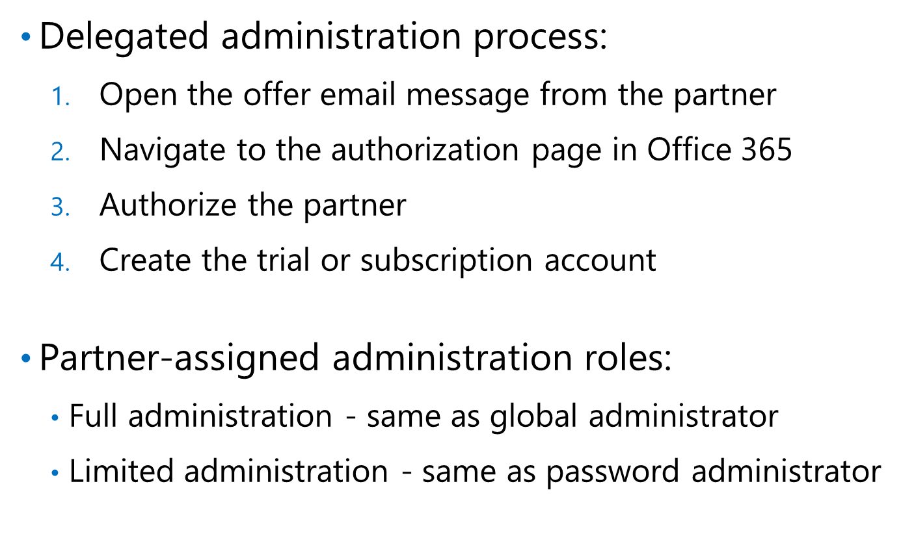
Planning delegated administration
Notes:
Describe the best practices for delegating administration.
20347B
2: Managing Entra ID users and groups

Slide 27
Lab B: Managing Entra ID groups and administration
Exercise 1: Managing Entra ID groups
Exercise 2: Managing Entra ID users and groups by using Windows PowerShell
Exercise 3: Configuring service administrators
Logon Information
Virtual machine: 20347B-LON-DC1
20347B-LON-CL1
User names: Adatum\Administrator
Adatum\Beth
Password: Pa55w.rd
Estimated Time: 60 minutes
Notes:
Exercise 1: Managing Entra ID groups
Your organization has a policy that groups rather than individual user accounts must be in use to assign permissions. Ensure that you can manage groups in the Microsoft 365 admin center.
Exercise 2: Managing Entra ID users and groups by using Windows PowerShell
If the pilot project is a success, you expect that you will need to manage hundreds of user and group accounts. To manage these efficiently, you will need to use Windows PowerShell. In preparation for this, you need to familiarize yourself with managing users and groups by using Windows PowerShell.
Exercise 3: Configuring service administrators
Members of the pilot project team have different responsibilities during the pilot. To ensure that team members have only the permissions that they require to perform various tasks in Entra ID, you are going to assign different administrator roles to different users.
20347B
2: Managing Entra ID users and groups

Slide 28
Lab Scenario
In addition to creating user accounts, you also need to know how to create group accounts in Entra ID. In this pilot project, you will use Windows PowerShell commands to manage users and groups. If the pilot is successful, you can manage several hundred users and groups, and Windows PowerShell will be a means to manage them efficiently. One of the goals in the pilot project is to test delegated administration in Entra ID, so you also need to delegate password management and billing management to different users.
Notes:
20347B
2: Managing Entra ID users and groups

Slide 29
Lab Review
How would you design your group structure to minimize adding and removing people from groups?
What should you do before you can use Windows PowerShell to administer users and groups in Entra ID?
Why would you create multiple administrative roles in Entra ID by using role-based access control (RBAC)?
Notes:
Question
How would you design your group structure to minimize adding and removing people from groups?
Answer
Use nested groups and assign permissions to the group rather than to individual users.
Question
What should you do before you can use Windows PowerShell to administer users and groups in
Entra ID?
Answer
Run Entra ID Module for Windows PowerShell with administrative rights, and then run the Connect-MsolService command. Provide the credentials of an account that has global admin or user management admin rights.
Question
Why would you create multiple administrative roles in Entra ID by using role-based access control (RBAC)?
Answer
RBAC provides predefined permissions assigned to different users or groups. By using RBAC, you can separate administrative tasks for different administrators according to organizational security and business requirements. For example, some administrators are responsible for managing user and group accounts, and other administrators are responsible for assigning appropriate Entra ID licenses to users.
20347B
2: Managing Entra ID users and groups

Slide 30
Module Review and Takeaways
Review Questions
Best Practices
Notes:
Review Questions
Question
What is the most efficient way of creating user accounts if your organization decides to migrate to Entra ID?
Answer
Answers will vary depending on the type of identities that you use in an organization. The types of identities include:
Cloud identities. An administrator exports user accounts from the Active Directory site and performs bulk import into Entra ID.
Synchronized identities by using an on-premises directory service to synchronize with Entra ID.
Federated identities by using AD FS. When using federated identities, administrators manage users on-premises and synchronize on-premises directory objects with Entra ID. The process where users sign in only once is referred to as single sign-on (SSO).
Question
How will you configure Entra ID password policies in your organization, and will you use multi-factor authentication?
Answer
Answers might vary, but possible answers might include:
Some organizations configure a longer period before passwords expire, and some organizations shorten the period because of security restrictions.
Some organizations want to strengthen security and enable multi-factor authentication.
20347B
2: Managing Entra ID users and groups
(More notes on the next slide)

Slide 31
Notes:
Question
Why is it more convenient to assign permissions to security groups than to users?
Answer
Assigning permissions to security groups helps makes administering security for resources easier and more efficient. When you assign permissions to groups, administrators control group membership only to provide users with appropriate permission levels. For example, if a user needs a permission level, the administrator includes that user as a member of the appropriate group that has preassigned permissions. Removing the user from the group removes permissions from the user that were assigned because of a group membership.
Question
In which management scenarios will you use Entra ID with Windows PowerShell rather than the Microsoft 365 admin center?
Answer
Use Windows PowerShell in scenarios where bulk object management is necessary, whereas, if you need to configure a single setting, the Microsoft 365 admin center is more convenient.
Question
In which scenarios will you use RBAC in Entra ID?
Answer
Use RBAC in enterprise organizations where multiple administrator teams have responsibilities for different aspects of Entra ID administration, such as managing users, groups, subscriptions, and passwords. Smaller organizations might not use RBAC because only a few administrators are responsible for all types of administrative tasks.
(More notes on the next slide)
20347B
2: Managing Entra ID users and groups

Slide 32
Notes:
Best Practices
Always perform detailed planning for user and group management, and check the plan in a test Entra ID tenant before deploying in production.
Plan and test user administrative tasks to improve user management efficiency and to eliminate errors in the production environment, especially when running Windows PowerShell scripts.
Plan for multi-factor authentication to help administrators choose the authentication method that suits their organizational security requirements.
Plan administrative roles to distribute administrative tasks according to organizational security and business requirements.
20347B
2: Managing Entra ID users and groups

