Slide 1
Module 4
Planning and configuring
directory synchronization
Notes:
Presentation: 70 minutes
Lab: 90 minutes
After completing this module, the students will be able to:
Plan and prepare for directory synchronization.
Implement directory synchronization by using Microsoft Azure Active Directory Connect (Entra Connect).
Manage Microsoft Microsoft 365 identities with directory synchronization.
Required materials
To teach this module, you need the Microsoft PowerPoint file 20347B_04.pptx.
Preparation tasks
To prepare for this module, you should:
Read all of this module’s materials.
Practice performing the demonstrations and labs.
Work through the Module Review and Takeaways section to determine how you will use the information to reinforce student learning and promote knowledge transfer to on-the-job performance.
As you prepare for this class, it is imperative that you complete the labs yourself. This gives you an understanding of how the labs work and the concepts that each covers, so that you can provide meaningful hints to students who might have issues. Furthermore, it will help guide your lecture to ensure that you discuss the concepts that the labs cover.
20347B
4: Planning and configuring directory synchronization

Slide 2
Module Overview
Planning and preparing for directory synchronization
Implementing directory synchronization by using Entra Connect
Managing Microsoft 365 identities with directory synchronization
Notes:
Provide an overview of the module content.
20347B
4: Planning and configuring directory synchronization

Slide 3
Lesson 1: Planning and preparing for directory synchronization
Microsoft 365 authentication options
Overview of directory synchronization
Planning directory synchronization
Prerequisites for directory synchronization
Preparing for directory synchronization
Configuring a tenant for directory synchronization
Notes:
Provide an overview of the lesson content.
20347B
4: Planning and configuring directory synchronization

Slide 4

Microsoft 365 authentication options
Cloud identity
Synchronized identity
Federated identity
Entra ID
Entra ID
Entra ID
Entra Connect and Password Sync
Entra
Connect
Federation
AD DS
AD DS
Independent cloud identity
Single identity, enabling a same sign-on experience with password hash synchronization
Single federated identity, enabling SSO in some scenarios and additional flexibility
Notes:
Provide an overview of the topic content. Explain the authentication options. Mention pass-through authentication as an alternative to Active Directory Federation Services (AD FS), but don’t go into too much detail as this will be discussed later.
20347B
4: Planning and configuring directory synchronization

Slide 5







Overview of directory synchronization
HR database
Entra ID
Database
Identity management
Exchange Mail
Synchronization
LDAP
Windows Server Active Directory
Notes:
Provide an overview of the topic content.
20347B
4: Planning and configuring directory synchronization

Slide 6
Planning directory synchronization
Best practices for deploying directory synchronization:
  Have a proper project plan
  If AD DS filtering is used, configure it before synchronizing objects to Microsoft 365
  Work with a cloud services partner
  Perform thorough capacity planning
  Remediate AD DS before deploying directory synchronization
  Add all SMTP domains as verified domains before synchronizing
Notes:
Discuss best practices for directory synchronization. Use real-world examples if you have experience with directory synchronization.
20347B
4: Planning and configuring directory synchronization

Slide 7
Prerequisites for directory synchronization
When reviewing the prerequisites for directory synchronization, your tasks should include:
  Capacity planning for your directory synchronization database server
  Identifying the hardware requirements for your directory synchronization computer
  Identifying if your environment exceeds the Entra ID object quota
  Reviewing the network ports required by directory synchronization
  Determining if any schema extensions to AD DS are required
Notes:
If students ask what the current version number of Entra Connect is, tell them that you can check your Entra Connect version using Add/Remove Programs, and noting the version history on the installer properties.
20347B
4: Planning and configuring directory synchronization

Slide 8
Preparing for directory synchronization
You will need to prepare your environment for directory synchronization
  If you will be using SSO in your environment, then you should deploy it before directory synchronization
  You will need to prepare your on-premises AD DS environment
  You will identify and configure the appropriate UPN suffixes in your on-premises AD DS environment
  You will use Microsoft 365 IdFix to resolve any issues identified by the Microsoft 365 readiness checks
Notes:
Discuss important steps in preparing an environment for successful directory synchronization. Take additional time to explain potential attribute issues.
20347B
4: Planning and configuring directory synchronization

Slide 9
Configuring a tenant for directory synchronization
To enable Active Directory synchronization by using the Microsoft 365 admin center you should start Directory sync setup assistant
You can also enable directory synchronization by using Windows PowerShell
You can view status of the directory synchronization by using DirSync Status in the Microsoft 365 admin center
Notes:
Provide an overview of the topic content. Explain how you can enable directory synchronization in the Microsoft 365 admin center and by using Windows PowerShell.
20347B
4: Planning and configuring directory synchronization

Slide 10
Lesson 2: Implementing directory synchronization by using Entra Connect
Overview of Entra Connect
Entra Connect requirements
Entra Connect express synchronization settings
Entra Connect customized synchronization
Upgrading to Entra Connect
Entra Connect Health
Entra Connect in multi-forest scenarios
Entra Connect pass-through authentication
Notes:
Provide an overview of the lesson content.
20347B
4: Planning and configuring directory synchronization

Slide 11
Overview of Entra Connect
When using Entra Connect for directory synchronization:
  New user, group, and contact objects in on-premises
  AD DS are added to Microsoft 365
  Attributes of existing user, group, or contact objects that are modified in on-premises AD DS are modified in
  Microsoft 365
  Existing user, group, and contact objects that are deleted from on-premises AD DS are deleted from Microsoft 365
  Existing user objects that are disabled on-premises are disabled in Microsoft 365
Notes:
Inform the student that while multiple versions of directory synchronization exist, always use the latest version as it will provide the most features and include the longest support.
20347B
4: Planning and configuring directory synchronization

Slide 12
Entra Connect requirements
When identifying the Entra Connect requirements, you should assess:
  Entra ID requirements
  Domain and forest requirements
  Operating system and supporting software requirements
  Permissions and accounts
  Database requirements
Notes:
Explain the requirements for Entra Connect. Be sure that students understand what they need to do to prepare for establishing directory synchronization between Entra ID and the local AD DS.
20347B
4: Planning and configuring directory synchronization

Slide 13
Entra Connect express synchronization settings
Scenarios for using the Express Settings include:
  If you have a single forest AD DS
  Users sign in with the same password using password synchronization
Installing Entra Connect with Express Settings:
  Installs the synchronization engine
  Configures Entra Connector
  Configures the on-premises AD DS connector
  Enables password synchronization
  Configures synchronization services
  Configures sync services for Exchange hybrid deployment (optional)
  Enables automatic update for Entra Connect
Notes:
Explain what is achieved by selecting express synchronization settings in Entra Connect.
20347B
4: Planning and configuring directory synchronization

Slide 14
Entra Connect customized synchronization
The scenarios for when to select customized settings include:
  When you have multiple forests
  When you customize your sign-in option, such as AD FS for federation or use a non-Microsoft identity provider
  When you customize synchronization features, such as filtering and writeback
Notes:
Explain which options are available when you choose to customize synchronization settings. In addition, explain in which scenarios you should customize default synchronization options.
20347B
4: Planning and configuring directory synchronization

Slide 15
Upgrading to Entra Connect
Different options for an Entra Connect upgrade:
  In-place upgrade, if the expected upgrade time is less than three hours then the recommend option is to do an in-place upgrade
  Parallel deployment, if the expected upgrade time is more than three hours then the recommend option is to do a parallel deployment on another server. It is estimated that if you have more than 50,000 objects in AD DS, then it will take more than three hours to do the upgrade; the preferred upgrade option is a parallel deployment in this scenario
Notes:
Explain the options available for upgrading to Entra Connect, and explain the scenarios in which you use each option.
20347B
4: Planning and configuring directory synchronization

Slide 16


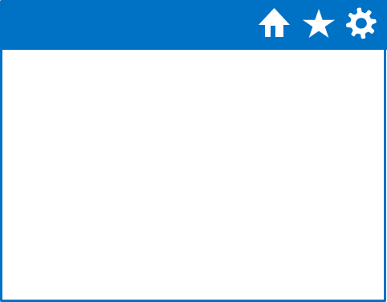
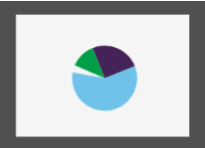



Entra Connect Health
Entra ID
Entra Connect
Entra Connect Health
On-premises AD DS/ AD FS
Notes:
Explain Entra Connect Health, emphasize that Microsoft 365 does not include this tool and that it requires a separate license. If time permits, demonstrate how to use this tool.
20347B
4: Planning and configuring directory synchronization

Slide 17
Entra Connect in multi-forest scenarios
Entra Connect supports synchronization from mutiple AD DS forests
You need to use a customized Entra Connect setup to configure this scenario
Each user must be identified uniquely
Notes:
Explain which scenarios are supported for multiple forest topologies. In addition, make sure that you explain when you should use these options.
20347B
4: Planning and configuring directory synchronization

Slide 18
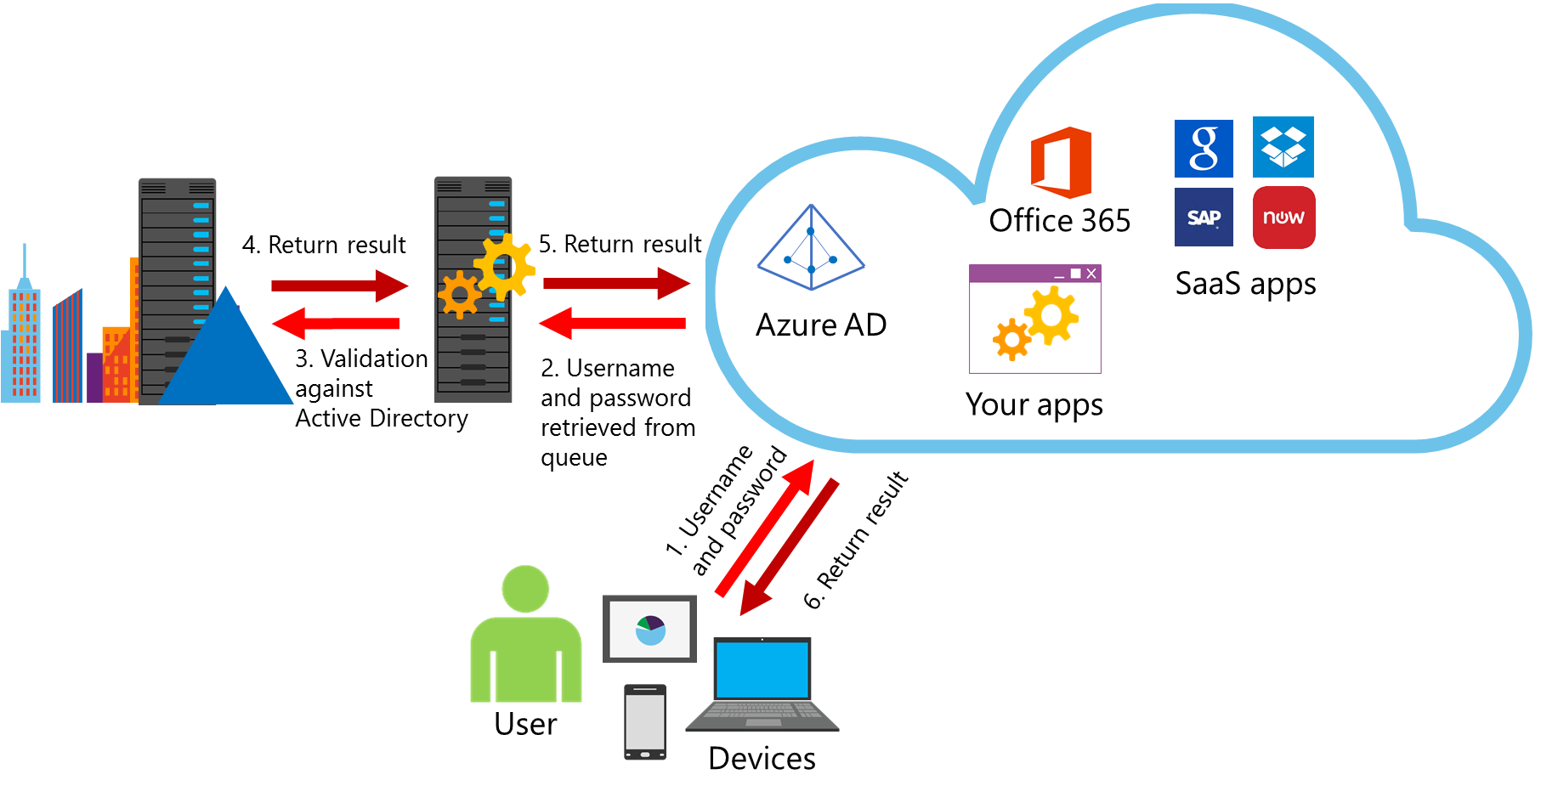
Entra Connect pass-through authentication
Entra ID pass-through authentication enables you to centralize authentication for both on-premise and cloud resources without deploying AD FS
Entra ID
Notes:
Explain Entra ID pass-through authentication and which scenario this technology addresses. Use the image on the slide to explain systematically, how Entra ID pass-through authentication works.
20347B
4: Planning and configuring directory synchronization

Slide 19
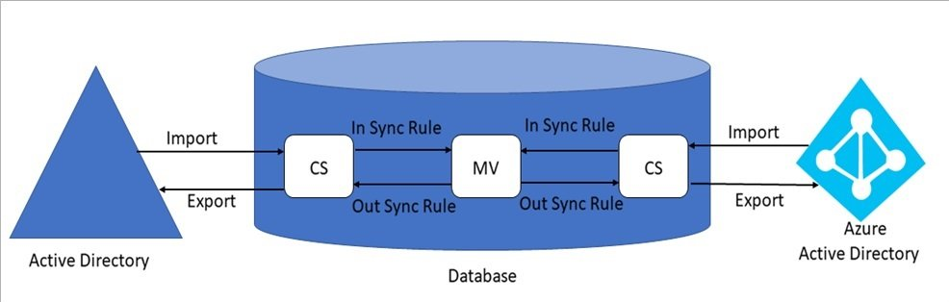
How does Entra Connect work?
A 3 step pipeline is used
  Import
  Synchronization
  Export
Each step is executed for AD and Entra
Entra

Slide 20
Lesson 3: Managing Microsoft 365 identities with directory synchronization
Managing users with directory synchronization
Managing groups with directory synchronization
Modifying directory synchronization
Monitoring directory synchronization
Troubleshooting directory synchronization
Notes:
Provide an overview of the lesson content.
20347B
4: Planning and configuring directory synchronization

Slide 21
Managing users with directory synchronization
After you deploy Entra Connect successfully and you enable scheduled synchronization, there are several required management tasks to ensure users are synchronize efficiently:
  Password writeback
  Device writeback
  Managing primary SMTP addresses
  Recovery from accidental deletes
  Recovery from unsynchronized deletes
  Accidental account deletion
  Bulk activation of new accounts
Notes:
Explain the features available in Microsoft 365 and Entra Connect for providing additional functionalities. In addition, explain the requirements for these features.
20347B
4: Planning and configuring directory synchronization

Slide 22
Managing groups with directory synchronization
If deployed, the Exchange Server hybrid writeback is the classic writeback from Entra ID and is separate from a group writeback
As such, an Exchange Server hybrid writeback is the only writeback option (for example, user writeback, password writeback, and device writeback) that does not require an Entra ID Premium license
Otherwise, an Entra ID Premium P1 or P2 license is required if you enable a group writeback without the Exchange Server hybrid writeback feature
Notes:
20347B
4: Planning and configuring directory synchronization

Slide 23
Modifying directory synchronization
The three filtering configuration types which can be applied to Entra Connect include:
  Domain, this filtering configuration type enables you to select which AD DS domains are allowed to synchronize to Entra ID, and uses Entra Connect or the Synchronization Service Manager
  OU, this filtering configuration type enables you to select which OUs in AD DS are allowed to synchronize to Entra ID, and uses Entra Connect or the Synchronization Service Manager
  Attribute, this filtering configuration type enables you to control which objects in AD DS should be synchronized to the Entra ID based on criteria of the object’s attributes, and uses the Synchronization Rules Editor
Notes:
20347B
4: Planning and configuring directory synchronization

Slide 24
Monitoring directory synchronization
Use these tools to monitor directory synchronization:
  Operations Manager, use the System Center Management Pack for Azure
  Microsoft 365 portal
  Classic and new Azure portal
  Event logs
  Windows PowerShell
Notes:
Discuss tools and techniques that you can use to monitor directory synchronization.
20347B
4: Planning and configuring directory synchronization

Slide 25
Troubleshooting directory synchronization
Key troubleshooting tasks for directory synchronization include analyzing logs for errors, and remediating synchronization errors with the tool
Typical issues that can lead to problems include:
  Installation errors, such as using incorrect on-premises or Microsoft 365 credentials
  Inadvertently deactivating directory synchronization in the portal or through Windows PowerShell
  Unexpected changes in AD DS that affect OU scoping or attribute filtering
  Corrupted AD DS requiring directory recovery
Notes:
20347B
4: Planning and configuring directory synchronization

Slide 26
Lab: Configuring directory synchronization
Exercise 1: Preparing for directory synchronization
Exercise 2: Configuring directory synchronization
Exercise 3: Managing Active Directory users and groups
Logon Information
Virtual machines: 20347B-LON-DC1
20347B-LON-DS1
20347B-LON-CL1
20347B-LON-CL2
User names: Adatum\Administrator
Adatum\Beth
LON-CL2\Francisco
Password: Pa55w.rd
Estimated Time: 90 minutes
Notes:
Exercise 1: Preparing for directory synchronization
Before directory synchronization can be configured, there are several checks that the team needs to run, including identifying duplicate accounts in AD DS, filtering the directory, correcting UPNs, and enabling directory synchronization in Microsoft 365.
In this exercise, you will prepare the environment for directory synchronization.
Instructor Note: In this exercise, students plan for the deployment of Entra Connect by identifying the design requirements and carrying out the preparation work in the on-premises AD DS.
Explain that in the second task in Exercise 1, the students are deliberately introducing errors in the AD DS accounts.
When identifying these Active Directory errors, note that:
@local in userPrincipalName generates format error, needs manual remediation.
@local in proxyAddresses generates format error, needs manual remediation.
Special characters in userPrincipalName generates character error, IdFix can fix this.
Two users with same mail attribute needs manual remediation.
Missing the mail attribute generates character needs manual remediation.
Exercise 2: Configuring directory synchronization
Now that the environment is prepared for directory synchronization, the next step is to install and configure the Entra Connect tool and configure an initial synchronization.
Exercise 3: Managing Active Directory users and groups
Now that directory synchronization is in place and working, you need to identify how managing user and group accounts has changed with directory synchronization.
20347B
4: Planning and configuring directory synchronization

Slide 27
Module Review and Takeaways
Review Question
Real-world Issues and Scenarios
Tools
Best Practices
Common Issues and Troubleshooting Tips
Notes:
Review Question
Question
What are some of the typical issues that can arise if UPN suffixes are not properly configured before directory synchronization is deployed?
Answer
If directory synchronization has already been deployed, the user’s UPN for Microsoft 365 might not match the user’s on-premises UPN defined in AD DS; this can occur if the user was assigned an Microsoft 365 subscription license before the domain was verified.
Real-world Issues and Scenarios
Because directory synchronization is the link between your on-premises AD DS objects and the services in Microsoft 365, be very careful when making changes to Entra Connect or the Synchronization Service Manager after production deployment. For example, a minor mistake in filtering could accidentally delete all user mailboxes in Microsoft 365 very quickly.
In some environments, you might test all changes on a separate directory synchronization server in test that is connected to a separate Microsoft 365 tenant (trial). In addition, you should manually initiate run profiles for each management agent in Synchronization Service Manager and observe the pending actions before exporting to Microsoft 365. In some cases, it might be a good idea to create a new run profile for exporting to Entra ID that includes a maximum limit on the number of allowed deletions.
Tools
IdFix. The Microsoft 365 IdFix tool provides you the ability to identify and remediate the majority of object synchronization errors in your AD DS forests in preparation for deployment to Microsoft 365.
20347B
4: Planning and configuring directory synchronization
(More notes on the next slide)

