Slide 1
ECM System
COMP1640

Slide 2
1. Introduction
System description:
ECM system is developed to collect and process Extenuating Circumstances (EC) claims by students.
It is web-based secure role-based and has its own data management.
Members:
Scrum master:
Phan Tiến Tùng: product owner, product tester
Scrum members:
Nguyễn Đức Anh: product tester
Đàm Cao Sơn : programmer, designer
Nguyễn Hải Nam: programmer, designer
Nguyễn Văn Ái: programmer, unit tester

Slide 3



What’s Extenuating Circumstances process
Notes:
During student period of study any number of circumstances may affect their ability
to perform well in assessments (this includes essays, class tests and final examinations).
Injury
Financial
Crime

Slide 4
Extenuating circumstances
- The process
- Informing school of the circumstances that have affected student
Notes:
Depending upon the nature and severity of these circumstances
your School may wish to take them into account when the
Board of Examiners meet to decide what your progress decision should be.

Slide 5
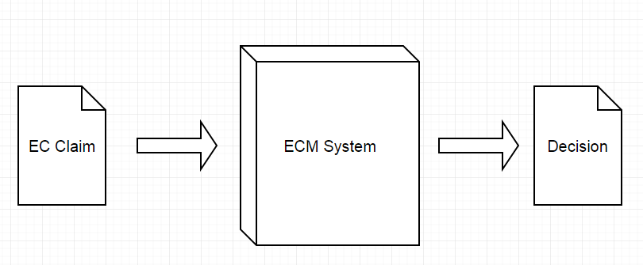
About the System
Notes:
collecting and processing Extenuating Circumstances (EC) claims by students in a large university.
Along with the Specification is provided
Plus other system exploration (GreenWich)
We have come up with a table of specific functions...
Function path

Slide 6
2. Functionality (user stories)
User:
As a user, I want to login/logout the system
As a user, I want to access website online
Admin:
As an administrator, I want to manage account of Users
As an administrator, I want to manage system data
As an administrator, I want to add more situation options (sick, injury, etc.) as
As an administrator, I can view all claims in the system for each years
As an administrator, I want to view items of assessment
As an administrator, I want to set up closure date of claim
Manager:
As admin or manager, I want to see weekly report or customize the report details
As an EC manager, I want to see all claims
As an EC Manager, I want to see claim Statistical Analysis (claims per year, per Faculty...)

Slide 7
Functionality (cont.)
Coordinator:
As an EC Coordinator, I want to receive email of notification when new claim is submitted
As an EC Coordinator, I want to process new claim
As an EC Coordinator, I want to see all the process of my Faculty
Student:
As a Student, I want to submit more than 1 EC claims for my items of assessment. The claim must be submitted before closure. date. And the claim must belong the faculties' student
As a Student, I want to submit evidences for my EC claims (e.g: Images, PDFs…) before final closure date
As a Student, I want to receive email which containing the decision of my EC claim
As a Student, I want to see all my claims which is submitted also the decisions
As a student, I want to searching and sorting claim

Slide 8
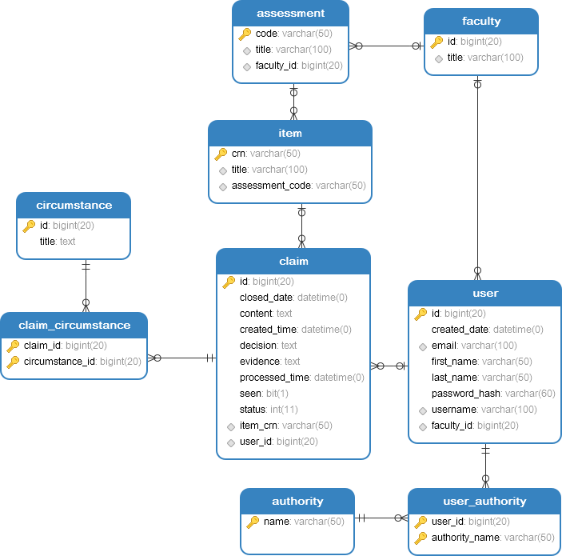
3. Database
System ERD:
Based on the Greenwich’s EC claim system
Database focus on:
- Users and Roles
- Claims
- Assessments

Slide 9
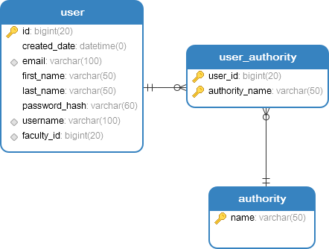
Database – Users and Roles (cont.)
User table: store user’s information.
Authority table: store role of user
User’s role:
- Administrator
EC Manager
EC Coordinator
Student

Slide 10
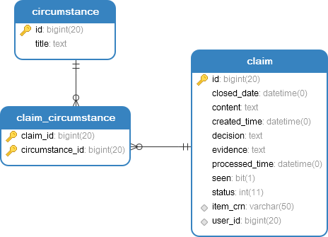
Database – Claims (cont.)
Claim table: store claim’s information
Circumstances table: type of claim’s circumstance

Slide 11
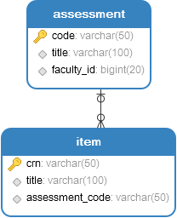
Database – Assessments (cont.)
Assessment table: store course information
Item table: store the type of point for each course, such as Examination or Coursework.

Slide 12
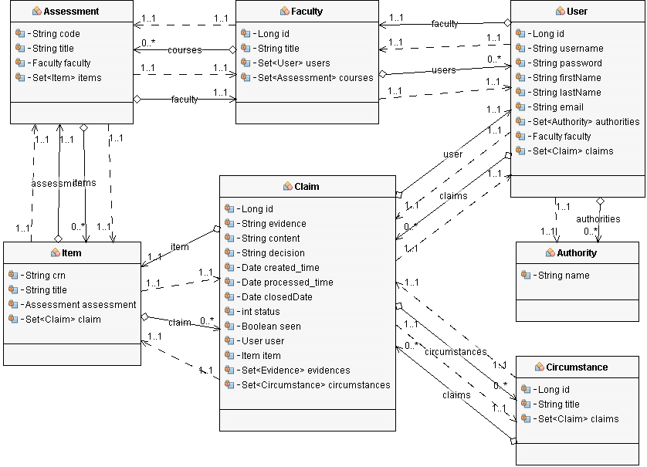
Database – Model
UML Diagram based on Database ERD

Slide 13
4. Site design
Libraries:
Twitter Bootstrap v3.3.7
JQuery v3.2.1
HTML 5
LTE Admin theme
Testing in different screen resolution
Desktop
Laptop
Tablet
Usability
Standard icon
Easy to read
Common layout
Accessibility

Slide 14
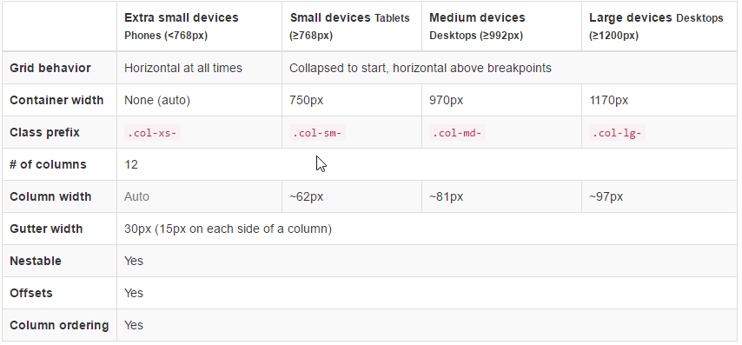
Bootstrap grid system
Difference screen size resolutions

Slide 15
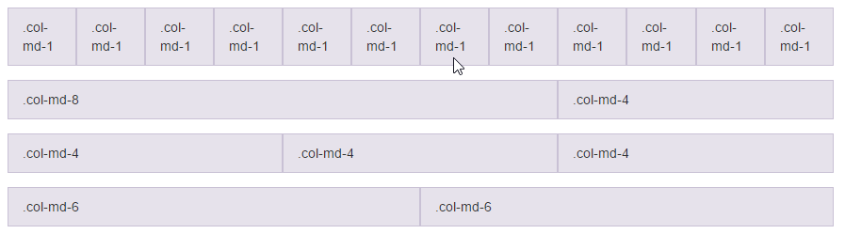
Cont.
12 Columns
Desktop: col-lg-(1-12)
Laptop: col-md-(1-12)
Tablet: col-sm-(1-12)
Mobile: col-xs-(1-12)

Slide 16
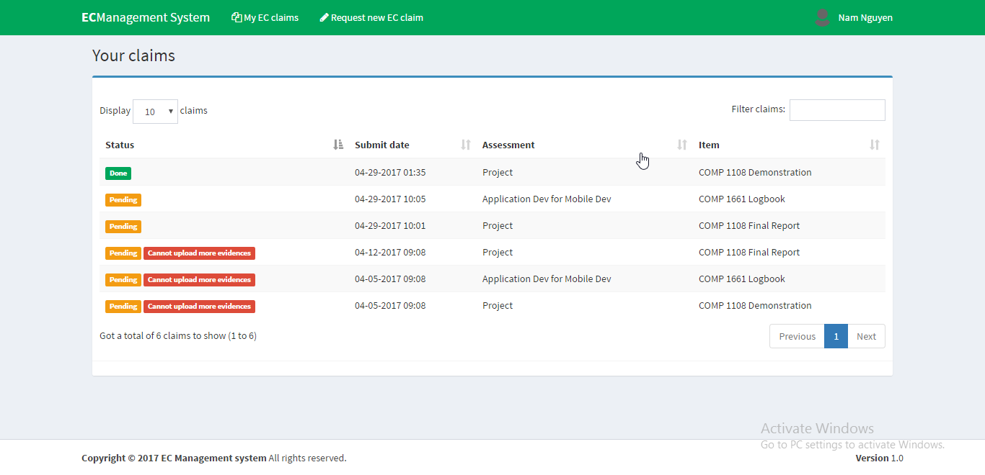
Design principle
Visibility
Clear content
Standard icons
Ease to use

Slide 17
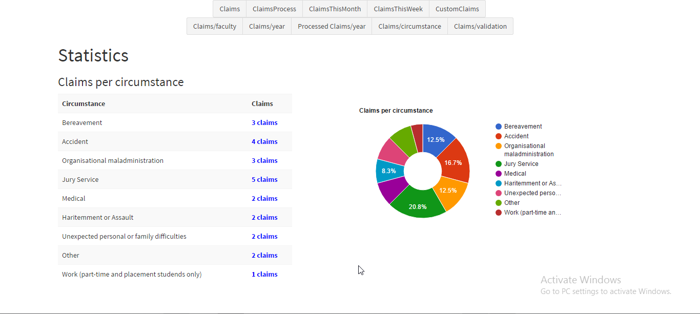
Cont.
Consistency
Uniform layout, color.
Button size, text field size.
font-size, font-family.

Slide 18
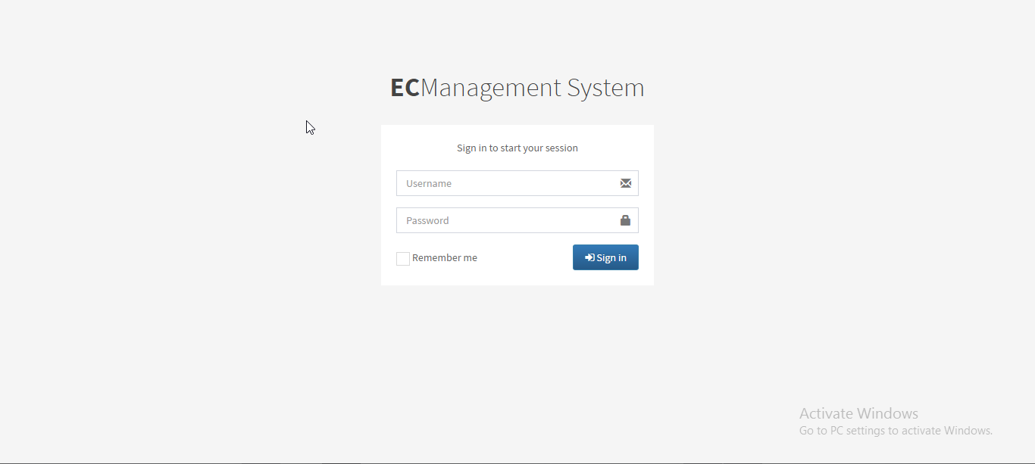
Cont.
Similarity: The site use common layout, the user do not need learn to use web site if they experience in the layout.

Slide 19
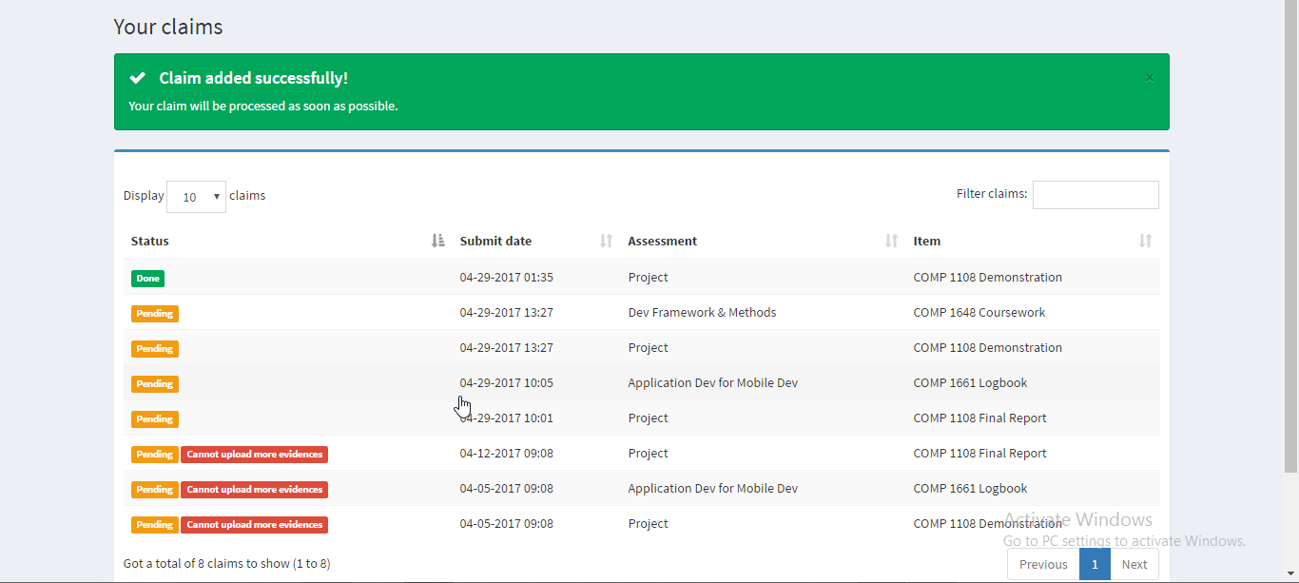
Cont.
Feedback: System present effect for the user interaction

Slide 20
Bootstrap grid system
Difference screen size resolutions

Slide 21
Cont.
12 Columns
Desktop: col-lg-(1-12)
Laptop: col-md-(1-12)
Tablet: col-sm-(1-12)
Mobile: col-xs-(1-12)

Slide 22
Design principle
Visibility
Clear content
Standard icons
Ease to use

Slide 23
Cont.
Consistency
Uniform layout, color.
Button size, text field size.
font-size, font-family.

Slide 24
Cont.
Similarity: The site use common layout, the user do not need learn to use web site if they experience in the layout.

Slide 25
Cont.
Feedback: System present effect for the user interaction

Slide 26
5. Testing
Test logs
Test plan
Unit tests

Slide 27
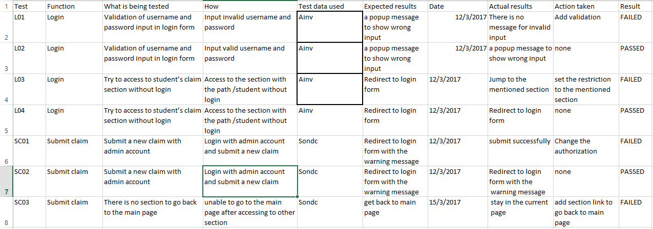
Test-log

Slide 28
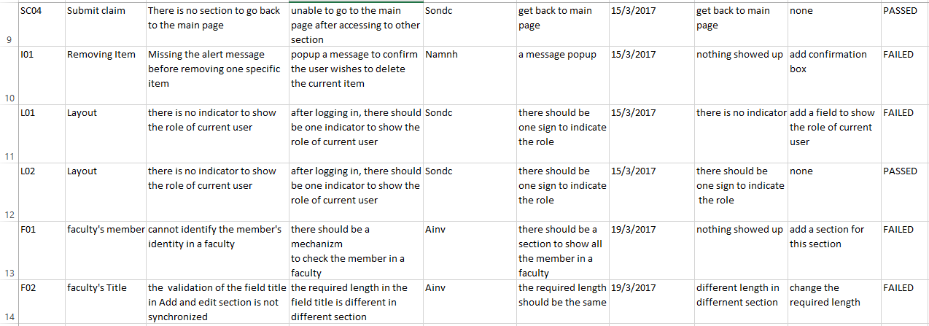
Test-log (cont.)

Slide 29
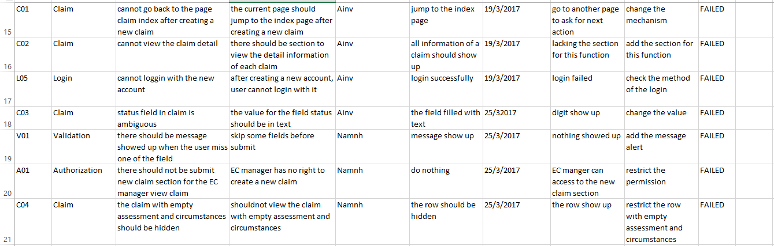
Test-log (cont.)

Slide 30
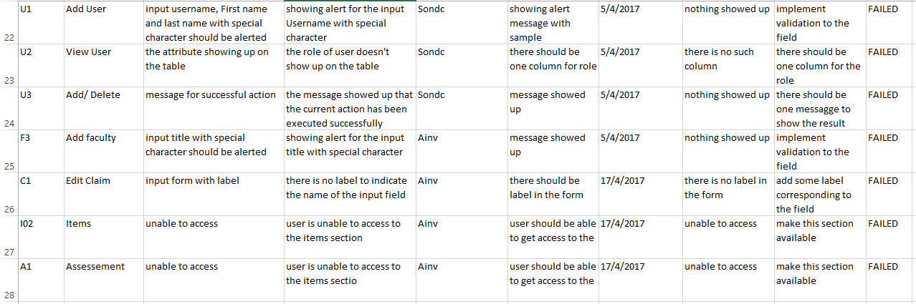
Test-log (cont.)

Slide 31
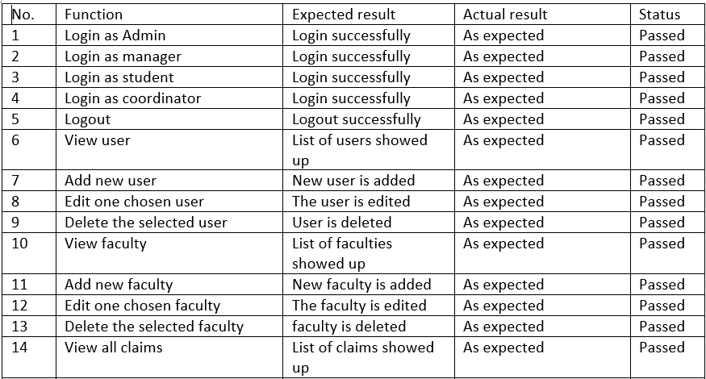
Test-plan

Slide 32
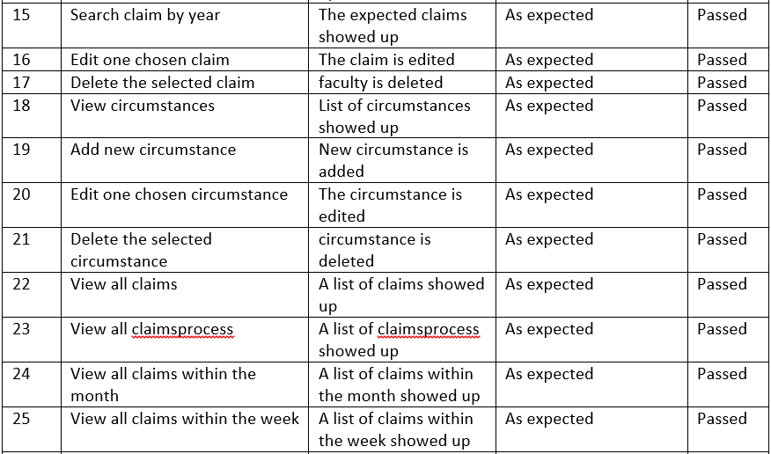
Test-plan (cont.)

Slide 33
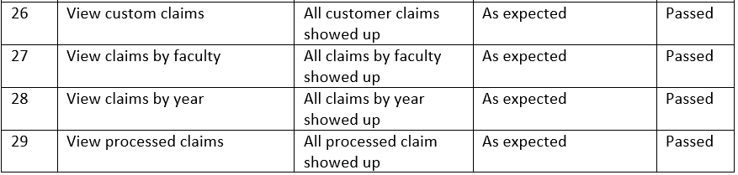
Test-plan (cont.)

Slide 34
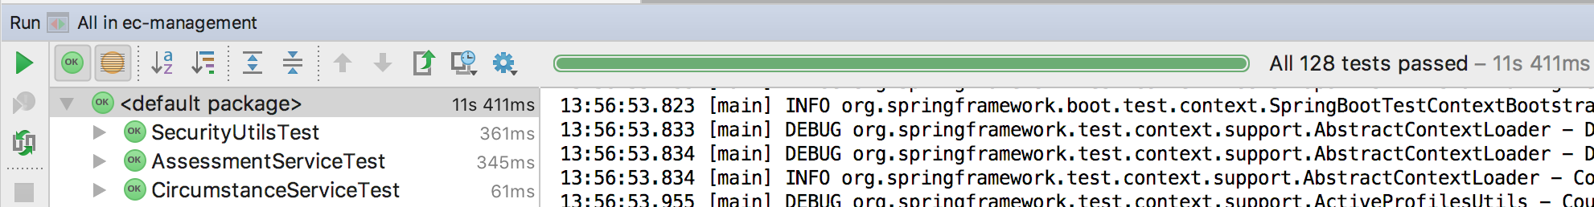
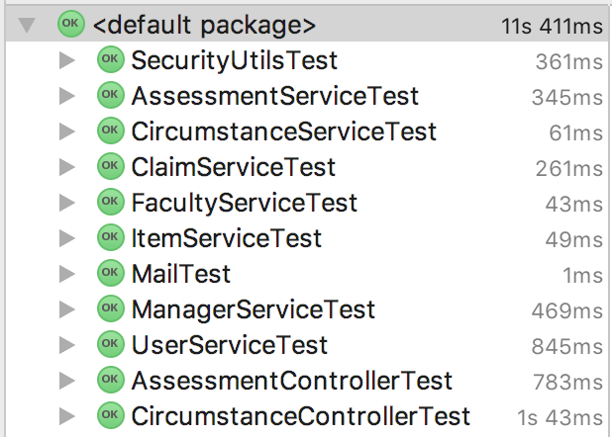
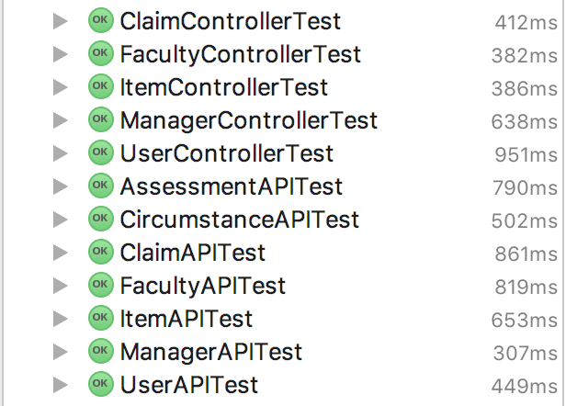
Unit tests

Slide 35
6. Agile methodology
Product backlog
Sprint (backlog, burndown chart)
Summary of meeting minutes
Notes:
In this section we will provide the proof
Demonstrate that we have used the Agile software development approach, namely Scrum

Slide 36
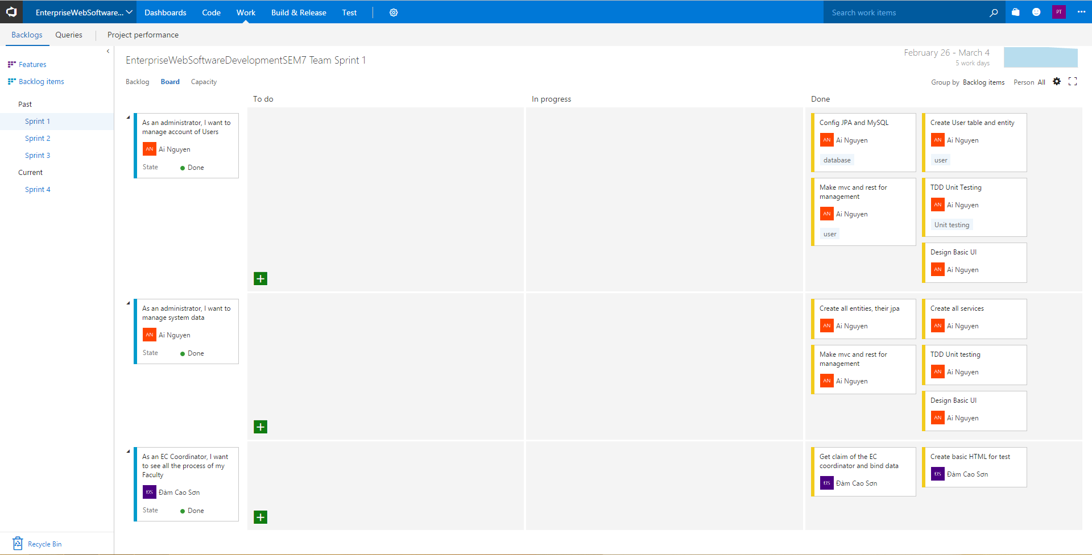
Support tools
- Scrum management: Visual Studo Team Services

Slide 37
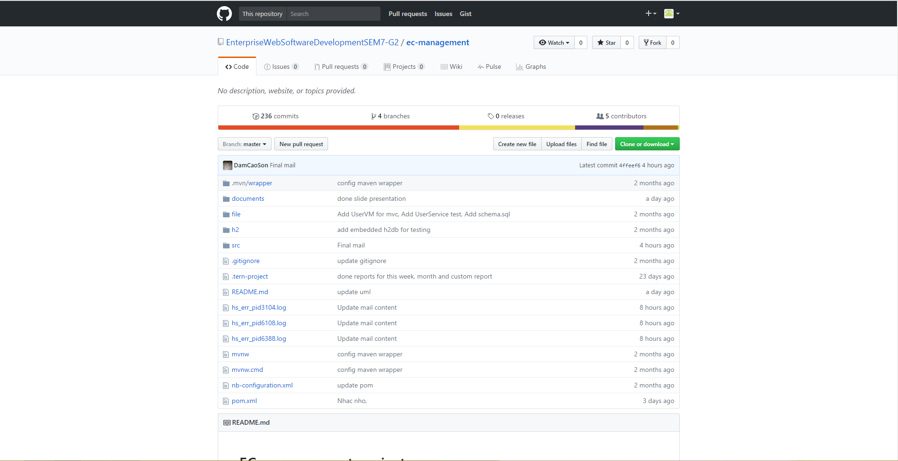
Support tools (cont)
- Version control repository management : Github

Slide 38
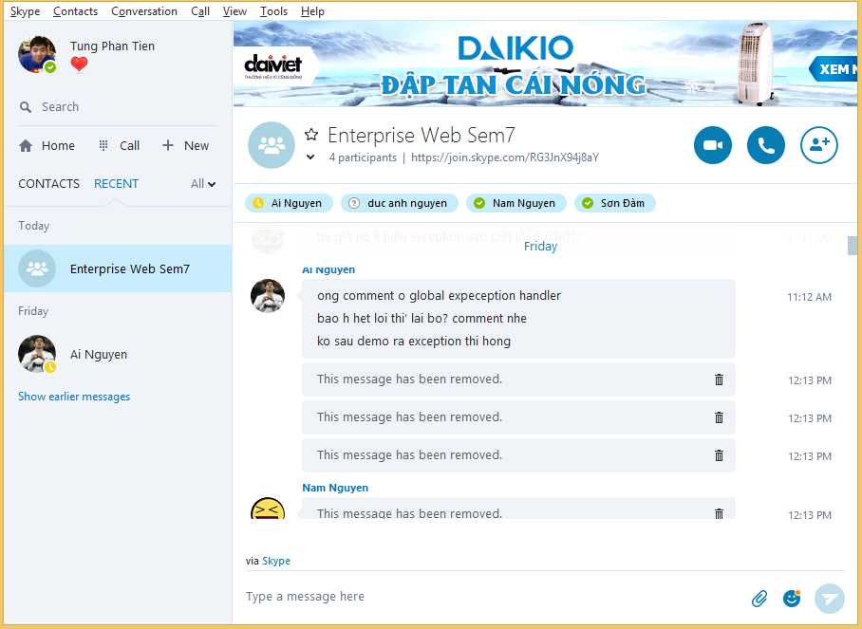
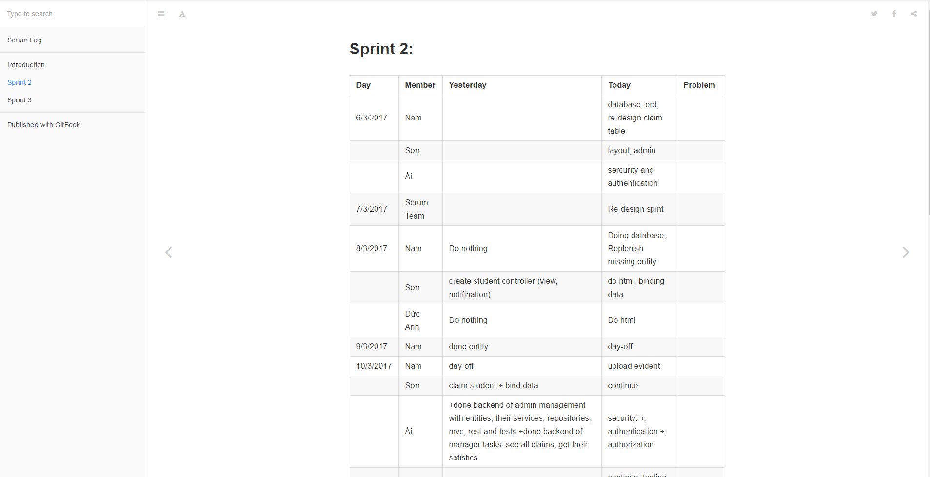
Support tools (cont)
- Scrum meeting and daily meeting log
Skype | Gitbook

Slide 39
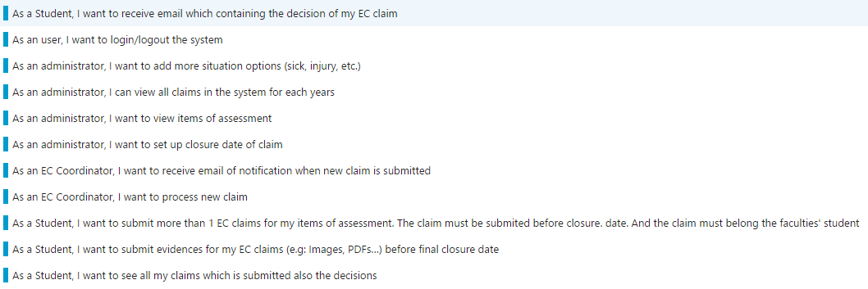
Product Backlog

Slide 40
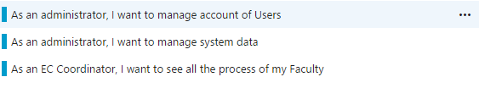
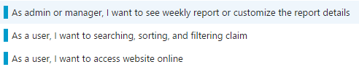

Product Backlog (cont)

Slide 41
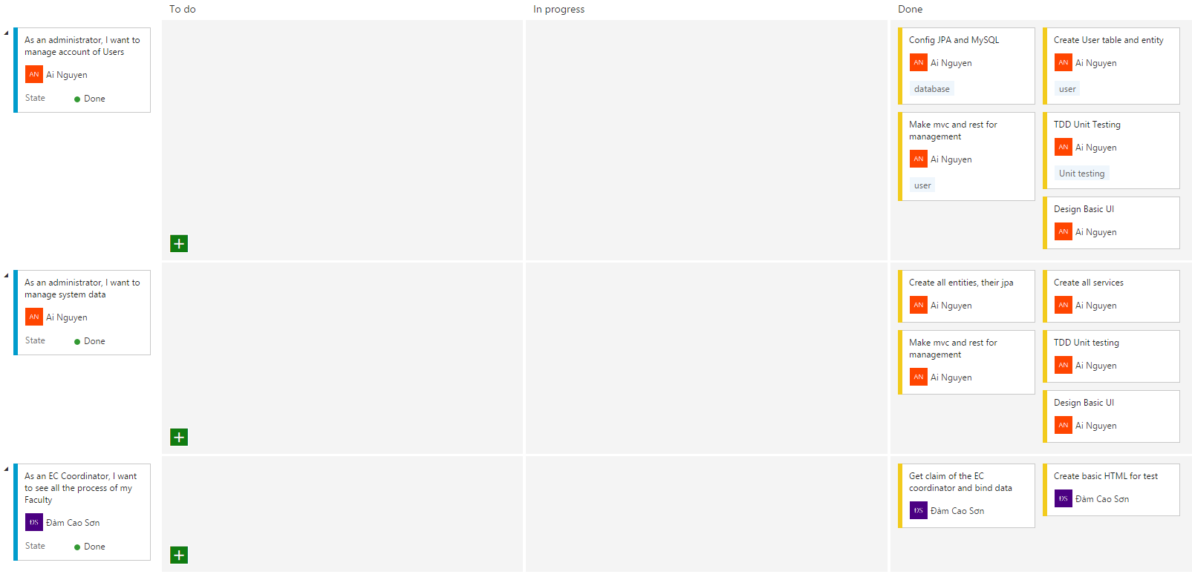
Sprint 1

Slide 42
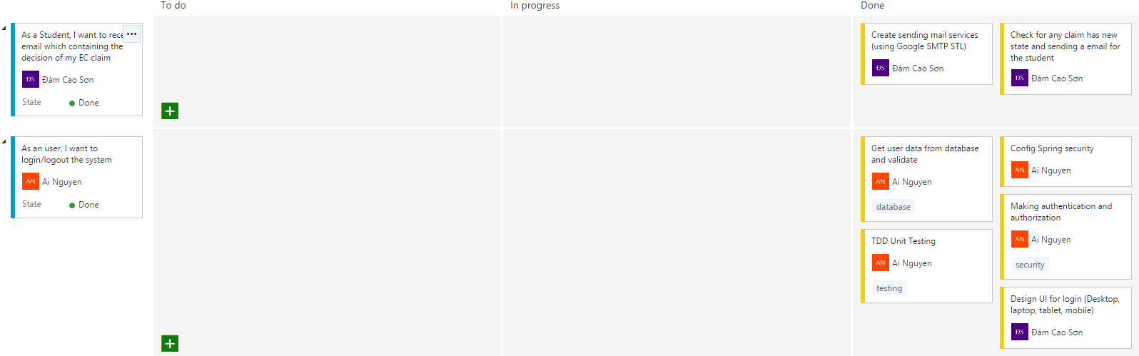
Sprint 2

Slide 43
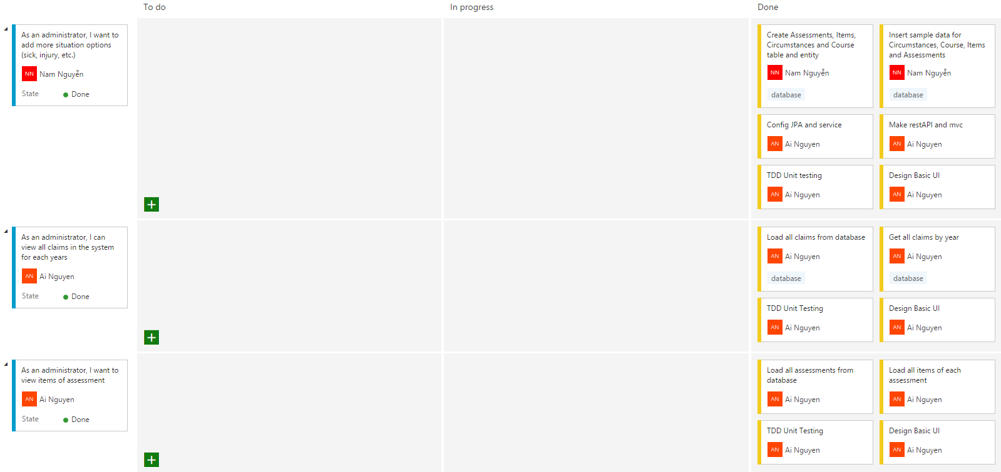
Sprint 2 (cont)

Slide 44
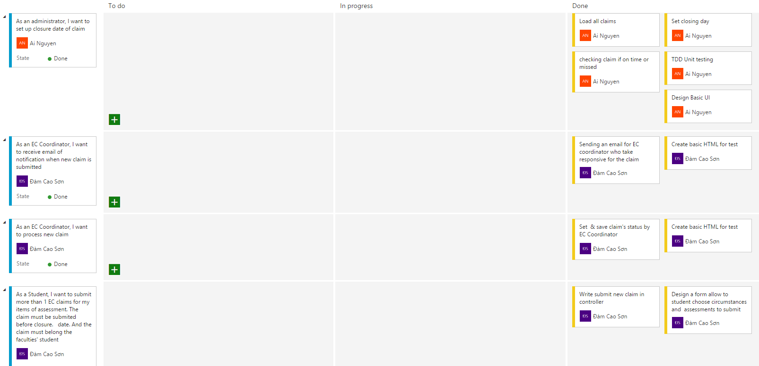
Sprint 2 (cont)

Slide 45
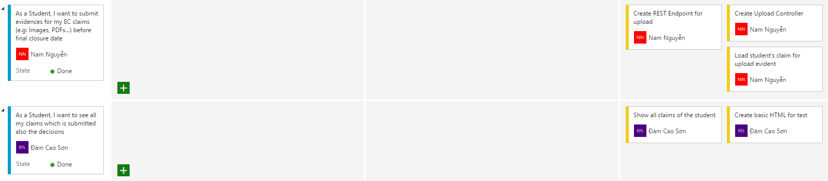
Sprint 2 (cont)

Slide 46
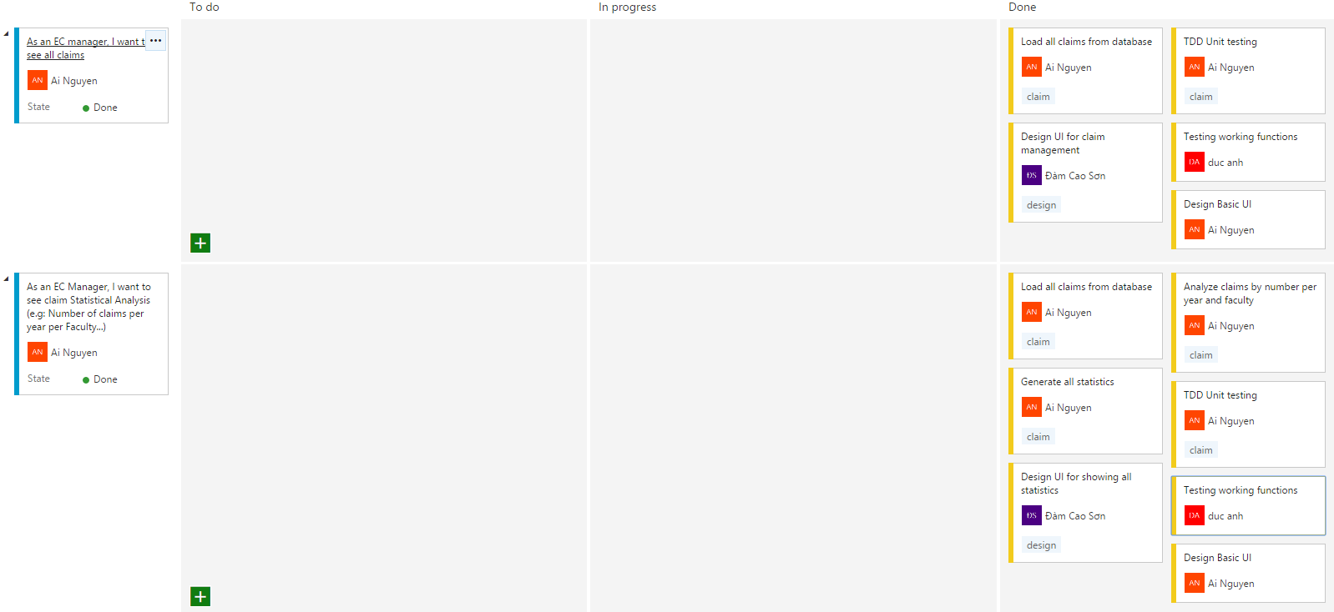
Sprint 3

Slide 47
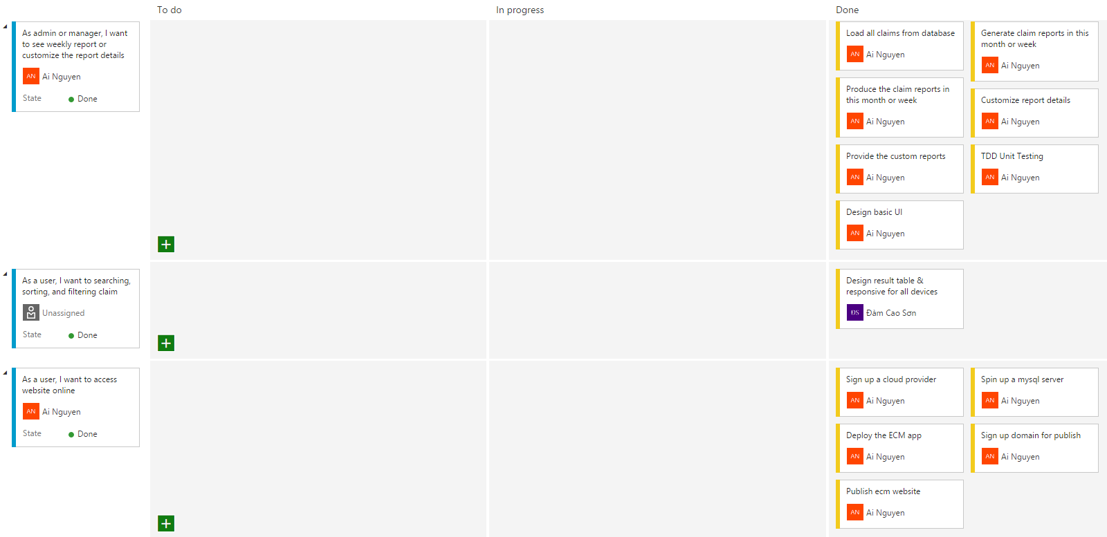
Sprint 4

Slide 48
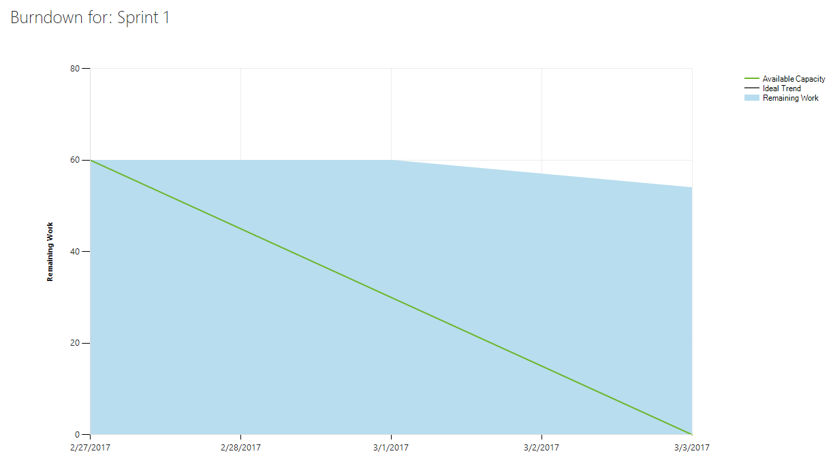
Burndown Chart

Slide 49
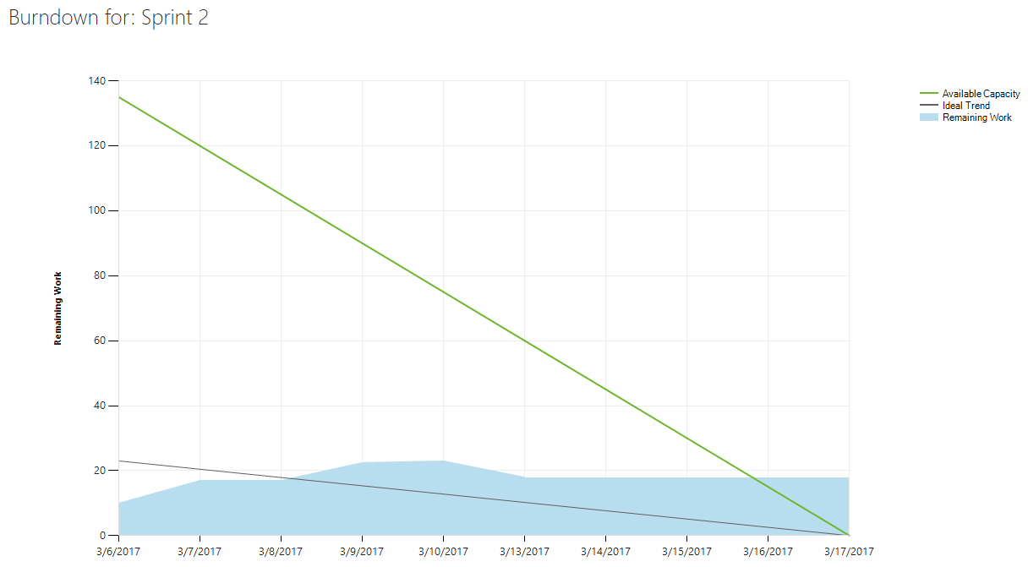
Burndown Chart (cont)

Slide 50
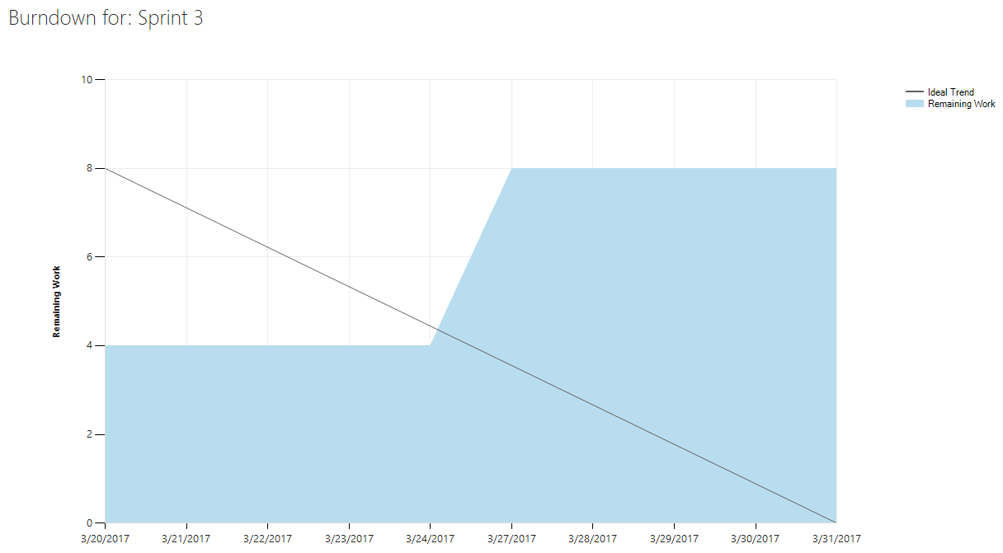
Burndown Chart (cont)

Slide 51
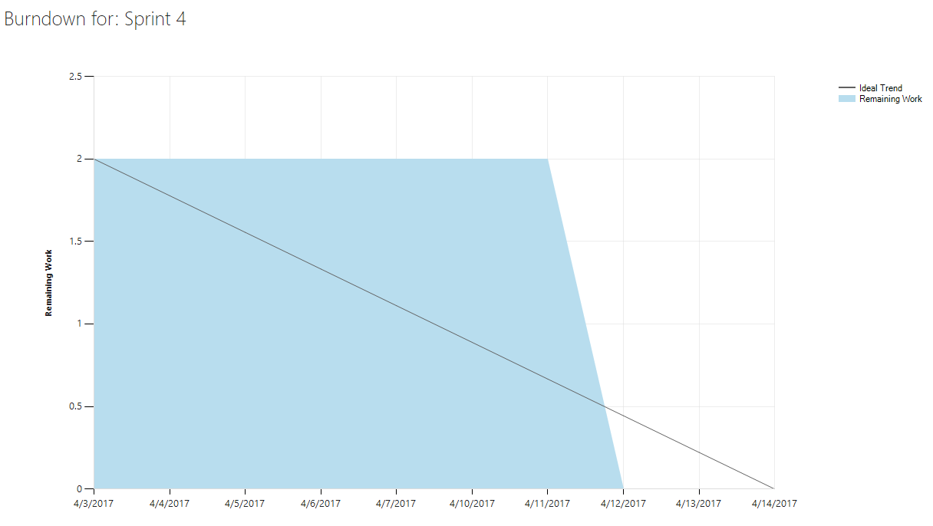
Burndown Chart (cont)

Slide 52
Daily Meeting
From day: 6/3/2017 – 31/3/2017
Total meetings minutes: 380 minutes

Slide 53
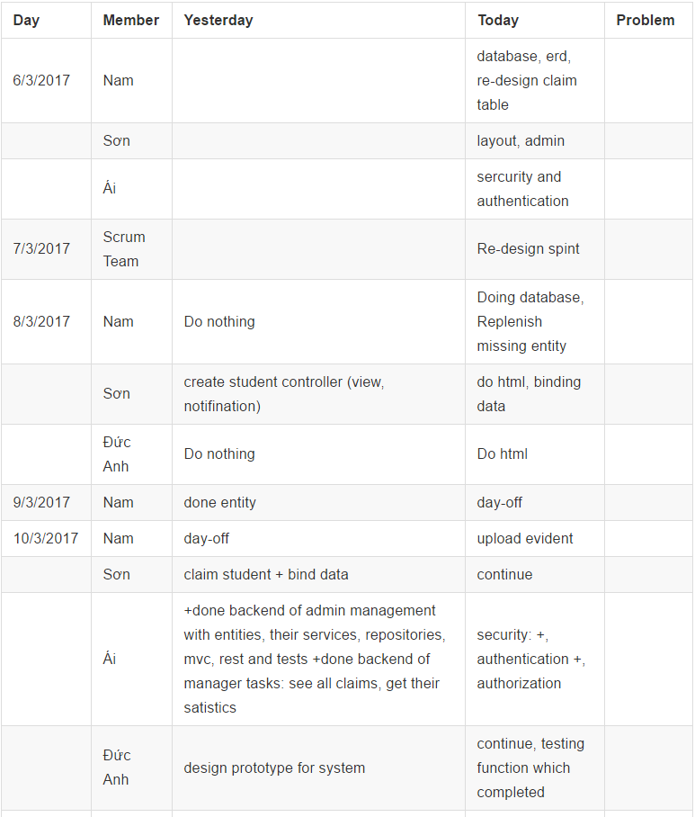
Daily meeting Logs(demo)

Slide 54
Demo Plan
Demo all system features
Demo data validation
Demo date-time relations
Demo authorization (different roles or authorities)
Demo all system reports

Slide 55
Demo 1: all system features
Authentication (login, logout)
Student submits claims
Student submits evidences
Student receive email which contains the decision of claim
Student views all submitted claims
Student searches and sorts claims

Slide 56
Demo 1: all system features (cont.)
Coordinator receives email of notification when new claim is submitted
Coordinator processes new claim
Coordinator views all the process of my Faculty
Manager views all claims
Manager view claim reports (statistics)
Admin or manager views weekly report or customize the report details

Slide 57
Demo 1: all system features (cont.)
Admin manages account of Users
Admin manages system data
Admin views all claims in the system for each years
Admin views items of assessment
Admin sets up closure date of claims
Admin sets up closure date of items
User accesses website online

Slide 58
Demo 2: data validation (form)
Text validation (title, content, name, username, code…)
Date validation (closure date)
File validation (upload file)

Slide 59
Demo 3: date-time relations
Date of claim submissions
Date of evidence submissions
Closure date of claims
Closure date of items
Processed date of claims

Slide 60
Demo 4: authorization
List all system roles or authorities
Authorized areas of each role
Reponses unauthorized messages
Reponses not found messages

Slide 61
Demo 5: system reports
Claims per year
Claims per faculty
Processed claims per year
Claims per circumstance
Claims per validation
Custom claim reports

Slide 62
ECManagement System
Website: http://ecmsystem.ga/
Screencast: http://rebrand.ly/ewsd_g2_cw_kaka

