Slide 1
Site design
Libraries:
Twitter Bootstrap v3.3.7
JQuery v3.2.1
HTML 5
LTE Admin theme
Testing in different screen resolution
Desktop
Laptop
Tablet
Usability
Standard icon
Easy to read
Common layout
Accessibility

Slide 2
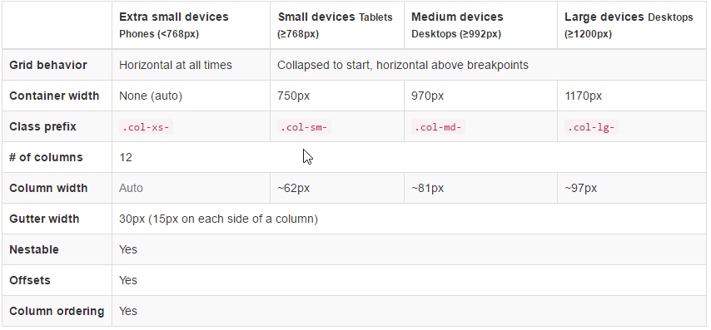
Bootstrap grid system
Difference screen size resolutions

Slide 3
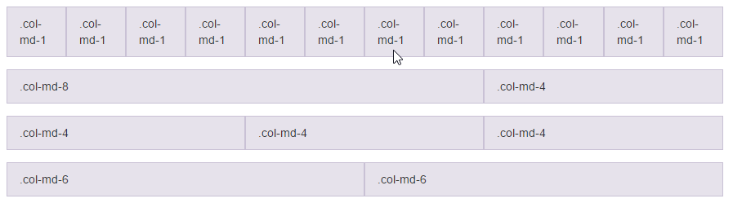
Cont.
12 Columns
Desktop: col-lg-(1-12)
Laptop: col-md-(1-12)
Tablet: col-sm-(1-12)
Mobile: col-xs-(1-12)

Slide 4
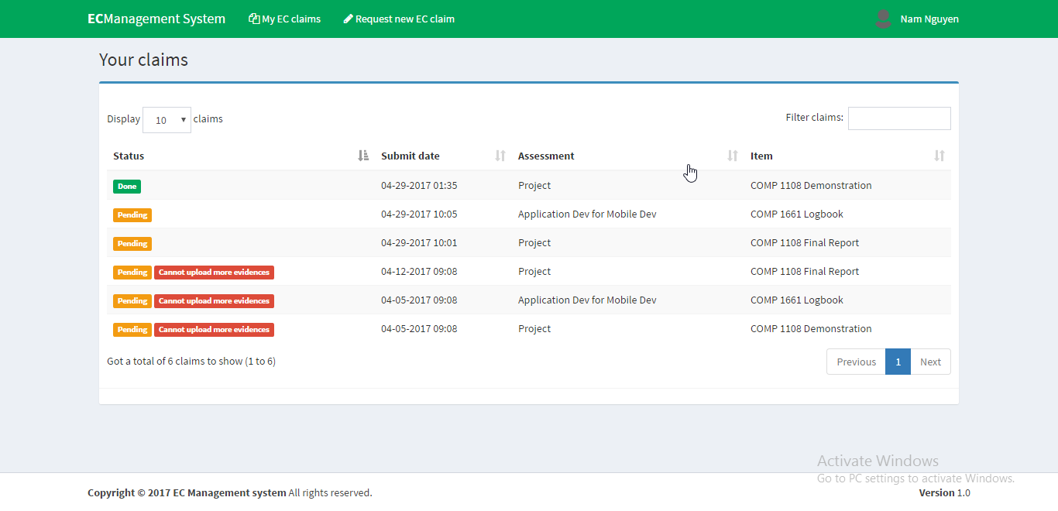
Design principle
Visibility
Clear content
Standard icons
Ease to use

Slide 5
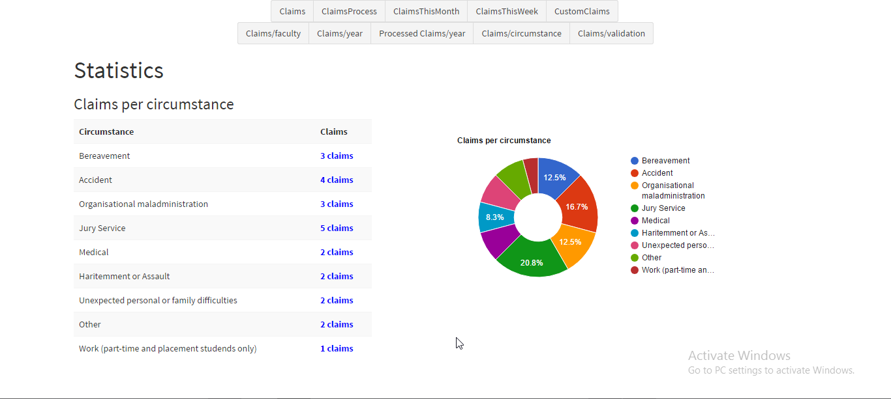
Cont.
Consistency
Uniform layout, color.
Button size, text field size.
font-size, font-family.

Slide 6
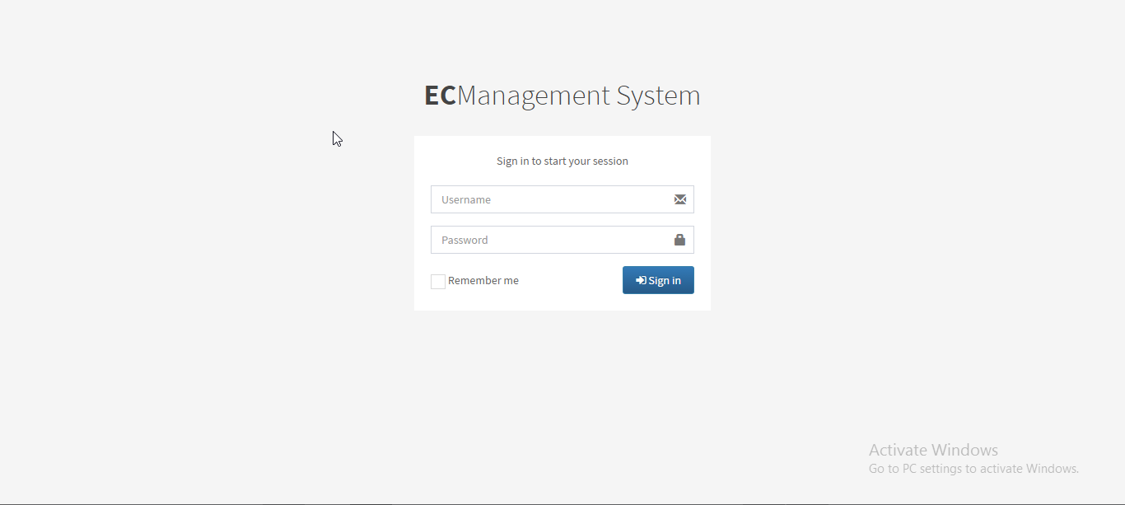
Cont.
Similarity: The site use common layout, the user do not need learn to use web site if they experience in the layout.

Slide 7
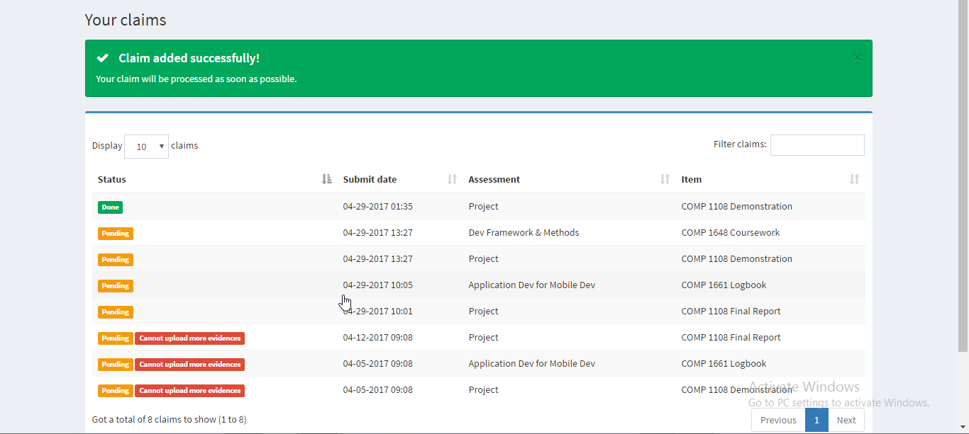
Cont.
Feedback: System present effect for the user interaction

