Slide 2
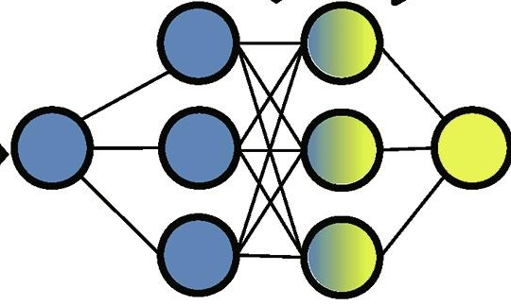
PROJECT 5: RESULTS
How can Transfer Learning resolve challenges with biased data?
Nomenclature:
A - D → Features
E → output
A
B
C
D
E
A
B
C
D
E
A
B
C
D
E
Source Model
Perform
Imputation
Extract
Imputed
Data
Knowledge
Transfer
Removed
Imputed
Data
A
B
C
D
E
Target Model

Slide 3
A
B
C
D
E
C
A
B
C
D
E
A
B
D
E
Train
Model
Source Model
Perform
Imputation
Extract
Imputed
Data
Database with incomplete data
Database with imputed data
Imputed
data
Randomized
NN model
Knowledge
Transfer
Removed
Imputed
Data
A
B
C
D
E
Finetune
Model
Target Model
Experiment
data
Pretrained
NN model

Slide 4
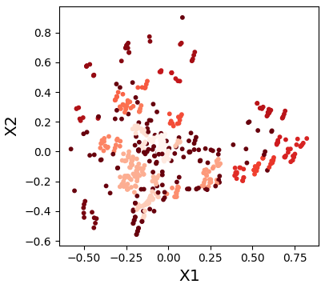
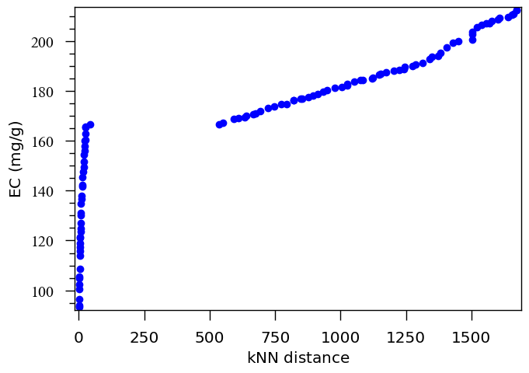







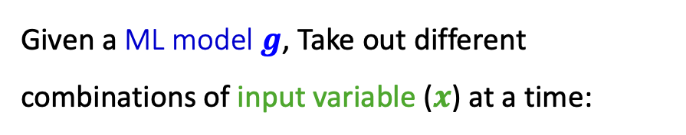

$$x_{2}$$
kNN distance threshold
Task
New point
Given a ML model $g$, Take out different combinations of input variable ($x$) at a time:
kNN distance with k = 4
$$min$$
$$f_{m}\left(x\right)=\left[−EC/−CAP,dist\right]$$
$$x_{1}$$
$$x∈ℝ^{n}$$
$$s.t.$$
$$l_{i}<x_{i}<u_{i} ∈ ℝ, i=1,….,n$$
$$EC/CAP≥0$$
Notes:
The Non-Dominated Sorting Genetic Algorithm II (NSGA-II) is a popular evolutionary algorithm used for multi-objective optimization. It is a modified version of NSGA that is faster, has a better sorting algorithm, and includes elitism.
A solution x⁽¹⁾ is said to dominate the other solution x⁽²⁾ if both condition 1 and 2 below are true:
Condition 1: x⁽¹⁾ is no worse than x⁽²⁾ for all objectives
Condition 2: x⁽¹⁾ is strictly better than x⁽²⁾ in at least one objective

