Slide 1
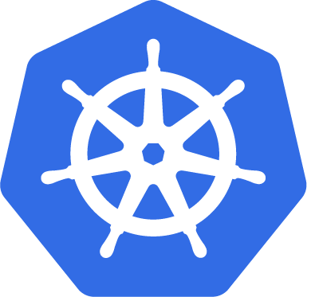
Research and implement security features in the Microservices environment
Group 1 - NT534.N21.ATCL

Slide 2
Table of Contents
01
03
02
04
Microservice
Kubernetes
Introduce Microservice architecture
Introduce K8s
Security features
Demo
Calico network and Kubescape
Demo of K8s cluster and sec. tools

Slide 3
Microservice
01
Introduce Microservice architecture

Slide 4
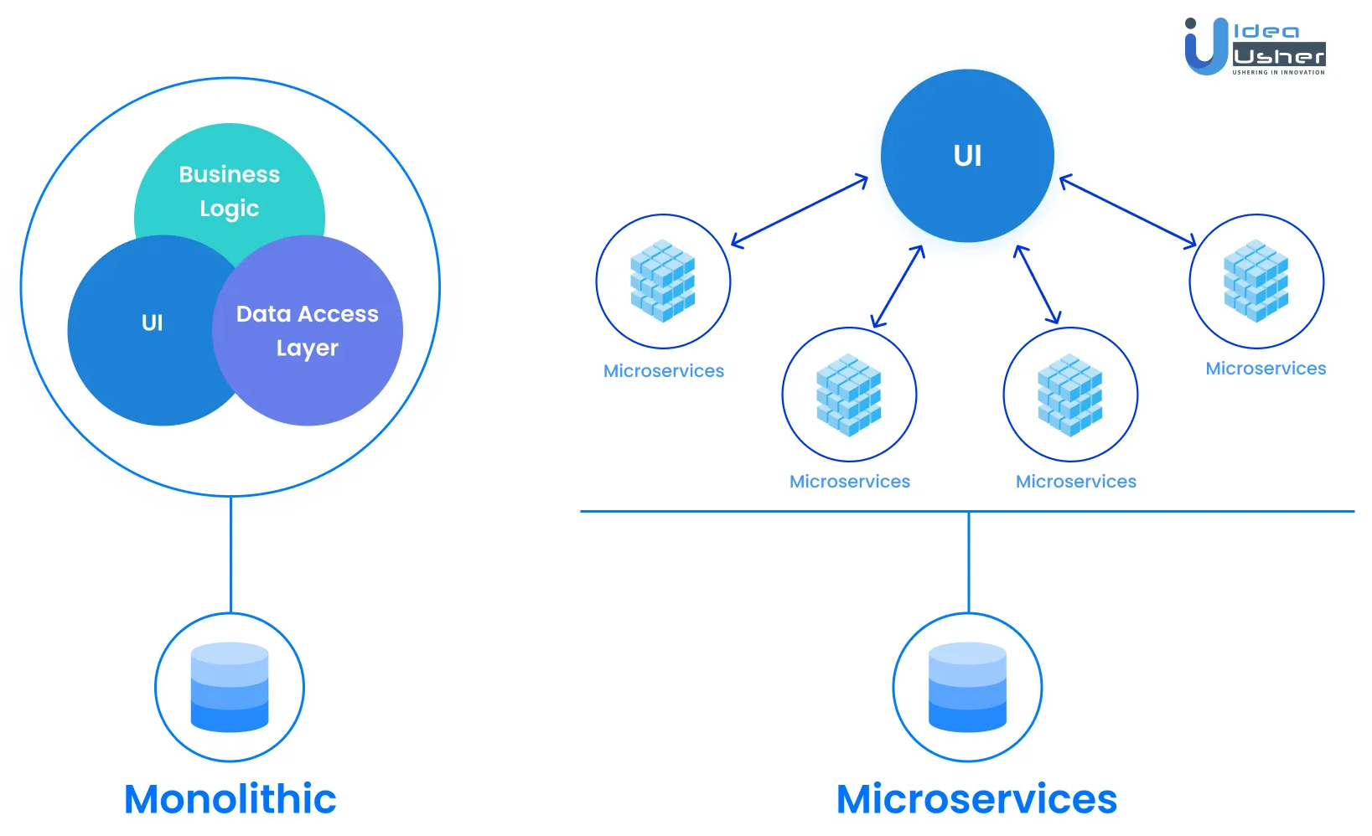
Microservice
A+
Microservices is an architectural approach to building software systems where the application is broken down into small, independent and scalable services.
Reduce barriers to software development, deployment, and maintenance.

Slide 5
Microservice
A+
Microservices are typically deployed as separate processes or containers, and are connected through APIs or messaging systems.
Avoid the issues associated with monolithic architecture, such as tight coupling, long release cycles, and difficulty with scaling.

Slide 6
Kubernetes
02
Introduce K8s

Slide 7
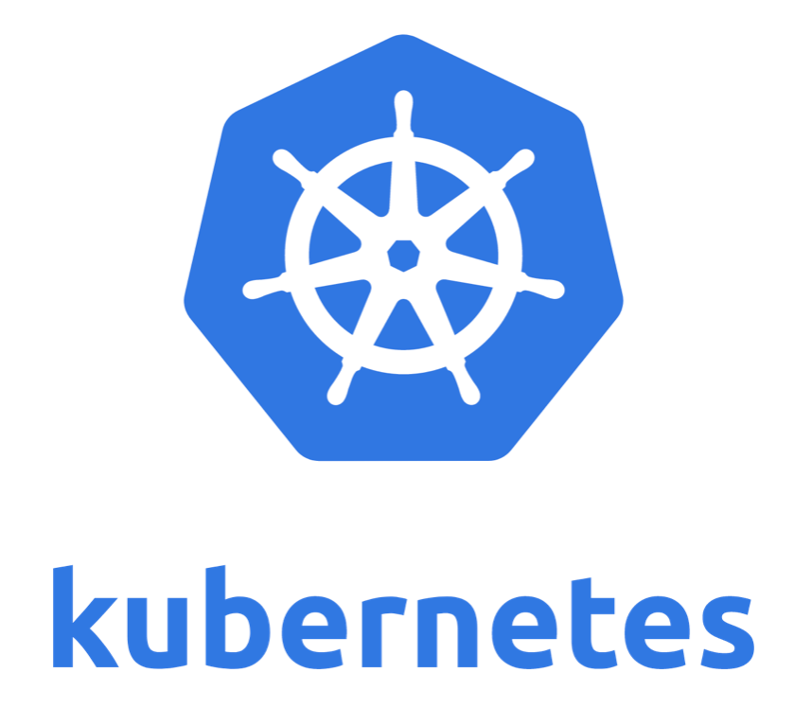
Kubernetes
Kubernetes (K8s) is an open-source platform for container orchestration & management developed by Google. Automating the deployment, scaling, and management of containerized applications on cloud easily and efficiently.
Kubernetes is used to deploy applications of microservices architecture.

Slide 8
Kubernetes
Kubernetes allows deploying application on an existing cluster of computers or on public or private cloud environments.
Kubernetes is widely used in applications that have a large number of containers, continuous development, flexibility and scalability.

Slide 9
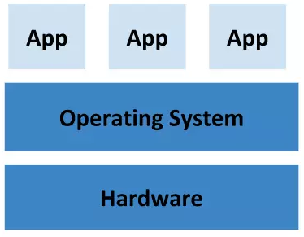
Deploying on physical server
There was no way to define resource boundaries for applications in a physical server, and this caused resource allocation issues.

Slide 10
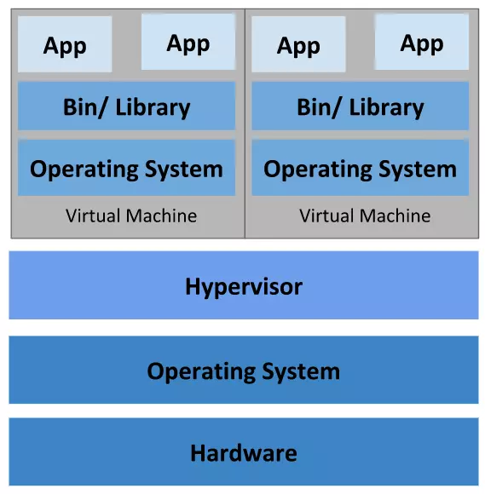
Virtualization
To solve the issue deploying the application on physical server, virtualization was introduced.
It allows you to run multiple Virtual Machines (VMs) on a single physical server. Each VM will have its own file system, OS, CPU. One application cannot be freely accessed by another application.

Slide 11
Virtualization
Because the VM is virtualized by copying both the OS and the hardware, only a small number of VMs can be created on a server.

Slide 12
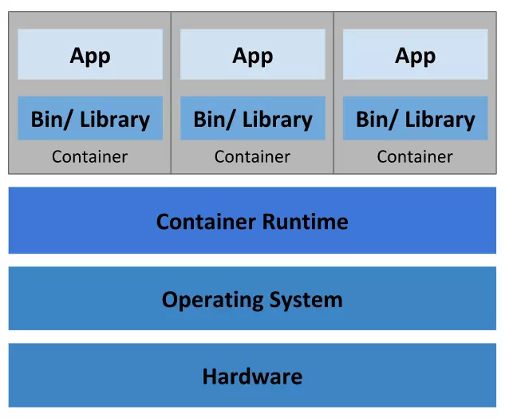
Container
Containers are similar to VMs, but they have relaxed isolation properties to share the OS among the applications. Therefore, containers are considered lightweight.
This allows us to run multiple applications on the same physical server on different operating systems.

Slide 13
Kubernetes
Group and manage containers by application and project.
Service Discovery and Load Balancing…
Storage orchestration, automated rollouts and rollbacks, automatic bin packing, self-healing, and secret and configuration management.
Ensures stable deployment, and can automatically handle issues such as container failure and scaling.

Slide 14
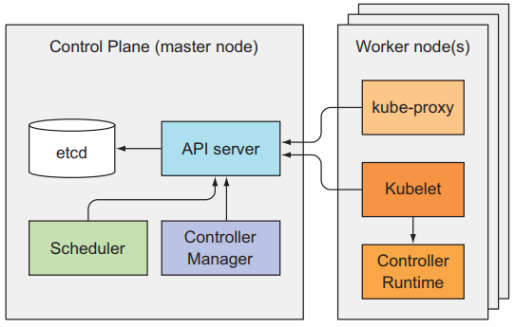
Architecture of Kubernetes

Slide 15
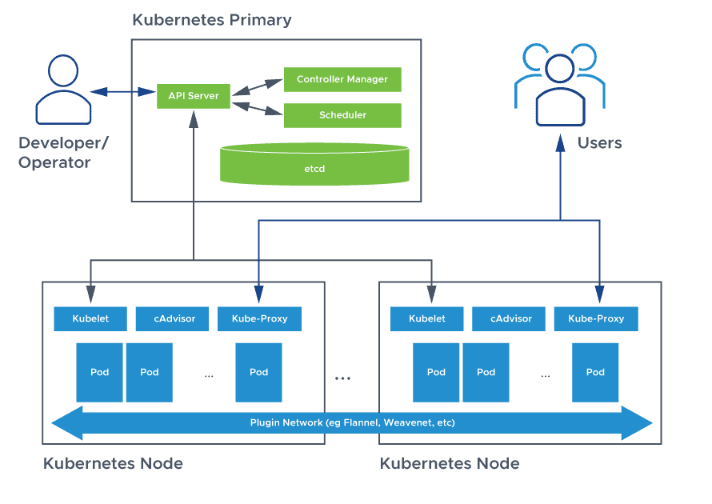
Architecture of Kubernetes

Slide 16
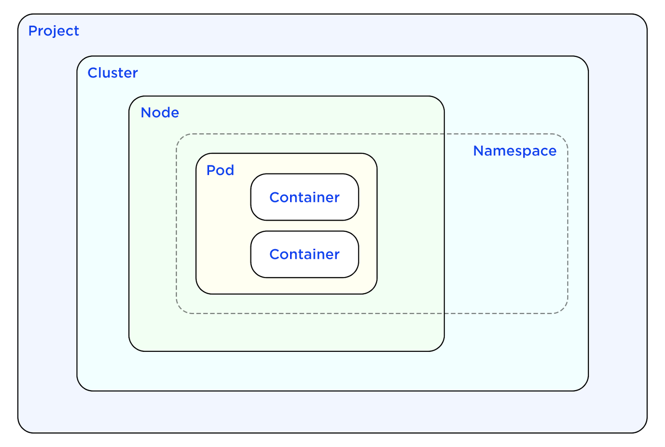
Pod
A+
Pod is the most basic component for deploying and running an application, created and managed by kubernetes.
A Pod is a group of one or more containers, with shared storage and network resources.
Co-located and co-scheduled, and run in a shared context.

Slide 17
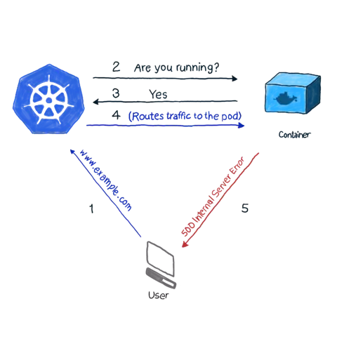
Pod
A+
Pod is the most basic component for deploying and running an application, created and managed by kubernetes.
A Pod is a group of one or more containers, with shared storage and network resources.
Co-located and co-scheduled, and run in a shared context.

Slide 18
Security features
03
Calico network and Kubescape

Slide 19

Calico network
Calico is an open source community project that provides networking for containers and virtual machines.
Networking and security solution that enables Kubernetes workloads and non-Kubernetes/legacy workloads to communicate seamlessly and securely.

Slide 20
Calico network
By default, all pods can communicate freely with each other without any restrictions.
Administrators can use network policy to lock down network connectivity and enforce access controls.

Slide 21
Calico network
Calico is a networking solution for Kubernetes that is built on layer 3 of the OSI model.
It creates a flat layer-3 network with a fully routable IP address for every pod and divides a large CIDR (Classless Inter-Domain Routing) into smaller blocks to assign to nodes in the cluster.

Slide 22
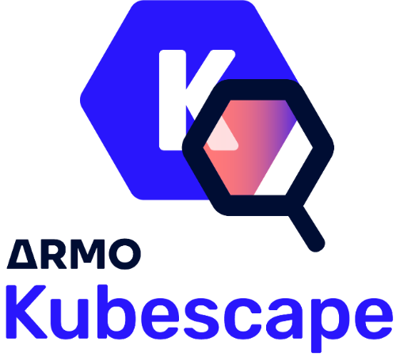
Kubescape
Kubescape is an open-source Kubernetes security platform. It includes risk analysis, security compliance, & misconfiguration scanning developed by CyberArk company.
Detection of threats, vulnerabilities in incorrect security settings and configurations, risk assessment, and remediation.

Slide 23
Demo
04
Demo of K8s cluster and sec. tools

Slide 24
Demo Kubescape
Cluster
Node
Namespace
Web app
MySQL

Slide 25
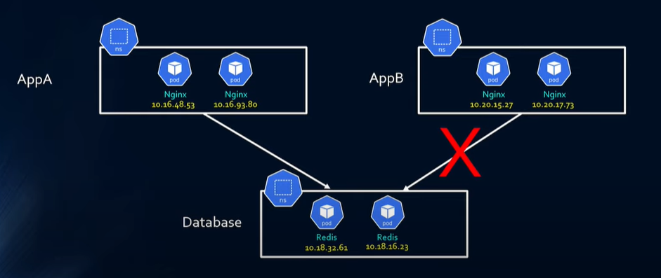
Demo Calico

Slide 26
Thank you!
A+
Thank you for your attention.

Slide 27
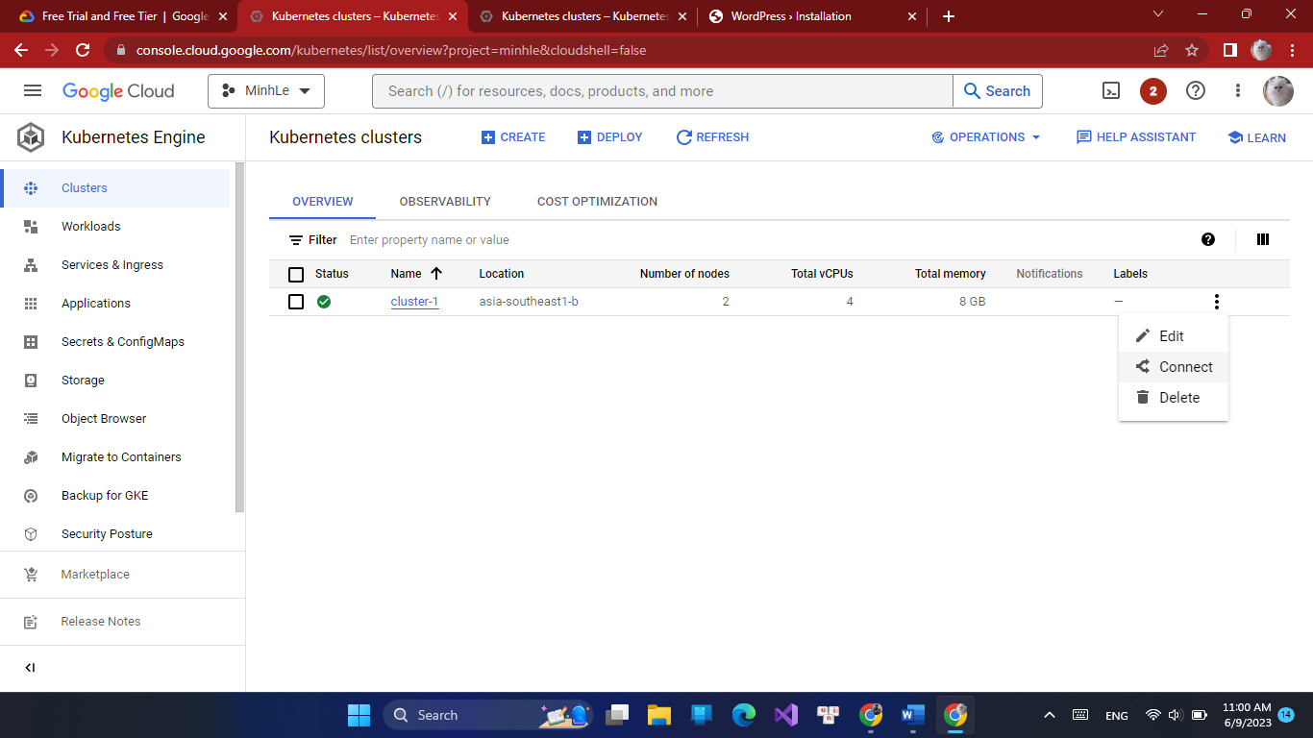

Slide 28



Slide 29
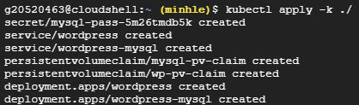


Slide 30
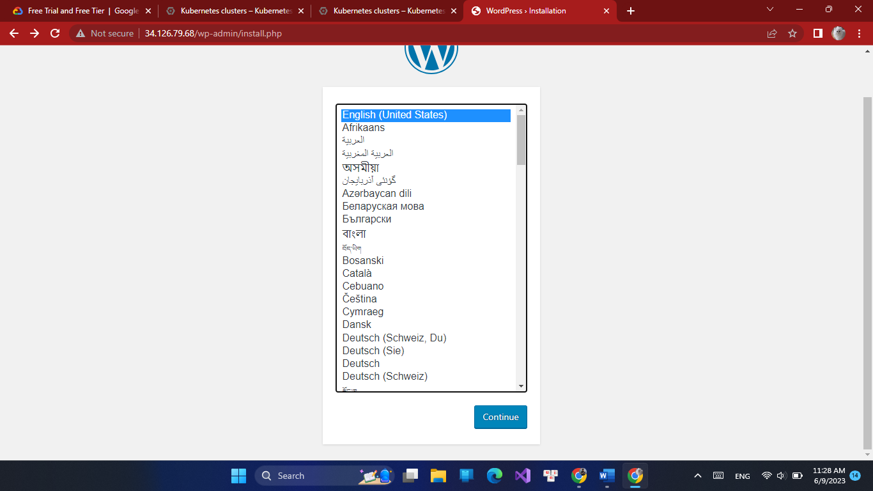

Slide 31
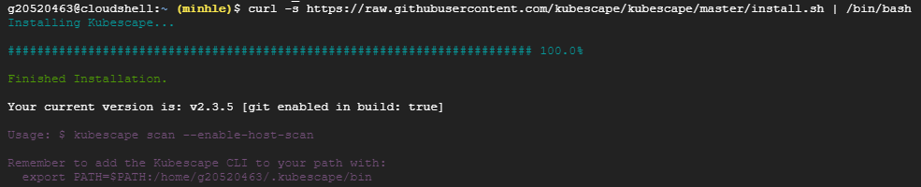
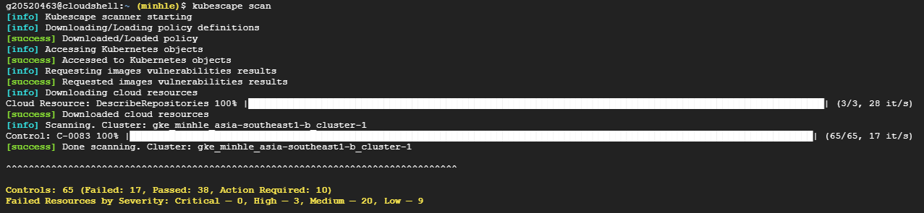
Deploy Kubescape

Slide 32
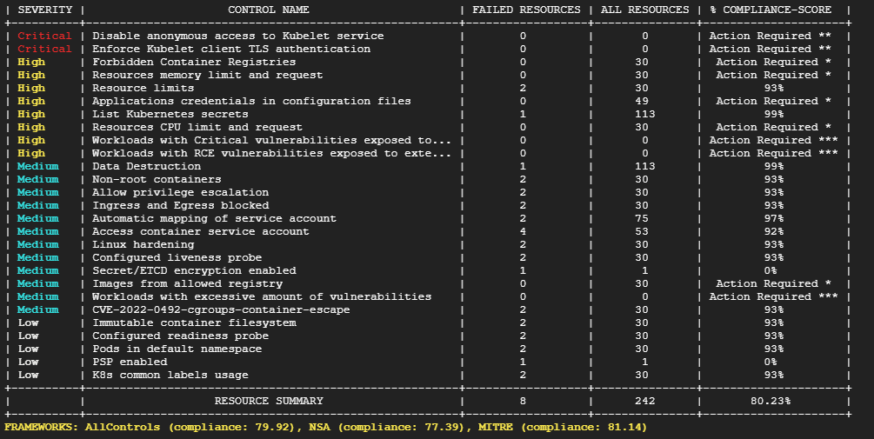

Slide 33
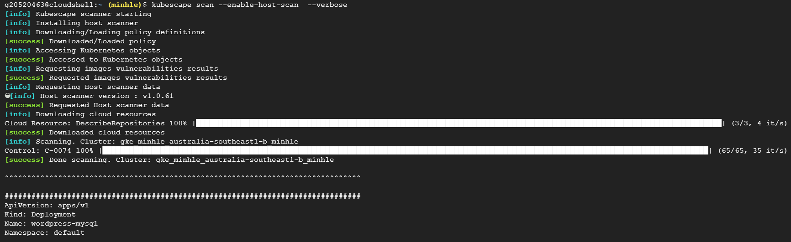
1st scan

Slide 34
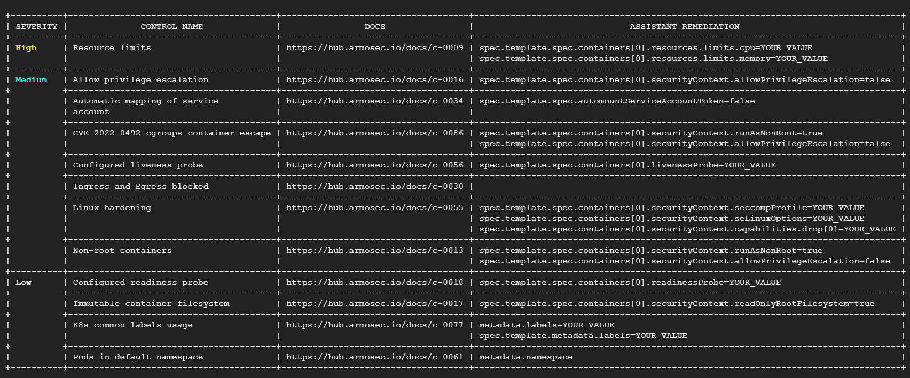

Slide 35
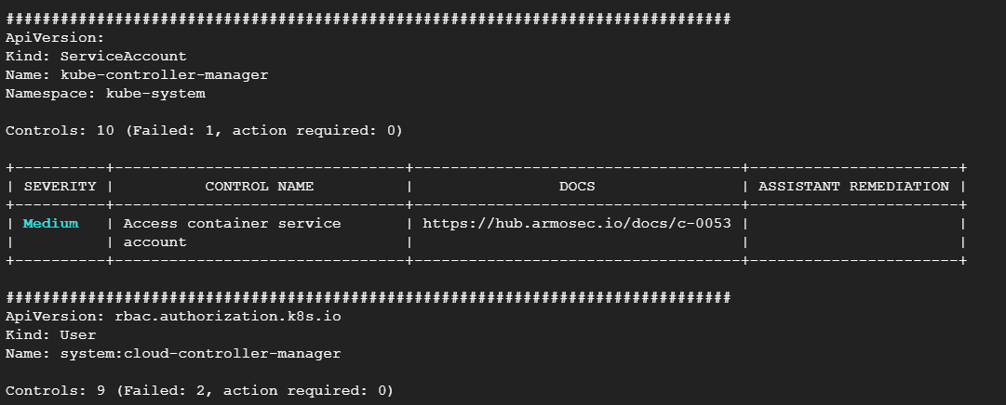

Slide 36
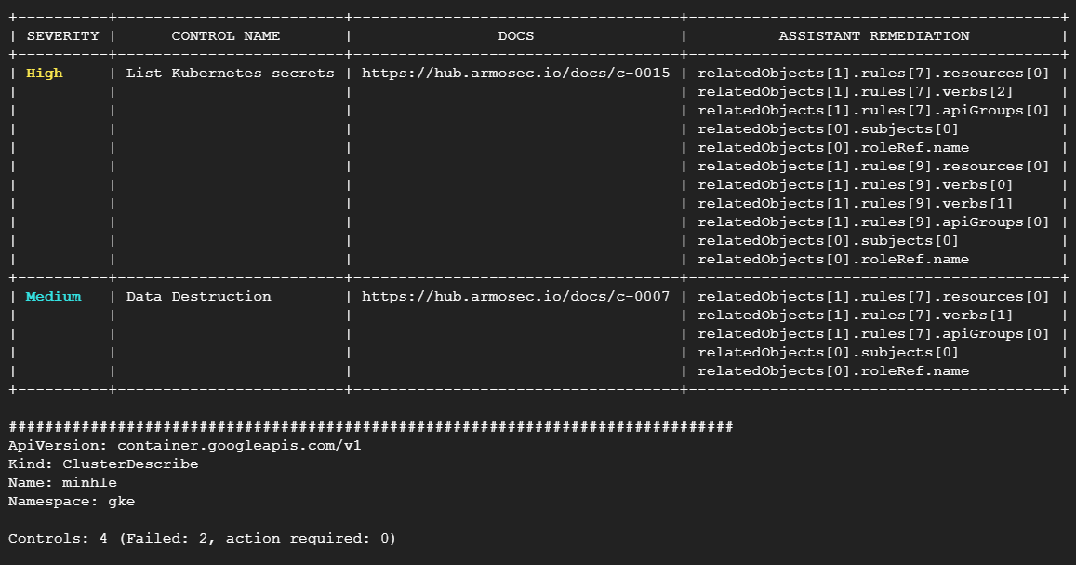

Slide 37
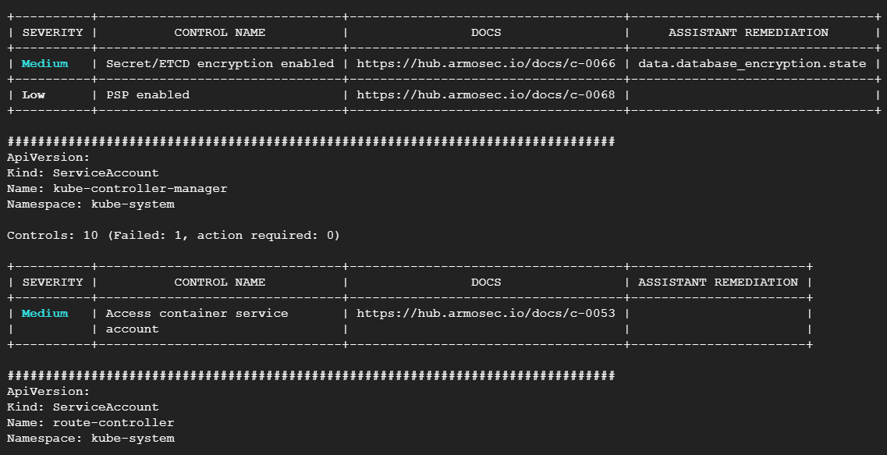

Slide 38
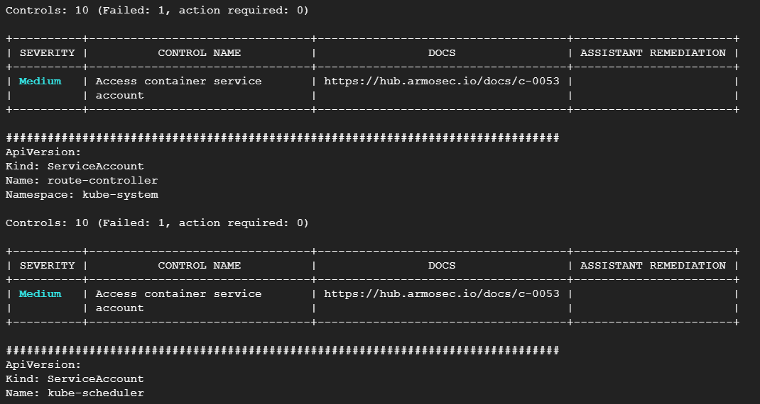

Slide 39
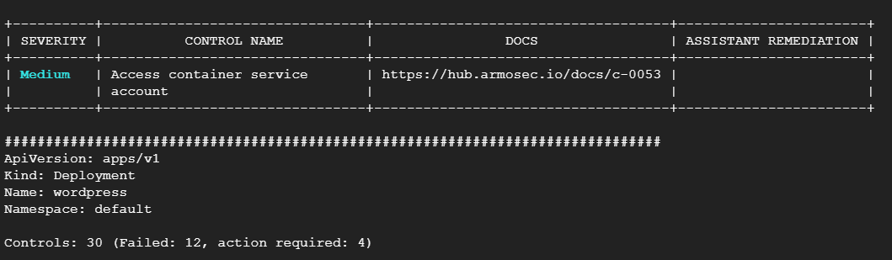

Slide 40
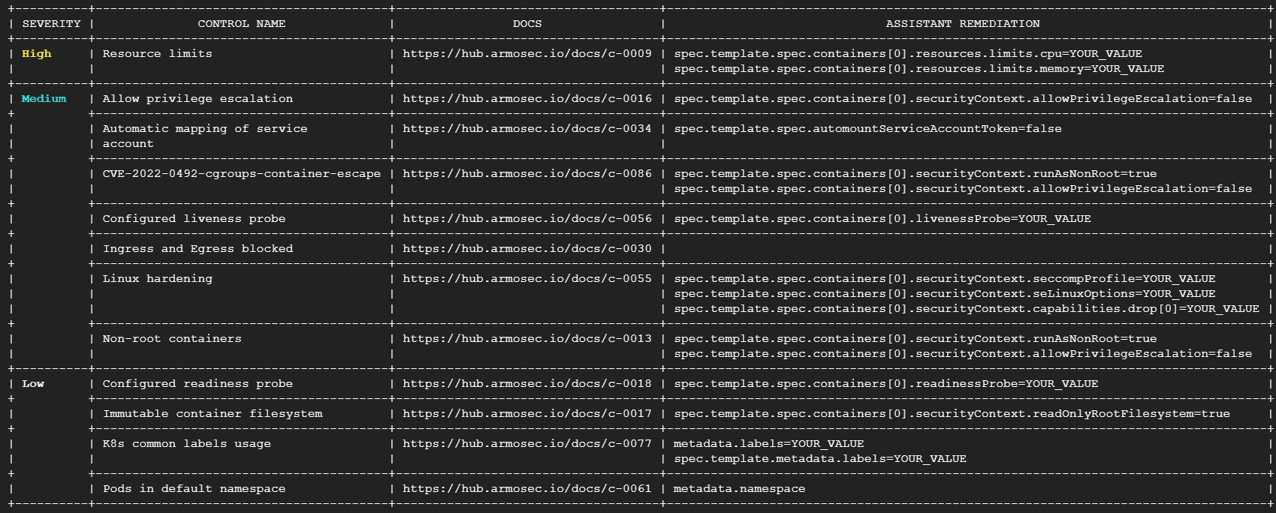

Slide 41
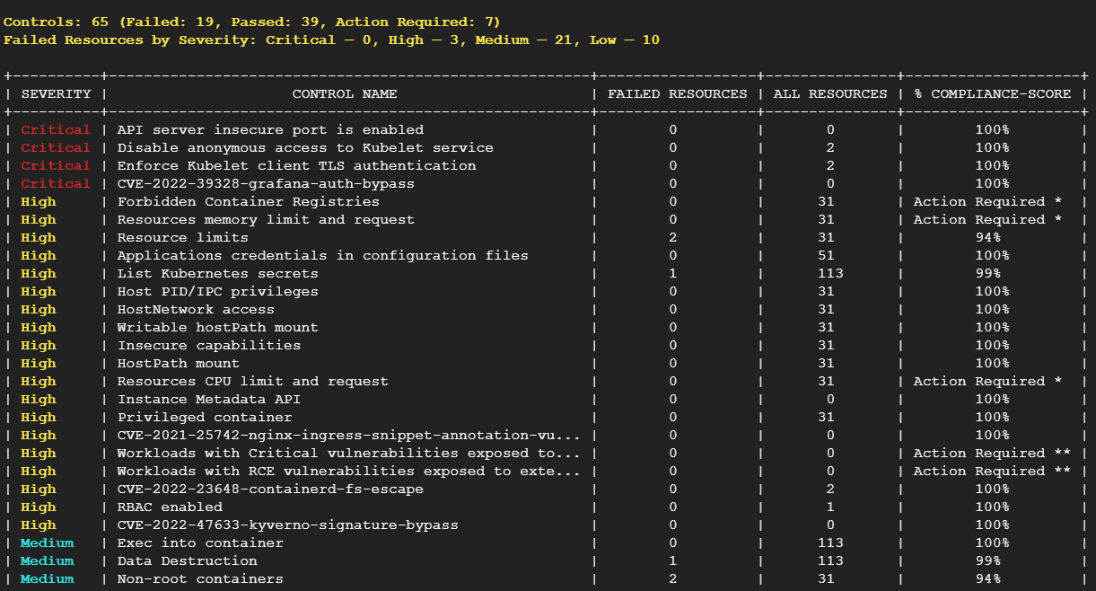

Slide 42
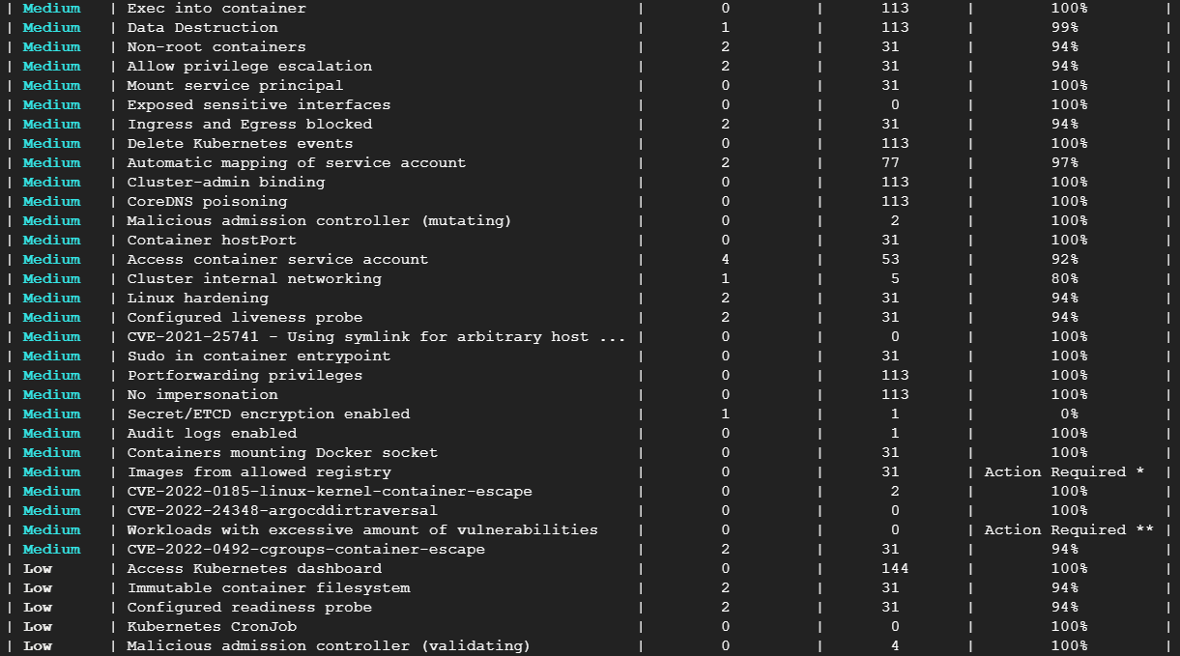

Slide 43
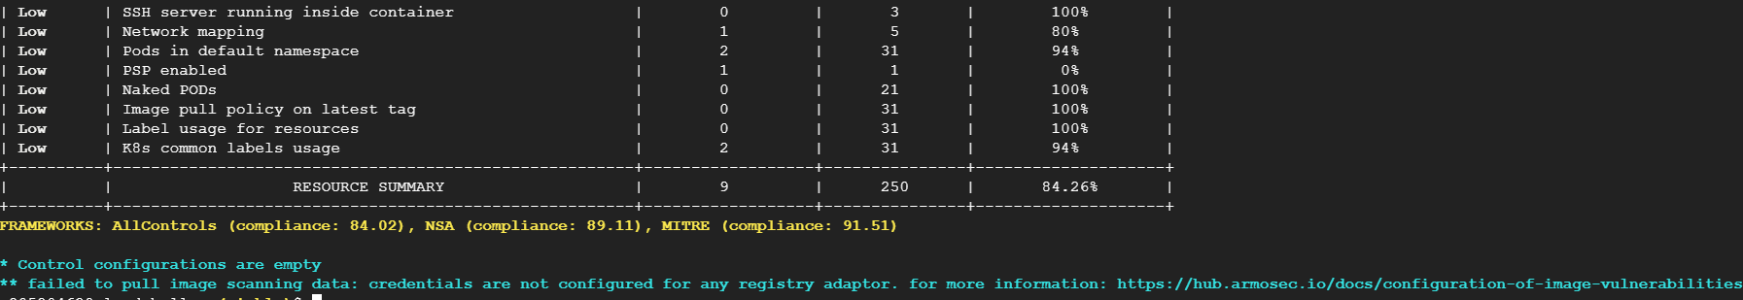
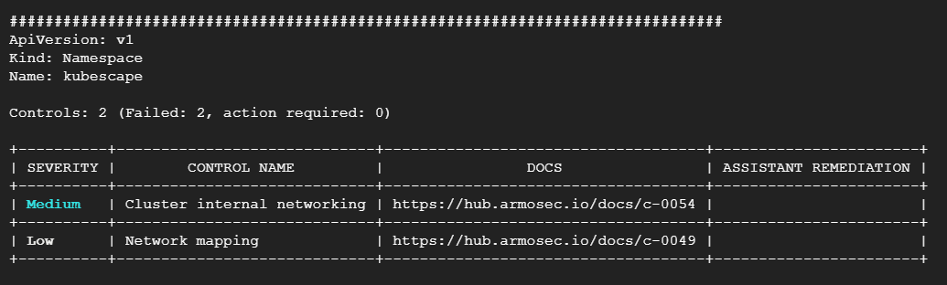

Slide 44
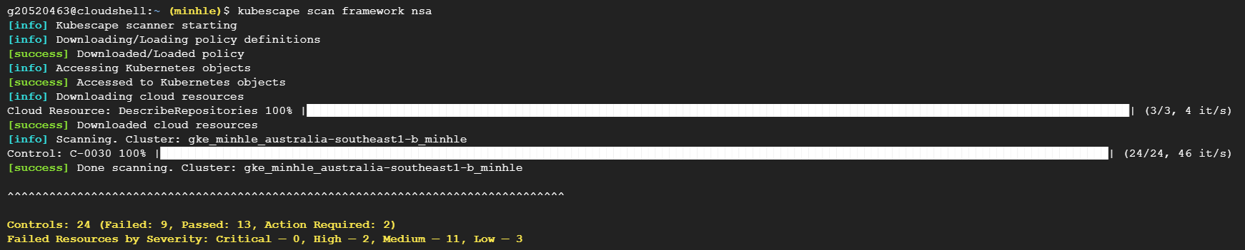
2nd scan

Slide 45
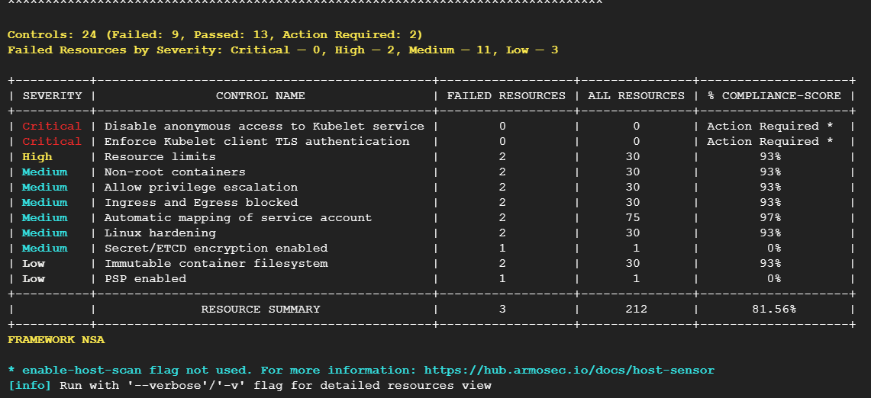

Slide 46
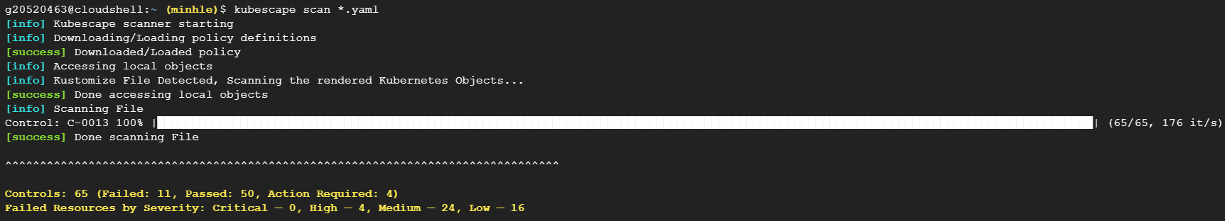
3rd scan

Slide 47
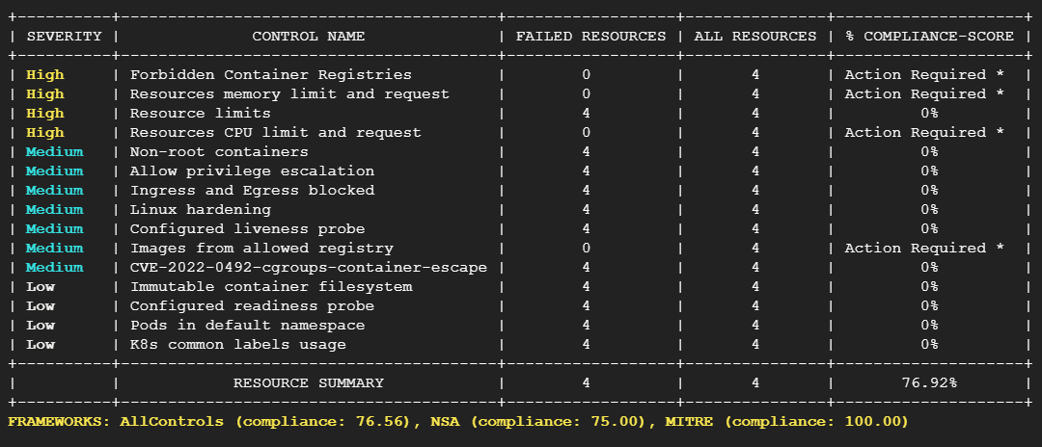

Slide 48

4th scan

Slide 49
