Slide 1
Stochastic Progressive Photon Mapping
随机渐进光子映射
Group: swl, thy, Entropy-Fighter

Slide 2
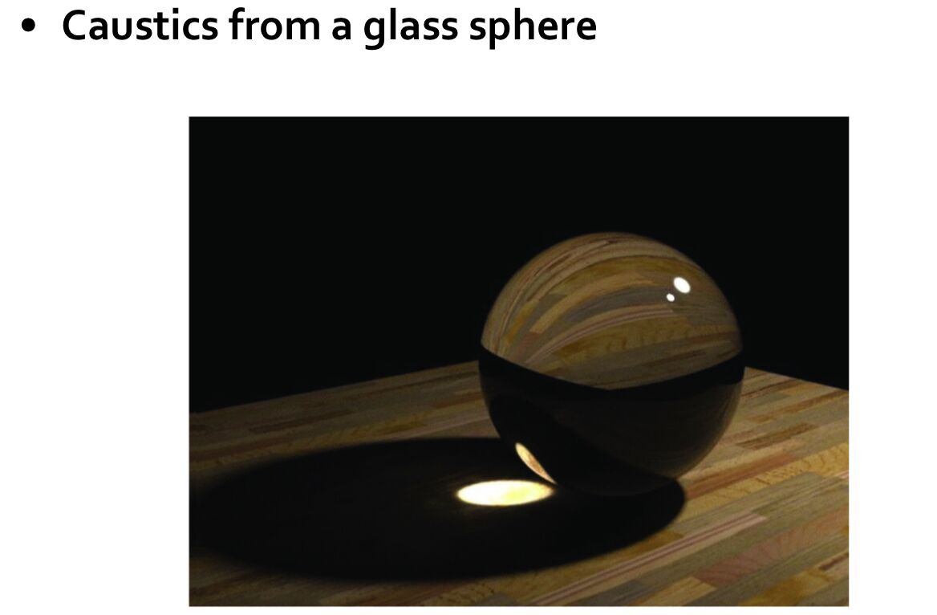
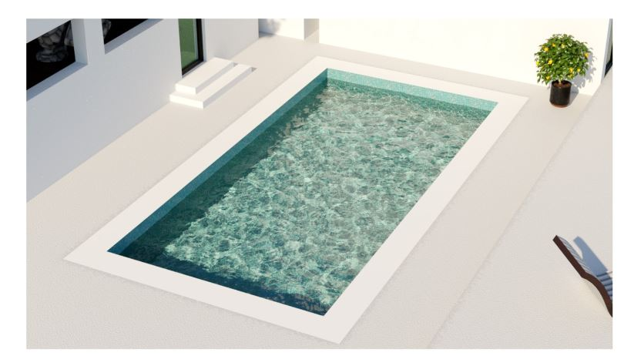
SDS(specular-diffuse-specular) path

Slide 3
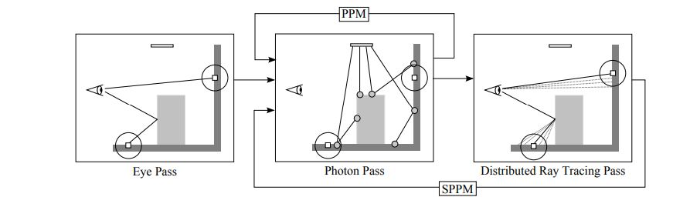
PM->PPM->SPPM
[2009]Stochastic Progressive Photon Mapping Toshiya Hachisuka, Henrik Wann Jensen

Slide 4
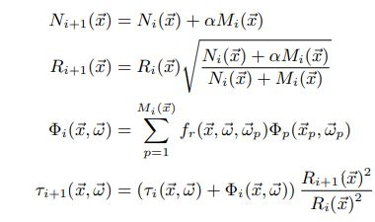
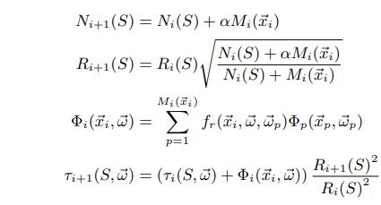


PPM
SPPM

Slide 5
Stochastic Progressive Photon Mapping
2 pass:
1.ray tracing pass
2. photon mapping pass

Slide 6
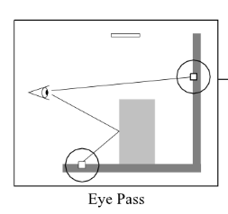
1.ray tracing pass
记录hitpoint用于photon mapping

Slide 7
brdf的属性：specular, diffuse, refraction, d, s
Russian Roulette 算法
for example: 对于一个物体的brdf属性有如下：0.1, 0.6, 0.3, 0.9, 0.1
应用Russian Roulette 算法随机0-1的数
specular
diffuse
refraction

Slide 8
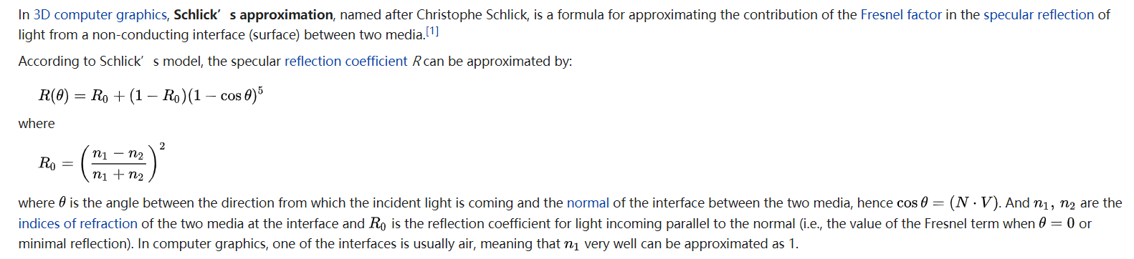
refraction

Slide 9
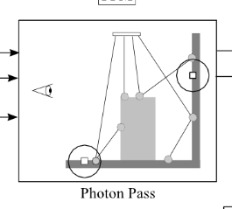
2.photon pass
d
s

Slide 10
kd-tree construction
ObjectKDTree(objects)
Initialized in camera::render once before all
Implemented in scene::ObjectKDTree
KDTree(hitpoints)
Initialized in camera::render_loop each time before photon mapping (after ray tracing)
Implemented in hitpoint::KDTree

Slide 11
ObjectKDTree(objects)
scene::ObjectKDTreeNode
Bounding box
Faces(such as triangles) vector
Child nodes
objectKDTree->intersect()
Intersect from an ObjectKDTreeNode, check the ray intersection and the intersection of child nodes

Slide 12
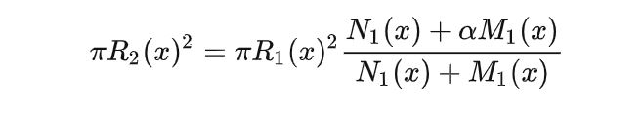
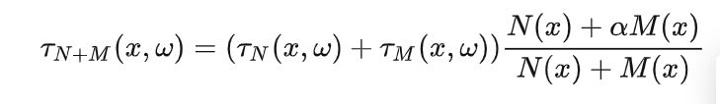
KDTree(hitpoints)
hitpoints::KDTreeNode
Bounding box
radius
hitpoints
Child nodes
hitpoints::update()
If a photon is within a KDTreeNode’s bounding box, update with the following formulas, then check its child nodes
Update the search radius
Update the flux

Slide 13
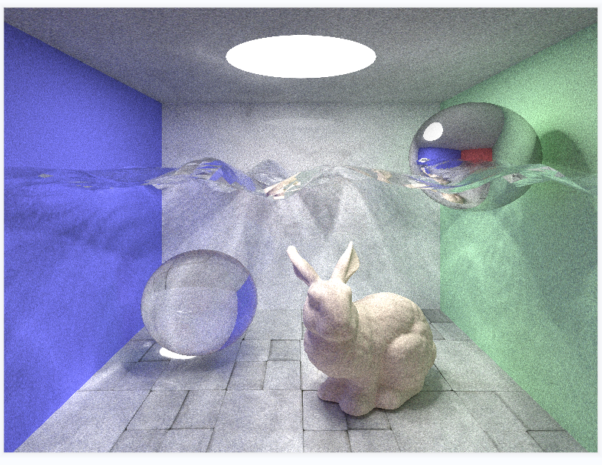
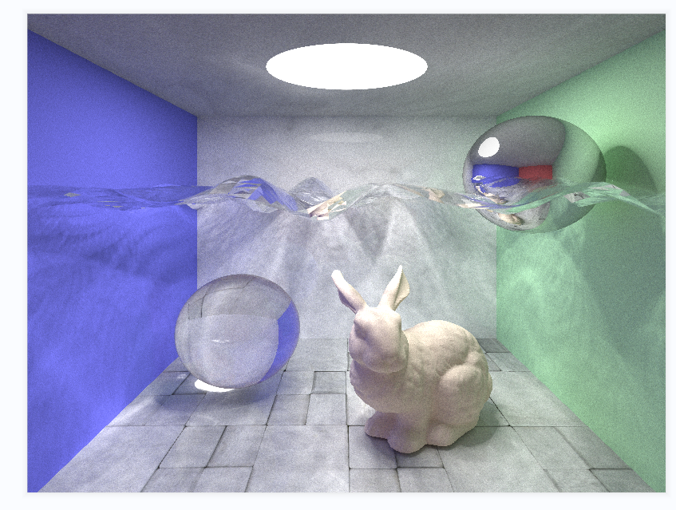
results
Picture resolution 800*600
100 rounds, 200000 photons
600 rounds, 200000 photons

