Slide 1
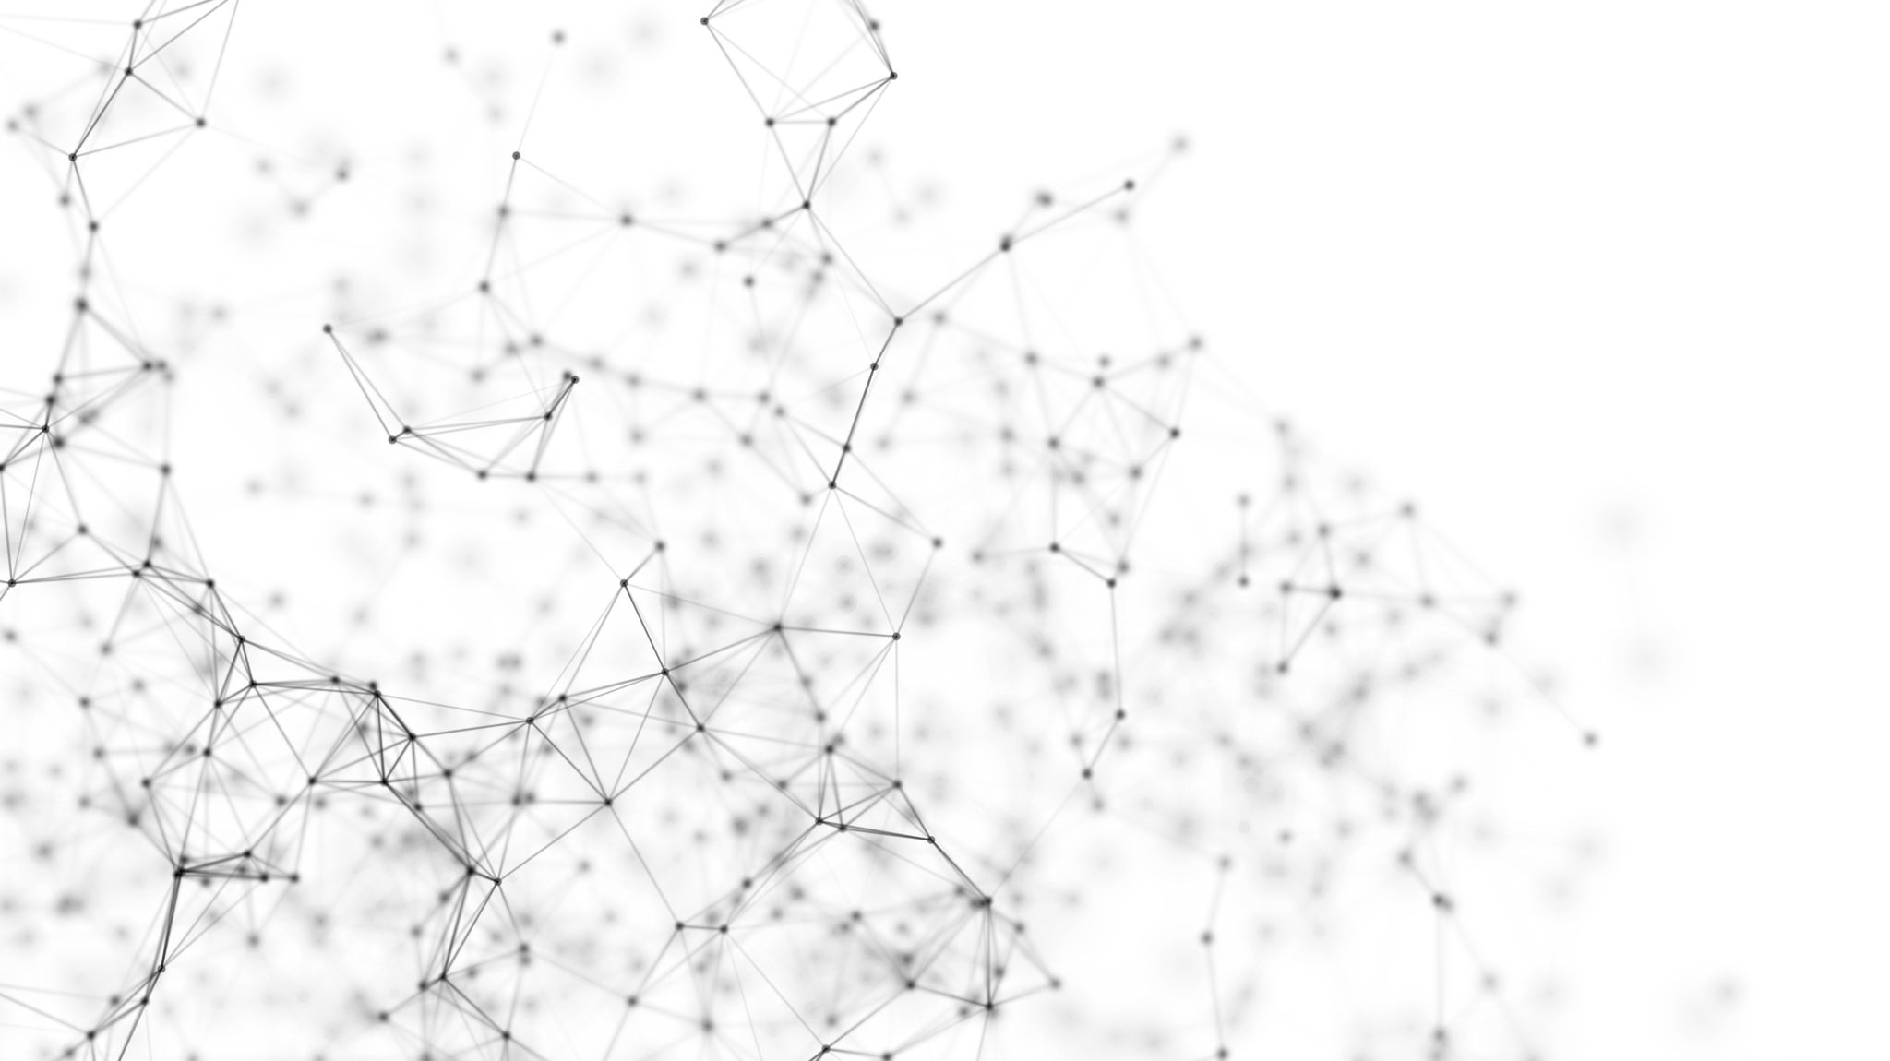
Executive Summary
Human Activity Recognition – Crisp Cerebella

Slide 2
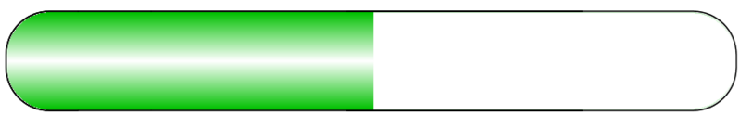


Timeline
Data loading
Data Preparation
Modelling
Model improvement
Model selection

Slide 3
Model improvement
LSTM
Tuning + Kfold Validation
Accuracy improvement: 89.196% (+/-3.298) → 98.135%
CNN LSTM
Tuning + Kfold Validation
Accuracy improvement: 90.835% (+/-0.896) → 92.79%
ConvLSTM
Tuning + Kfold Validation
Accuracy improvement: 90.970% (+/-0.670) → 93.51%
Transfer Learning
ConvLSTM used on new dataset (3 features and 6 Outcomes)
Freezing of the first layers and stacking new layers on top
Accuracy: 90.87%

Slide 4
