Slide 1

Async Serverless
Angular Meetup Graz
Rainer Stropek
software architects gmbh
Web
Mail
Twitter
http://www.timecockpit.com
rainer@timecockpit.com
@rstropek
with Angular and Azure

Slide 2

Your Host
Rainer Stropek
Developer, Entrepreneur
MVP Microsoft Azure
MVP Development Technologies
MS Regional Director
Contact
software architects gmbh rainer@timecockpit.com
Twitter: @rstropek

Slide 3

Code Sample
https://aka.ms/AA8wwcu

Slide 4





Patterns
Handling long-running, async processing in the backend
Idle HTTP Request
Keep HTTP request idle
Problem: Network timeout
Polling
Inefficient
Server → Client communication
Websockets, SignalR
Polling
Server → Client

Slide 5
What are Websockets
Full-duplex communication over a single TCP connection
Compatible with the HTTP
Over port 80 and 443
WebSocket handshake uses the HTTP Upgrade header
Demo: https://www.websocket.org/echo.html

Slide 6
SignalR Protocol (GitHub)
Protocol for duplex RPC
Works with any message-based transport (transport requirements)
Encodings: JSON, MessagePack
Handshaking
Client and server agreeing on a protocol version (handshake messages always JSON)
Invocation Types
Blocking invocation – caller calls callee and expects optional result synchronously
Non-blocking invocation – no result expected
Streaming invocation – one or more results
Pings to detect unexpected disconnects

Slide 7
SignalR
Transports
WebSockets
Server-Sent Events
Long Polling
Very well integrated in ASP.NET Core
E.g. Web API and SignalR in a single project
Clients
JavaScript (compatible down to IE11)
.NET (including mobile apps on Xamarin)
Java
Experimental: C++, Swift
https://docs.microsoft.com/en-us/aspnet/core/signalr/supported-platforms?view=aspnetcore-3.1

Slide 8
Challenges with Websockets
Very basic protocol
Solved with SignalR
Problem with SignalR: Server-side not available for all languages
Hard to scale
Keep a network connection open to each connected client
Hard to handle state about connected clients in a server farm
Azure SignalR solves this!
Serverless SignalR
Speaks SignalR to the (browser) client
Speaks RESTful Web API to the backend

Slide 9
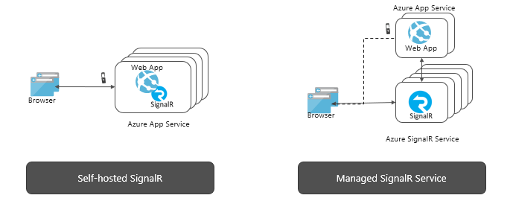
Purpose
Scalability
Many clients
Multiple regions
Serverless
No own SignalR server necessary
Different platforms
Event-driven functions

Slide 10
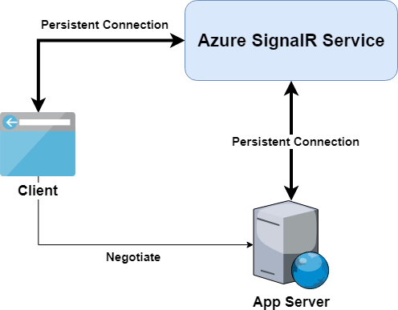
Protocol
Negotiate Endpoint
Multiplex connections through Azure SignalR
Serverless mode
No SignalR implementation in the backend at all
Backend speaks REST API to SignalR service

Slide 11
Demo Time
All Serverless
Azure Functions
SignalR Service
All TypeScript
Node.js
Angular
Notes:
Azure Infrastructure

Slide 12



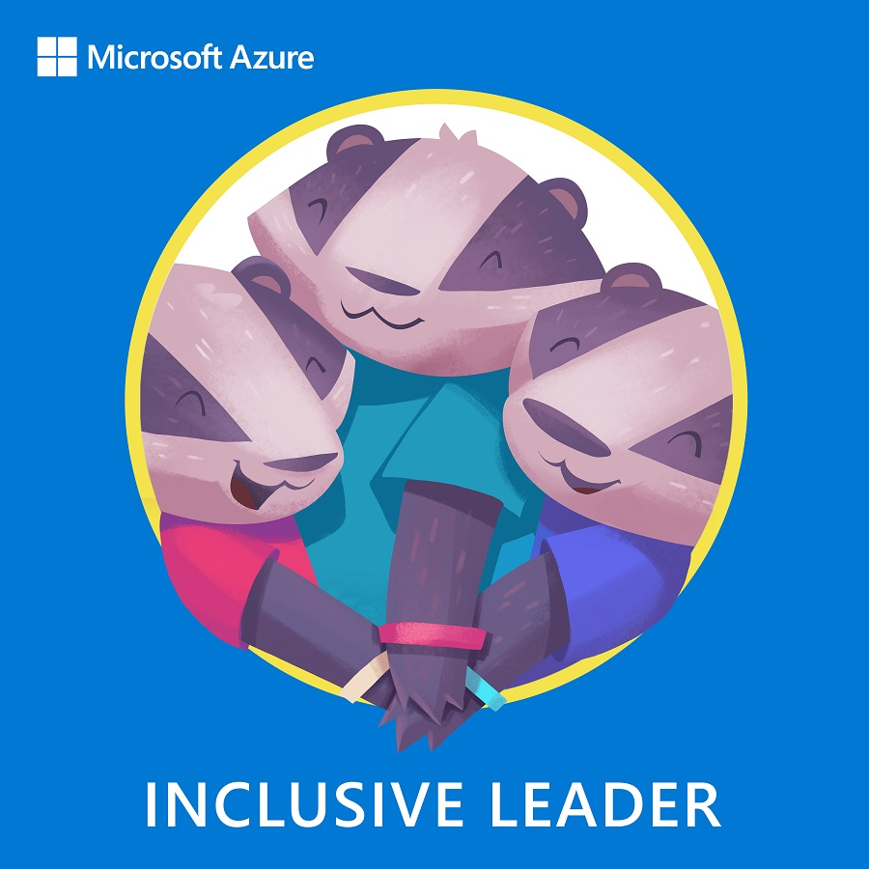

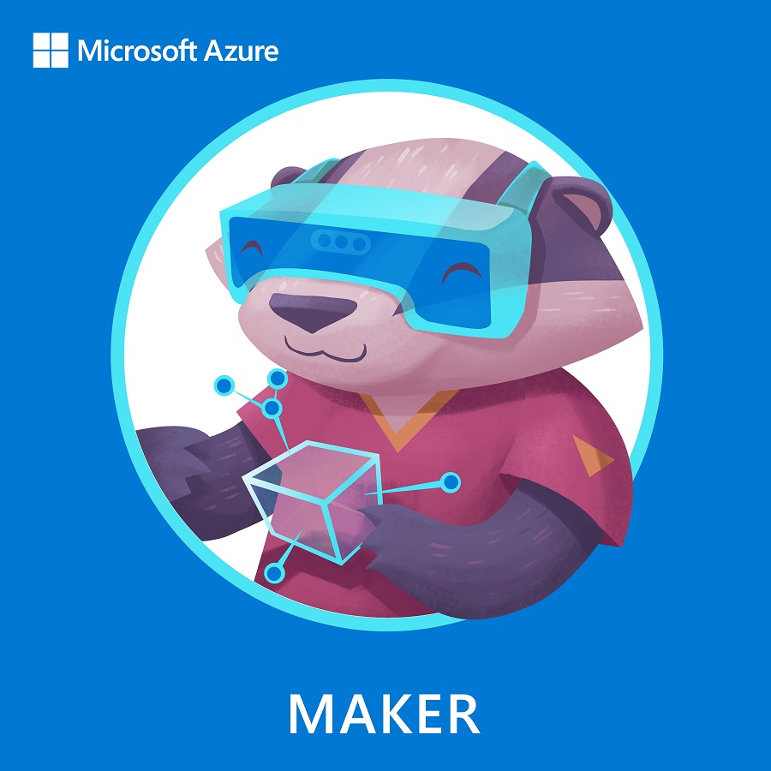

What is Azure Heroes?
Our mission is to empower technical practitioners of all backgrounds and in every organisation to achieve more. In that spirit, we created something unique to inspire you to learn, coach and build on Azure and to promote healthy and inclusive behaviours within the community.

Slide 13


The Learner badger is for anyone working with or learning about Azure!
Azure Heroes recognises Azure practitioners from across Europe
The other digital badgers must be earned with verifiable acts of impact
Our digital badgers live on the blockchain and are verifiably scarce, so they require a free blockchain wallet to safely store them
NOMINATE yourself or a community hero around you
For more information visit: aka.ms/azure.heroes

Slide 14
Q&A
Angular Meetup Graz
Rainer Stropek
software architects gmbh
Mail Web Twitter
rainer@timecockpit.com http://www.timecockpit.com @rstropek
Thank your for coming!

