Slide 1
Computational thinking Lab session

Slide 2
Assignment
In this case study, we have four tasks.
The first task is to manually download DNA and protein sequence
data to your computer.
The second task is to import the DNA data into Python.
The third task is to create an algorithm that
Translates to DNA using the translation table provided.
The fourth task, the final task, is to check if your DNA translation matches
the protein string you have downloaded.

Slide 3
File download
From NCBI to nucleotide database and search the accession NM_ 207618.2.
Select fasta at top of page, select the sequence only and save as a txt file.
CDS at bottom right and get the complimentary protein sequence. Then create another protein file with the aa sequence.

Slide 4
Importing files to python
Reading lines one at a time and working on each lines indvdually, or all at the go.
Check the directory (pwd) or cd to the directory desired
Open function to read and store in a object. Check to see undesirable characters. If any found remove with the replace function on the string
Open the table file (table.py) with dictionary of aa and codons by double clicking. Correct the indentation
NB all inputs are strings also check that the length of the string to be investigated is divisible by 3

Slide 5
Pseudocode
Check sequence length is divisible by 3
If true, loop over the sequence
Extract a single codon
Look up the codon and store the result in a list

Slide 6
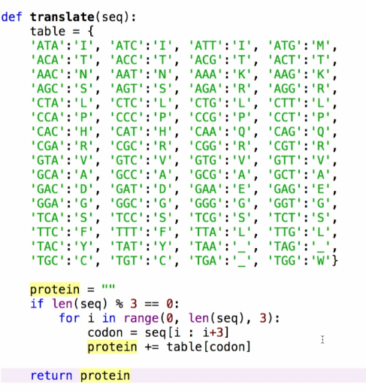

Slide 7
Include a docstring

Slide 8
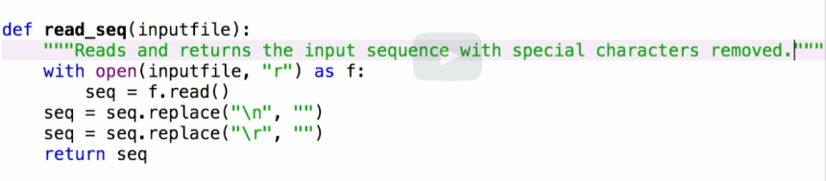
Did we translate well? Checking and automating
Introduce With statement
with open (inputfile, “r”) as f:
Seq = f.read()

Slide 9
More examples?
NB. Sequence indices of the genes in NCBI
Stop codons
Which characters to omit( slice and exclude the last character)
One more example. Students can chose which gene or sequence

Slide 10
Should we do same with R?

