Slide 1
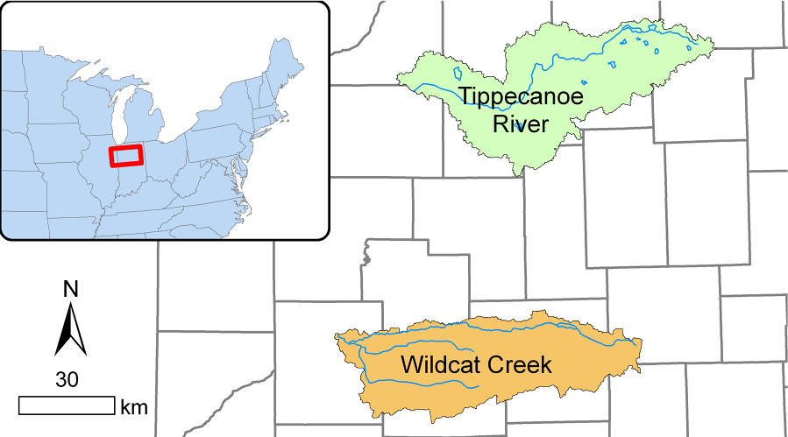
Statistical Visualization of Tippecanoe River and Wildcat Creek

Slide 2
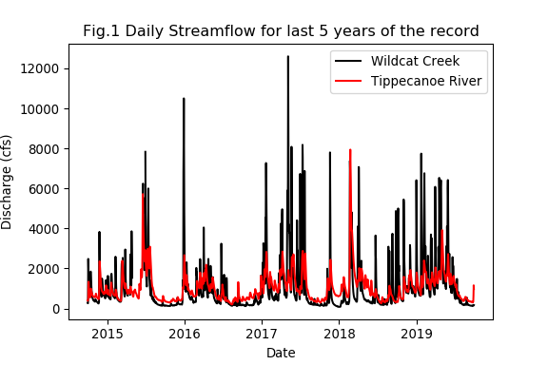
Daily discharge for last 5 years

Slide 3
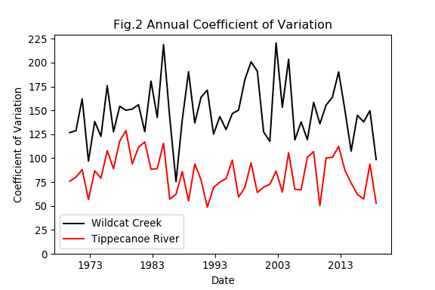
Annual Coefficient of Variation

Slide 4
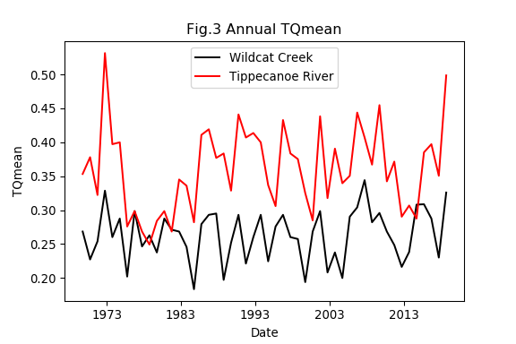
Annual TQmean

Slide 5
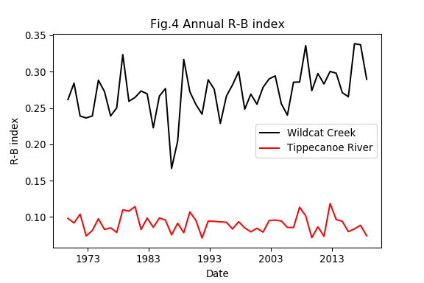
Annual R-B index

Slide 6
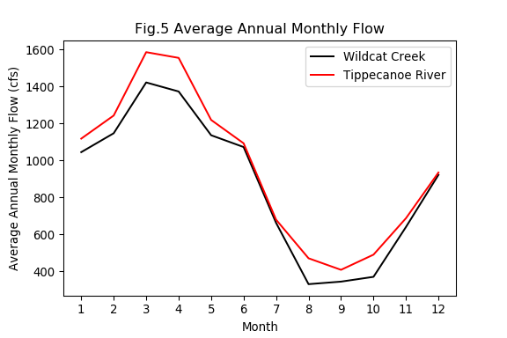
Average Annual Monthly Flow

Slide 7
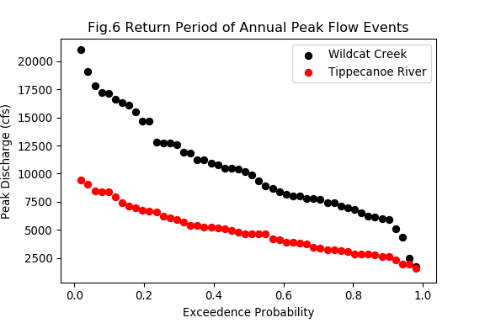
Return Period of Annual Peak Flow

