Slide 1
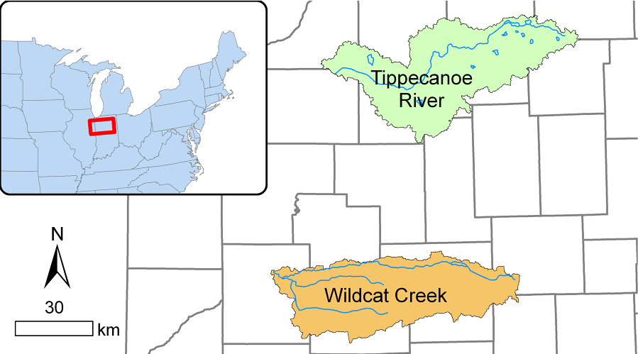
Presentation Graphics for Tippecanoe and Wildcat creek river

Slide 2
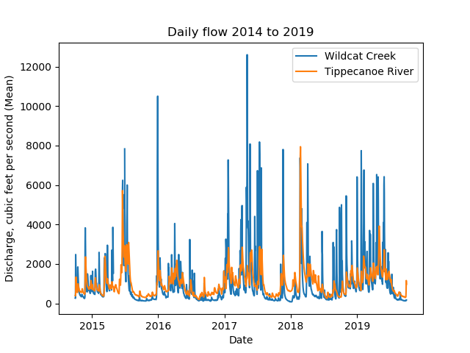
Daily discharge for past 5 years(2014-2019)

Slide 3
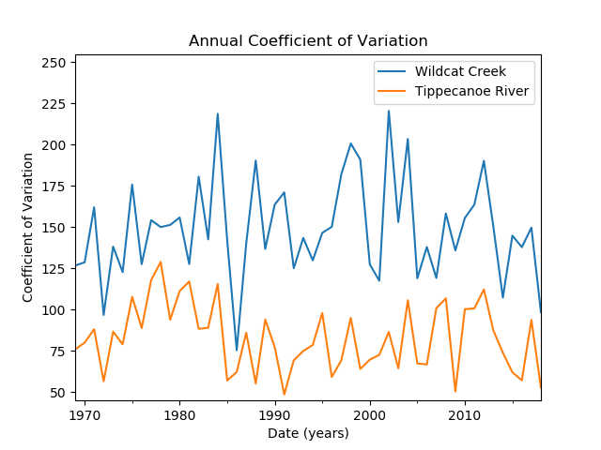
Annual coefficient of variation between
1969 to 2019

Slide 4
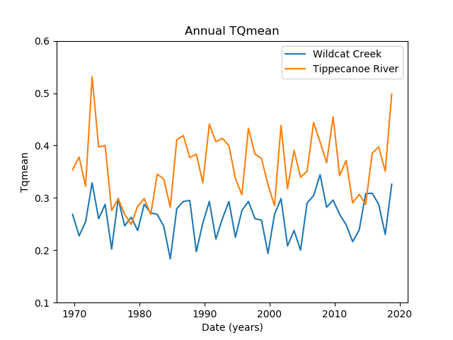
Annual TQmean between
1969 to 2019

Slide 5
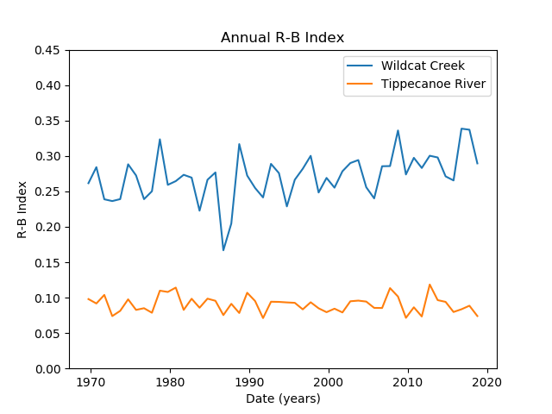
Annual R-B Index between
1969 to 2019

Slide 6
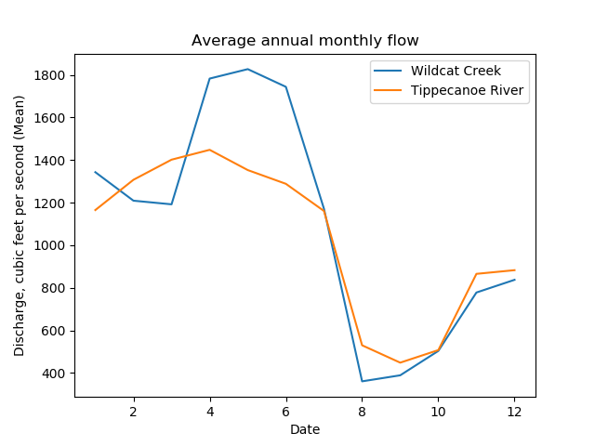
Average annual monthly flow between
1969 to 2019

Slide 7
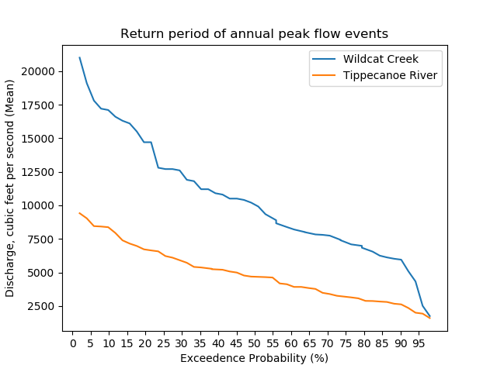

Return period of annual peak flow events
Equation 1: where m = rank of precipitation event x, and N = number of observations

