Slide 1
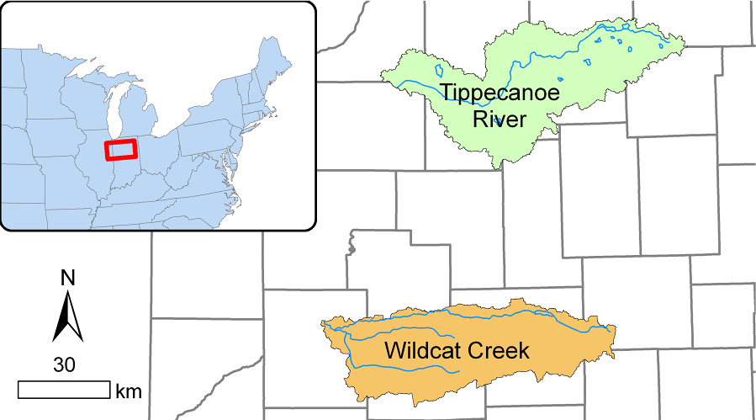
Visual Comparison of Tippecanoe River and Wildcat Creek

Slide 2
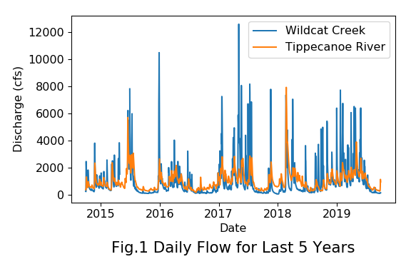
Daily Flow of the Last 5 Years

Slide 3
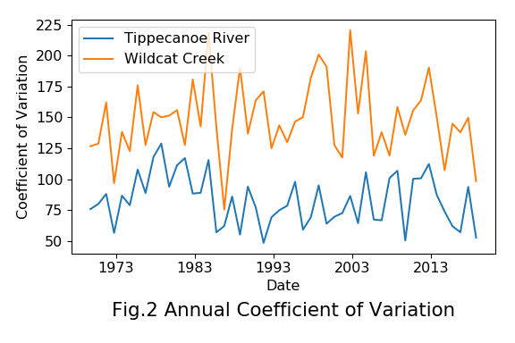
Annual Coefficient of Variation

Slide 4
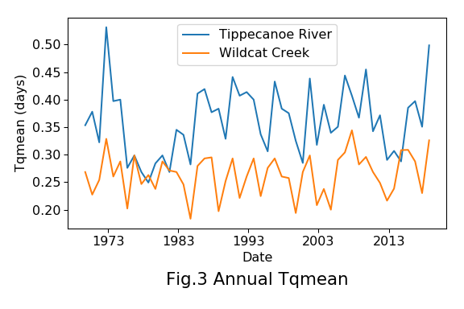
Annual Time Series of Tqmean

Slide 5
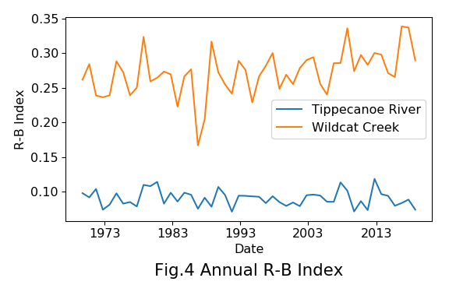
Annual Time Series of R-B Index

Slide 6
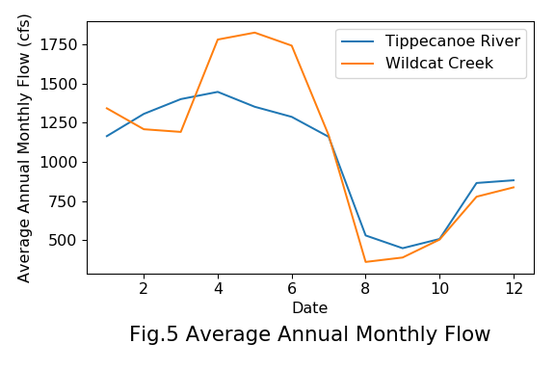
Average Annual Monthly Flow

Slide 7
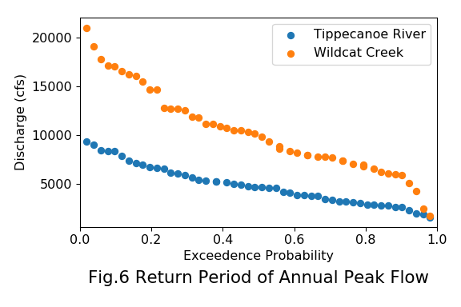
Return Period of Annual Peak Flow

