Slide 1
Lab 11 Presentation Graphics
Logan Heusinger

Slide 2
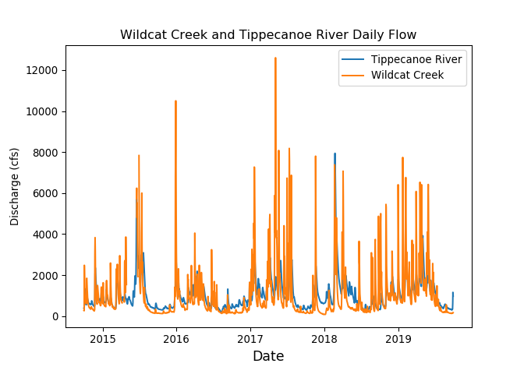
Daily Flow

Slide 3
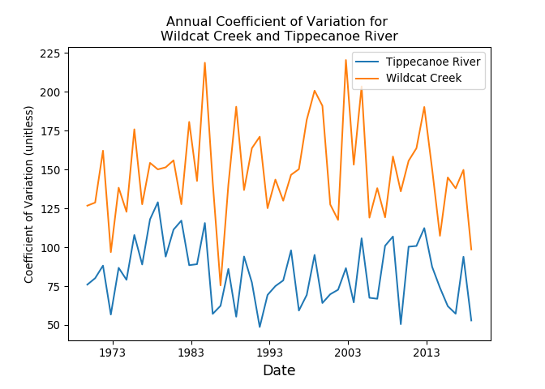
Annual Coefficient of Variation

Slide 4
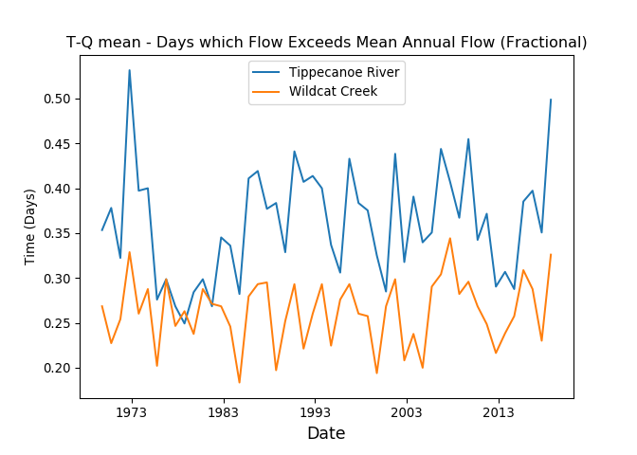
T-Q Mean

Slide 5
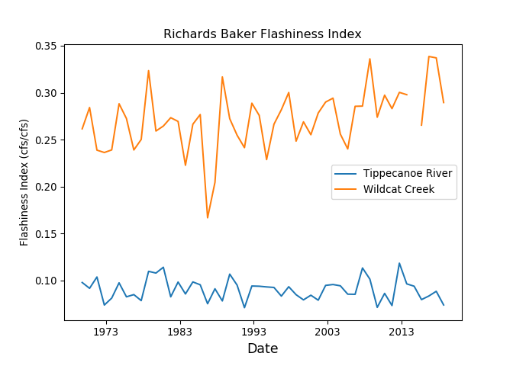
R-B Index

Slide 6
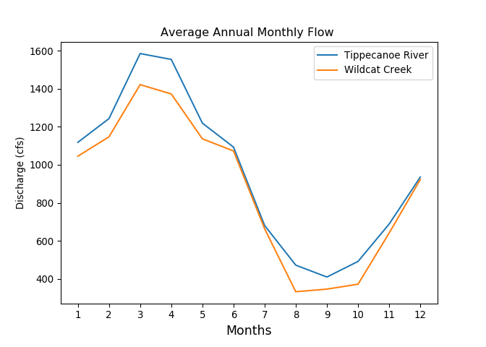
Average Annual Monthly Flow

Slide 7
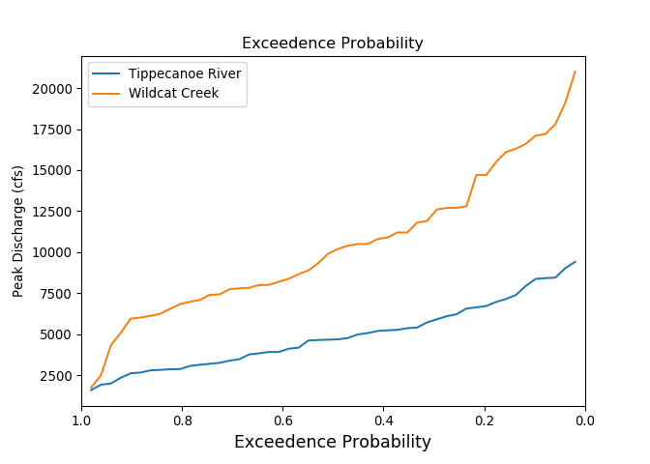
Return Period of Peak Flow Events

