Slide 1
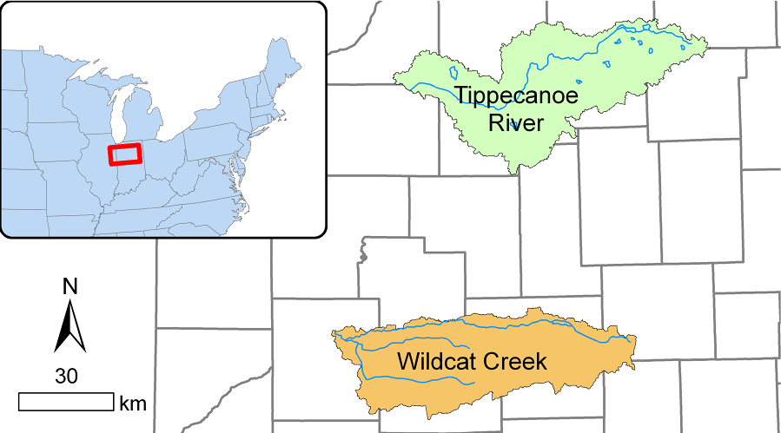
Streamflow Metrics for Tippecanoe River and Wildcat River
Marissa Cubbage 4/19/2019

Slide 2
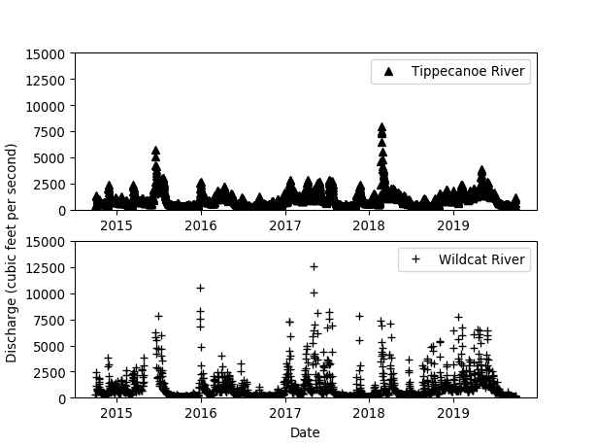
2014-2019 Daily Discharge
Figure 1: Daily discharge in cubic feet per second for Tippecanoe River and Wildcat River during the years 2014-2019.

Slide 3
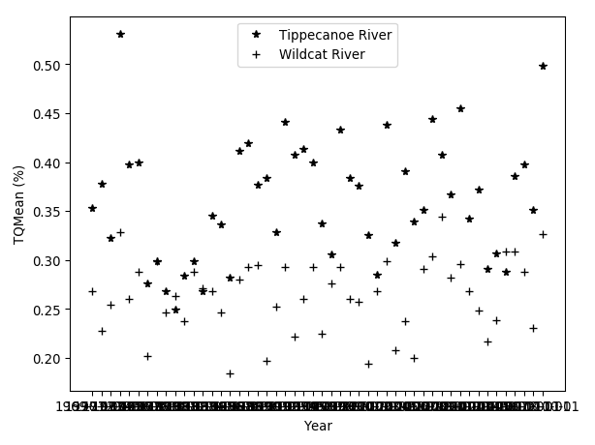
Annual TQMean
Figure 2: Annual TQMean for Tippecanoe River and Wildcat River during the years 1969-2019.The TQMean is the fraction of days that streamflow exceeds mean annual streamflow.

Slide 4
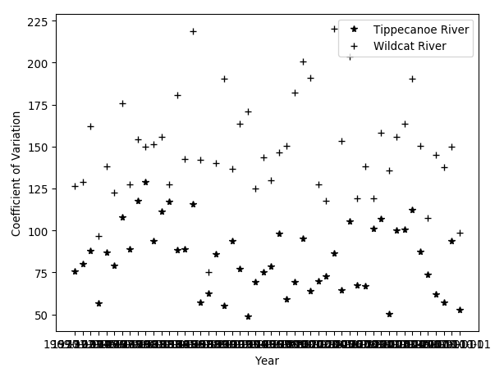
Annual Coefficient of Variation
Figure 3:Annual Coefficient of variation for Tippecanoe River and Wildcat River during the years 1969-2019.The coefficient of variation is calculate as the standard deviation divided by the mean annual streamflow, then multiplied by 100.

Slide 5
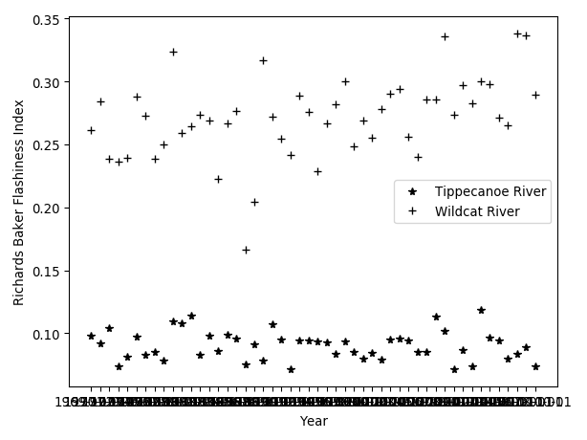
Annual Richards Baker Index
Figure 4: Annual Richards Baker Index for Tippecanoe River and Wildcat River during the years 1969-2019.The Richards Baker index is a measure of streamflow “flashiness’

Slide 6
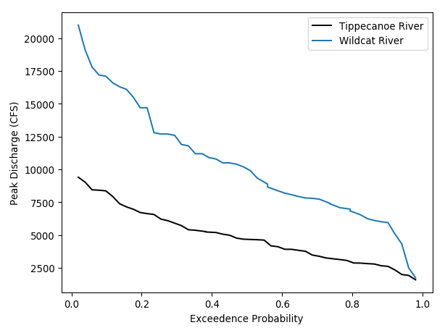
Return Period of Annual Peak Flow Events
Figure 2: Return period of annual peak flow events for Tippecanoe River and Wildcat River during the years 1969-2019.

