Slide 1
ABE 651: Lab 11
Tyler Field

Slide 2
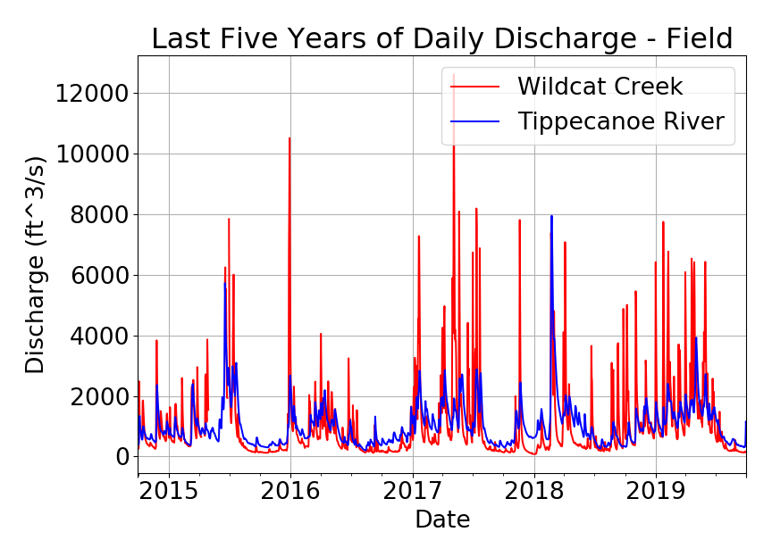
5 Years of Daily Flow Data

Slide 3
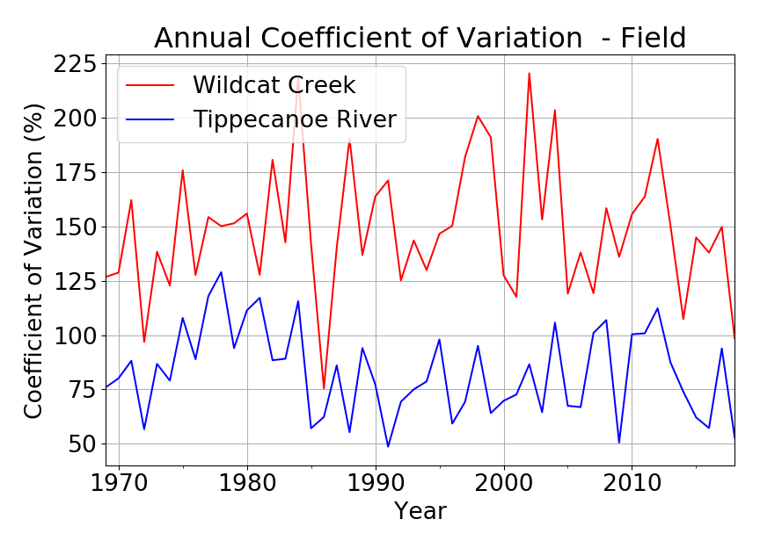
Annual Coefficient of Variation

Slide 4
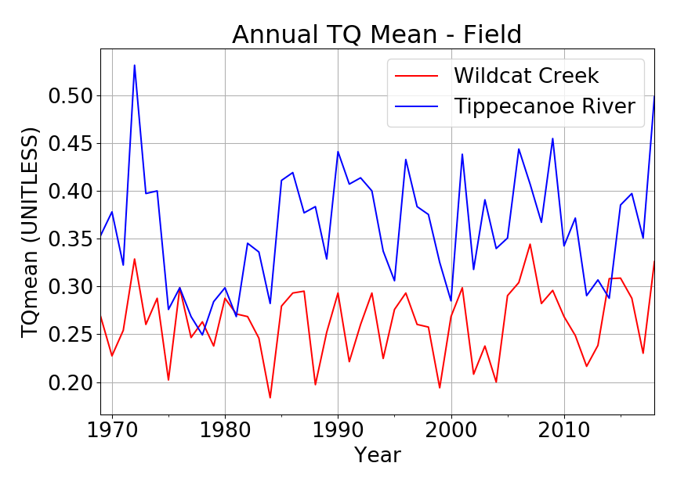
Annual TQ Mean

Slide 5
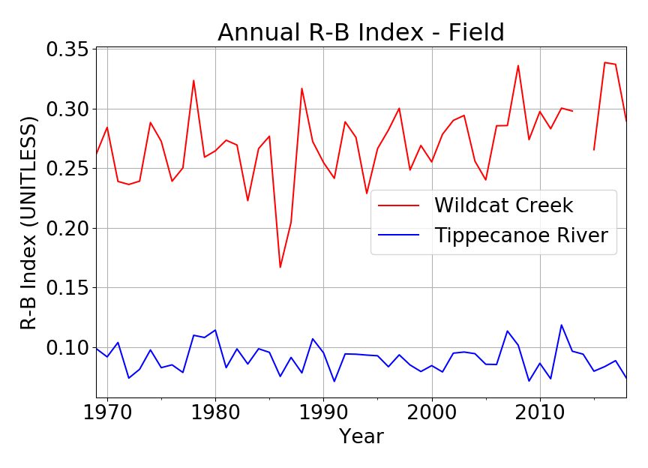
Annual R-B Index

Slide 6
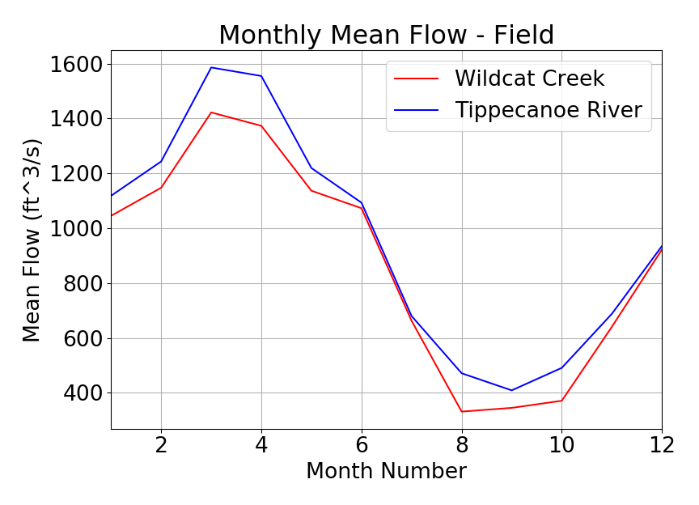
Monthly Mean Flow

Slide 7
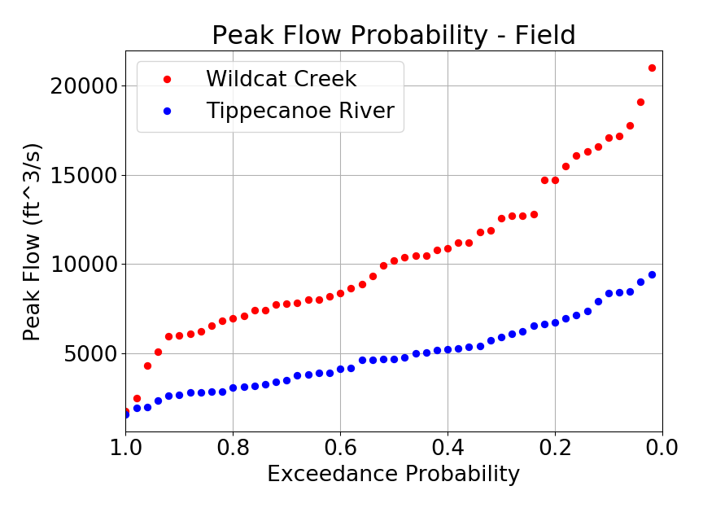
Exceedance Probability

