Slide 1
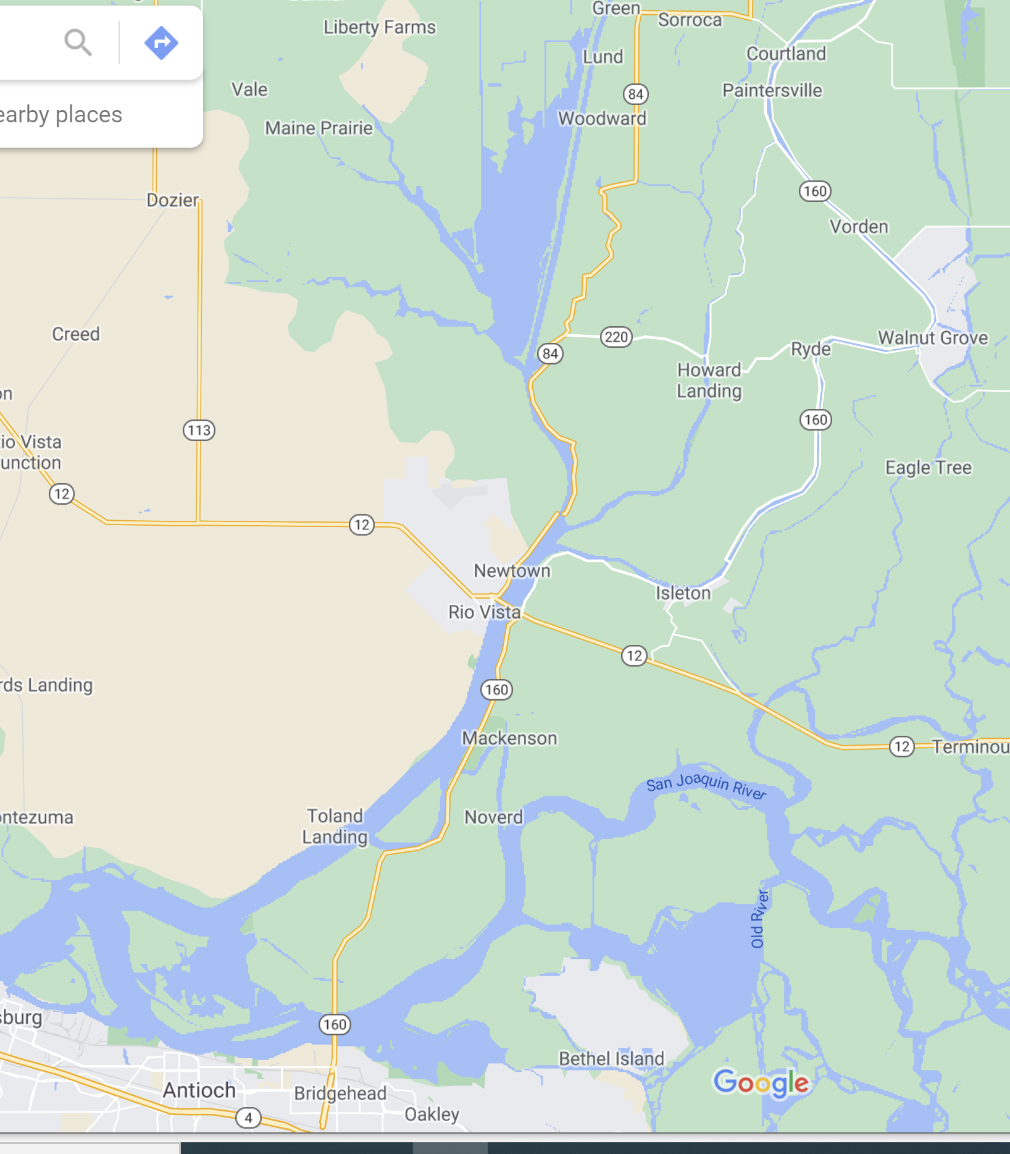
Courtland
Sac1
Sutter
Sac2
Steam1
Sac3
Steam2
Geo/ID
Sac4
Chipps Island

