Slide 1
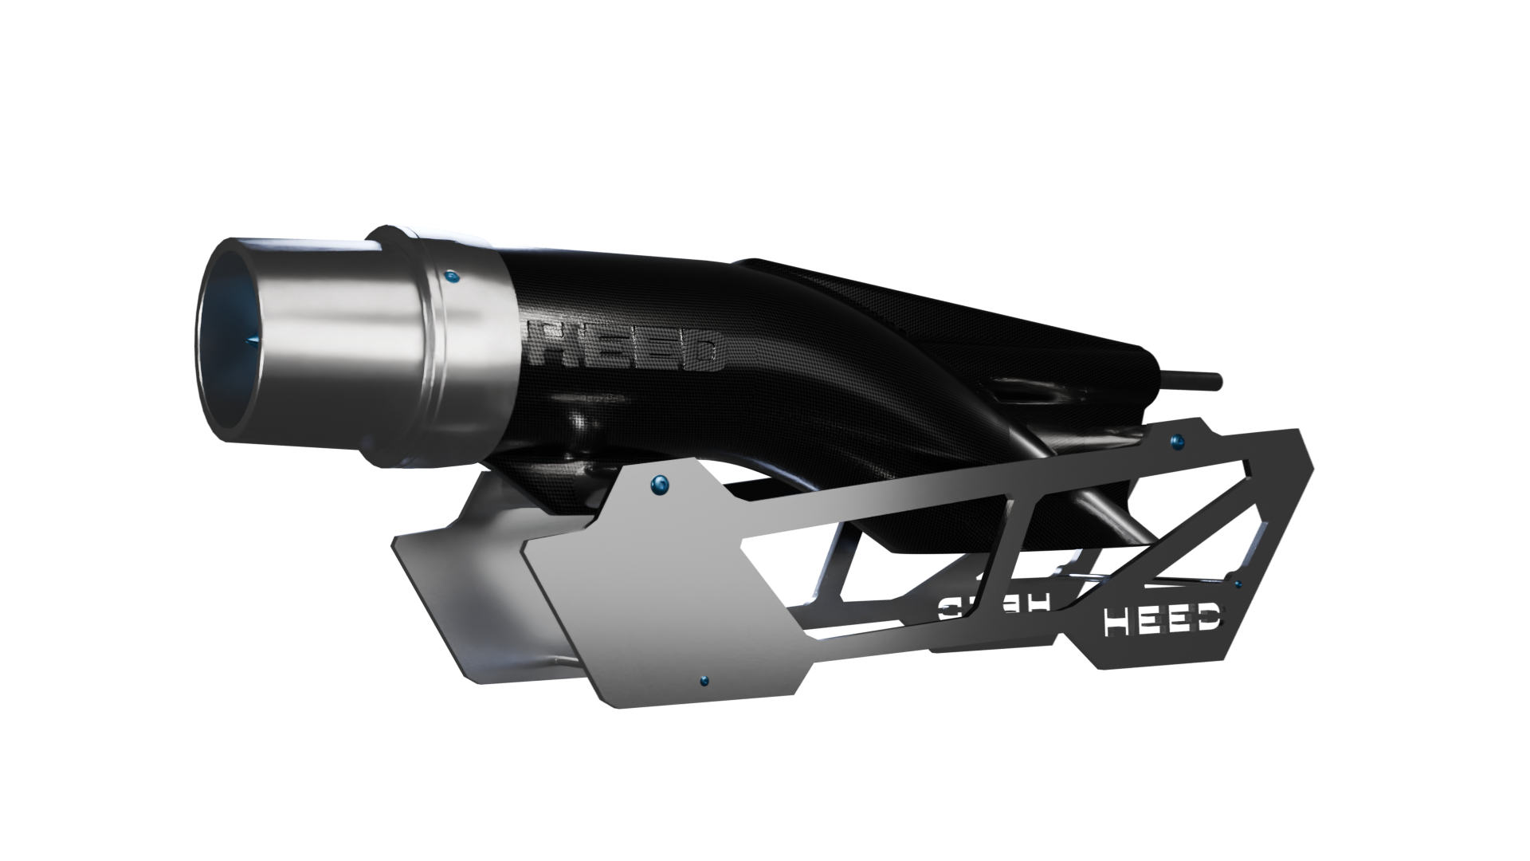

E - JET
TECHNOLOGY THAT PROPELS
PATENT PENDING
CONFIDENTIAL

