Slide 1
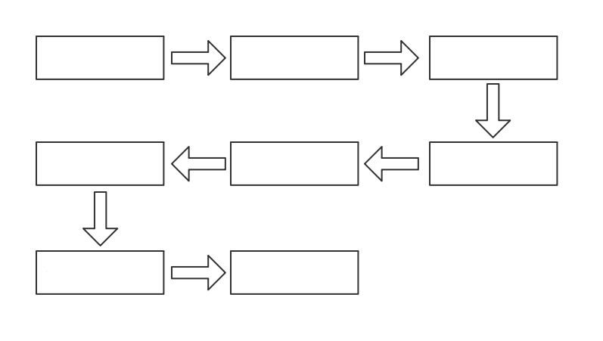
Create Project
Create Application
Create Deployment
Create a Pipeline
Configure Service and Route
Configure Config Map and Update the Deployment
Run the Pipeline and View the Results
Use the Published Application

