Slide 1
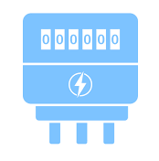


scenario_stream_tsdb_api.png
Origin Data
Rule Engine
Smart Meter
IoT Hub
API
Stream Processing
Engine
TSDB
App
Calculated Data

Slide 2
Engine Layer
Kafka Topic
Kafka Topic
Streamset
IoT Hub
Rule Engine
Origin Data Topic
Cal Data Topic
Spark Streaming
Storage Layer
4
Redis
5
Storage Policy
(User defined)
TSDB
Storage Policy
(User defined)
Archive

