Slide 1
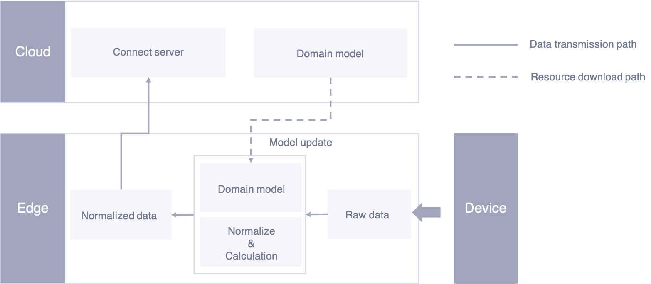
Add edge
Add Connection
Add device
Inspect
connection status
Publish configuration
Configure logical
Address or offset
Inspect
Connection Status

Slide 2
Resource
management
Connective
Storage
Authentication
Slicing
Transfer
SDK
Domain
Redis
Real-time computing
Mdm
Job scheduler
DAG parser
Script engine
Message queue
Event
Access
Protocol
Protocol management
Protocol adapter
SDK

Slide 3
Cloud
Connect server
Data transmission path
Domain model
Resource download path
Edge
Model update
Device
Domain model
Normalized data
Raw data
Normalize
&
Calculation

Slide 4
Upload the communication driver
Upload the configuration file
Configure the mapping relation

