Slide 1


Slide 2
301
Environment Setup

Slide 3

Objectives
Know the tools that are required for basic development
How to set up Java development environment
How to set up Python development environment

Slide 4
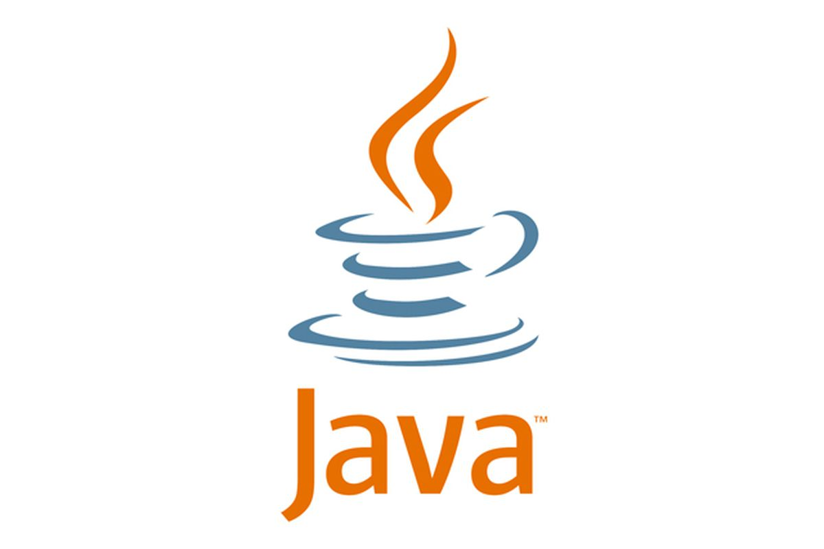



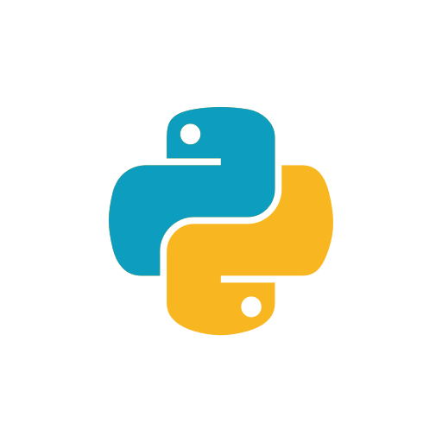
Development Environment Setup
Install the following tools for setting up your development environment on Windows.
If you choose Java
IDE
Java SE 8
Maven 3
IntelliJ IDEA
Community Edition for JVM and Android development
Development Kit 8 or above version
Apache Maven 3 or above version
If you choose Python
Pycharm
Python
Community Edition for pure Python development
Python 3.7.5

Slide 5
Java Development Environment Setup

Slide 6
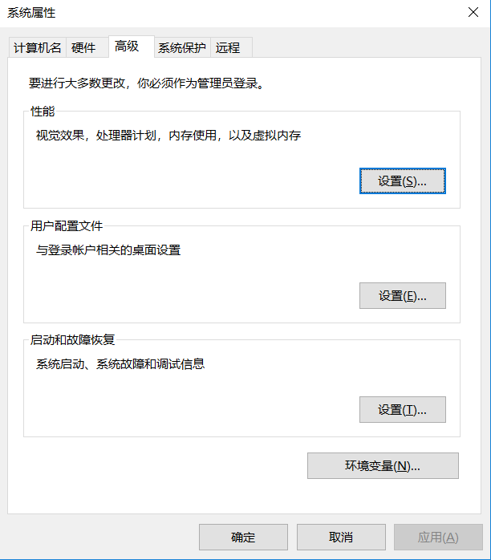
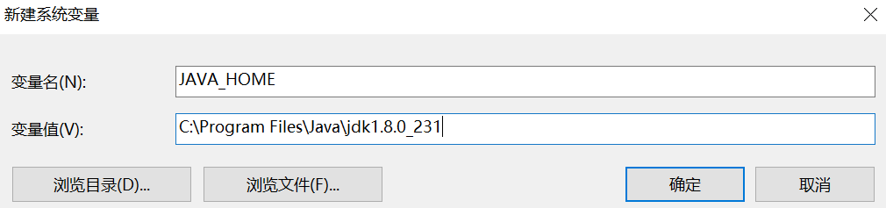
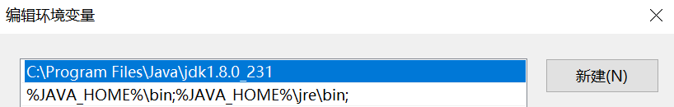
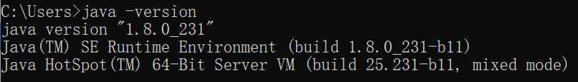
Installing Java SE 8
You can skip this step if you already have JDK installed.
Download the installation image (8u231 for Windows x64) at https://www.oracle.com/technetwork/java/javase/downloads/jdk8-downloads-2133151.html (you may need to register an Oracle account).\
Run the downloaded installation file jdk-8u231-windows-x64.exe, and follow the prompts of the wizard to install the JDK. Note the installation path, which will be used as you set the system variables.
Add the system variable JAVA_HOME, and set the value to the installation path of the JDK.
Edit system variable Path to add the following values. (Note that the variable is case-sensitive).
Verify if the installation is successful: enter java -version in the command line and ensure that the version information is properly returned.

Slide 7
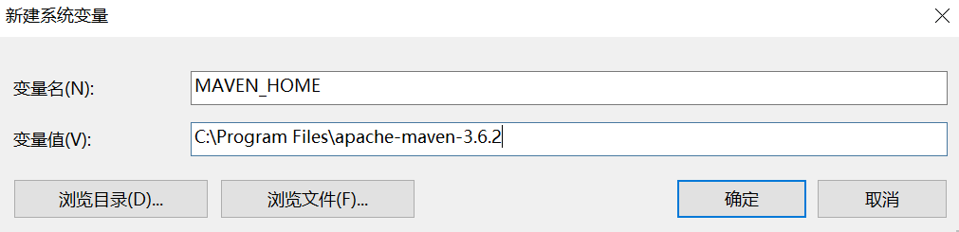
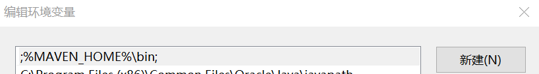
Installing Maven 3
Download the source files of Apache Maven 3.6.2 (apache-maven-3.6.2-bin.zip) at http://maven.apache.org/download.cgi.
Extract the downloaded file to your specified path, for example, C:\Program Files\apache-maven-3.6.2.
Add system variable MAVEN_HOME with the above path as the value.
Edit system variable Path and add
%MAVEN_HOME%\bin
Verify if the installation is successful by entering mvn -version in the command line.

Slide 8
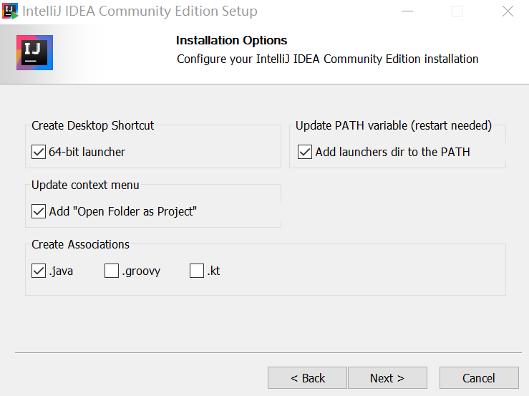
Installing IntelliJ IDEA
Download the installation image (Community Edition) at https://www.jetbrains.com/idea/download/#section=windows
Run the downloaded file ideaIC-2019.2.4.exe, and follow the prompt of the wizard to install IntelliJ IDEA.
Restart your computer to complete the installation.

Slide 9
Python Development Environment Setup

Slide 10
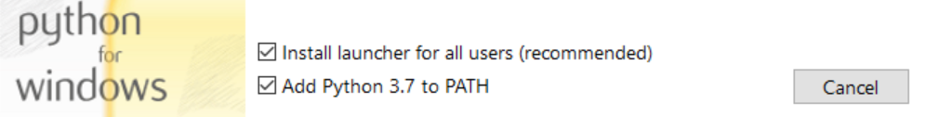
Installing Python 3.7.5
You can skip this step if you already have a Python installed.
Download the installation image (Windows x86-64 executable installer) at https://www.python.org/downloads/release/python-375/
Run the downloaded file python-3.7.5-amd64.exe, and choose “Quick Install” to install Python 3.7.5.
Verify if the installation is successful: enter python in the command prompt.

Slide 11
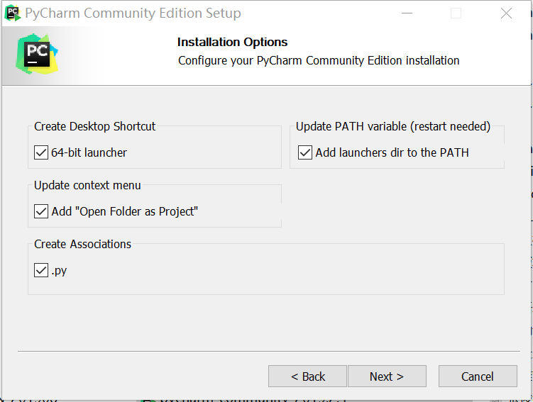
Installing PyCharm
Download the installation image (Community Edition) at https://www.jetbrains.com/pycharm/download/#section=windows
Run the downloaded file pycharm-community-2019.2.4.exe, and follow the wizard to install PyCharm.
Restart your computer to complete the installation.

Slide 12
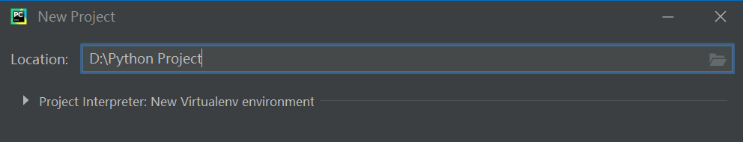
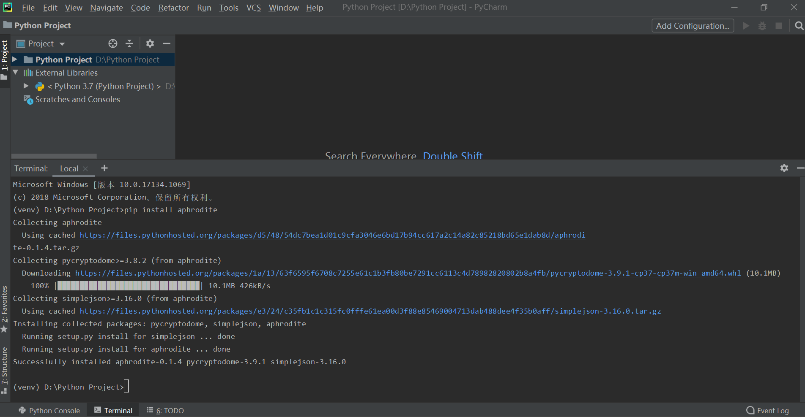
Setting up PyCharm
Start up Pycharm, select Do not import settings, click Skip Remaining and Set Defaults, and then click Create New Project.
Select a project space location and click Create.
On the new project page, click Terminal, and enter pip install aphrodite to install the Python Core SDK for EnOS API.
Now you’ve completed setting up the development environment for Python.

