Slide 1
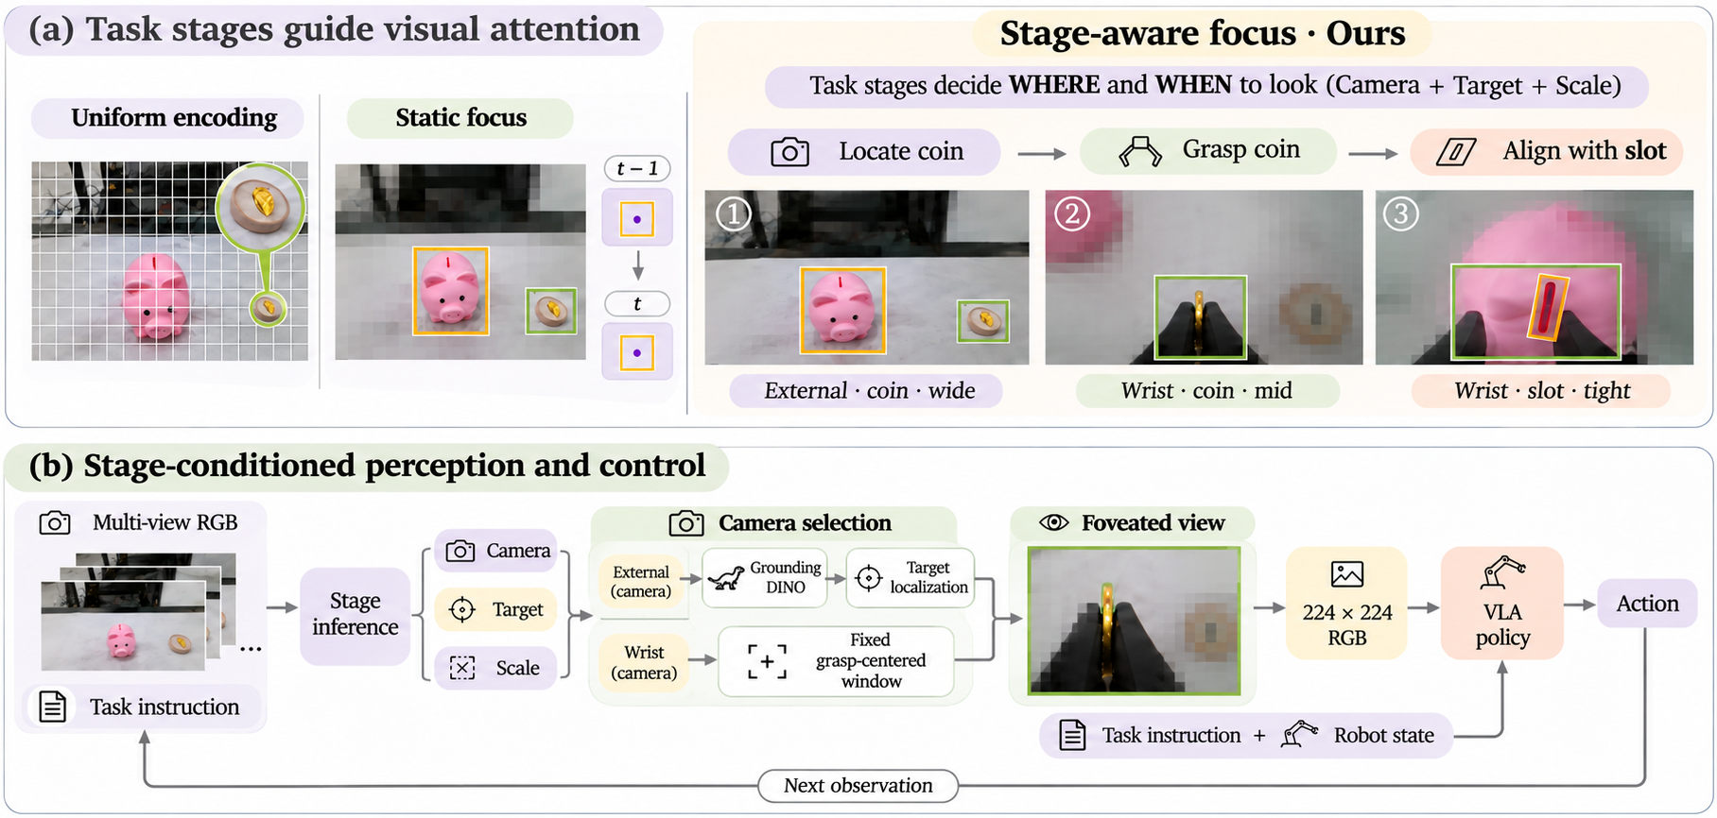
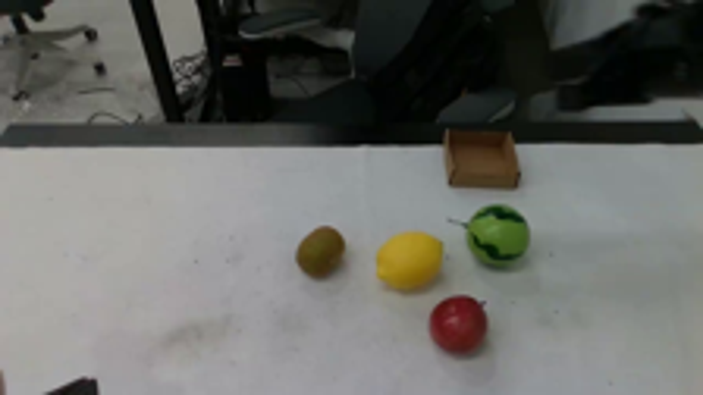
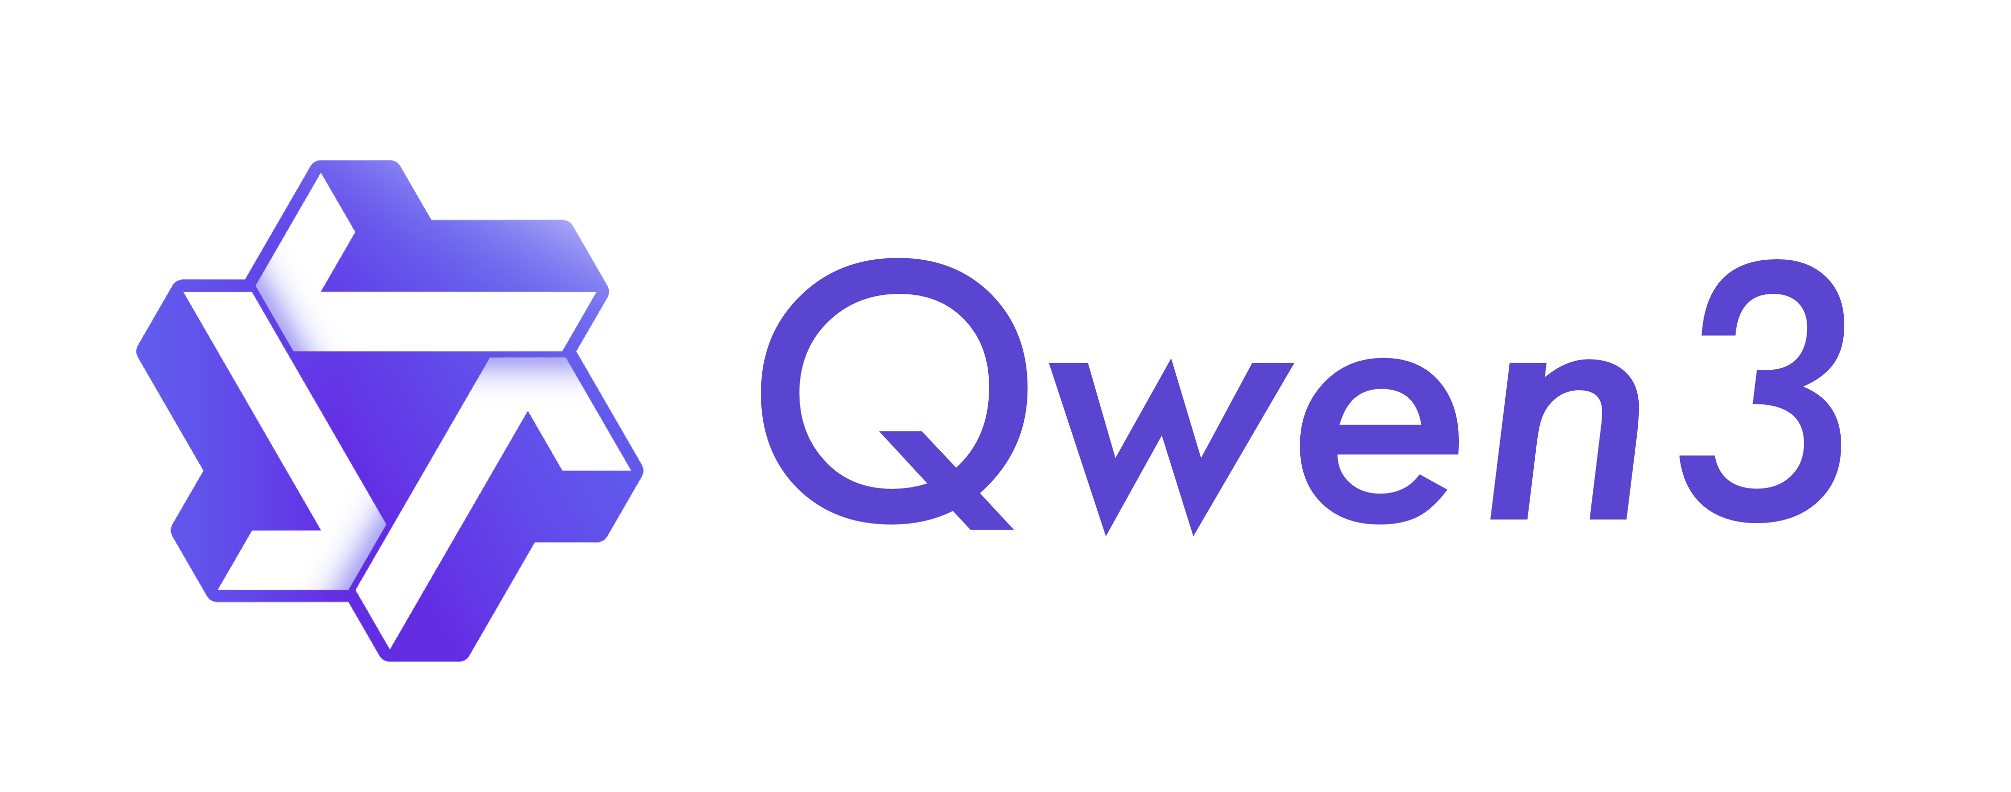
Task stages decide WHERE and WHEN to look
Uniform encoding
Target detail
Uniformly resized input
Few tokens cover the target
Camera selection
VLM

Slide 2
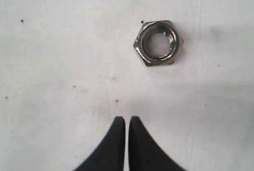
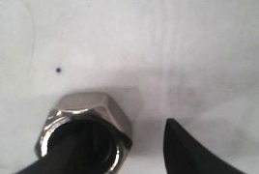
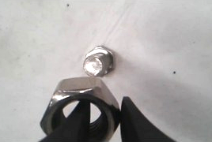
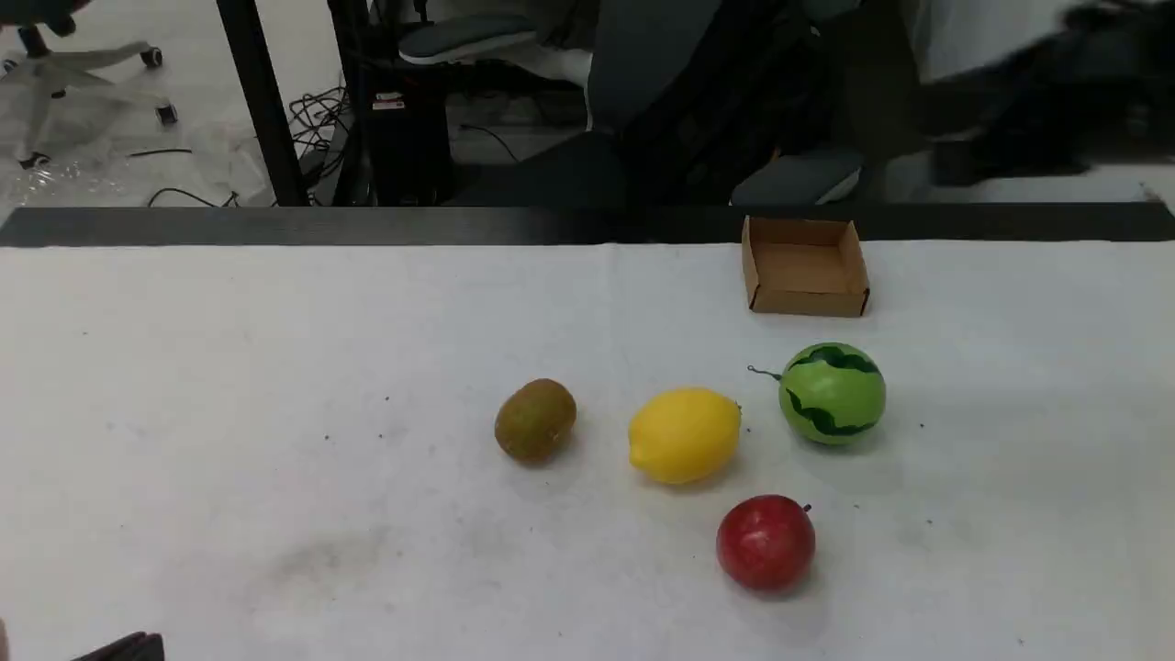
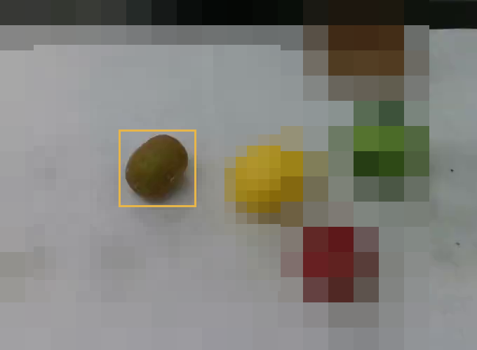
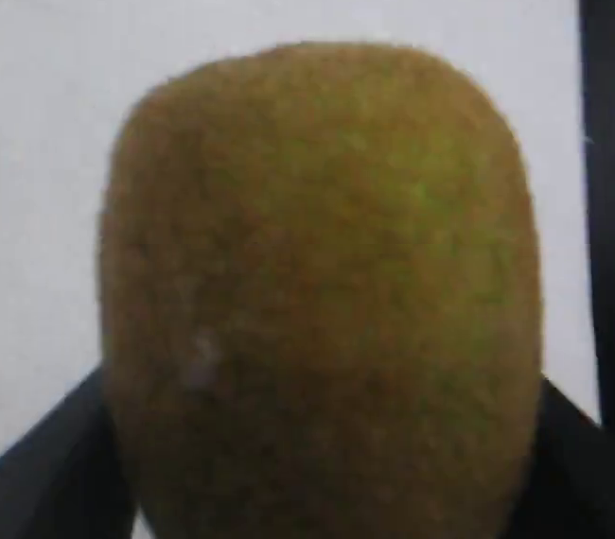
Task-derived active perception
LEARN FROM DEMONSTRATIONS
Task structure
Stage supervision → Qwen adaptation
Same perception front-end → focused replay → VLA adaptation
T = {(gₖ, cₖ, τₖ, Vₖ, Sₖ)}
Lstage = −log pθ(k* | o, T)
(xₜ, gₖₜ, qₜ) → πθ → Aₜ ↔ A*ₜ
Approach
Grasp
Align
One demo + instruction → VLM → validated stage plan
LoRA: W′ = W + sBA
Aligned expert actions · adapt the visual encoder
ONLINE EXECUTION
1 Observe
2 Infer stage
3 Select & focus
4 Act
Qwen3-VL
External
Wrist
One selected view
κ = clip(1.6m, 8, 112)
bʷ = fixed window
xₜ = Φ(oₜ, αₜ)
pⱼ = (k̂ⱼ, τ̂ⱼ, v̂ⱼ, ŝⱼ)
u
224 × 224 RGB
k̂ⱼ₋₁
k̂ⱼ
✓
Current multi-view RGB
k′ = min(k̂ⱼ₋₁, k̂ⱼ)
VLA policy
oₜ = {Iᵛₜ}ᵥ∈V
k̂ⱼ₋₁ > k ∧ k̂ⱼ > k
βℓ ∈ {2, 6, 12}
400 × 400 → 224 × 224
External + wrist
Aₜ ∼ πθ(· | xₜ, gₖₜ, qₜ)
🦖 bₜ = DINO(Iᵛₜ, τₖ)
xₜ = Resize(Crop(Iʷₜ, bʷ))
Camera vₜ
Target τₖ · Scale sₜ
Task instruction ℓ + plan T
Crop + graded averaging
Fixed contact window
Action chunk → robot
gₖ: subgoal cₖ: completion τₖ: target vₜ: camera sₜ: scale qₜ: robot state κ: sharp-core size βℓ: averaging block size

Slide 3
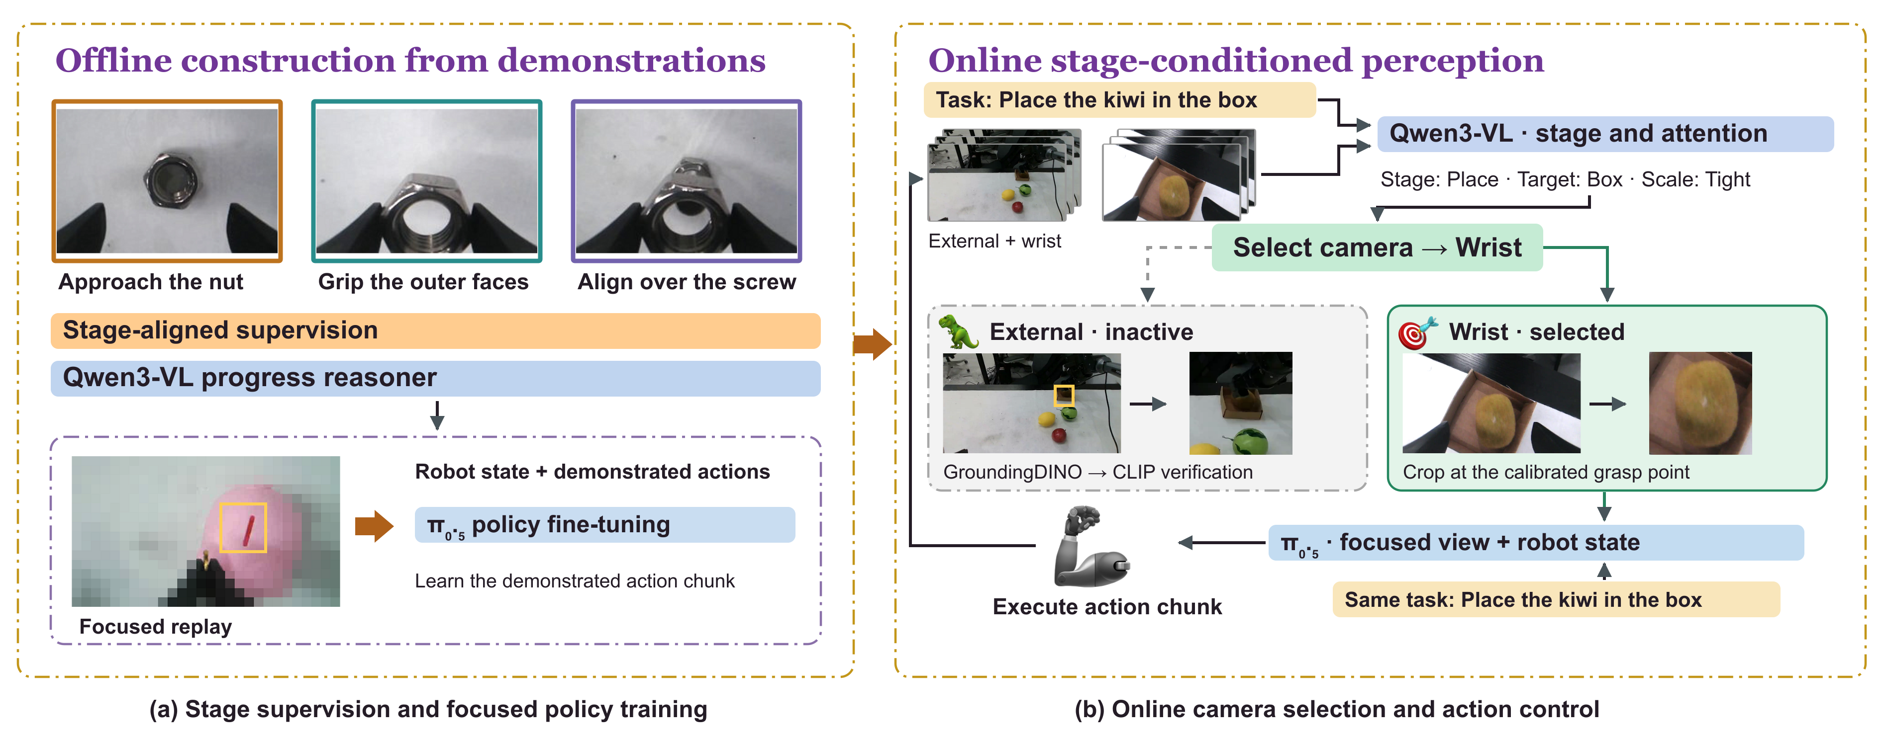
Offline construction from demonstrations
Online stage-conditioned perception
Task: Place the kiwi in the box
Qwen3-VL • stage and attention
Stage: Place • Target: Box • Scale: Tight
External + wrist
Select camera -› Wrist
Approach the nut
Grip the outer faces
Align over the screw
Stage-aligned supervision
External • inactive
🎯 Wrist · selected
Qwen3-VL progress reasoner
Robot state + demonstrated actions
GroundingDINO - CLIP verification
Crop at the calibrated grasp point
π₀.₅ policy fine-tuning
π₀.₅ · focused view + robot state
Learn the demonstrated action chunk
Same task: Place the kiwi in the box
Execute action chunk
Focused replay
(a) Stage supervision and focused policy training
(b) Online camera selection and action control

Slide 4
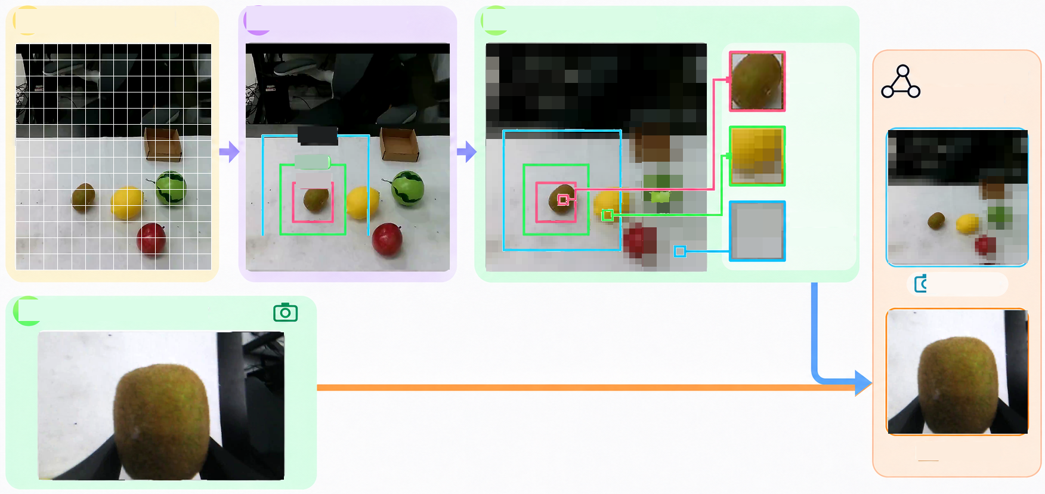
A
Uniform grid
B
Three scales
C
Graded detail
Sharp core
Select one
camera
Wide
Mid
Transition
Tight
Coarse
periphery
📷 Scene
D
Direct wrist view
📷 Wrist

Slide 5
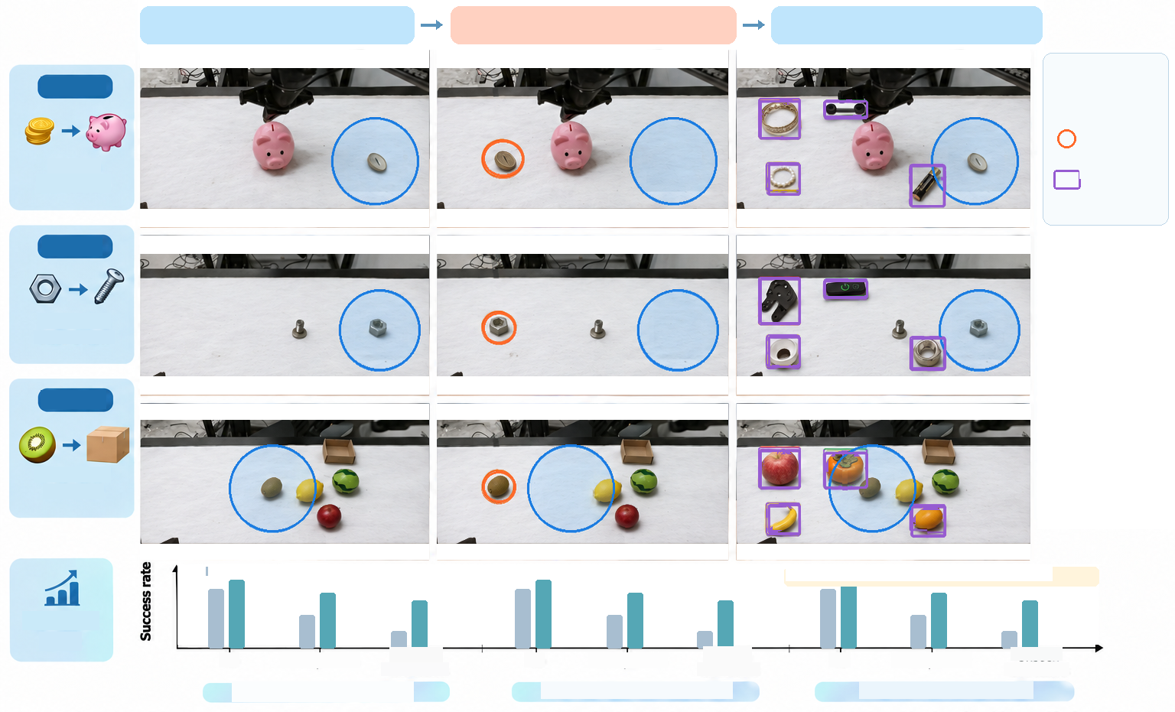
ID
OOD
Unseen distractors
Legend
Task 1
ID region
OOD target
Coin to
piggybank
Unseen
distractors
Task 2
Insert nut
onto screw
Task 3
Place kiwi
into box
Baseline
Ours
ILLUSTRATIVE TREND - NOT EXPERIMENTAL DATA
Success
rate
ID
OOD position
Unseen
ID
OOD position
Unseen
ID
OOD position
Unseen
distractors
distractors
distractors
Task 1: Coin to piggybank
Task 2: Insert nut onto screw
Task 3: Place kiwi into box

Slide 6
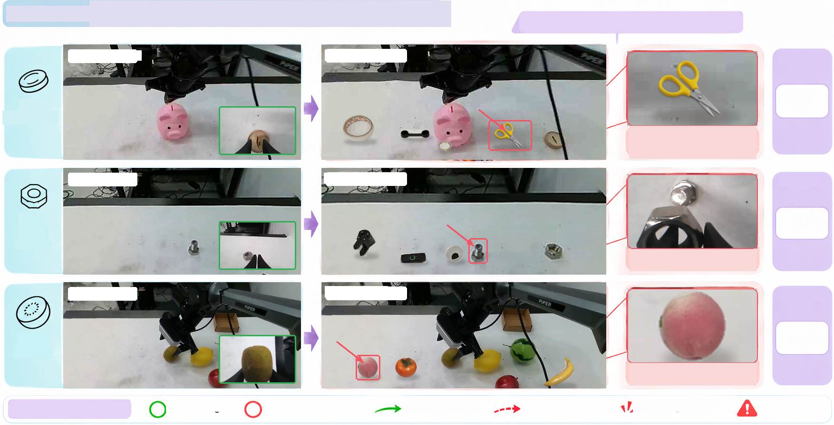
FIGURE 5 Failure mechanisms under distraction
Illustrative failure mechanisms
Dataset observation
Photo composite
Failure
(%)
Coin
insertion
Wrong target
Similar-shape distraction
Dataset observation
Photo composite
Failure
(%)
Nut
onto
screw
Alignment risk
Dataset observation
Photo composite
Failure
(%)
Kiwi
to box
Wrong object
Photo-based illustration
Correct target
Wrong target (distractor)
Correct movement
Incorrect movement
• Contact / collision
Failure case

Slide 7
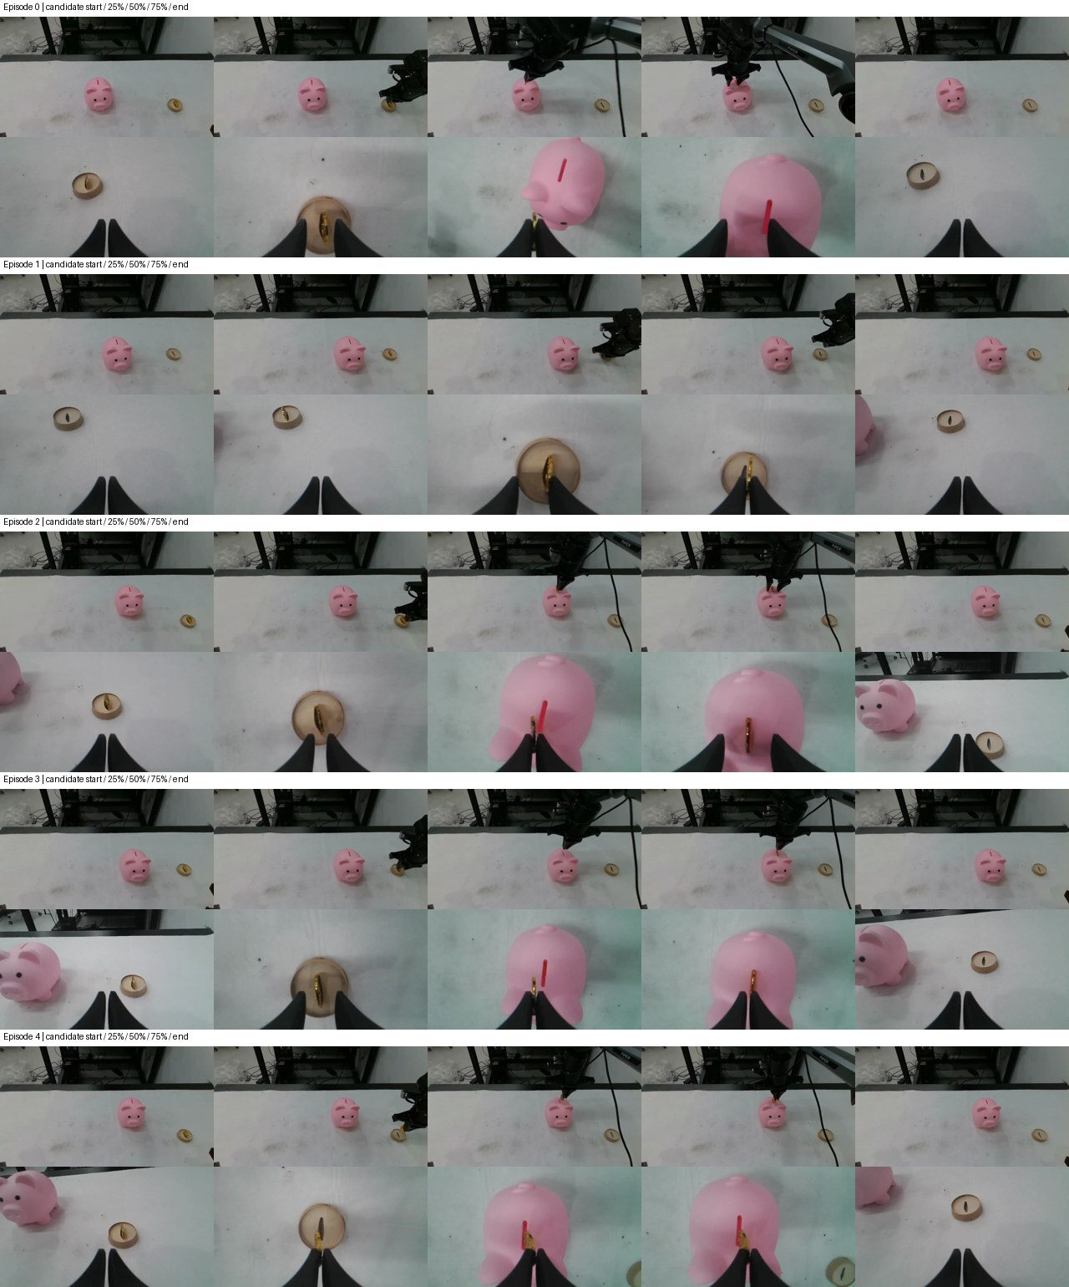
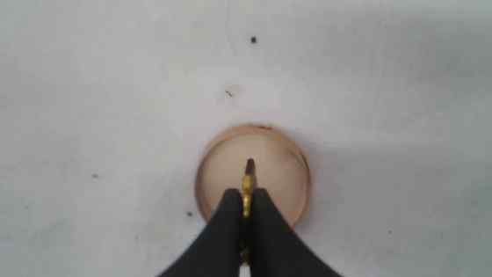
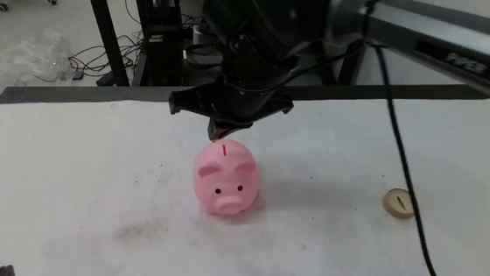
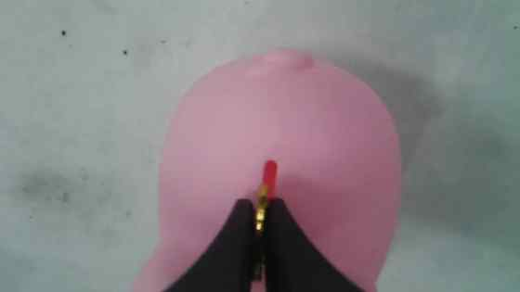
Front-end behavior · InsertCoin
1 Locate coin
2 Grasp coin
3 Locate pig
4 Insert coin
5 Retreat
External
Wrist
External
Wrist
Wrist
Target: Coin
Target: Coin
Target: Piggy bank
Target: Slot
Target: Workspace
Stage interpretation
Stage interpretation
Stage interpretation
Stage interpretation
Stage interpretation
Locate coin
Grasp coin
Locate pig
Insert coin
Retreat
Visual target
Visual target
Visual target
Visual target
Visual target
Coin
Coin
Piggy bank
Slot
Workspace
⚠ Check
⚠ Check
⚠ Check
⚠ Check
⚠ Check
Premature stage switch
Coin not securely held
Wrong target fixation
Coin–slot misalignment
Incomplete retreat
Camera label: selected view Orange box: relevant target / region ⚠: failure risk to check
Dataset frames; stage interpretation and risk labels are illustrative, not measured predictions or failure rates.

Slide 8
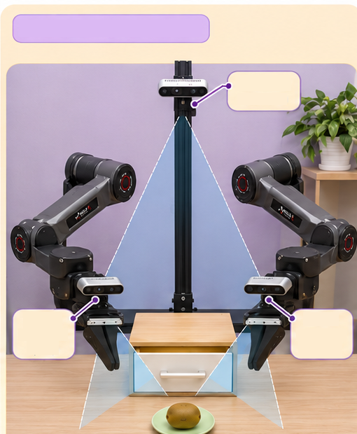

Real-robot setup and rollouts · InsertCoin
Locate
Grasp
Insert
Retreat
PiperX platform
ID
External
camera
External
Wrist
External
Wrist
External
Wrist
External
Wrist
Locate
Grasp
Insert
Retreat
Wrist
Wrist
OOD
camera
camera
left
right
Single-arm InsertCoin
External
Wrist
External
Wrist
External
Wrist
External
Wrist
External camera / Wrist camera
Select one camera · green border = selected view
Left: rendered setup retained. Right: real dataset frames. OOD row: composited illustrations, not executed rollouts.

