Slide 1
SENTRY
A 3-in-1 Static Security Configuration Linter
Finds insecure settings in sshd, nginx, and docker-compose configs, before they ship.
sshd_config
nginx.conf
docker-compose
Hood Security Department · NSSECU2 (S04) · Custom Ethical Hacking Tool
Notes:
Introduce Sentry: a static linter that reads three kinds of config files and reports insecure settings. Emphasise 'static': it never touches a live system.

Slide 2
02
THE TEAM
Group Members and Roles
Hood Security Department · NSSECU2 (S04)
James Edsel Alvarez
Team lead & system architecture
JA
Hans Gabriel Obcena
Rule engine & matcher design
HO
Lorenzo Enrique Suerte
Configuration parsers (sshd / nginx / compose)
LS
Jarick Klein Viray
Reporters (console / JSON / HTML)
JV
Jeruel Fabricante
Testing, QA & documentation
JF
Notes:
Each member states what they personally built. This answers the 'explain what your group implemented' requirement. James is team lead.

Slide 3
03
WHY & WHAT
Purpose and Features
The problem
One engine, three formats
Rules are data
Misconfiguration, not exotic exploits, is one of the most common causes of real breaches.
sshd, nginx and compose share one linting core.
Every check lives in YAML; add one without touching code.
Our goal
Severity ranking
Absence is a finding
Catch those mistakes in config files before deployment, safely and offline, with a tool small enough to fully explain.
High / Medium / Low / Info, with a fix for each finding.
A missing hardening directive is flagged, not just bad values.
Secret detection
3 report formats
Flags hardcoded compose secrets by name, ignores ${ENV} refs.
Console, JSON, and a self-contained HTML report.
Notes:
Left: purpose. Right: six features. Rules-as-data is our original contribution.

Slide 4
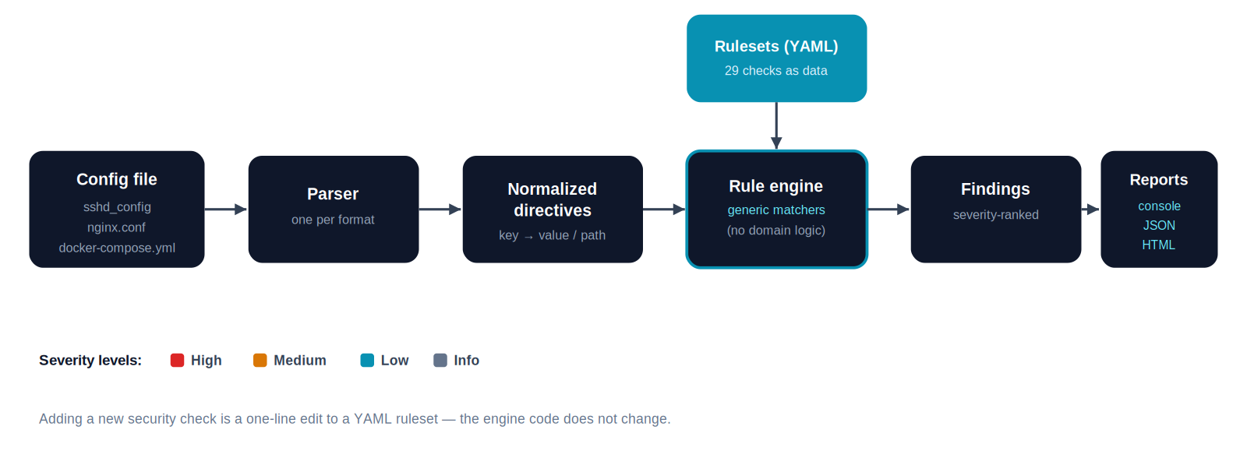
04
HOW IT WORKS
System Architecture
Notes:
Left to right: a config file is parsed into normalized directives; the engine applies YAML rules; findings go to a reporter. The engine has no SSH/nginx/Docker knowledge; that lives in the rulesets.

Slide 5
05
SAFE BY DESIGN
Testing Environment
Bundled test fixtures
No live systems required
samples/sshd_config.bad
Sentry only reads local text files. It never connects to, scans, or tests any running system, service, or network.
Deliberately insecure SSH config
samples/sshd_config.good
Hardened SSH config (no findings)
That means there is no attack target to set up and no risk of touching a real system. The whole 'tested only in a controlled environment' requirement is satisfied by design.
samples/nginx.conf.bad
Deliberately insecure nginx config
samples/docker-compose.bad.yml
Deliberately insecure compose file
Notes:
We test against intentionally-weak sample files shipped with the tool. The .good file proves clean configs correctly report nothing.

Slide 6
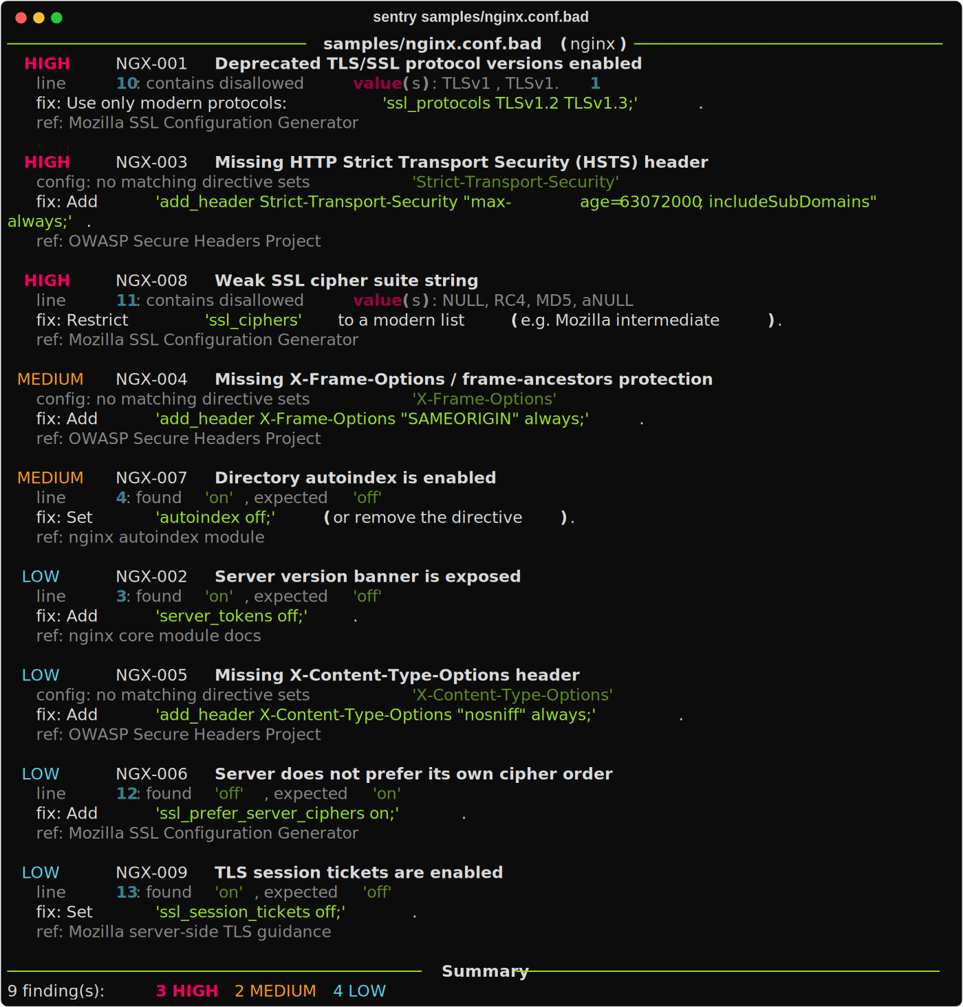
06
SEE IT RUN
Tool Demonstration
Try these commands
$ sentry samples/nginx.conf.bad
$ sentry samples/*.bad \
--min-severity high
$ sentry samples/nginx.conf.bad \
--format html -o report.html
$ sentry --list-rules
Notes:
Live-demo these if possible; otherwise the screenshot shows the real output. Point out the severity colours, the exact line numbers, and the fix on each finding.

Slide 7
07
UNDER THE HOOD
Code Review: Rules as Data
A security check is a data record, not code. This is the whole rule for 'root login over SSH':
sentry/rules/sshd.yaml
becomes this finding
- id: SSH-001
title: Direct root login over SSH
severity: high
remediation: Set 'PermitRootLogin no'.
reference: CIS SSH 5.2.8
match:
selector: PermitRootLogin
assert: equals
value: "no"
on_missing: warn
HIGH
SSH-001 Direct root login over SSH is permitted
line 3: found 'yes', expected 'no'
fix: Set 'PermitRootLogin no'.
The engine that turns rules into findings is ~200 lines and has no knowledge of SSH, nginx, or Docker, so every team member can read and explain it.
Notes:
Answers 'explain how the code works'. One YAML record on the left, the finding it produces on the right. The engine is generic; the knowledge is data.

Slide 8
08
WHAT IT FINDS
Results / Sample Report
Findings by severity
28
issues found
across the 3 sample files
29
rules
shipped across 3 formats
18
unit tests
all passing
Notes:
Left: headline numbers. Right: findings by severity per sample file. 28 issues total across the three weak configs.

Slide 9
09
BEING HONEST
Limitations and Future Improvements
Limitations
Future Improvements
~29 rules; mature tools like Checkov have thousands
No CVE / software-version vulnerability awareness
nginx parsing is directive-level, not fully block-scoped
Secret detection is pattern-based; can miss odd names
docker-compose findings have no line numbers
More formats: Dockerfile, Apache, PostgreSQL, Kubernetes
Line numbers for YAML findings
Context-aware nginx parsing (per-server scoping)
A --fix mode that suggests hardened values
Map findings to CIS / OWASP ASVS compliance controls
User-supplied rule files via a --rules flag
Notes:
Naming real incumbents (Checkov) and our own gaps shows we understand the landscape.

Slide 10
10
TAKEAWAYS
Lessons Learned
1
Design beats size
2
Separate data from logic
A small, well-structured tool that we can explain beats a big copied one.
Rules-as-data kept the engine tiny and made new checks trivial to add.
3
Test as you build
4
Build on libraries, don't fork them
18 unit tests caught real bugs, like a broken secret-detection assertion.
We call pyyaml and rich as black boxes; the tool stays original.
5
Static analysis is safe analysis
6
Honesty is credible
Reading config text means zero risk to any live system.
Naming our limits and real incumbents is stronger than overclaiming.
Notes:
Close the content with what we learned: technical and process lessons both.

Slide 11
Ethical Use
This tool was developed for educational purposes only.
It must only be used in authorized and controlled testing environments. Unauthorized testing against real systems, public websites, or third-party services is strictly prohibited.
Sentry: static analysis only. It never connects to a live system.
Thank you.
Hood Security Department · NSSECU2 (S04)
Notes:
Close on the ethical statement (required) and thank the audience. Be ready for questions on how the code works.

