Slide 1
Analytic Dashboards
Overview
http://builder.osirium.net/
&
http://customeranalytics.osirium.net/
How are designed
and
What insights can provide

Slide 2
Customers Dashboard
Connects to Osirium PostgresSQL Techouts.
The user select a customer installation Osirium Server/DB.
From the DB selected, the application runs queries on historic and Real-Time data and cache in memory the results;
Transforms the query results into usable data-frames;
Analysed the data frames and Visualized the relevant insights.

Slide 3
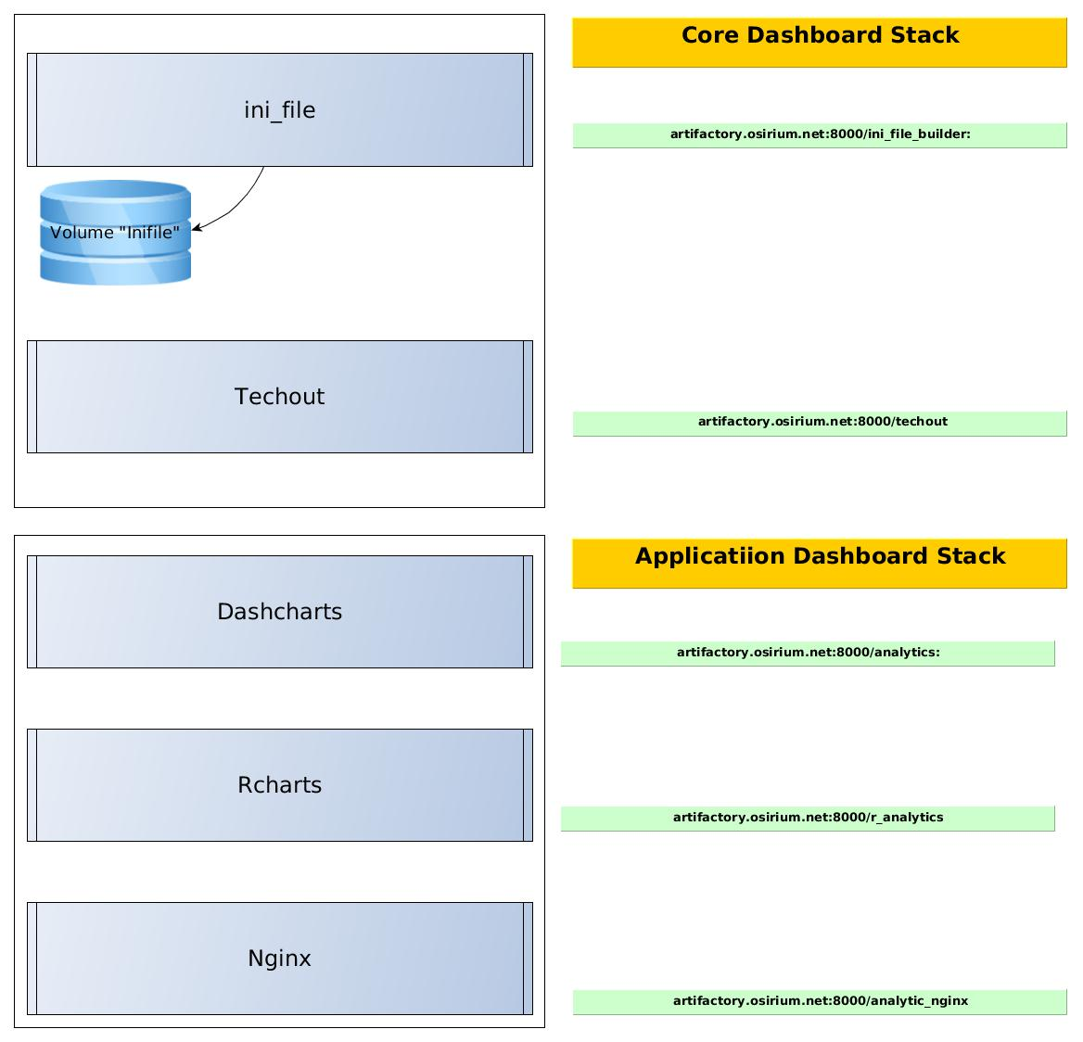
Implementation
Customers Dashboard
Docker version
based on
docker-compose

Slide 4
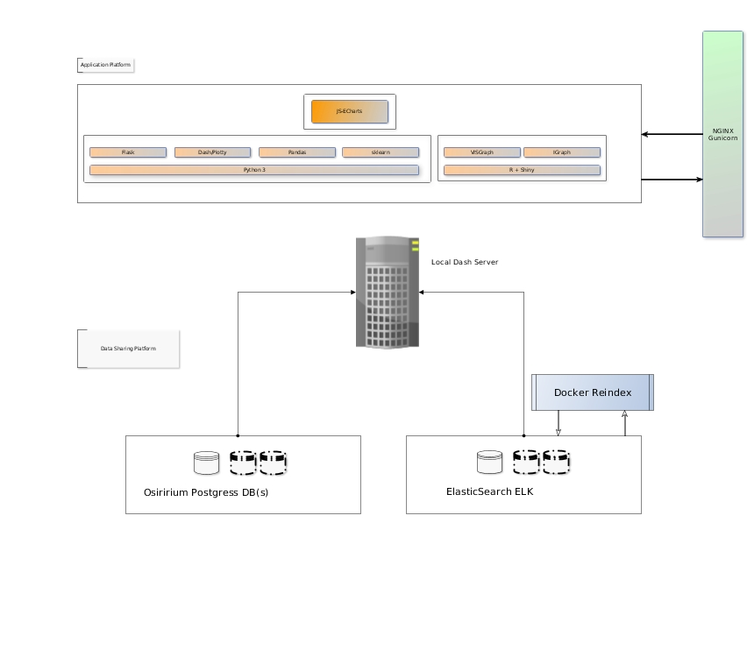
Overview Customers Dashboard

Slide 5
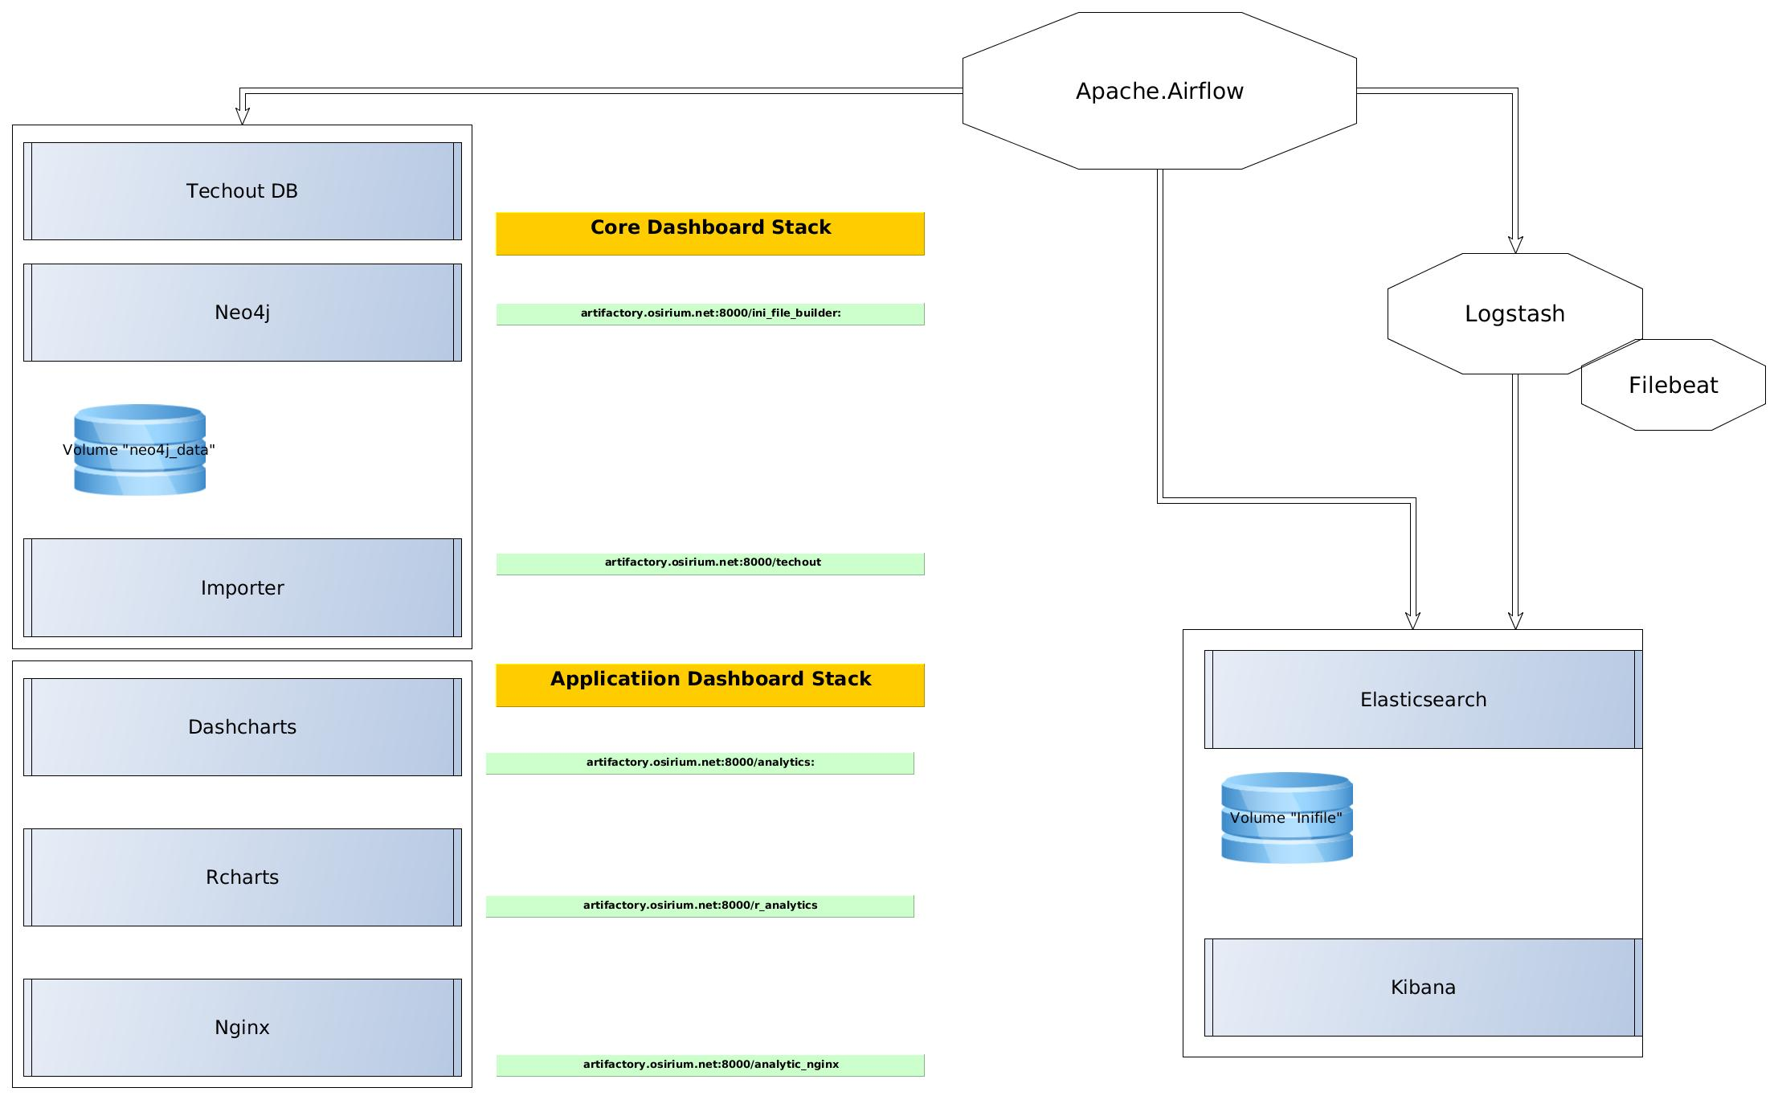
Implementation
Builder/MagicBox Dashboard
docker-compose

Slide 6
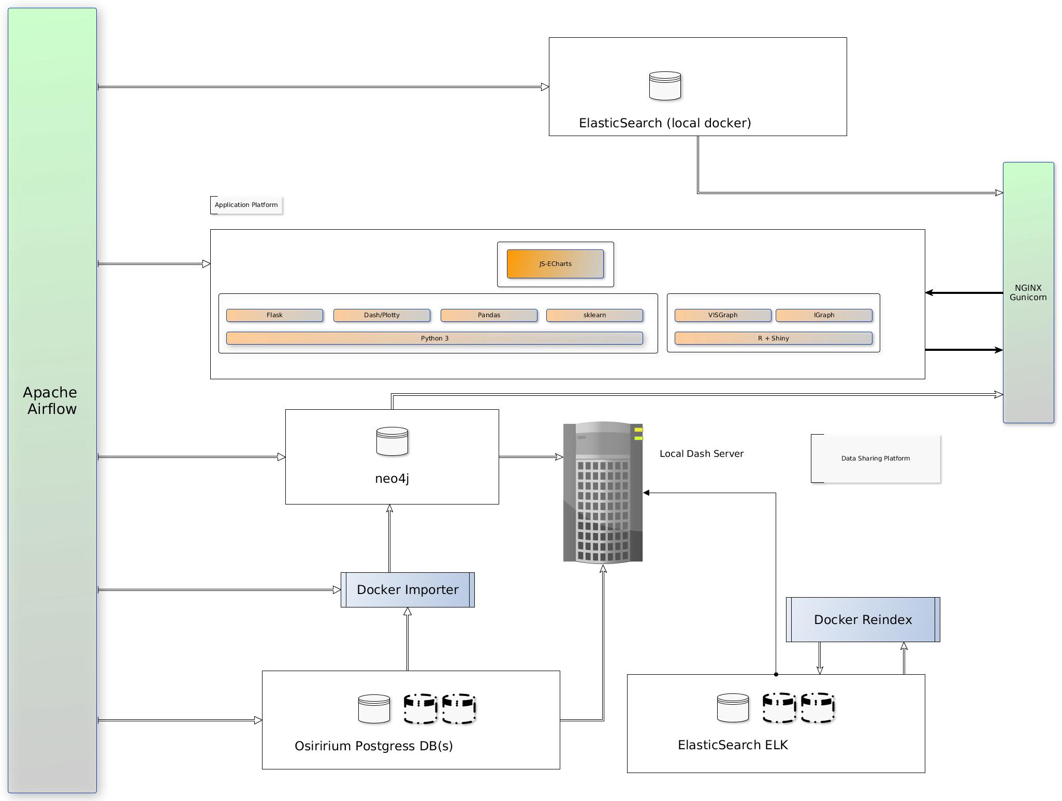
Overview MagicBox

Slide 7
Local Analytic Dashboard
What is showing? https://analytics.osirium.net/
(otherwise the docker-compose stack)
Home page:
Sparkline: Time sereis
Sessions Analytic:
Time-series: Global + per User
Distribution:Global +per single User (zoom able by time)
Channels Analytic:
Protocol usage: Global + per User
Heat-map protocol vs Devices: Global + per User
Device type and access by: Global + per User
Sankey Diagram User vs Protocol and Device: Global + per User
Network Analytic (classics):
Percentages IP, subnets usage Global and per User (zoom-able by time)
Template Analytic:
Interactive Sunburst
Time-series templates usage:global
Percentages templates usage based on type, vendor and types.
Tasks Analytic:
Streamline Visualization
Time-Series for the task usages aggregate tasks and for each task
Percentage for each Tasks usage zoom able by time.
Sankey Diagram User vs Task vs Device: Global + per User
Failed Password (feeding from Elastic-search):
Time-series of the events
    Percentage based on IP, Users and time filter
Revealed Password (feeding from Elastic-search):
Time-series of the events
    Heat-map, Users vs Devices (number of events and time filters)
Revealed Password (feeding from Elastic-search):
Time-series of the events
    Heat-map, Users vs Devices (number of events and time filters)
User Behaviour:
2-D version (changing the displayed variables, filtering for the time.
3-D version (changing the displayed variables, filtering for the time.
Graphs Charts: My favourite one!!!!
Graph Relation between Users and devices,
Real-time visualizations
Audit based on time filtered

Slide 8
Analytic Dashboards
Overview
Customer vs Builder
Customer Dashboard
Implementation
Customer Dashboard
Overview Customer Dashboard
Local Analytic Dashboard
What is showing?
https://analytics.osirium.net/
(otherwise the docker-compose stack)
Next Step(s)

