Slide 1
Analytic Local Dashboard
Overview
How is designed
and
What insights can provide

Slide 2
Customer vs Local Dashboard
Customers Dashboard:
(https://customeranalytics.osirium.net)
    Connected to TechOuts
    (multi DBs, multi customers).
    Static information
    Focus on BI
Local Dashboard:
(https://analytics.osirium.net/)
    Connected to a single Customer.
    (for the demo to a single DB)
    Dynamic (real-time build in)
    Focus on the “customers needs”
    (Audit, Troubleshooting, Understand and investigate what is happening)

Slide 3
What it is doing?
Connects to Osirium PostgresSQL
(in the demo to a docker snapshot of dog-food)
Connect to ELK/elastic-search server
…….
From the connections runs queries on historic and Real-Time data and cache in memory the results;
Transforms the query results into usable data-frames;
Analysed the data frames and Visualized the relevant insights.

Slide 4
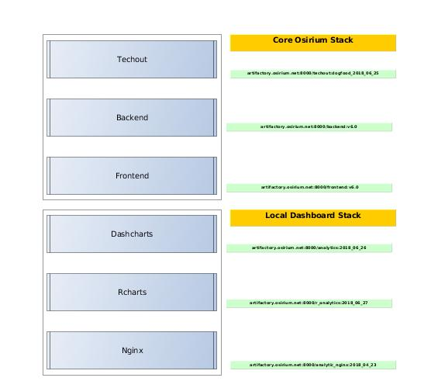
Implementations
Two options
Docker version
based on
    github
    Jenkins
    Artifactory
    http://builder.osirium.net
“Classical” on Ubuntu
(as in http://analytical.osirium.net)

Slide 5
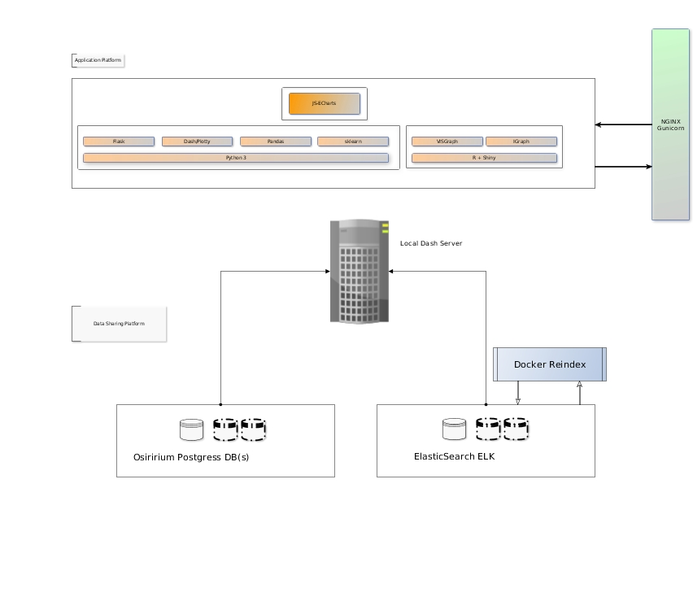
Overview Local Dashboard

Slide 6
Local Analytic Dashboard
What is showing? https://analytics.osirium.net/
(otherwise the docker-compose stack)
Home page:
Sparkline: Time sereis
Sessions Analytic:
Time-series: Global + per User
Distribution:Global +per single User (zoom able by time)
Channels Analytic:
Protocol usage: Global + per User
Heat-map protocol vs Devices: Global + per User
Device type and access by: Global + per User
Sankey Diagram User vs Protocol and Device: Global + per User
Network Analytic (classics):
Percentages IP, subnets usage Global and per User (zoom-able by time)
Template Analytic:
Interactive Sunburst
Time-series templates usage:global
Percentages templates usage based on type, vendor and types.
Tasks Analytic:
Streamline Visualization
Time-Series for the task usages aggregate tasks and for each task
Percentage for each Tasks usage zoom able by time.
Sankey Diagram User vs Task vs Device: Global + per User
Failed Password (feeding from Elastic-search):
Time-series of the events
    Percentage based on IP, Users and time filter
Revealed Password (feeding from Elastic-search):
Time-series of the events
    Heat-map, Users vs Devices (number of events and time filters)
Revealed Password (feeding from Elastic-search):
Time-series of the events
    Heat-map, Users vs Devices (number of events and time filters)
User Behaviour:
2-D version (changing the displayed variables, filtering for the time.
3-D version (changing the displayed variables, filtering for the time.
Graphs Charts: My favourite one!!!!
Graph Relation between Users and devices,
Real-time visualizations
Audit based on time filtered

Slide 7
Next Step(s)
How to integrate the Local Analytic into the Osirium Product

