Slide 1
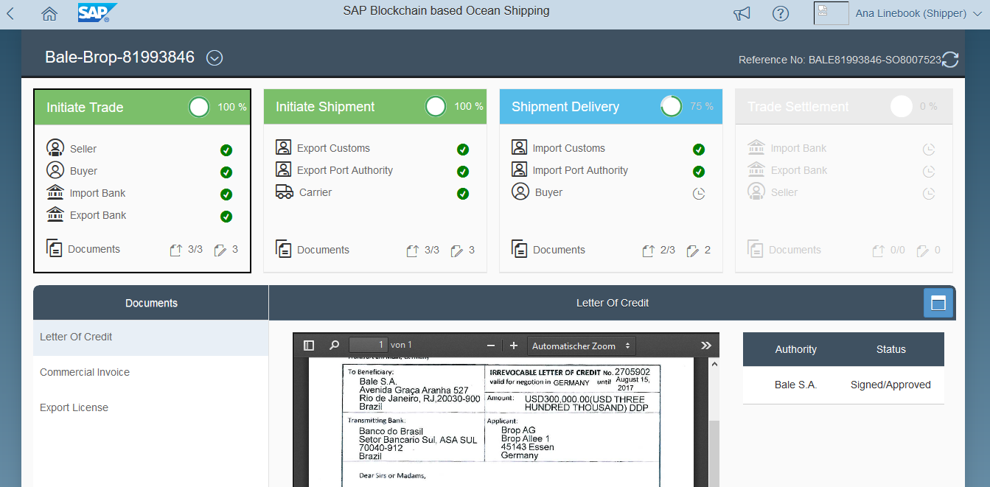
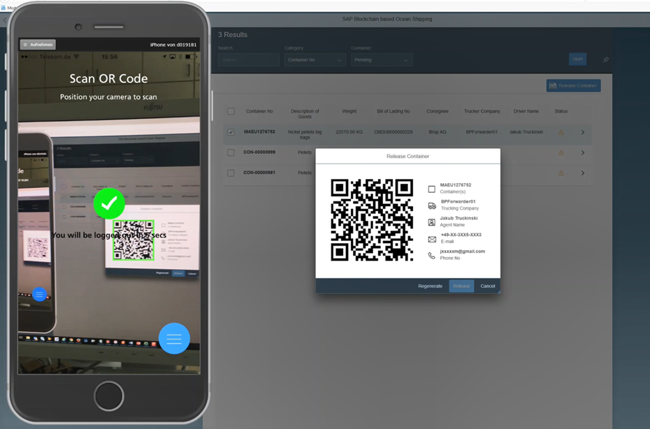
Blockchain for International Trade Proof-Of-Concept for blockchain based ocean shipping
Challenge
International trade documents are rarely digitized and spread across multiple data silos. Process participants lack a common view on information.
Proof-of-Concept Objectives
Build single version of the truth with relevant data into one place shared by involved business partners
Integration into SAP Transportation Management posting a Bill of Lading to blockchain as unique asset
Asset ownership transfer with full transparency and status tracking
Secure container release process via mobile device
Notes:
An international trade in blockchain holds relevant data about involved business partners and relevant documents.
Various business partners can access the blockchain and post or look up data or documents according to roles and authorizations.
SAP Transportation Management posts a Bill of Lading into the Blockchain as an unique token of an asset for which the ownership can be handed over securely.
Digital signing of PDF documents via mobile app. Digitally signed B/L document can be used as e-B/L based on blockchain.
Secure container release process via secure QR code scan authenticating entitled trucker based on blockchain.

