Slide 1

SAP Cloud Platform: Start Cloud-Native Development

Slide 2
Agenda
Introduce EMS solution and Architecture
Overview
Give example(basic on EMS technical )
Instance manager(MDC)
On-boarding call back API
How to monitor performance and how to analyze it using previous example
Q&A
Share EMS experience
Notes:
Today , I already apply for environment with session in the cloud foundry from Dev/Ops
UAA on-boarding
Database on-boarding
With my question ,I am not sure exactly where I push my example code ,GitHub?

Slide 3

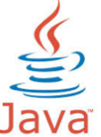
















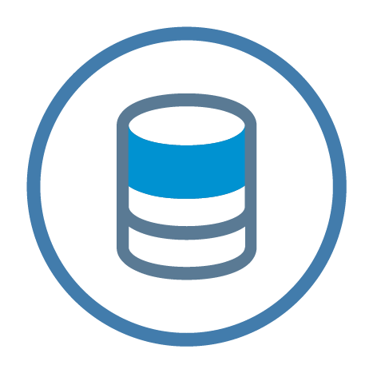


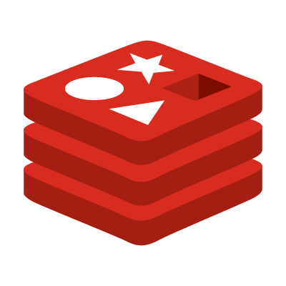
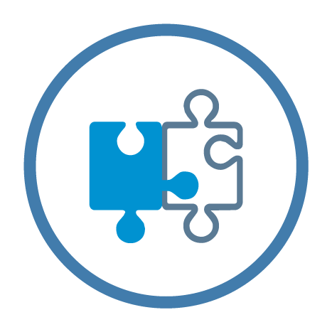

Cloud Foundry Environment in SAP Cloud Platform
Environment
Cloud Foundry CLI
User Account & Authentication
App Autoscaler
XSA/XSC
Corporate Identity Provider
SAP Cloud Platform cockpit
Your Application
Admin
Application Logs
PostgreSQL
…
Connectivity
Service
MongoDB
Cloud Connector
RabbitMQ
Redis
Job Scheduler
SAP HANA
Innovation Services
[IoT, Machine Learning, etc.]
¹
2
1) BETA 2) planned innovation
Notes:
Cloud Controller – SaaS and PaaS metadata
Blob store - buildpacks, app code, droplets
Diego cells – staging/running
Service Broker (Managed & UPS)
App deployment
Buildpacks
Diego cell
Services – backing services, service broker?, other services?
DevOps – monitoring, logging, health management, scale
Tools – cockpit, CF cli, eclipse plugin?
Multi cloud story?
Chinese Wiki

Slide 4

SAP Cloud Platform architecture with the focus on Cloud Foundry
Development
Operations
Commerce
SAP Web IDE / SAP API Business Hub
Cockpit
Marketplace
SAP Cloud Platform
Programming models
HTML5 XSC/XSA
Java
XSJS/Node.js Python
Community buildpacks
Business Services
Commerce
Localization/ Tax
Data Quality
…
Dev / Ops Development
Application Logging
Lifecycle Management
Profiling
Monitoring
Debugging
Performance statistics
Platform Services
Integration
Analytics
Mobile
IoT
Collaboration
Security
UX
Machine Learning
Data & Storage Services
SAP ASE
Redis
(Big) Data Services:
PostgreSQL
MongoDB
SAP HANA
Hadoop SAP Vora²
Virtual Machines
Amazon Web Services
Microsoft Azure ¹
Google Cloud Platform ²
1) beta 2) planned innovations / future direction
Notes:
The advantages of CF
1. Multiple technical stack: HTML, Phthon, NodeJS, Java, XSJS
2. FrontEnd, BackEnd Development, easy deployment
3. Many popular services: MQ, Redis, Block-Chain…
4. HANA Database with features
5. Dev-ops Monitoring, Deployment

Slide 5









The Application - Architecture
Environment
Trial Org and Space
Binding
SAP HANA
HTTPS
Other
Services
Jade(HTML)/CSS
Node. Js
Express App
Java ..
Binding
Queue
Integrate
Apps, Data & Processes
RabbitMQ
Notes:
CF app

Slide 6

BO Cloud
Browser
Browser
Analysis Report / Dashboard
Portal Service - Fiori Launchpad
UAA Admin UI
Rule Engine UI
Entitlement UI
Configure UI
Monitor & Log UI
Error and Conflict Handler UI
Job Schedule
User Management
Entitlement
Configuration
Monitor & Trace
Portal Service - Fiori Launchpad
Archive UI
Builder
R
R
Order Management System
nGoM
YaaS Billing
S/4
…
HCI/PI/
Direct Connect
CF@HCP
Load Balance + Router
CF Routes
R
R
EMS
Business Application – EMS
Business Application – EMS
Application Router(Node.js)
Application Router(Node.js)
Static Content
Static Content
SAPUI5
SAPUI5
Forward JWT Token
binds
Forward JWT Token
binds
Backing Services
Backing Services
Entitlement Micro Services
Rule Engine Service
Entitlement Services
UAA
Java
Micro Service
Other
Micro Service
UAA
R
Integration Service
Workflow Service
Rule Service
Reporting
Job Schedule
binds
binds
Fulfillment
Entitlement Service
Event Management Service
Monitor Service
Configuration Service
IdP
IdP
HANA
…
IDP
HANA
Portal Service
…
Customer data
Customer data
Customer2 data
Portal Service
Customer1 data
SAP Data Center
SAP Data Center
Customer Data Center
SAP Data Center
Partner Data Center E.g. AWS
SAP Data Center

Slide 7
An Introduction to SAP HANA Native Development with Cloud Foundry

Slide 8
Cloud Foundry:
Development Environment & Lifecycle Management
Git repository
Apps
Web IDE, Eclipse,…
Application frontend
App router
Application backend
Node.js
Java
…
Workspace
Cloud Foundry
Deploy service
Catalog
HDI Container

Slide 9
SAP HANA Core Data Services (CDS)
Defining data models (tables, views) for native SAP HANA applications in Cloud Foundry/HDI
Source-based definition ➔ deployment managed by HDI
Lifecycle management
SQL + User defined types + Associations + …
Data model is located in the database and not part of an application stack or framework on top
Notes:
Cloud Foundry don’t support Annotation

Slide 10
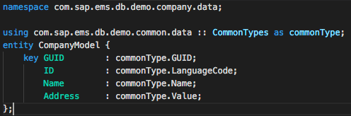
Model information available for each application stack
Cloud Foundry
JavaScript
Java
other…
additional CDS metadata available for each runtime
CDS source
HANA
CDS Catalog
HDI
CDS
additional CDS metadata
SQL Engine
HANA Catalog
table

Slide 11
SAP Web IDE(Full Stack) / CDS / Calculation Views / SQLScript
operates on CalcViews
SQLScript Declarative/imperative logic Defining procedures & functions
can use table functions (replace scripted CalcViews)
SAP Web IDE(Full Stack)
Calculation Views Analytical scenarios
Calculation Engine
CalcViews on top of tables/ views
operates on tables/views defined via CDS
CDS Basic persistency Tables & views
Notes:
Calculation Views in the cloud foundry which SAP Web IDE develop don’t support SQL Script

Slide 12

Let’s get started…
https://github.wdf.sap.corp/Hands-On-Session/CloudFoundry.git → Basic Hands-on

Slide 13
Exercise Steps
Setup the environment
Clone the target sample application
Develop the application – from 0 to running app
Push to SAP Cloud Platform
Observe the application (logs, metrics, events)

Slide 14

Sample Application Components Overview
Srv Example Application
Eureka
SAP HANA
Redis
Dynatrace Logs
RabbitMQ
Environment
Your Service 1 service instance
Eureka
Srv Example Application
Your Service 2 service instance
SAP HANA
App User
Your Service 3 service instance
Redis
Your Service 4 service instance
Dynatrace Logs
Your Service 5 service instance
RabbitMQ
Notes:
A logical view of a sample business app:
Consists of multiple micro-services which are deployed as separate applications
Each micro-service can be developed in different language
Micro-services use multiple backing services

Slide 15





Sample Application Components Overview
Srv Example Application
SAP HANA backing service
Redis backing service
Dynatrace backing service
RabbitMQ backing service
User
Local Environment
Environment
Eclipse
Router
Cockpit
Eureka
Register Center
Hana Studio
Srv Example app
Micro-
services
CF CLI
SAP HANA
RabbitMQ
Redis
Dynatrace
Service
instances
Maven/Git/Java
Platform
& Business
Services
SAP HANA
RabbitMQ
Redis
Dynatrace Logs
Notes:
A logical view of a sample business app:
Consists of multiple micro-services which are deployed as separate applications
Each micro-service can be developed in different language
Micro-services use multiple backing services

Slide 16
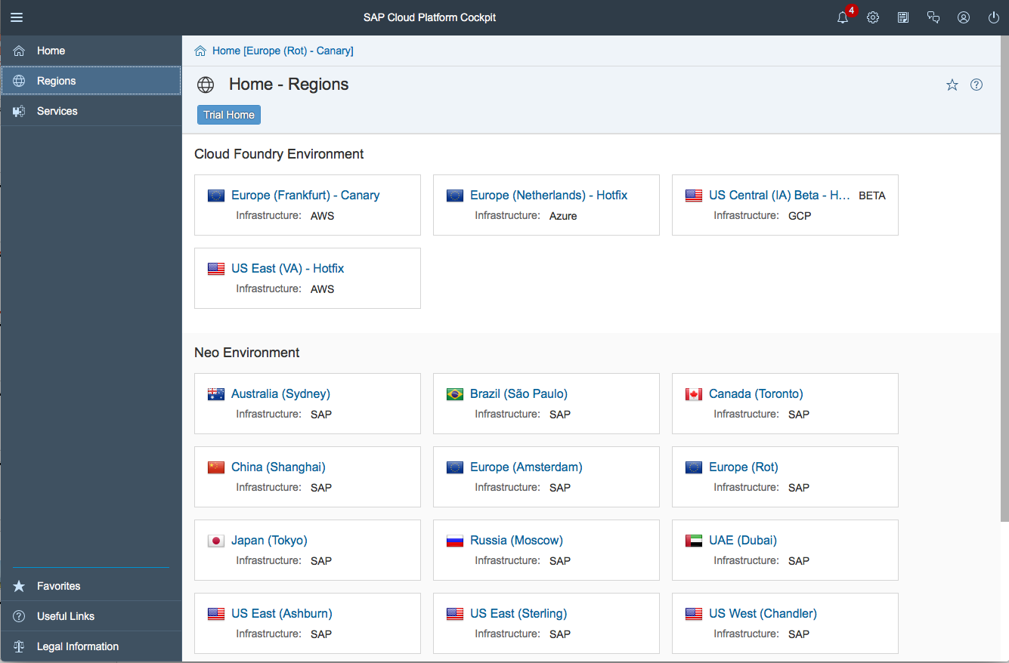
User Home Screenshot from cockpit
You can select which environment to administer – Cloud Foundry
For each environment there is a list of available regions
https://account.int.sap.hana.ondemand.com/cockpit#/home/overview
Notes:
Some of the terms used in the platform have been aligned for more consistency and to reflect actual usage. For more details, see the help.
Data center – Region
Developer Account – Trial Account
Account – Subaccount
Landscape Host – Host

Slide 17

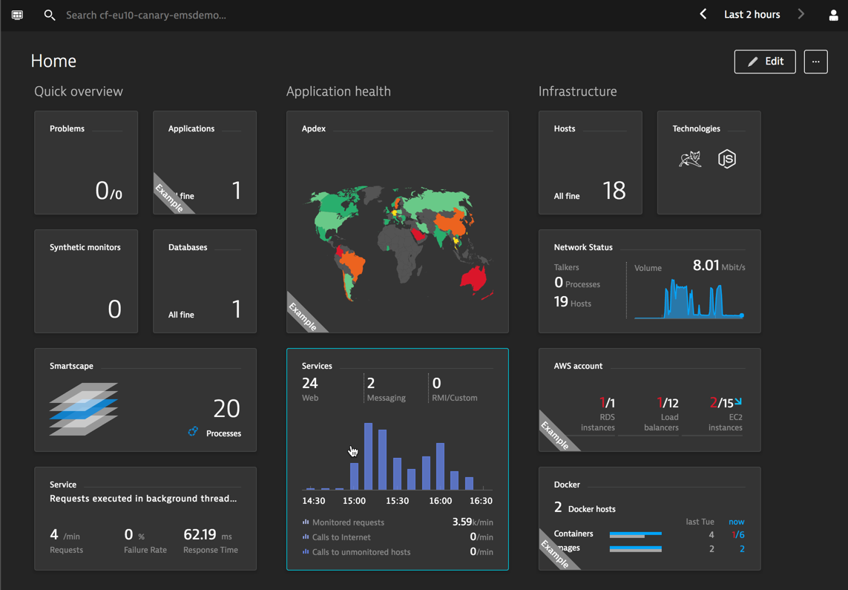
Analyze application logs with Application Performance Cockpit Dynatrace dashboards
Application Logs
Overview - understand the evolution of logs, basic KPIs (failures, response time and size)
Usage - investigate the requests (URLs, users, components)
Performance and Quality - check failures & response times
Network and Load - network traffic and payloads
Requests and Logs - analyze the set of logs, requests and involved components

Slide 18

Feedback
Thanks for attending this session.
Contact information:
Kevin Li
Architecture/Developer
Kevin.li06@sap.com
Drummond Zhuang
Developer
drummond.zhuang@sap.com
Please complete your session evaluation for .

