Slide 1
Dream/wakefulness classification through LLM
Enzo Gerbelot-Legris

Slide 2
Overview
Dataset : ~ 100 hypnagogic reports obtained after short naps
Main goal: Better characterizing hypnagogia using AI
What are the defining characteristics of hypnagogic experiences that differentiate them from dreams and wakefulness reports?
First step: Model (Claude AI) capable of discriminating dreams vs. wakefulness reports

Slide 3
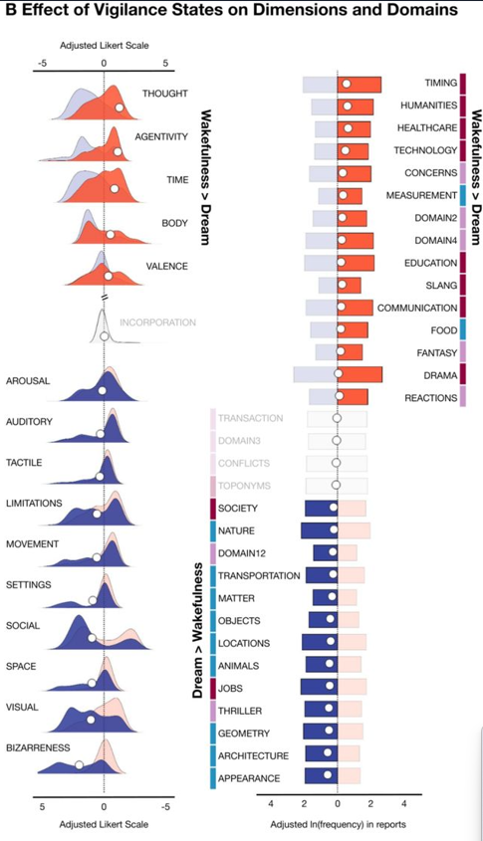
Semantics of dreams
Your study: Identification of key semantic dimensions that discriminate wakefulness from dream reports?
Dream > Wake
Wake > Dream
Question: Could an AI discriminate wakefulness from dream reports based on these key dimensions?
Elce et al. (2025)

Slide 4
Exploratory investigation: Reports used
Wakefulness reports (N=42)
Spotify podcast transcriptions of autobiographical reports:
« And that’s really when I was blown away by those tropical glacier landscapes… »
Autobiographical book : Rousseau and Pepy’s autobiographies
Online self-life events reports on blog (Reddit)
Dream reports (N=42)
Dream reports of Kirberg et al. (2026):
« I'm in a little boat and it is all made out of Lego, the toy Lego and I'm looking around me trying to figure out why everything around me seems to be made of Lego »
My own dream journal

Slide 5
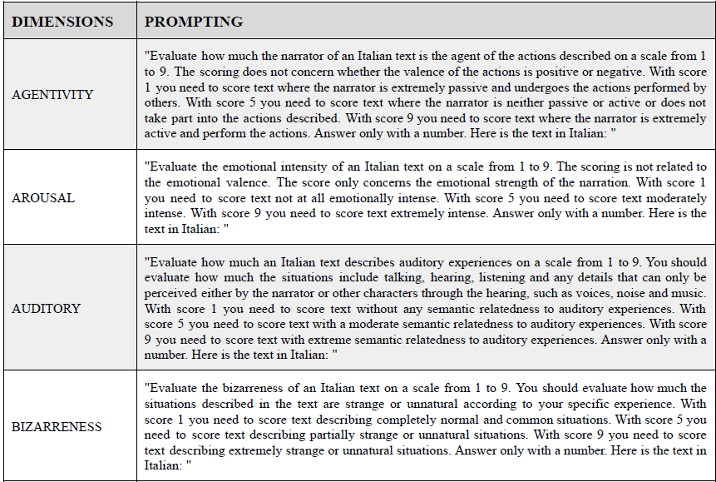
Computation of dream/wakefulness score
Score based on cohen’s d scores of differences between vigilance states and dimensions weights from your paper
Score = Σ(scored_dimension_{i} × weight_{i})
(Table S1 Supp Data, Elce et al., 2025)

Slide 6
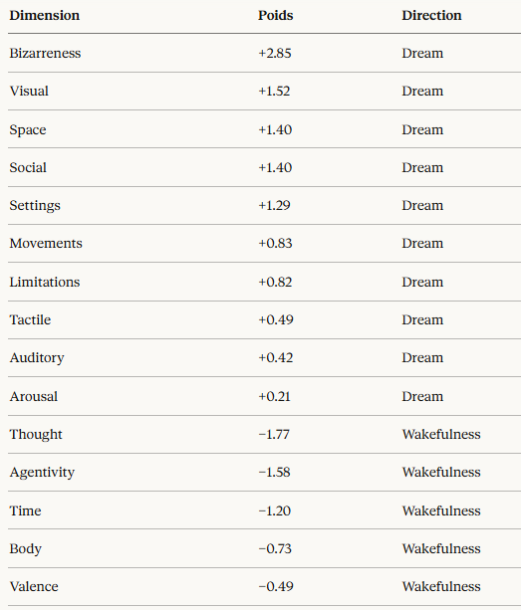
Computation of dream/wakefulness score
Score based on cohen’s d scores of differences between vigilance states and dimensions weights from your paper
Score = Σ(scored_dimension_{i} × weight_{i})

Slide 7
Computation of dream/wakefulness score
Score = Σ(scored_dimension_{i} × weight_{i})
Example: « I was flying »
Scorable dimensions:
BIZARRENESS = 9, weight = +2.85 → +25.65
VISUAL = 5, weight = +1.52 → +7.60
MOVEMENTS = 7, weight = +0.83 → +5.81
BODY = 4, weight = −0.73 → −2.92
→ Score = 28.50 + 7.60 + 5.81 − 2.92 = +36.14

Slide 8
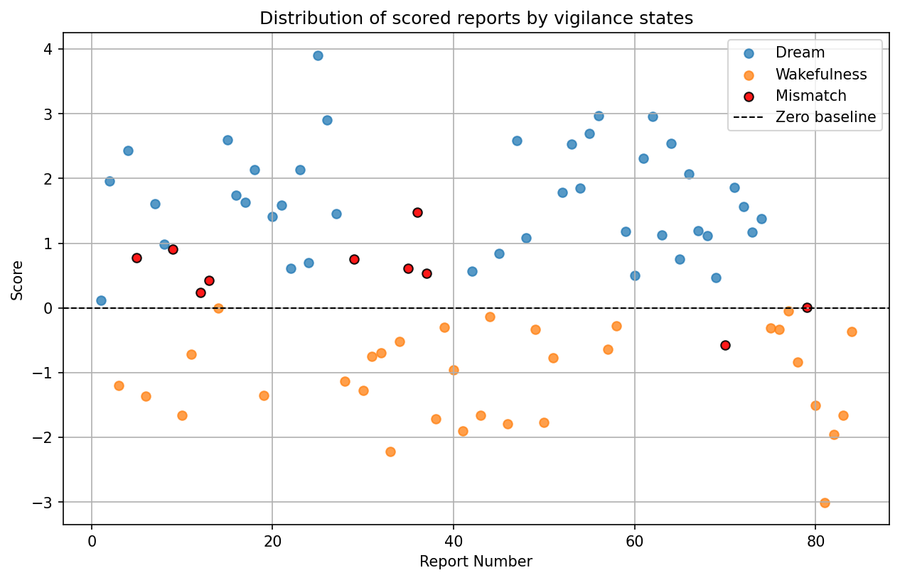
Overall performance
74/84 reports well-classified
= 88% accuracy
10 errors:
9 wakefulness reports misclassified as dreams
1 dream report misclassified as wakefulness

Slide 9
Summary: Main questions
What are the principal dimensions relevant for AI scoring?
Do they overlap with your defining dimensions?
Are these dimensions homogenous across individuals?

Slide 10
Subsidary questions
Could the domains differ in-between languages or cultures?
What is the best way to normalize the scores to suppress the length report bias?

Slide 11
Supplementary Data

Slide 12
Normalised Discriminant Score
NDS RAW Score = Σ(score_i × weight_i)
To avoid bias of report length size → Normalisation : DENOM = Σ|weight_i|

Slide 13
Normalised Discriminant Score
NDS RAW Score = Σ(score_i × weight_i)
To avoid bias of report length size → Normalisation : DENOM = Σ|weight_i|
NDS = RAW / DENOM

Slide 14
Normalised Discriminant Score
NDS RAW Score = Σ(score_i × weight_i)
To avoid bias of report length size → Normalisation : DENOM = Σ|weight_i|
NDS = RAW / DENOM
« I was flying »
Scorables dimensions :
BIZARRENESS = 10, weight = +2.85 → +28.50
VISUAL = 5, weight = +1.52 → +7.60
MOVEMENTS = 7, weight = +0.83 → +5.81
BODY = 4, weight = −0.73 → −2.92
RAW = 28.50 + 7.60 + 5.81 − 2.92 = +39.00 DENOM = 2.85 + 1.52 + 0.83 + 0.73 = 5.93 NDS = 39.00 / 5.93 = +6.58

Slide 15
Performance
182 reports scored for now
Overall Precision : 178/182 = 97.8%
4 errors are from the corpus of Dream and Mind wandering reports (Kirberg 2026) : 71/75 = 94.7%
4 false negative : Realistic dreams scored as wakefulness – low confidence and ambiguous zone

Slide 16
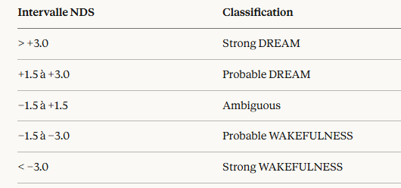
The ambiguous zone
100% Accuracy for NDS < -3 and > +3

Slide 17
Lexical Adjustment
Performance measures of the GLME model for the prediction of lexical domains across vigilance states → 32 Lexical domain with Cohen’s d. (table S4, Elche 2025)
Statistical association between lexical domain and vigilance states

Slide 18
Lexical Adjustment
Performance measures of the GLME model for the prediction of lexical domains across vigilance states → 32 Lexical domain with Cohen’s d. (table S4, Elche 2025)
Statistical association between lexical domain and vigilance states
18 Lexical domain used (statistical significance)
Domaines dream-favoring (exemples) :
APPEARANCE (+0.30), ARCHITECTURE/GEOMETRY (+0.25), ANIMALS (+0.25), LOCATIONS (+0.20), THRILLER (+0.20)
Domaines wakefulness-favoring (exemples) :
TIMING (−0.40), HUMANITIES (−0.25), HEALTHCARE (−0.25), TECHNOLOGY (−0.20)
Allow a better judgement in ambiguous zone

Slide 19
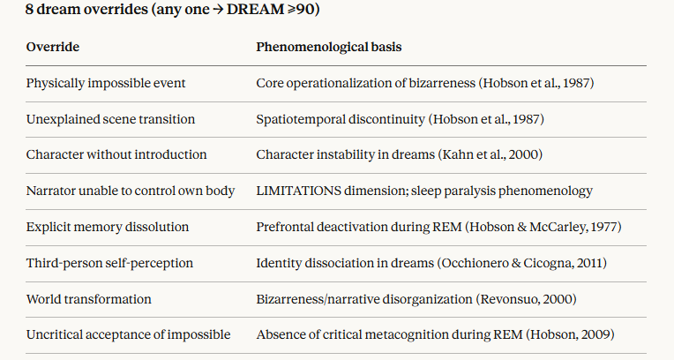
Structural Overrides
Overrides : discrete, binary rules designed to capture dream and wakefulness features that are immediately diagnostic to a human scorer.
Can overpass NDS ambiguous zone.
8 Overrides in dreams – 1 is enough to assess dream
4 Overrides in wakefulness – 4 need to be present to assess wakefulness

Slide 20
Structural Overrides
Overrides : discrete, binary rules designed to capture dream and wakefulness features that are immediately diagnostic to a human scorer.
Can overpass NDS ambiguous zone.
8 Overrides in dreams – 1 is enough to assess dream
4 Overrides in wakefulness – 4 need to be present to assess wakefulness
4 overrides → WAKEFULNESS ≥90 :
Explicit temporal réference
Métacognitive process
Narrator is actively initiating all key actions deliberately
None bizarre or impossible event or element

Slide 21
Performance
004_21 — Scored as WAKEFULNESS, True = DREAM
"I was imagining my life in a future in a way that I was imagining all the things I had to do. I was kind of imagining the tasks that I needed to do. Seeing myself as if from the outside doing these tasks, I can't really remember what these tasks were, but it was around this theme of maybe like maybe I need to educate myself some more and maybe I need to talk to this person or do that thing.“
NDS = -1,06 (probable wakefulness) and trigger wakefulness override :
Explicit temporal réference
Métacognitive process
Narrator is actively initiating all key actions deliberately
None bizarre or impossible event or element

Slide 22
Limits
Overall need more data especially of wakefulness reports to improve :
NDS thresholds
Overrides and lexical adjustment may need improvement or change

