Slide 1

Black Lives Matter
Social Justice
Team: Analytics Dream Team
Adriana Ortiz
Enzo Migliano
Juan Zambrano
Image: Abril

Slide 2

Projects Motivation
Image:
Freepik
Statistics and hard facts
Jurors are more likely to give the death penalty in cases in which Afrincan American Defendents are accused of killing [1].
Unarmed African Americans are 3.5 more likely to be shot by police than unarmed Caucasian [2].

Slide 3
Project Motivations
Image:
Freepik
Up to March of 2017, 47% of all exonerations of wrongfully convicted people were African Americans while making up only 13% of the United States Population [3].
African Americans are 6 times more likely than Caucasians to victim of a homicide (African Americans 19.6 homicides per 100,000, Caucasians 3.3 homicides per 100,000) [4].

Slide 4
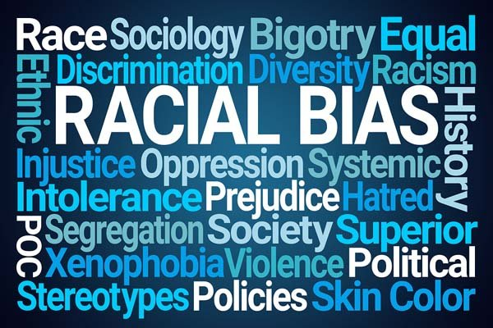
Issue at stake
Are African-American treated differently by law enforcement?
Image: The New Social Worker

Slide 5
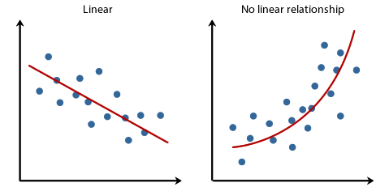
Analyses
Linear regression
Among other issues, we will identify with the linear regression if there is a significant correlation between the number of african-americans in a neighborhood and the numbers of people killed by law enforcement in the same neighborhood.
Image: Hacker Noon

Slide 6
Analyses
Non-linear regression
Among other issues, we will discover with a non-linear regression if the there is a relationship between the number of deaths by the Police and the State where they take place.
Image: Hacker Noon

Slide 7
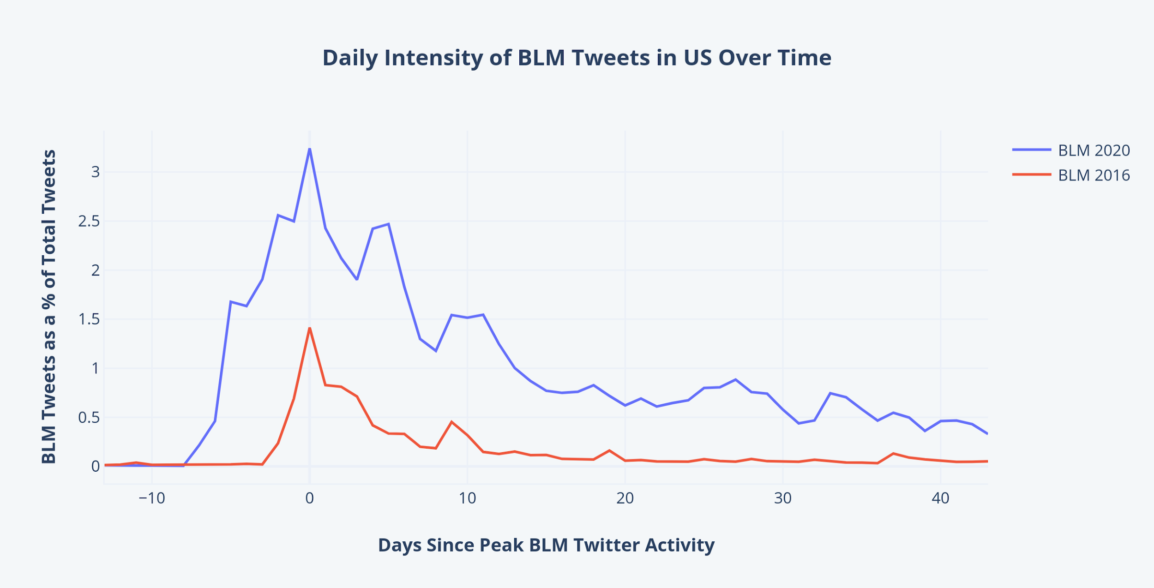
Analyses
Time Series Analysis
Among other issues, we will identify with the analysis if law enforcement has treated differently african-americans over the years.
Image: Anthony Xie

Slide 8
Data
Data Sources?
Kaggle, FiveThirtyEight data on police killings and fatal encounters, New York Police Department, United States Census Bureau, Data.gov, Florida Department of Law Enforcement.
How will we get the minimum 2 GB worth of data?
We are going to compile and contrast different datasets from different sources.

Slide 9
Data
How will you use at least 2 gb of data?
We are going to make an exploratory and statistical analysis on the data we found, to determine the relevant data to conduct comparisons in terms of race, state, gender, age to provide insights and determine if there is sufficient evidence supporting that african american are being treated different from law enforcement in the US.

Slide 10
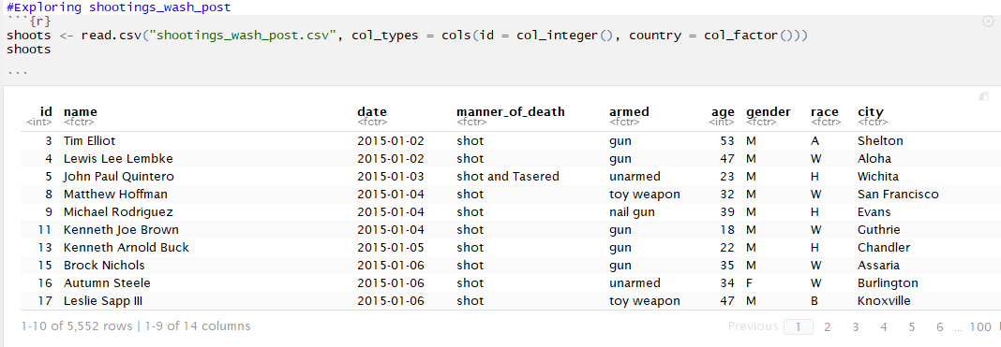
Exploratory Analysis
Table of raw data

Slide 11
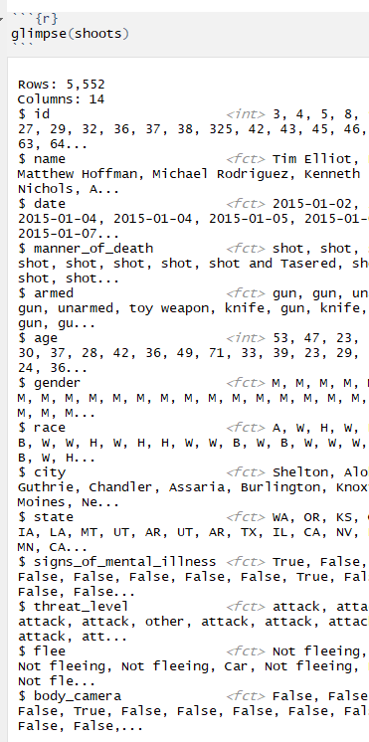
Exploratory Analysis
Data Description

Slide 12
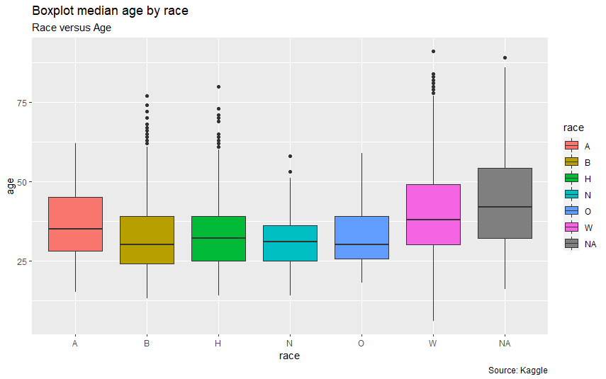
Exploratory Analysis
Generate a scatterplot, boxplot, and bargraph. All color coded and appropriately labelled.

Slide 13
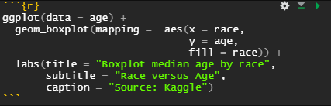
Coding

Slide 14
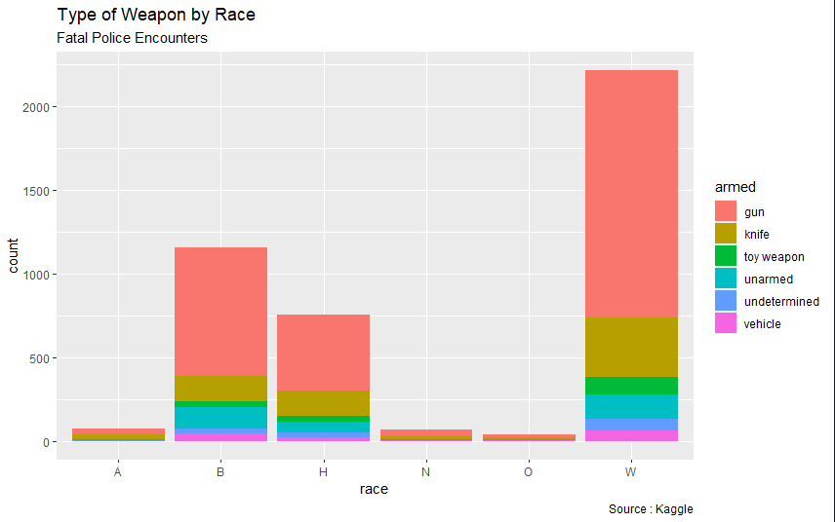

Slide 15

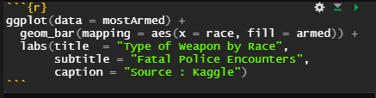
Coding

Slide 16
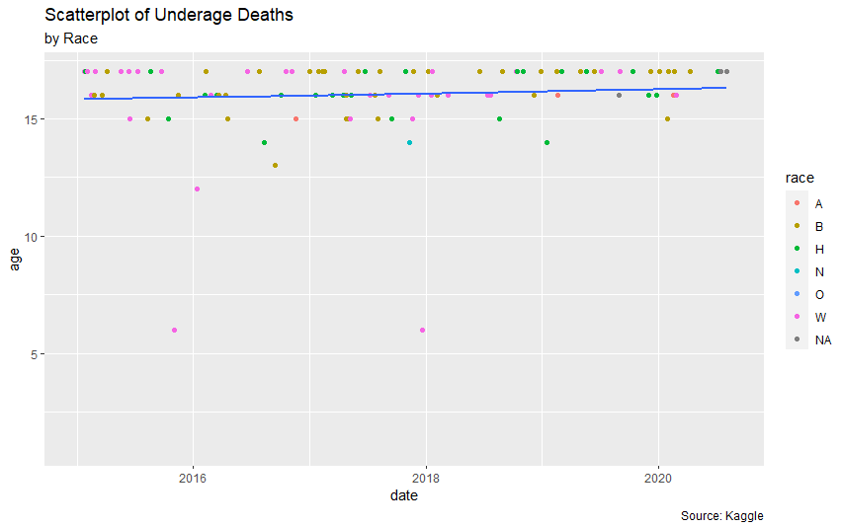

Slide 17
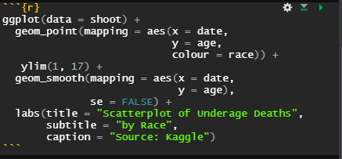
Coding

Slide 18
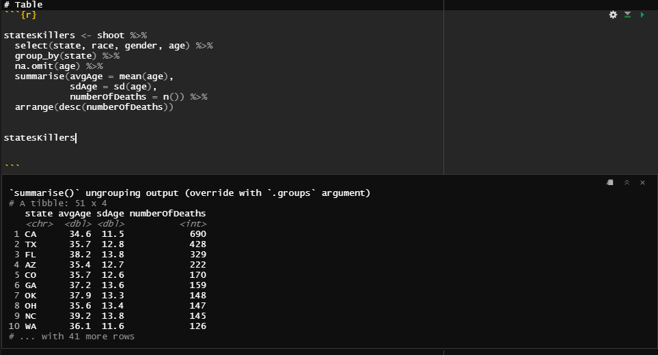
Show our code

Slide 19
THANK YOU!
“Keep calm and be significant”
Analytics Dream Team

Slide 20
Bibliography
[1] J. S. Hunt, “Race, ethnicity, and culture in jury decision making,” Annu. Rev. of Law and Social Sci., vol. 11, pp. 269-288, Nov. 2015, doi: 10.1146/annurev-lawsocsci-120814-121723.
[2] C. T. Ross, “A multi-level bayesian analysis of racial bias in police shootings ar the county-level in the United States, 2011-2014,” PLos ONE, vol. 10, no. 11, pp. E0141854, Nov. 2015, doi: 10.1371/journal.pone.0141854.
[3] National Registry of Exonerations, “Race and wrongful convictions in the United States,” 2017. [Online]. Available: https://www.law.umich.edu/special/exoneration/Documents/Race_and_Wrongful_Convictions.pdf
[4] US Department of Justice, “Homicide trends in the United States, 1980-2008,” 2011. [Online}. Available: https://www.bjs.gov/content/pub/pdf/htus8008.pdf

