Slide 1
P1906.1 Field Component Update
Stephen F Bush
1/9/2015

Slide 2
SVN Update Information
https://ieee-p1906-1-reference-code.googlecode.com/svn/trunk/p1906/model-mol/p1906-mol-field.cc
https://ieee-p1906-1-reference-code.googlecode.com/svn/trunk/p1906/model-mol/p1906-mol-field.h
Both at Revision 16
Stephen F Bush (bushsf@research.ge.com)

Slide 3
INSTALLATION
Make sure GSL is installed
Make sure GSL is enabled in ns-3 using configure
Issue: waf
Move mol-example.cc to scratch
Issue: ./waf --run scratch/mol-example
Tests will be run and the results output to standard out
*.mma and *.dat files will be created to imported into Mathematica and MATLAB
See documentation in p1906/html/index.html
Stephen F Bush (bushsf@research.ge.com)

Slide 4
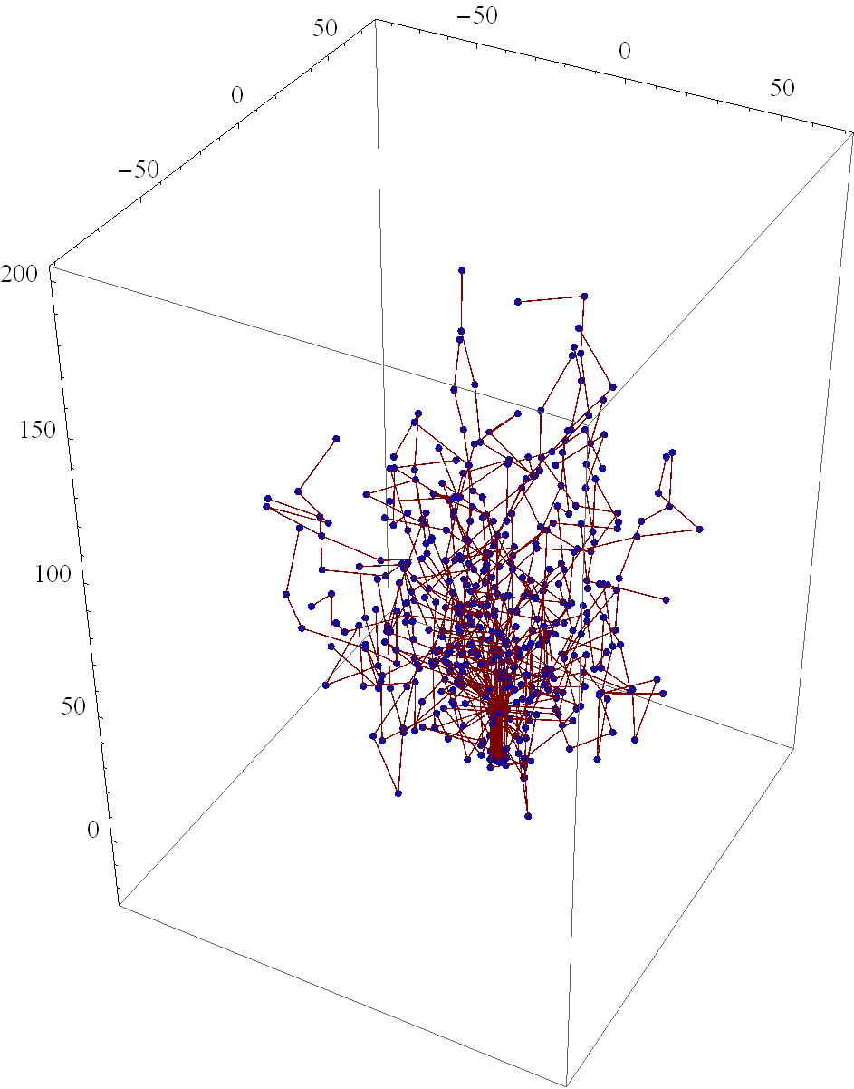
3D Tube Structure Output (tubes.mma)
microtubules
Stephen F Bush (bushsf@research.ge.com)

Slide 5
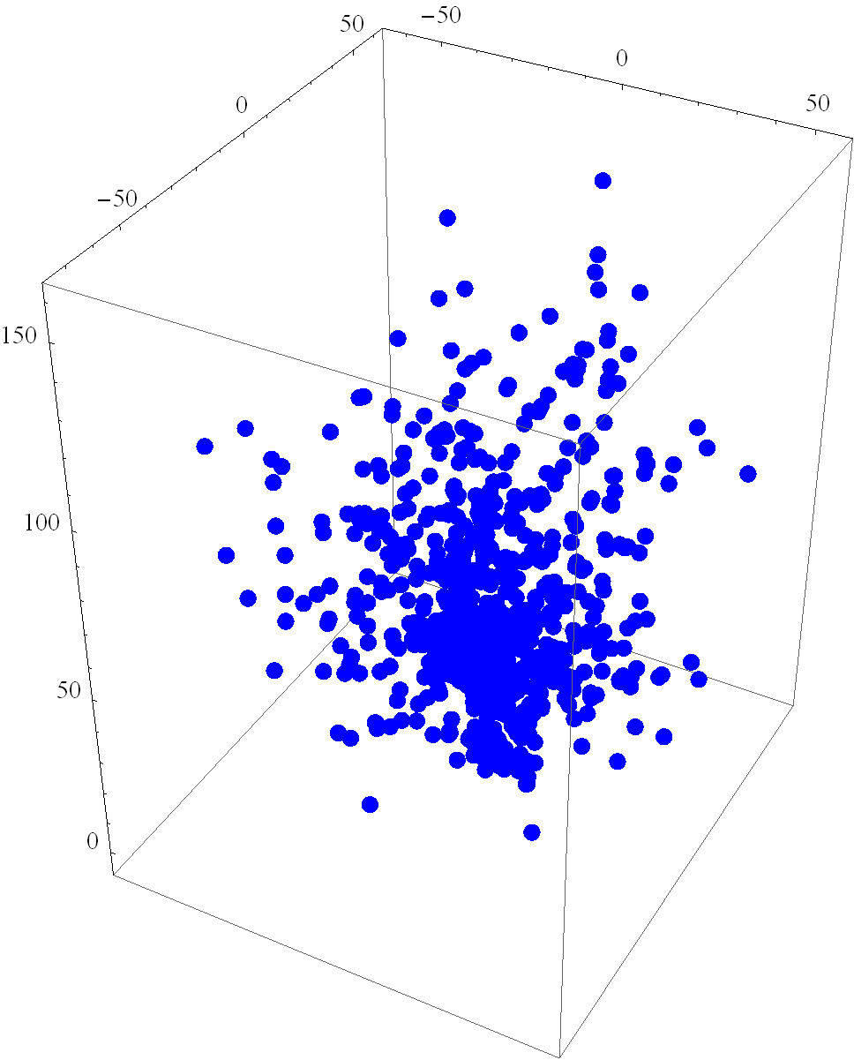
3D Tube Intersection Points (pfile.mma)
Points where tubes overlap
Stephen F Bush (bushsf@research.ge.com)

Slide 6
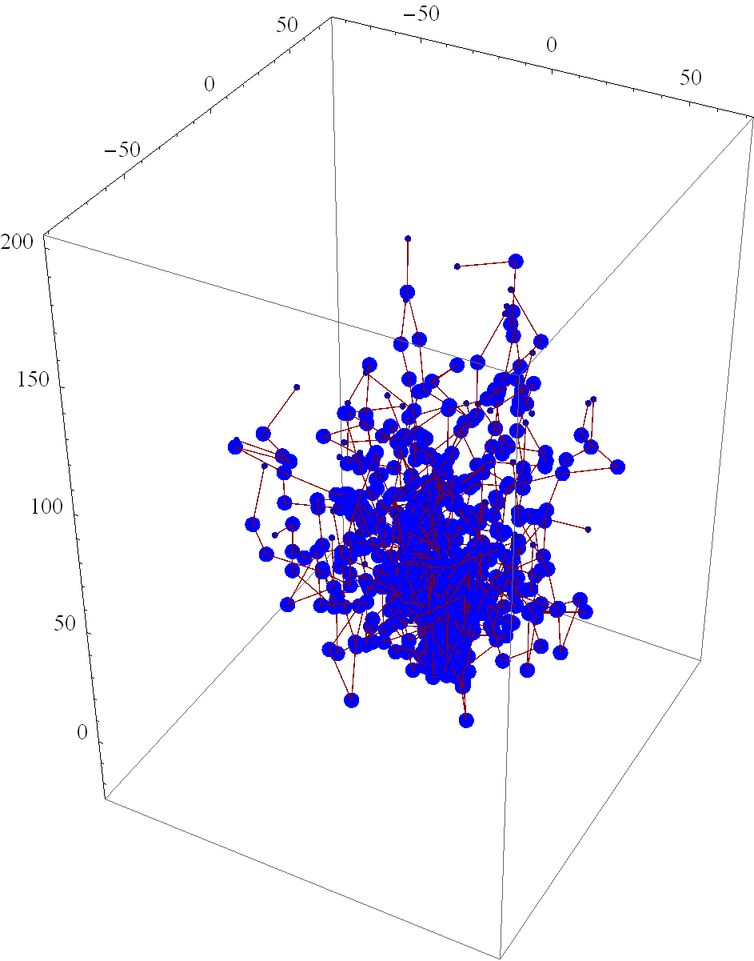
3D Tubes & Intersection Points (superposition of images)
Tubes with intersection points laid on top
Stephen F Bush (bushsf@research.ge.com)

Slide 7
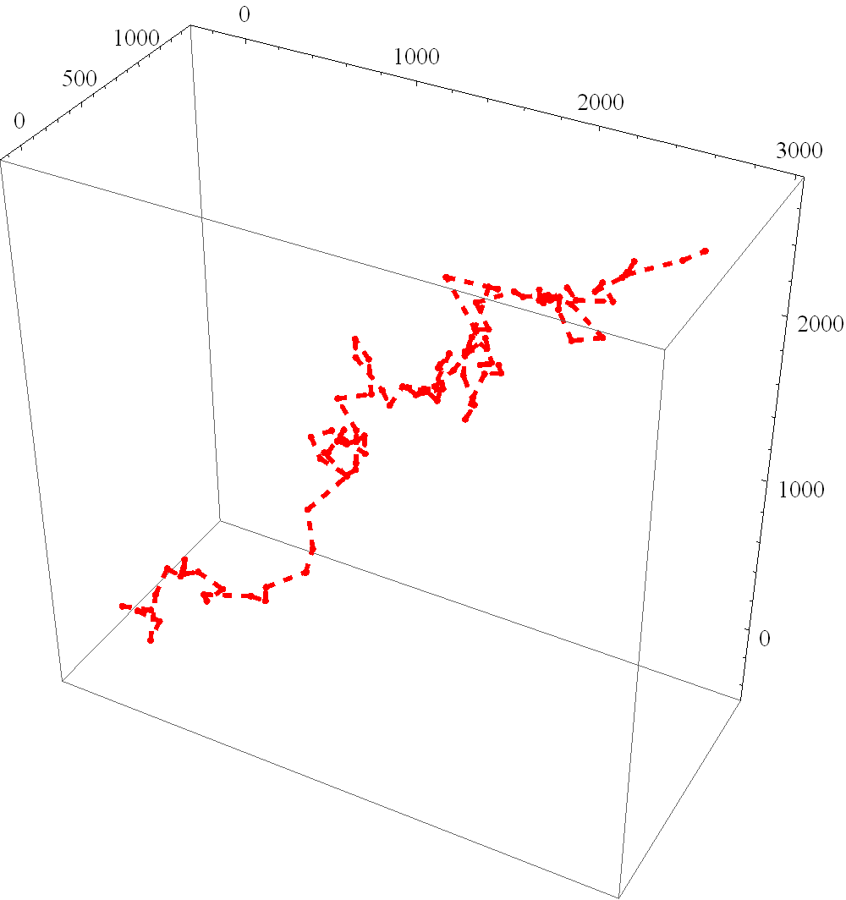
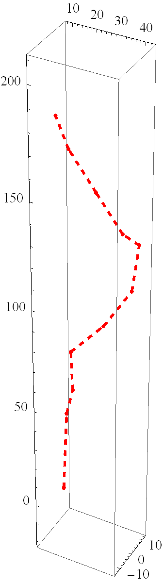
3D Brownian Motion Trajectory (motion.mma and tubewalk.mma)
Brownian motion
Bound to Tube
Stephen F Bush (bushsf@research.ge.com)

Slide 8
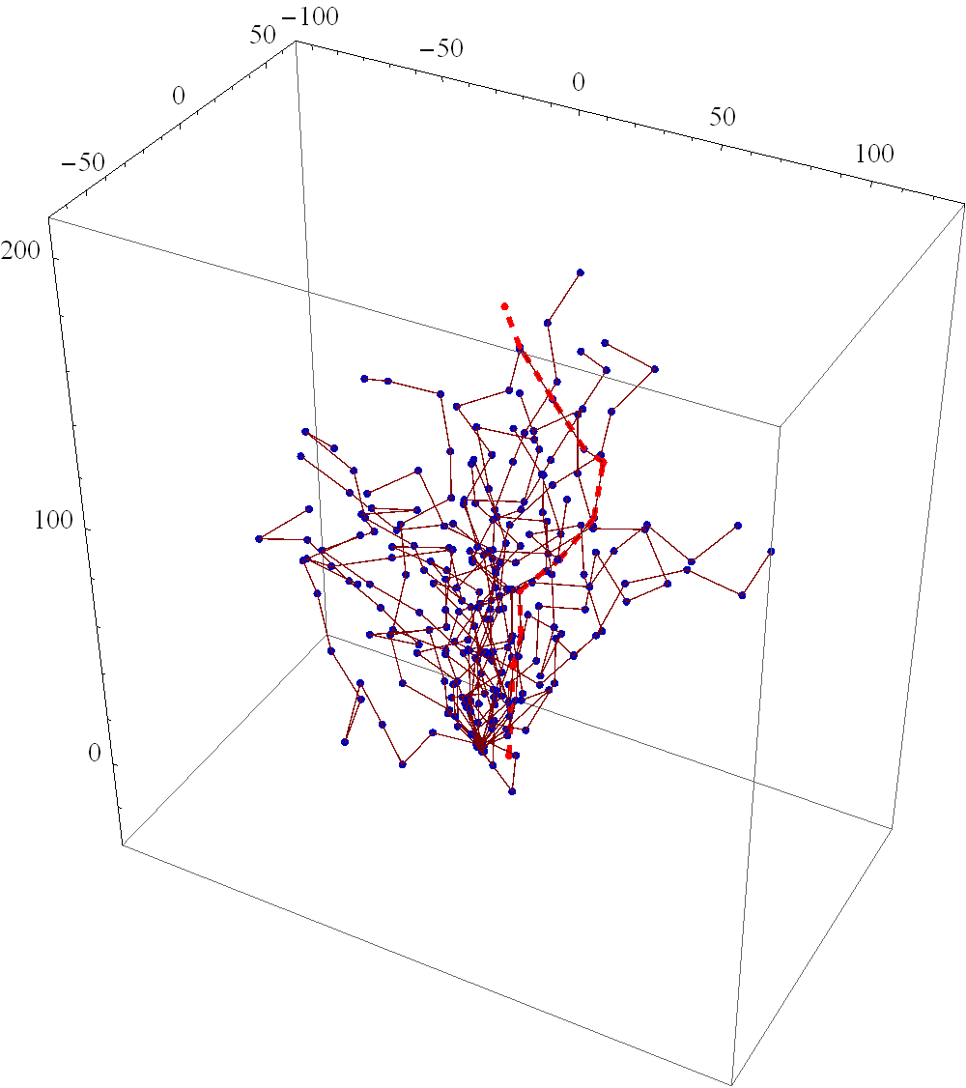
3D Brownian Motion Trajectory (superposition of images)
Motor motion (red dashed line)
Stephen F Bush (bushsf@research.ge.com)

Slide 9
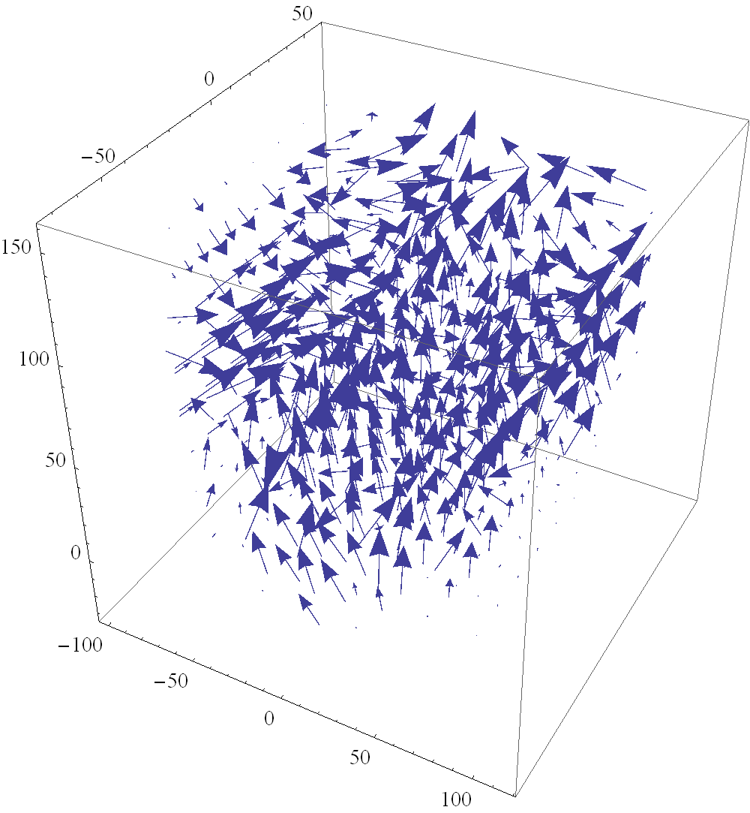
Vector field reconstructed from samples (vectorField.dat)
Tangent points along the microtubule structure
Can be refined by using more samples
Enables vector field analysis, e.g. Div, Curl, etc.
May enable tensor and mechanical analysis
Stephen F Bush (bushsf@research.ge.com)

Slide 10
Goals
Extend the P1906.1 Field component to enable structural modeling aimed toward (simple) cytoskeletal modeling as infrastructure for nanoscale communication
Examine the concept of structural entropy, implementing said metric in the code
Stephen F Bush (bushsf@research.ge.com)

Slide 11
I/O
Input:
microtubule structure
photo, mathematical description
mathematical description
random tinker toy sticks
mean tube length
mean intra-tube angle (p-length)
mean inter-tube angle
mean tube density
node locations
mean bound rate
mean bound time
Output:
coordinates of each segment
expected motor transport time
Stephen F Bush (bushsf@research.ge.com)

Slide 12
Sub-Goals
Add simple model of microtubule dynamics to 1906.1 ns-3 simulation
Molecular motors are messages
Microtubule structure is the communication channel “waveguide”
Explore entropy of microtubule structure
Transmitter and receiver – locations within the microtubule network
Motor propagation delay allows us to infer information about the structure
Use message input distribution and latency to estimate structure
Use estimate of structure to assign latency
Stephen F Bush (bushsf@research.ge.com)

Slide 13
Structural entropy and latency
Can structural entropy be used to characterize this?
Low persistence length -> high structural entropy
Use graph spectra to estimate propagation delay (Field)
Can persistence length be converted to mathematical field?
Yes, persistence length is precisely the expected change in the tangent field lines with distance from one another.
Tangent lines are the direction of the motor(s) [field lines]
Orientation is critical for high persistence length
Stephen F Bush (bushsf@research.ge.com)

Slide 14
Random walk within a field
Unbound time: random walk
Bound time: follows tangents defined microtubules (field lines)
How long if no field (pure random walk)?
How long if field added (correlated tangents)?
Stephen F Bush (bushsf@research.ge.com)

Slide 15
Connecting to ns-3
Assume microtubule intersections are nodes
Nodes move as the microtubule network dynamically changes
OR
Assume fixed nodes and compute impact of topology within the propagation module
Ns-3 node mobility
http://www.nsnam.org/docs/models/html/mobility.html
Matrix math using GNU Scientific Library w/ns-3
http://www.gnu.org/software/gsl/manual/html_node/Eigenvalue-and-Eigenvector-Examples.html#Eigenvalue-and-Eigenvector-Examples
Stephen F Bush (bushsf@research.ge.com)

Slide 16
Cytoskeleton to 1906.1 Map
P1906.1 Component | Corresponding components
Transmitter | Cytoskeletal system
Receiver | Cell (healthy operation)
Message | Regulators of the cytoskeletal system
Medium | Regulatory system of cytoskeletal structure
Message carrier | Regulator
Component < 100 nm | Regulator
Non-standard physics | Brownian motion / molecular rail transport
Motion | Diffusion
Field | Microtubule structure
Perturbation | Changes in regulatory messages
Specificity | TBD
Stephen F Bush (bushsf@research.ge.com)

Slide 17
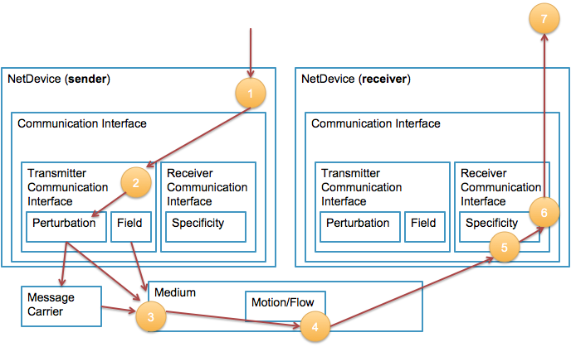
Components/entities interaction
Stephen F Bush
Stephen F Bush (bushsf@research.ge.com)

Slide 18
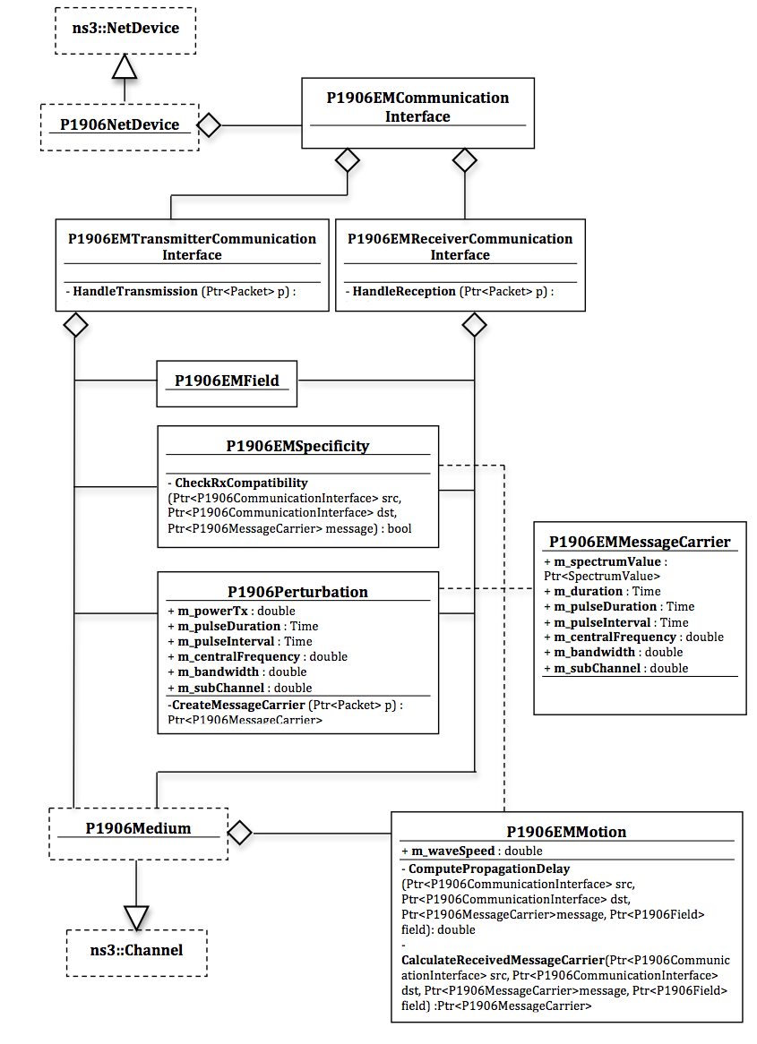
1906.1 Reference Code Diagram
Stephen F Bush (bushsf@research.ge.com)

Slide 19
Next Steps (Comments Welcome)
See
mol-example.cc
_RUN_MOL_CHANNEL_CAPACITY_.sh
Notice that nodeDistance can be passed
./waf --run "scratch/mol-example --nodeDistance=${nodeDistance}“
Perhaps nodePosition could be passed
For Mobility, see
mobility.SetMobilityModel("ns3::ConstantPositionMobilityModel");
The question is how to integrate into ns-3
microtubule as ns-3 node?
vector field in Field Component?
Brownian and walking in Motion?
Stephen F Bush (bushsf@research.ge.com)

