Slide 1
Mapping scheme from the P1906.1 reference model to the reference code
Giuseppe Piro, Ph.D.
Telematics Research Group (Politecnico di Bari) - giuseppe.piro@poliba.it telematics.poliba.it/piro

Slide 2
Core of the module (list of classes)
Components belonging to the P1906.1 framework:
MessageCarrier,
Motion,
Field,
Perturbation,
Specificity
Entities belonging to the P1906.1 framework:
Medium,
Message
Additional entities:
NetDevice, CommunicationInterface,
TransmitterCommunicationInterface,
ReceiverCommunicationInterface
Giuseppe Piro, Ph.D.
Telematics Research Group (Politecnico di Bari) - giuseppe.piro@poliba.it telematics.poliba.it/piro

Slide 3
Interaction among components and entities (1/2)
7
NetDevice (sender)
NetDevice (receiver)
1
Communication Interface
Communication Interface
Transmitter Communication Interface
Receiver
Communication Interface
Transmitter Communication Interface
Receiver
Communication Interface
2
6
Perturbation
Field
Specificity
Perturbation
Field
Specificity
5
Message Carrier
Medium
Motion/Flow
3
4
Giuseppe Piro, Ph.D.
Telematics Research Group (Politecnico di Bari) - giuseppe.piro@poliba.it telematics.poliba.it/piro

Slide 4
Interaction among components and entities (2/2)
The NetDevice receives a message from upper layers. The message is delivered to the Transmitter Communication Interface
The Perturbation component is used to create the Message Carrier
The Transmitter Communication Interface triggers the propagation in the medium by passing MessageCarrier, Perturbation, and Field components
The Motion component modify properties of the Message Carrier (i.e., propagation loss, delay)
The Message Carrier is delivered to the receiver and the Specificity component verifies the compatibility
In case of compatibility, the message is delivered to upper layers
The message is received by upper layers
Giuseppe Piro, Ph.D.
Telematics Research Group (Politecnico di Bari) - giuseppe.piro@poliba.it telematics.poliba.it/piro

Slide 5
Simulate the simple scenario (ideal communication)
download and install the simulator
https://code.google.com/p/ieee-p1906-1-reference-code
https://code.google.com/p/ieee-p1906-1-reference-code/source/browse/README
run the simple example through command line
cp ns-3-dev/p1906/example/first-example.cc scratch
./waf --run scratch/first-example
Giuseppe Piro, Ph.D.
Telematics Research Group (Politecnico di Bari) - giuseppe.piro@poliba.it telematics.poliba.it/piro

Slide 6
EM example
Giuseppe Piro, Ph.D.
Telematics Research Group (Politecnico di Bari) - giuseppe.piro@poliba.it telematics.poliba.it/piro

Slide 7
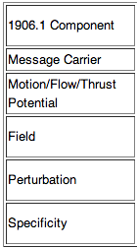
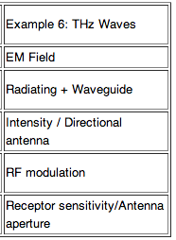
Goals
Example dedicated to electromagnetic communication
Single transmitter / receiver pair
Re-use the NANO-SIM code, but fit into P1906.1 framework
Giuseppe Piro, Ph.D.
Telematics Research Group (Politecnico di Bari) - giuseppe.piro@poliba.it telematics.poliba.it/piro

Slide 8
Message Carrier
P1906.1 EM Example: An electromagnetic wave (physical) from 0.3 to 3 terahertz (THz)
Parameters:
Number of subchannels
Bandwidth size
Central frequency
Pulse duration
Pulse interval
Starting time
Duration
Spectrum Values (i.e., Power Spectral Density)
Message to transmit (packet)
All the parameters are set by the perturbation component before the physical transmission
Giuseppe Piro, Ph.D.
Telematics Research Group (Politecnico di Bari) - giuseppe.piro@poliba.it telematics.poliba.it/piro

Slide 9
Field (optional)
P1906.1 EM Example: Ability of wave to be directed in particular direction
assume omnidirectional
Giuseppe Piro, Ph.D.
Telematics Research Group (Politecnico di Bari) - giuseppe.piro@poliba.it telematics.poliba.it/piro

Slide 10
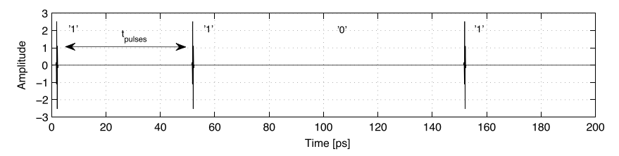
Pertubation
P1906.1 EM Example: TS-OOK Modulation
Parameters
Details about the modulation scheme (pulse duration, pulse interval)
Time instant in which the transmission starts
Expected signal duration (i.e., number of bits * pulse interval)
Power transmission
Giuseppe Piro, Ph.D.
Telematics Research Group (Politecnico di Bari) - giuseppe.piro@poliba.it telematics.poliba.it/piro

Slide 11
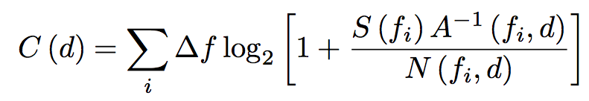
Specificity
P1906.1 EM Example: Antenna aperture, frequency/resonance, etc… (will CNT resonate with the received signal?)
The signal is received only if:
- transmitter and received use the same channel configuration (bandwidth and central frequency)
- the channel capacity (Shannon bound) is higher or equal to the transmission physical data rate
- A and N represents the pathloss and the
molecular noise, respectively
(provided by Akram’s model)
Giuseppe Piro, Ph.D.
Telematics Research Group (Politecnico di Bari) - giuseppe.piro@poliba.it telematics.poliba.it/piro

Slide 12
Motion/Flow
P1906.1 EM Example: How a wave travels (reflections, slow down in some mediums, etc)
Parameters:
Speed of wave in different materials
Propagation loss (Akram’s team contribution)
Giuseppe Piro, Ph.D.
Telematics Research Group (Politecnico di Bari) - giuseppe.piro@poliba.it telematics.poliba.it/piro

Slide 13
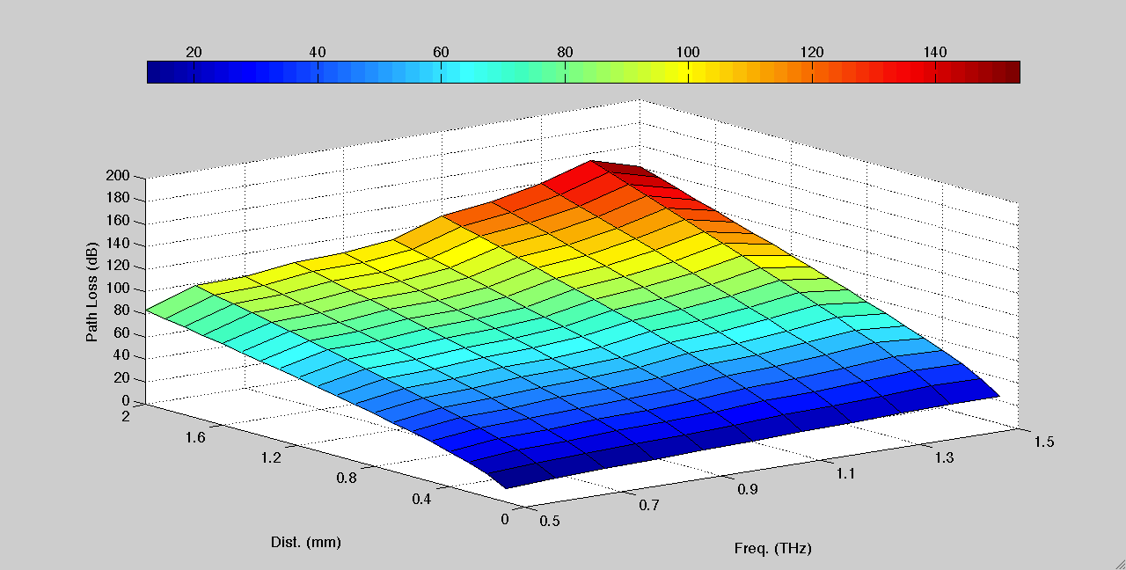
Motion/Flow
Akram’s team contribution (path loss)
Giuseppe Piro, Ph.D.
Telematics Research Group (Politecnico di Bari) - giuseppe.piro@poliba.it telematics.poliba.it/piro

Slide 14
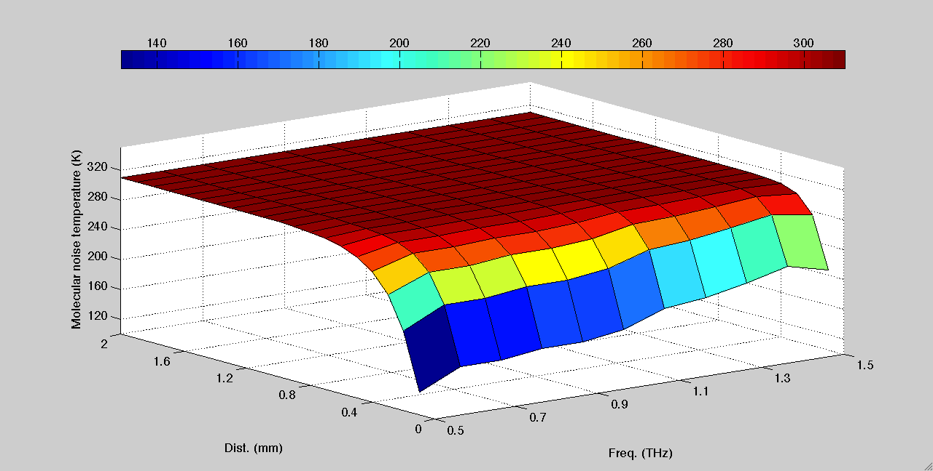
Motion/Flow
Akram’s team contribution (molecular noise)
Giuseppe Piro, Ph.D.
Telematics Research Group (Politecnico di Bari) - giuseppe.piro@poliba.it telematics.poliba.it/piro

Slide 15
Simulate the EM example
download and install the simulator
https://code.google.com/p/ieee-p1906-1-reference-code
https://code.google.com/p/ieee-p1906-1-reference-code/source/browse/README
run the EM example through command line
cp ns-3-dev/p1906/example/em-example.cc scratch
./waf --run scratch/em-example
Giuseppe Piro, Ph.D.
Telematics Research Group (Politecnico di Bari) - giuseppe.piro@poliba.it telematics.poliba.it/piro

Slide 16
Molecular example
Giuseppe Piro, Ph.D.
Telematics Research Group (Politecnico di Bari) - giuseppe.piro@poliba.it telematics.poliba.it/piro

Slide 17
Goals
Example dedicated to molecular communication
Single transmitter / receiver pair
Giuseppe Piro, Ph.D.
Telematics Research Group (Politecnico di Bari) - giuseppe.piro@poliba.it telematics.poliba.it/piro

Slide 18
Message Carrier
P1906.1 Mol Example: description
Parameters:
Message to transmit (packet)
xxx
All the parameters are set by the perturbation component before the physical transmission
Giuseppe Piro, Ph.D.
Telematics Research Group (Politecnico di Bari) - giuseppe.piro@poliba.it telematics.poliba.it/piro

Slide 19
Field (optional)
P1906.1 Mol Example: description
assume omnidirectional or not ?
Giuseppe Piro, Ph.D.
Telematics Research Group (Politecnico di Bari) - giuseppe.piro@poliba.it telematics.poliba.it/piro

Slide 20
Pertubation
P1906.1 Mol Example: description
Parameters
xxx
Giuseppe Piro, Ph.D.
Telematics Research Group (Politecnico di Bari) - giuseppe.piro@poliba.it telematics.poliba.it/piro

Slide 21
Specificity
P1906.1 Mol Example: description
Giuseppe Piro, Ph.D.
Telematics Research Group (Politecnico di Bari) - giuseppe.piro@poliba.it telematics.poliba.it/piro

Slide 22
Motion/Flow
P1906.1 EM Example: description
Parameters:
xxx
Giuseppe Piro, Ph.D.
Telematics Research Group (Politecnico di Bari) - giuseppe.piro@poliba.it telematics.poliba.it/piro

