Slide 1

INTINÉRAIRE AÉRIEN SECURISÉ PAR METEO
Romuald TIAKO
Elsa KUPFER
Enzo VILLAMANDOS
Lucas BONNEAUD
ÉCOLE DE TECHNOLOGIE SUPÉRIEURE

Slide 2
Contents of this template
You can delete this slide when you’re done editing the presentation
Fonts | To view this template correctly in PowerPoint, download and install the fonts we used
Used and alternative resources | An assortment of graphic resources that are suitable for use in this presentation
Thanks slide | You must keep it so that proper credits for our design are given
Colors | All the colors used in this presentation
Icons and infographic resources | These can be used in the template, and their size and color can be edited
Editable presentation theme | You can edit the master slides easily. For more info, click here
For more info: SLIDESGO | BLOG | FAQs
You can visit our sister projects: FREEPIK | FLATICON | STORYSET | WEPIK | VIDEVO

Slide 3
Table of contents
01
02
03
04
Theory lesson
Features of the topic
You can describe the topic of the section here
You can describe the topic of the section here
Useful tips
Practical exercise
You can describe the topic of the section here
You can describe the topic of the section here

Slide 4
01
Theory lesson
You can enter a subtitle here if you need it

Slide 5
Introduction
Mercury is the closest planet to the Sun and the smallest one in the entire Solar System. This planet's name has nothing to do with the liquid metal, since Mercury was named after the Roman messenger god. Its temperatures aren't as terribly hot as that planet's
Mercury takes a little more than 58 days to complete its rotation, so try to imagine how long days must be there! Since the temperatures are so extreme, albeit not as extreme as on Venus, Mercury has been deemed to be non-habitable for humans

Slide 6
Java basics
Do you know what helps you make your point crystal clear? Lists like this one:
They’re simple
You can organize your ideas clearly
You’ll never forget to buy milk!
And the most important thing: the audience won’t miss the point of your presentation

Slide 7
—Someone Famous
“This is a quote, words full of wisdom that someone important said and can make the reader get inspired.”

Slide 8
Concepts
Inheritance
Polymorphism
Mercury is the closest planet to the Sun and the smallest one in the Solar System—it’s only a bit larger than the Moon
Venus has a beautiful name and is the second planet from the Sun. It’s hot and has a very poisonous atmosphere

Slide 9
Access modifiers
Private
Protected
Public
Mercury is the closest planet to the Sun and the smallest one of them all
Venus has a beautiful name and is the second planet from the Sun
Despite being red, Mars is actually a cold place. It’s full of iron oxide dust

Slide 10
Modifiers on some elements
Abstract
Static
Mars is actually a very cold place
Neptune is the farthest planet from the Sun
Final
Synchronized
Jupiter is the biggest planet of them all
Saturn is a gas giant and has several rings

Slide 11
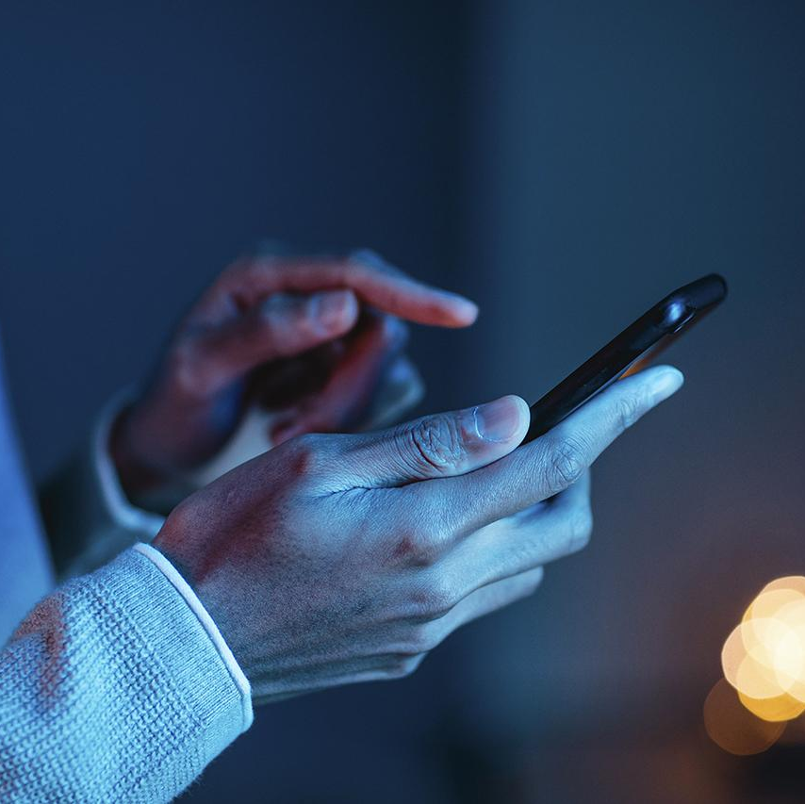


What can be done with Java examples?
Big data
AI
Video game
Mercury is the closest planet to the Sun and the smallest one of them all
Venus has a beautiful name and is the second planet from the Sun
Despite being red, Mars is actually a cold place. It’s full of iron oxide dust

Slide 12
Recommendations
Mars
Venus
Neptune
Mars is actually a very cold place
Venus is the second planet from the Sun
Neptune is the farthest planet from the Sun
Mercury
Saturn
Jupiter
Mercury is the closest planet to the Sun
Saturn is a gas giant and has several rings
Jupiter is the biggest planet of them all

Slide 13

A picture always reinforces
the concept
You can give a brief description of the topic you want to talk about here. For example, if you want to talk about Mercury, you can say that it’s the smallest planet in the entire Solar System

Slide 14
4,498,300,000
Big numbers catch your audience’s attention

Slide 15
9h 55m 23s
333,000
386,000 km
Jupiter’s rotation period
The Sun’s mass compared to Earth’s
Distance between Earth and the Moon

Slide 16
Awesome words

Slide 17

A picture is worth a thousand words

Slide 18
Class operations
Static void main(String[] args) {
int a=10;
int b=5;
int sum=a+b;
int subtract=a-b;
int multiplication=a*b;
int division =a/b;
System.out.println("The sum of " + a + " plus " + b + " equals " + sum);
System.out.println("Subtraction of " + a + " minus " + b + " equals " + subtraction);
System.out.println("The multiplication of " + a + " by " + b + " is equal to " + multiplication);
System.out.println("The division of " + a + " by " + b + " is equal to " + division);

Slide 19
Brainstorming and idea generation
A | Abstract
B | Block
C | Class
D | Default
E | Enum
F | Field
G | Generic
H | Hexadecimal
I | Identifier
J | Java
K | Keyword
L | Lexical
M | Method
N | Native
O | Object
P | Package
Q | -
R | Reference
S | Sandbox
T | Thread
U | Unicode
V/W | Variable
X/Y | XML
Z | -

Slide 20
Main topic and details
Java
Topic 1
Topic 2
Topic 3
Mercury is the closest planet to the Sun and the smallest one in the Solar System
Despite being red, Mars is actually a cold place. It’s full of iron oxide dust
Venus has a very beautiful name and is the second planet from the Sun

Slide 21
Simple data types
Tipo | Size/Format | Description
Byte | 8-bit, 2's complement | 1-byte integer
Short | 16-bit, 2's complement | Short integer
Int | 32-bit, 2's complement | Whole
Long | 64-bit, 2's complement | Longint
Float | 32-bit, IEEE 754 | Real simple precision
Double | 64-bit, IEEE 754 | True double precision
Char | 16 bit character | Simple character

Slide 22
Sequence
Start
Declare variables
Read data
Mercury is the closest planet to the Sun
Venus is the second planet from the Sun
Despite being red, Mars is actually a cold place
Process
Show
End
Jupiter is the biggest planet of them all
Saturn is composed of hydrogen and helium
Neptune is the farthest planet from the Sun

Slide 23
Classification
Sequence in Java
Arrays | Collections | Popular API
Feature 1 Feature 2 Feature 3 Feature 4 | Feature 1 Feature 2 Feature 3 Feature 4 | Feature 1 Feature 2 Feature 3 Feature 4
Mars is actually a very cold place | Venus has high temperatures | Mercury is the smallest planet

Slide 24
Cause and effect
Abstract
Public
The Moon is Earth’s only natural satellite
Static
Modifiers
Neptune is the farthest planet from the Sun
Final
Protected
Saturn is composed of hydrogen and helium
Synchronized
Despite being red, Mars is a cold place

Slide 25
Question and answer
What are Java IDEs?
Is Mercury the closest planet to the Sun and the smallest one in the Solar System? Note that it’s a bit larger than the Moon
Eclipse and NetBeans
Venus has a beautiful name and is the second planet from the Sun. It’s hot and has a poisonous atmosphere

Slide 26
Timeline
Venus is the second planet from the Sun
Despite being red, Mars is a very cold place
Project start
Prototype
Data analysis
Feedback
Mercury is the closest planet to the Sun
Jupiter is the biggest planet of them all

Slide 27
Parts and whole
The whole object
What would happen if the part was missing
Mercury is the closest planet to the Sun and the smallest one in the entire Solar System
Venus has a beautiful name and is the second planet from the Sun. It’s terribly hot, even hotter than Mercury, and its atmosphere is extremely poisonous
Parts of the object
What’s the function of the part?
Mercury is very small
Venus is very hot
We all live on Earth
Saturn is a gas giant and has several rings. It’s composed mostly of hydrogen and helium. It was named after the Roman god of wealth and agriculture

Slide 28
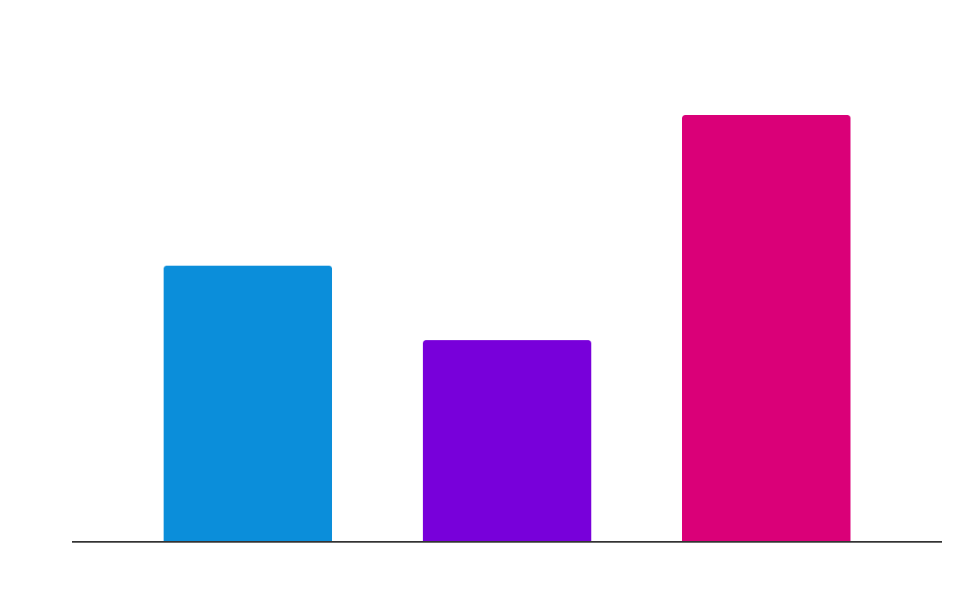
Evolution of the students
Venus
Venus is the second planet from the Sun
Mercury
Mercury is the closest planet to the Sun
Mars
Despite being red, Mars is a very cold place
Follow the link in the graph to modify its data and then paste the new one here. For more info, click here

Slide 29
Most used programming languages
25%
50%
75%
HTML
Python
Java
Mercury is the closest planet to the Sun and the smallest of them all
Venus has a beautiful name and is the second planet from the Sun
Despite being red, Mars is actually a cold place. It’s full of iron oxide dust

Slide 30
Best centers
Venus
Venus is the second planet from the Sun
Mercury
Mercury is the closest planet to the Sun
Mars
Despite being red, Mars is a very cold place

Slide 31
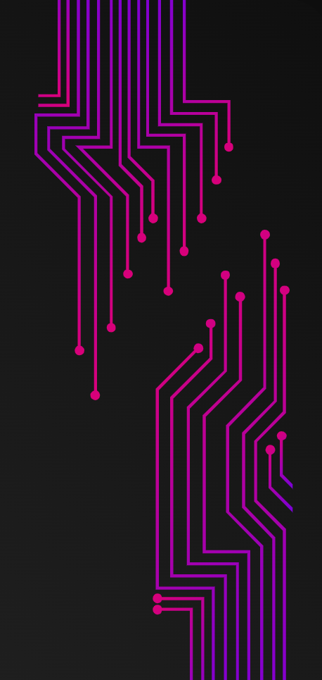

Mockups
You can replace the images on the screen with your own work. Just right-click on them and select “Replace images”

