Slide 2
Data & method
6 mia vs 6 ut
4 fastqs for each
cat -> 1 fastq for each
Align to hg38 -> bam file
Sorted->indexed-> sortedbam and bai files
Macs2 peak calling using q 0.00001, BAMPE, peaks in bed file
No input sample
DiffBind (removed 3259mia, 3378mia, 3381ut, 3511ut)

Slide 3
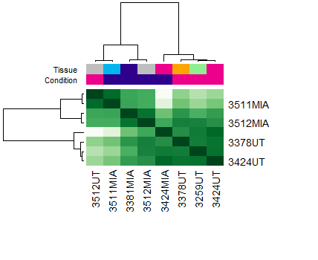
Peaks number
Peaks
Sample | MIA | UT
3259 | 583 | 709
3378 | 1914 | 879
3381 | 438 | 440
3424 | 594 | 667
3511 | 406 | 408
3512 | 403 | 185

Slide 4
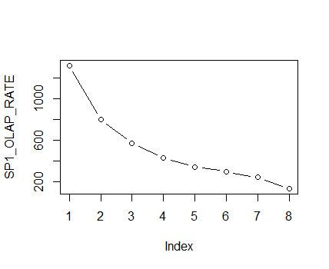
overlap
The 8 samples have almost 200 genomic regions overlapping.

Slide 5
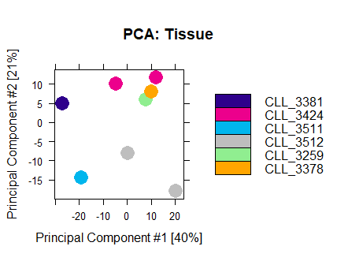
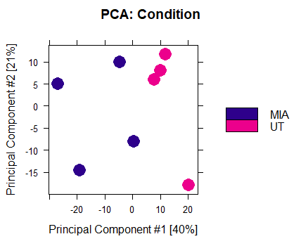
PCAs
Aa

Slide 6
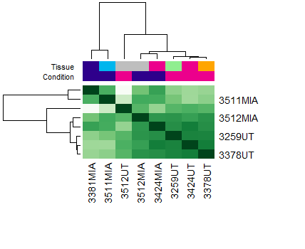
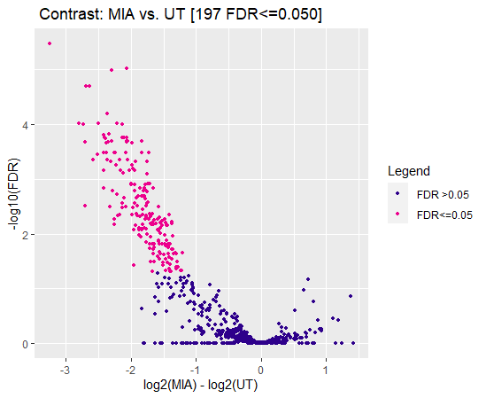
197 genomic regions decreased in MIA-treated
Chr

Slide 7
Genomic ranges as promoters
MNT, RAB3A, TMEM53, C21orf58
JUND, KLF16
Promoters to 203 genes are affected
http://dbarchive.biosciencedbc.jp/kyushu-u/hg38/target/SRX100550.1.html

