Slide 1
Software Test

Slide 2
Manual vs. Automated test
Manual Test
People testing software
Slow
Expensive (recurring cost)
Time consuming
Error Prone
Repetitive
Boring
Tedious
Automated Test
Software testing software
Fast
Cheap (once off cost + maintenence)
Repeatable
Easy to execute
Reliable
Catches regressions with minimal effort

Slide 3
Types of Testing
Unit test
Fast execution time
Reliable
Test small changes in isolation
Find bugs early
Component / Service / Integration test
Test interactions between objects or subsystems
Can be fast or slow to execute
Can be unreliable
End to End (E2E) / UI / Solution tests
Slow execution time
Unreliable
Expensive to maintain
Vulnerability / Fuzz testing
Identify common security vulnerabilities
Slow to execute

Slide 4

Unit test vs. Integration test

Slide 5
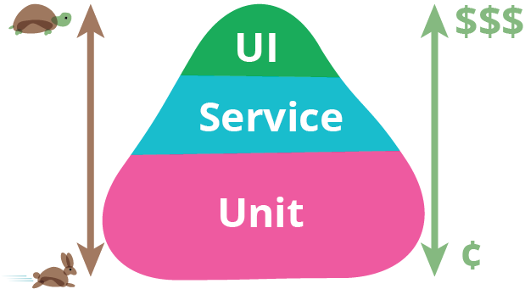
Test Pyramid

Slide 6
Unit Tests - Why?
Speed
Unit tests should execute in milliseconds
Easy to write*
Identify logic / programmer error
Reliability
External dependencies are mocked out so flakiness is removed
Build up a contract of how your code works
You define the behaviour of your code in your tests
Reliably recreate defects
Forces you to think of edge cases
Promotes code clean

