Slide 1
Project IV Presentation II
Cross-Platform 2D Tile Level Editor
(Jigsaw Tiled Level Editor)
Eoin Abbey-Maher
C00217717

Slide 2
Why I Chose This Project
Increase the Speed of Development Time
Speed Up Prototyping of Levels
Quickly discover issues with the planned level design
More of an interest in the Graphical Side of Games Development
Simple Maze editor for last year’s Project
Opportunity to learn new Development Environment
Why QT?
Less Technical Limitations to SFML
Increase Career Prospects

Slide 3
Development Tools
Qt Development Environment
Cross-Platform Application Development Environment
Developed in 1990 By Norwegian Company TrollTech.
Is now the open source “QT Project”.
Uses Widget Modules and event systems
Used by Multiple large companies e.g LucasFilms, AutoDesk & Valve.
Qmake
Created by Qt for the construction of Make files
Automates and Simplifies the generation for make files

Slide 4
Development Tools (Continued)
Linux & Windows Operating Systems
C++
Oracle Virtual Box VM

Slide 5
Features
Cell Based Texture Selection and Placement
Custom User selected Map Sizes
Free Camera Movement and Zoom around the Map
Custom User loaded Tiles
Export map and rebuild using SFML

Slide 6
Planned Future Features
Load Existing Maps From XML Files
Free placing of Images

Slide 7
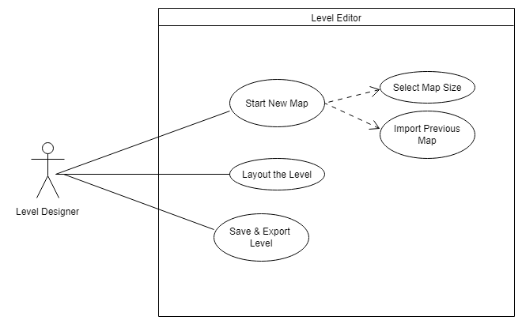
Typical Level Designer Use Cases

Slide 8
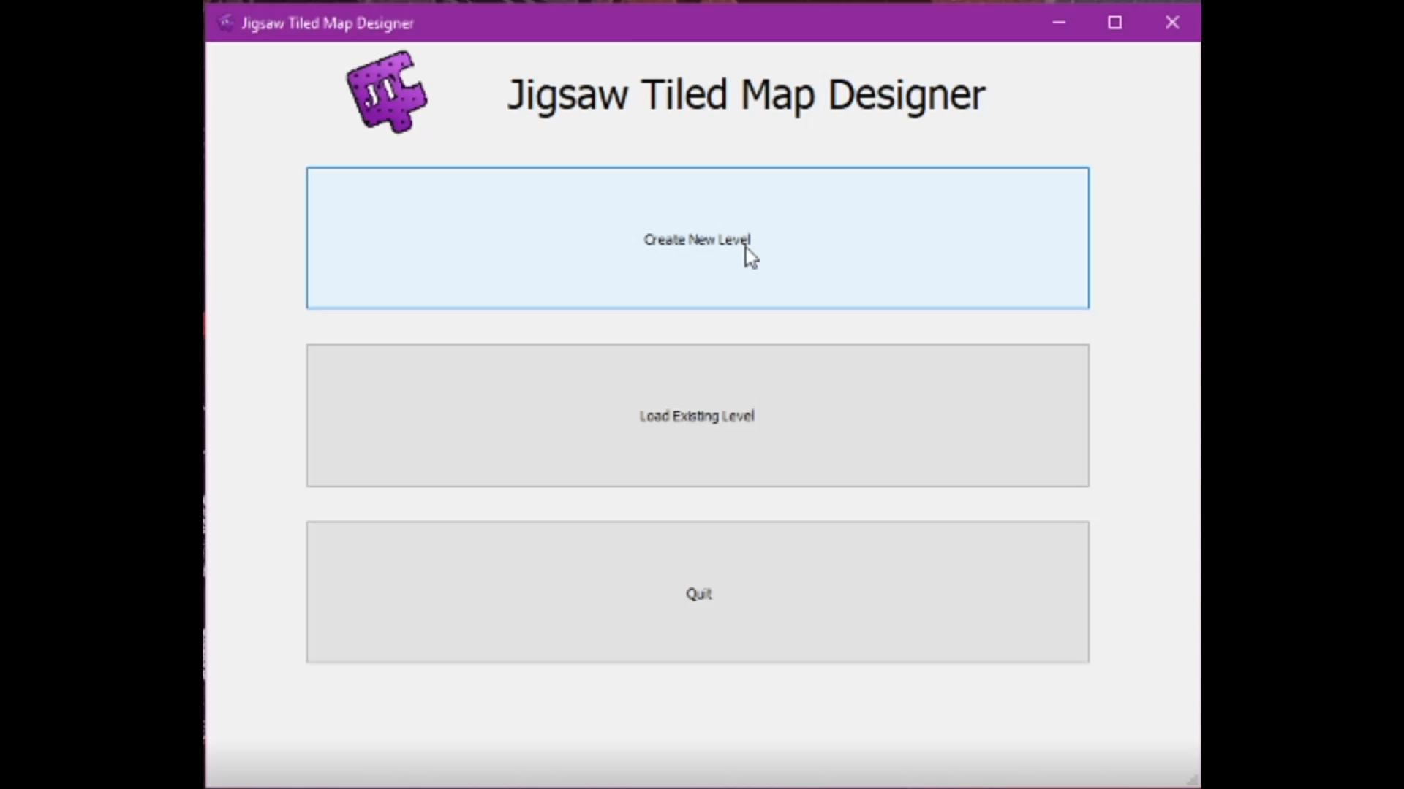
Demonstration
Release Build Running on Window

Slide 9
Thank You For Listening
Any Questions

