Slide 1
Final Project Presentation
Cross-Platform 2D Tile Level Editor
(Jigsaw Tiled Level Editor)
Eoin Abbey-Maher
C0017717

Slide 2
Why I Chose This Project
Speed Up The Development Time On Levels & Offer An Alternative Solution To Level Artists Without Needing To Code.
Challenge Myself To Develop An Easy To Use Tile-Based Editor In A 7 Month Period That Could Be Quickly Used To Build A “Ready-To-Go” Use SFML Levels.
Why QT?
Less technical limitations to SFML
Useful GUI and code based editing for quick development
Support for cross-platform Development
Increased career prospects ( 23 new Jobs in Ireland | LinkedIn)

Slide 3
Development Tools
Qt Development Environment
Cross-Platform Application Development Environment
Uses signal and slots for communication between widgets
Uses Widgets for quick building
Includes deployment software to make release easier
Oracle Virtual Box VM
Linux Ubuntu & Windows 10 Operating System
C++
MinGW & GCC

Slide 4
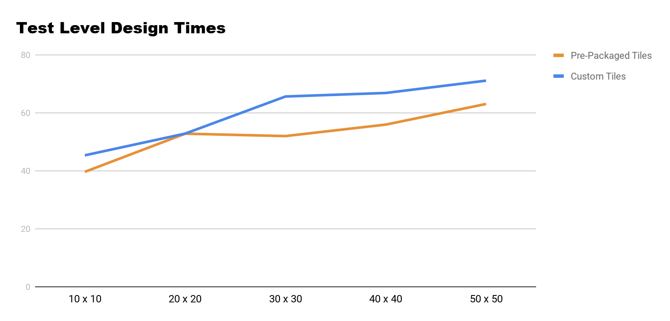
Testing the Application
Testing The Amount Of Time To Build A Level
Using different size maps
Time tested from launch of level editor to the end of opening the SFML project with the level loaded.
The average time to create a level using the pre-packaged tiles was: 52.68s
The average time to create a level using a custom tile was: 1m 04s
Noticed an increase in time taken when placing tiles on the full table
Map Size | Custom Tile | Time Taken
10 x 10 | YES | 45.36s
10 x 10 | NO | 39.61s
20 x 20 | YES | 52.85s
20 x 20 | NO | 52.82s
30 x 30 | YES | 1m 05s
30 x 30 | NO | 52s

Slide 5
Features
Cross Platform, Tested on Windows 10 and Linux Ubuntu 18.04.4 LTS
Cell Based Texture Selection and Placement
Custom User Selected Sized Map
Custom User Loaded Tiles
Player & NPC Nodes For Quick Placement On Multiple Layers
Export Map & Rebuild Using SFML & XML
Re-Opening Pre-Existing Projects To Re-Edit
Custom Tile Types For Easy Collisions in SFML

Slide 6
Personal & Technical Learnings
Personal Learnings
Working under the pressure of time constraints and deliverables
Ability to adapt to a software I have never used before
Overcome challenges and obstacles with development
Technical Learnings
Learned about the Qt environment
Working with XML files for writing and receiving data
Learned about make files
Working in a linux environment and virtual machines

Slide 7
Conclusion & Things I’d Do Different
Things I Would Change
Wouldn’t change much
Spend more time reading about Qt & how elements work early on in development
Do more test runs on the Linux build
Continued Development
Develop for Mac OS, would be quiet easy using gcc and Qt, wasn’t done this time due to lack of access to Mac products
Users add their own layers and nodes
Add some extra button shortcuts and UX features
Build headers to allow the levels to be used with other libraries such as SDL or OpenGL

Slide 8
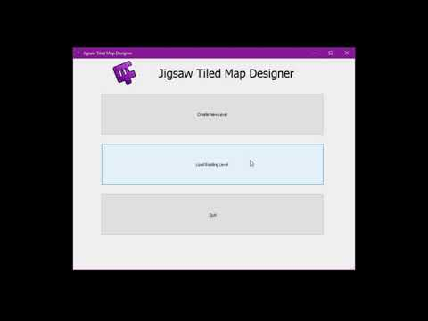
Demonstration
Final Release Trailer

Slide 9
Thank You For Listening
Any Questions?

