Slide 1
AI Smart Doorbell
Real-time face recognition, gesture recognition and a simple smart-home interface
Eoin Fitzpatrick
ATU Galway
Supervisor: Brian O'Shea
Eoin Fitzpatrick | ATU Galway | AI Smart Doorbell
1

Slide 2
The problem I wanted to solve
1
2
3
The results need to be simple and clear
Recognising visitors can become difficult
A normal camera does not fully solve this
For someone with memory loss or Alzheimer’s, a familiar person may not be recognised straight away when they arrive at the door or enter the home.
The aim is to clearly show whether the visitor is known or unknown, and help the user feel more confident before interacting with them.
The result should be clear at a glance: known person, unknown person, gesture, and door state.
Eoin Fitzpatrick | ATU Galway | AI Smart Doorbell
2

Slide 3
Project aim and scope
My aim was to build a working prototype that joins AI recognition with a real-time web app.
F
Recognise visitors
G
Use simple gestures
D
Store local data
P
Stay realistic
Detect a face from the camera feed and compare it with stored known users.
Classify hand gestures so the prototype can simulate actions such as open or close.
Use a small local database for enrolled users and face encodings.
Prototype first: test the concept, limits and risks.
Eoin Fitzpatrick | ATU Galway | AI Smart Doorbell
3

Slide 4
What I built
HIGH-LEVEL SYSTEM
React frontend
WebSocket layer
FastAPI backend
AI services
Stored data
Decodes frames and coordinates the recognition services
Face recognition, gesture recognition and smoothing logic
SQLite face database and trained gesture model
Live camera, overlay, controls, simulation and results page
Sends captured frames and receives JSON recognition results
→
→
→
→
The app takes live input, processes it in real time, and returns a result the user can understand.
Eoin Fitzpatrick | ATU Galway | AI Smart Doorbell
4

Slide 5
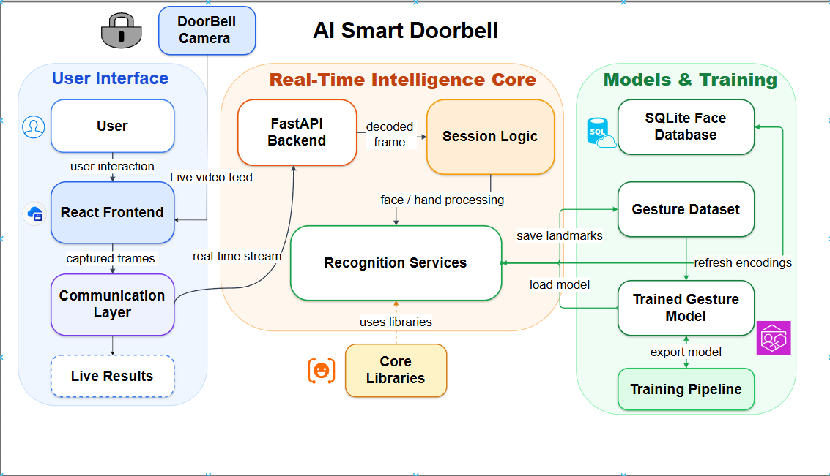
Architecture overview
Eoin Fitzpatrick | ATU Galway | AI Smart Doorbell
5

Slide 6
Real-time frame pipeline
ONE FRAME THROUGH THE SYSTEM
Webcam
3
Decode
4
Recognise
5
Session
6
Result
1
2
JPEG
Smoothing reduces flicker and stale results.
React captures a frame from the live video feed.
The frame is compressed and sent over /ws.
Backend decodes it into an OpenCV image.
Frontend receives person, gesture and latency.
Face and hand services process the same frame.
→
→
→
→
→
Why WebSocket? It suits continuous video frames better than repeated request-response calls.
Eoin Fitzpatrick | ATU Galway | AI Smart Doorbell
6

Slide 7
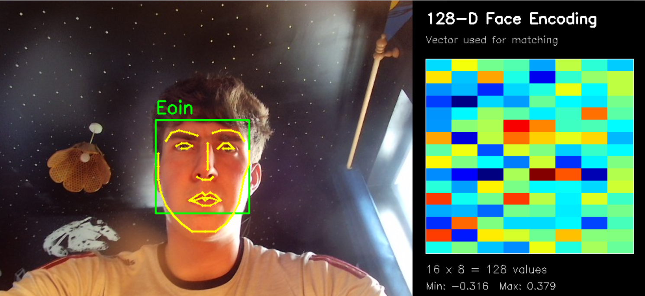
Face recognition: the main assistive feature
HOW IT WORKS
Enrol a known person
Compare live frames
The system captures samples and stores face encodings locally.
A live encoding is compared against the stored known encodings.
Return a usable result
Reduce flicker
The frontend receives person, confidence, distance and latency.
The session keeps the last known face briefly if detection drops.
Eoin Fitzpatrick | ATU Galway | AI Smart Doorbell
7

Slide 8
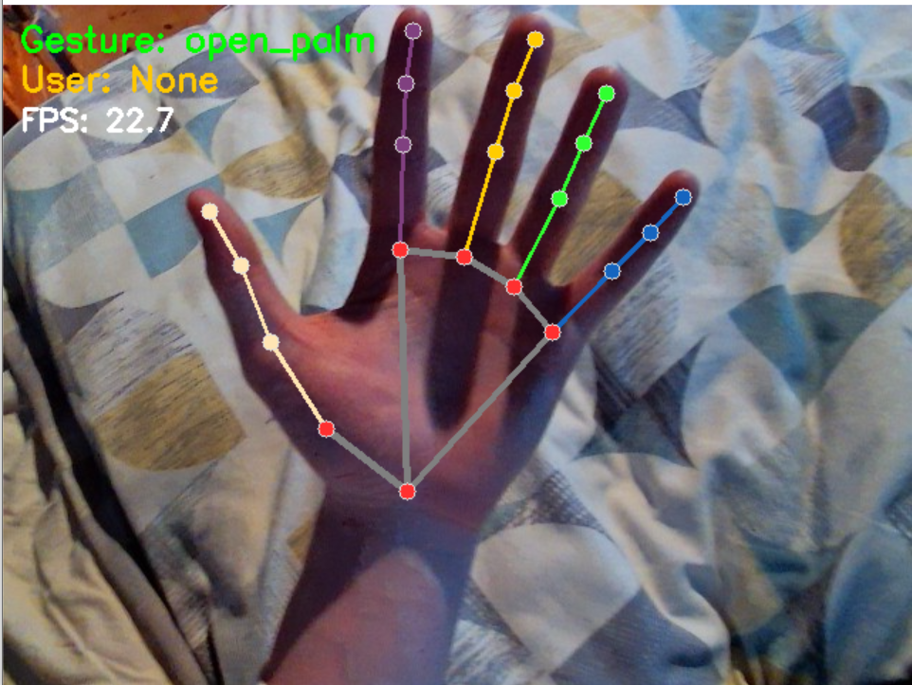
Gesture recognition: simple interaction after recognition
The gesture side uses landmarks rather than raw image pixels.
21 hand points
63 features
MediaPipe detects key hand landmarks from the frame.
Each landmark gives x, y and z values for the dataset.
Smoothing logic
Random Forest model
Recent predictions are voted on before updating the final result.
The trained classifier predicts the selected gesture.
In the simulation, gestures are only allowed to control the door after a face has been recognised.
Eoin Fitzpatrick | ATU Galway | AI Smart Doorbell
8

Slide 9
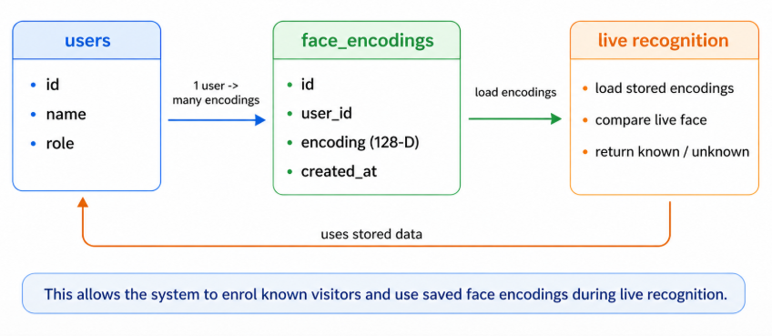
Database and enrolment
The database turns the prototype from fixed test images into an enrolable system.
users
face_encodings
Stores ID, name, role and creation time for each enrolled person.
Stores the 128-D face encoding linked to that user.
Live recognition
After saving a person, the backend reloads known faces.
Eoin Fitzpatrick | ATU Galway | AI Smart Doorbell
9

Slide 10
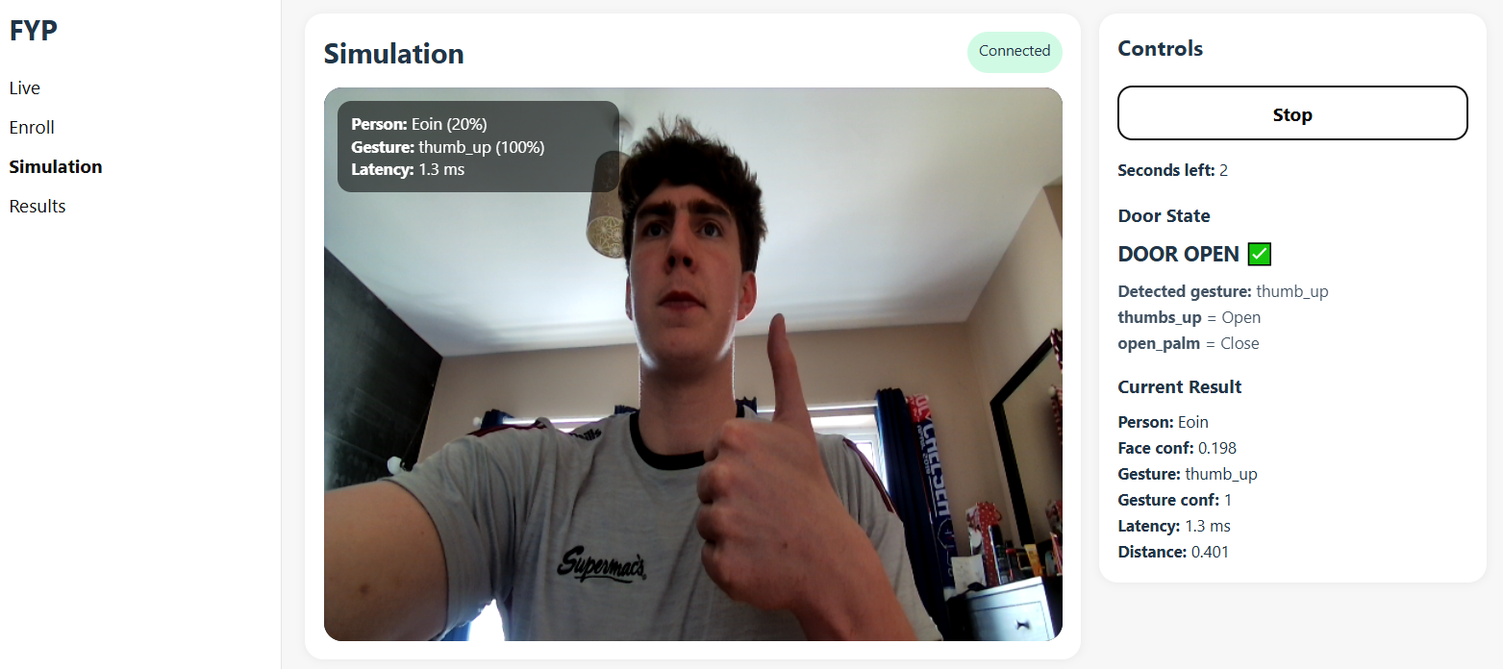
Frontend and user experience
FRONTEND PAGES
Live
Enrol
Continuous recognition view with overlay results.
Capture and save a new known person.
Simulation
Results
Timed session and door open or close behaviour.
Recent recognised visitors are shown back to the user.
Eoin Fitzpatrick | ATU Galway | AI Smart Doorbell
10

Slide 11
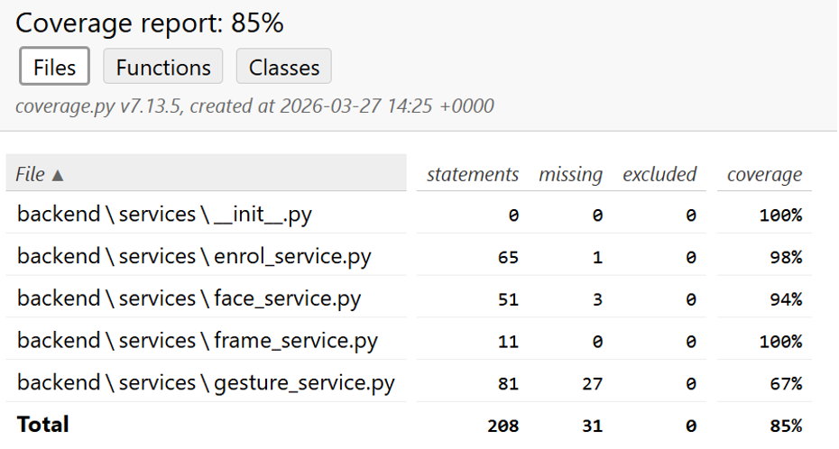
Testing and evidence
Backend service tests
The backend service tests reached 85% overall coverage, with strong coverage on enrolment, face and frame services.
Live feature testing
I tested known visitors, unknown visitors, hand gestures, simulation flow and frontend/backend connection stability.
What testing showed
The prototype works best with clear lighting, visible faces and visible hand positions. Smoothing improved unstable frame-by-frame predictions.
Eoin Fitzpatrick | ATU Galway | AI Smart Doorbell
11

Slide 12
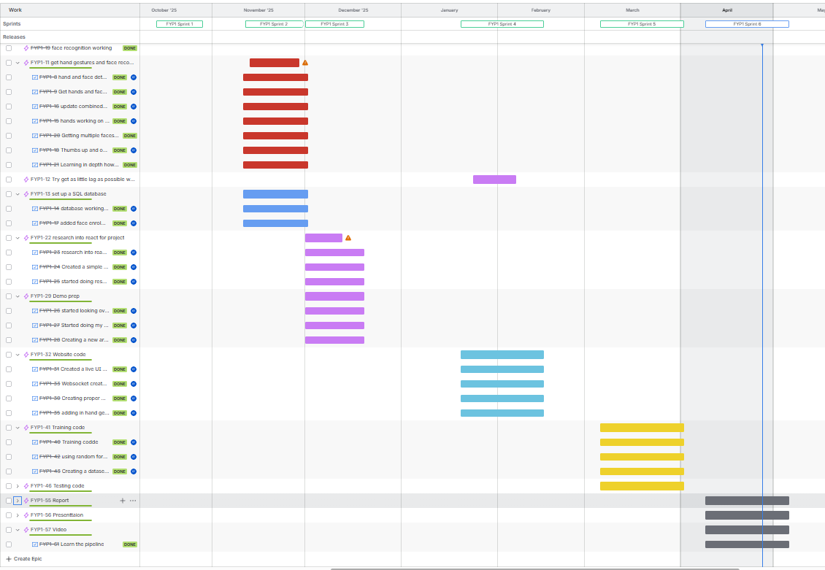
Jira
Used to break the project into smaller tasks and sprints
Tracked progress across face recognition, gesture recognition, frontend, backend and testing
Helped show steady development rather than leaving everything until the end
Eoin Fitzpatrick | ATU Galway | AI Smart Doorbell
12

Slide 13
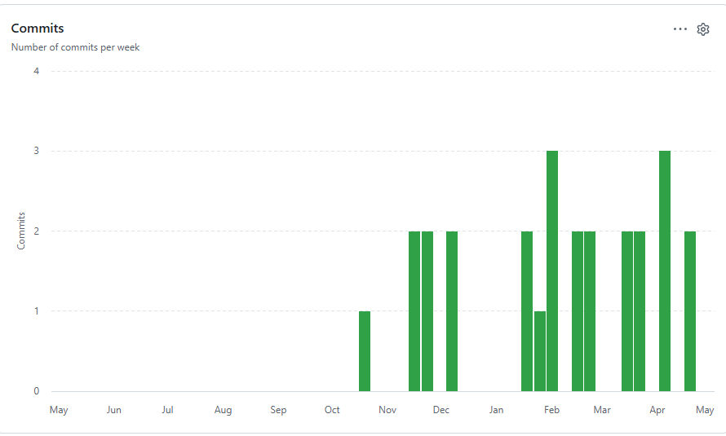
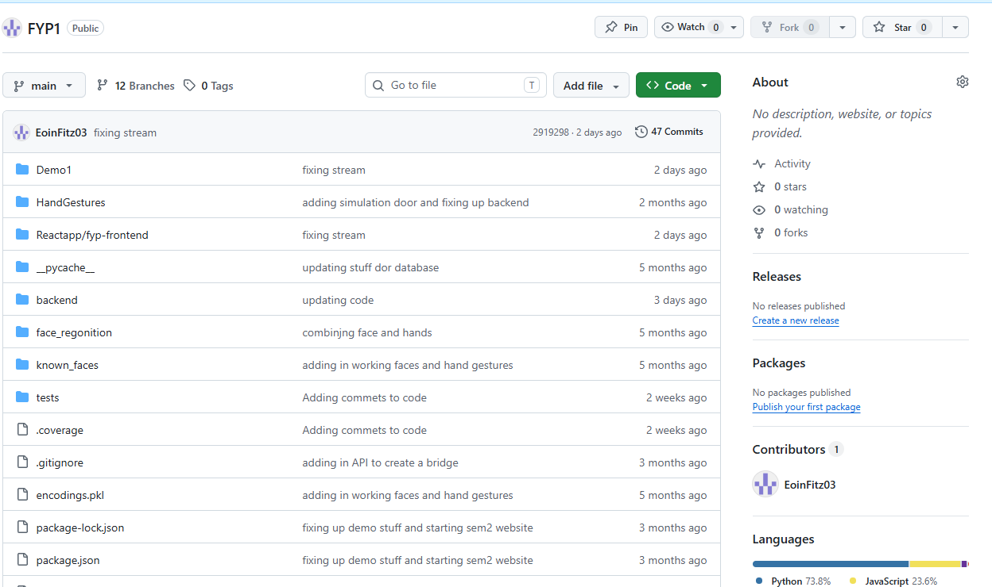
GitHub
Used for source control and tracking implementation progress
Commit history shows the project being built in stages
Helped manage changes across frontend, backend and training code
Eoin Fitzpatrick | ATU Galway | AI Smart Doorbell
13

Slide 14
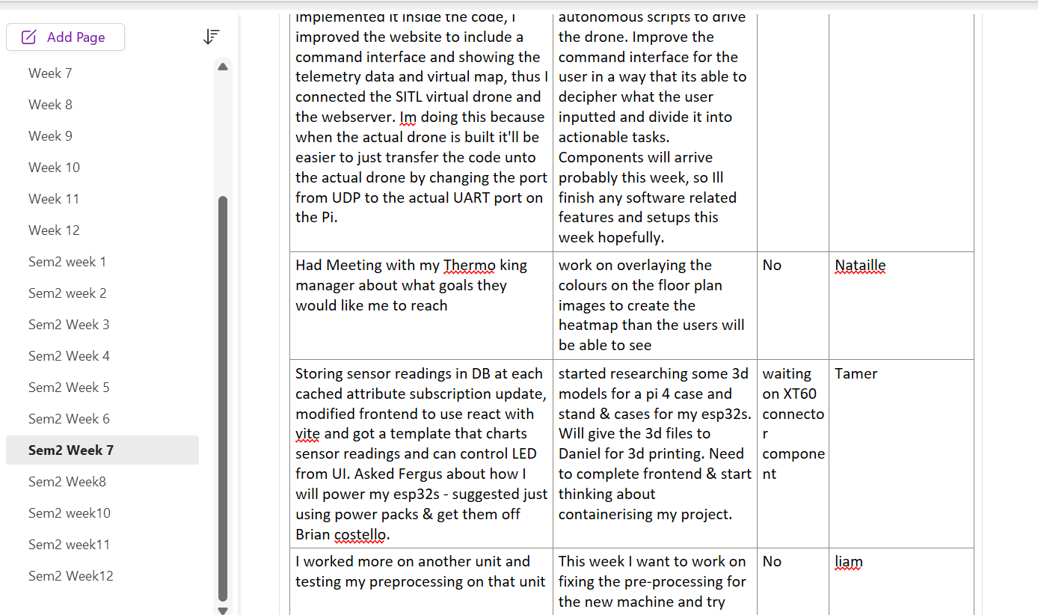
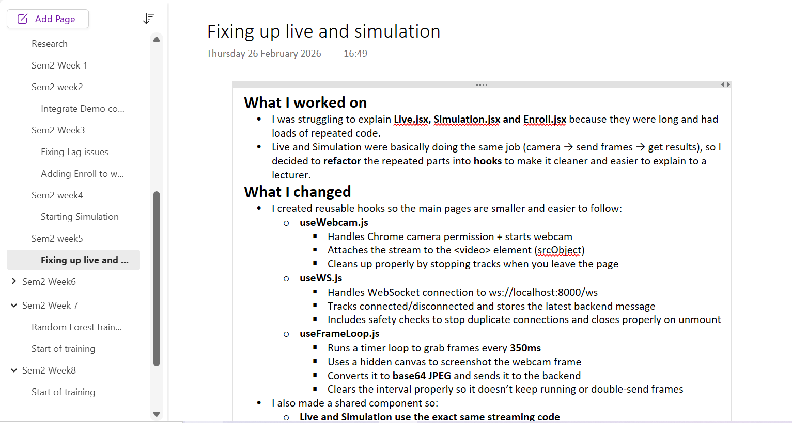
OneNote, TeamWork and Reflection
Used OneNote to record weekly progress, blockers and decisions
Took notes from stand-ups and supervisor meetings
Shared progress updates and explained what I had completed each week
Reflected on technical problems such as lag, flickering and recognition accuracy
Eoin Fitzpatrick | ATU Galway | AI Smart Doorbell
14

Slide 15
Evaluation, limitations and next step
What it did not prove
Future work
What the prototype proved
The full pipeline can work end-to-end: camera input, WebSocket transfer, recognition, smoothing, database support and a usable web interface.
It has not been tested as a deployed product in a real home, with varied cameras, weather, lighting or long-term users.
More user testing, better camera hardware, stronger privacy controls, mobile notifications and more robust model evaluation.
Eoin Fitzpatrick | ATU Galway | AI Smart Doorbell
15

Slide 16
DEMO
Eoin Fitzpatrick | ATU Galway | AI Smart Doorbell
16

