Slide 1
MOMENTUM
MULTI-DISCIPLINE MOTORSPORT MANAGER
Notes:
Hello, I’m Eoin Fitzsimons, a lifelong motorsport and sports‑simulation fan. This is Momentum, it is a multi‑discipline motorsport management simulator that aims to deliver deep management systems across multiple racing formats while also providing a real time racing system.
Who is it for?

Slide 2
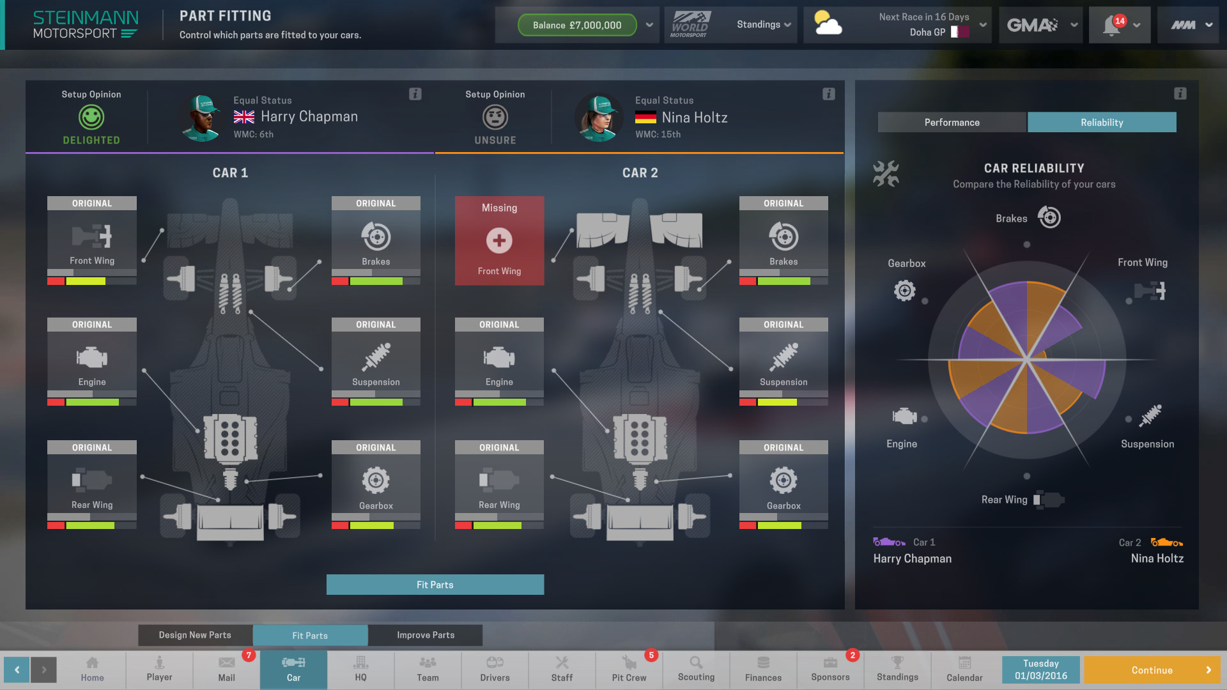
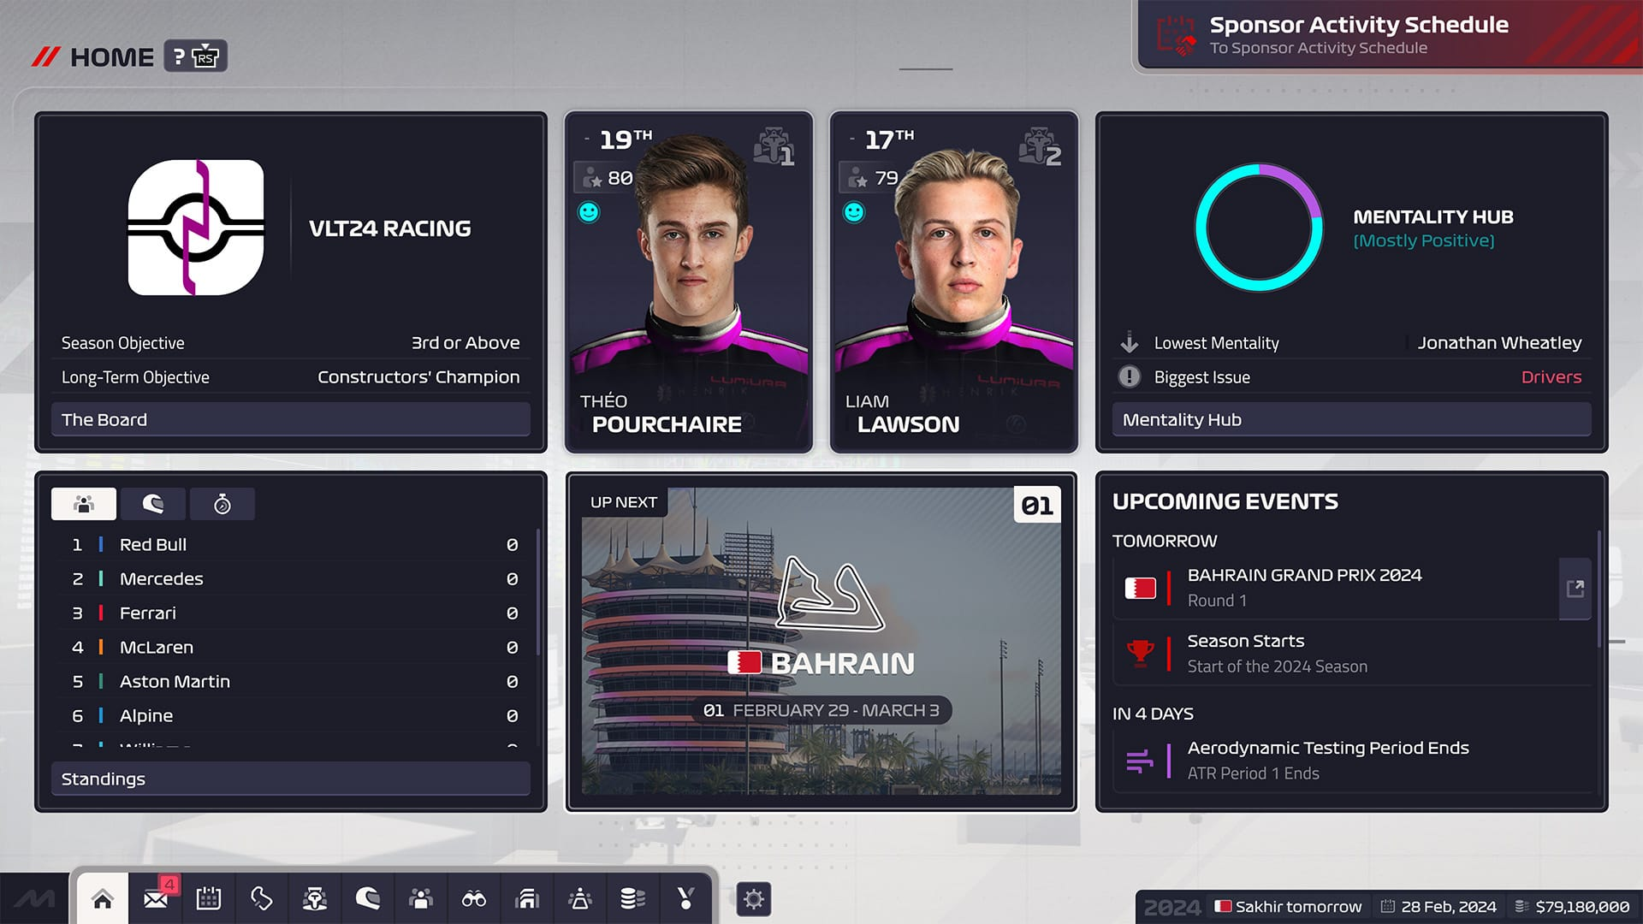
The Past – What Compares?
Motorsport Manager
F1 Manager
Notes:
Motorsport management games are niche and often single‑discipline or shallow in simulation. Inspired by modding work on car‑centric titles and by low‑fi, vehicle‑focused play, the project aims are broader coverage across disciplines, depth in management systems (contracts, staff, budgets, vehicle setup), and practical deliverability in a single repository with lightweight dependencies.
I found that these other games were much too simple when it came to what their driver attributes were, but it was a struggle to produce my own without redundancy, I had over 50 related to driving alone while both MM and F1 had 12. This made the diagrams hard to read.

Slide 3
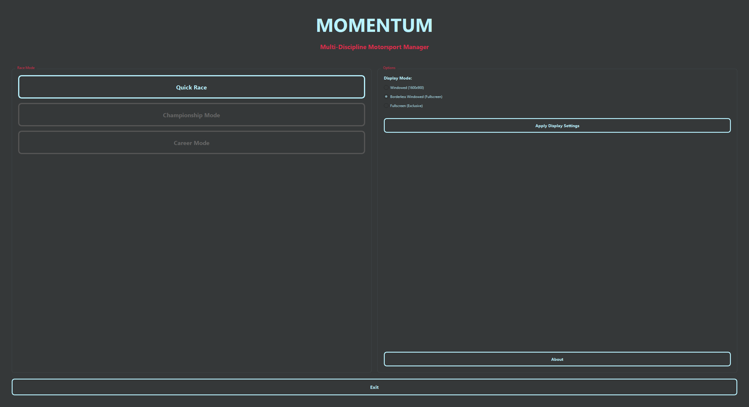
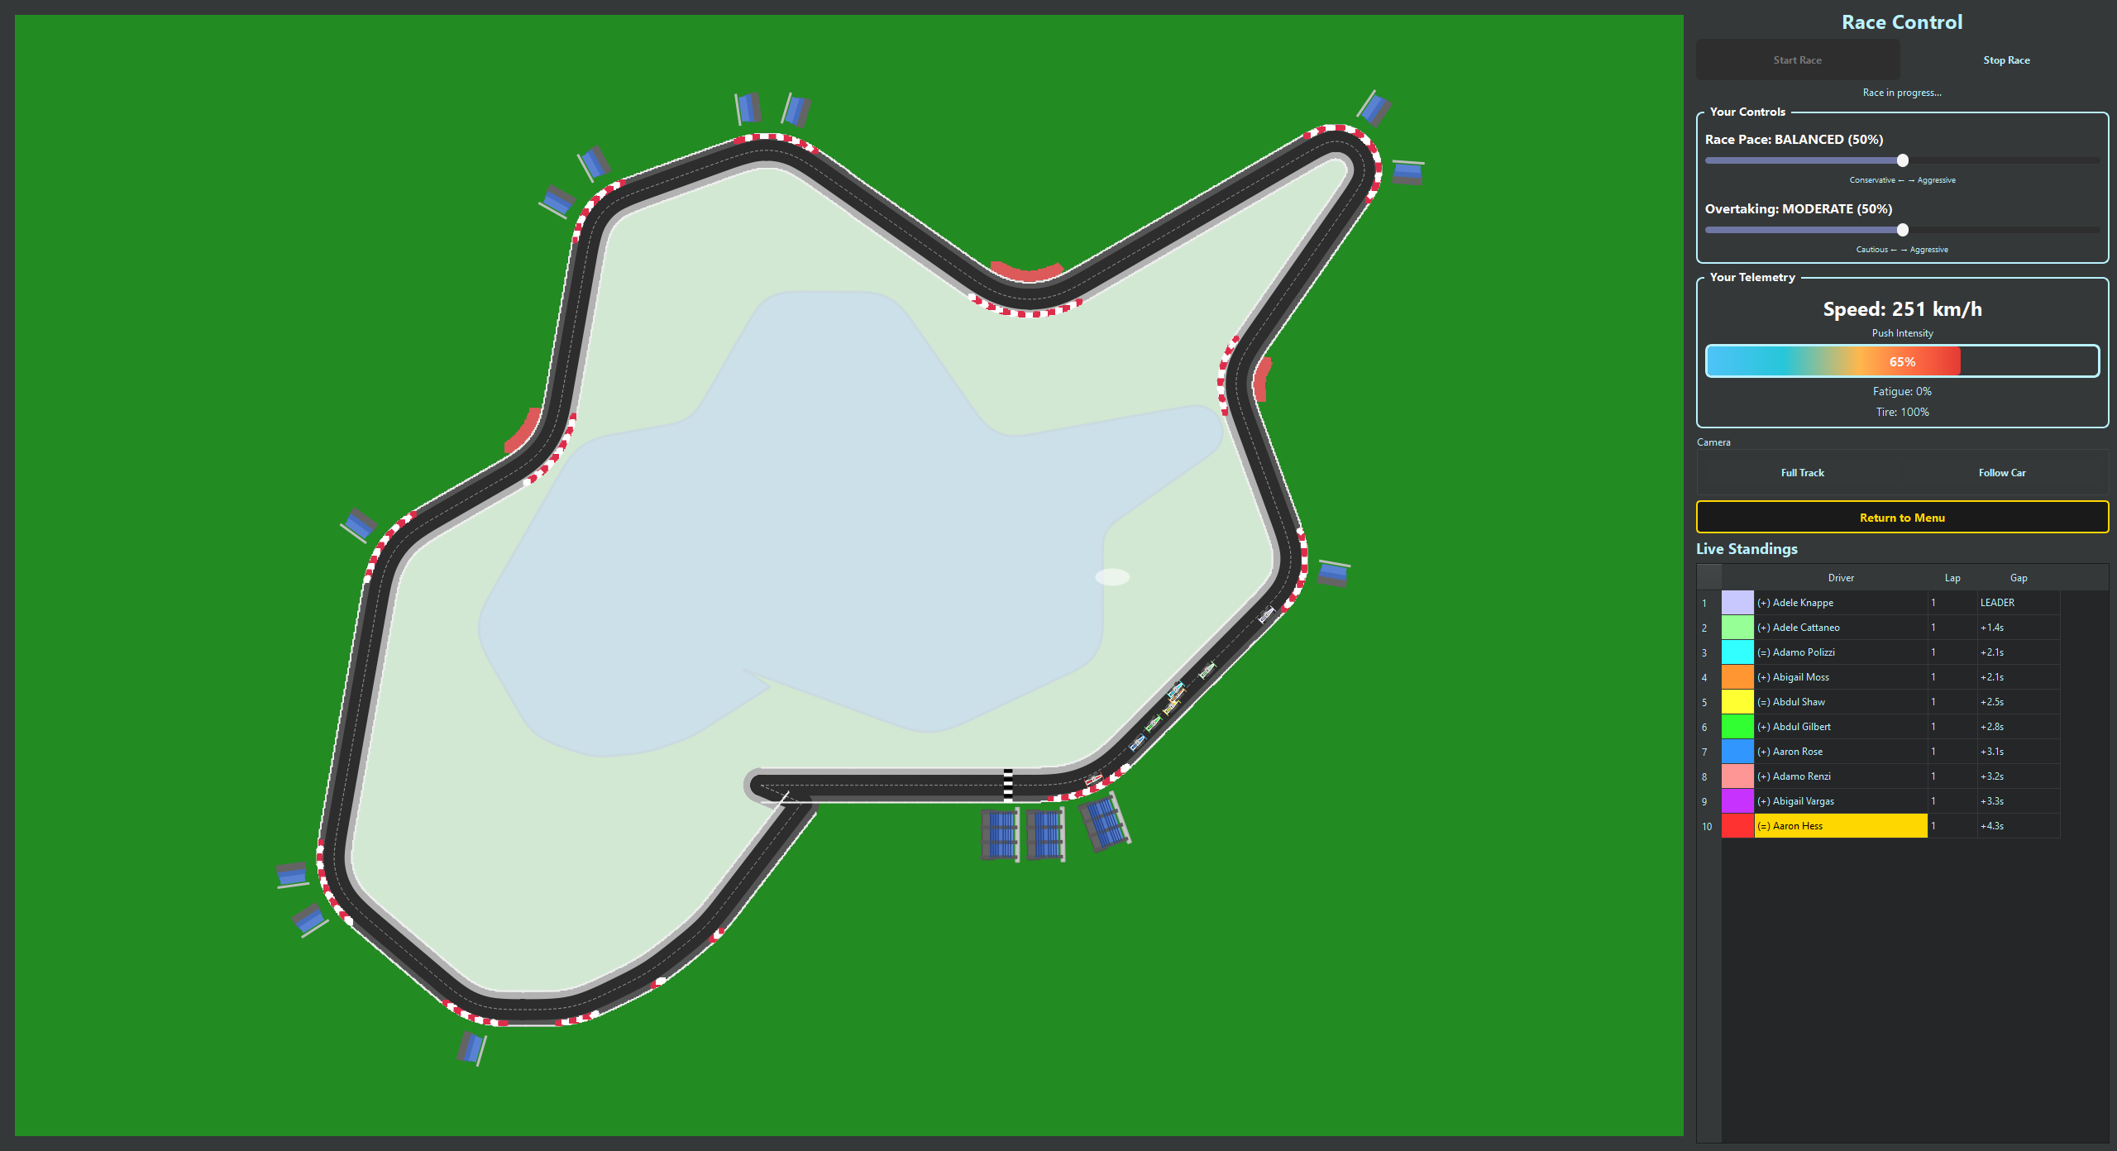
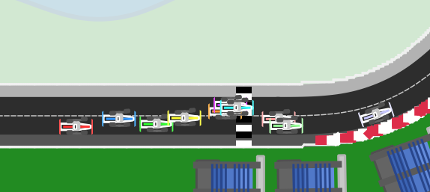
The Present – The MVP
Main Menu
Base Sprite
Track & Telemetry
Cars on Track
Notes:
The MVP concentrates on a demonstrable quick‑race, telemetry capture for tuning, a compact driver model, and output debugging that collect metrics such as DNFs and lap‑time volatility. Monte Carlo simulation was used earlier as an approach as it allowed for many lightning quick simulations that could then feed the best results out, but I felt there was not enough in race control.
The stack is Python 3.13 with FastAPI, SQLite, NumPy/pandas/SciPy and a PyQt6 GUI to balance rapid development and local distribution. Key challenges identified were data integrity, demo fragility, and performance trade‑offs, I documented conceptual diagrams and alternative solutions and used them to prioritise automated import/verification, seeded tests, and targeted optimisation.
The GUI is PyQt6 and drives the demo flow (launcher -> MainMenu -> RaceWindow).
The simulation API chooses a discipline adapter when available or falls back to RealtimeRaceEngine which simulates agents making attack/defend/manage decisions each tick.
Driver attributes are canonical and hydrated from the DB; derived attributes are computed in services/driver_attributes.py.
Python 3.13 - stable, typed, easy to work with.
FastAPI - simple HTTP endpoints for running simulations and tests.
SQLite - single-file database for saving runs and evidence.
NumPy - small numeric helpers and RNG used in the race code
PyQt6 - desktop GUI toolkit used for the Quick Race visualiser.

Slide 4
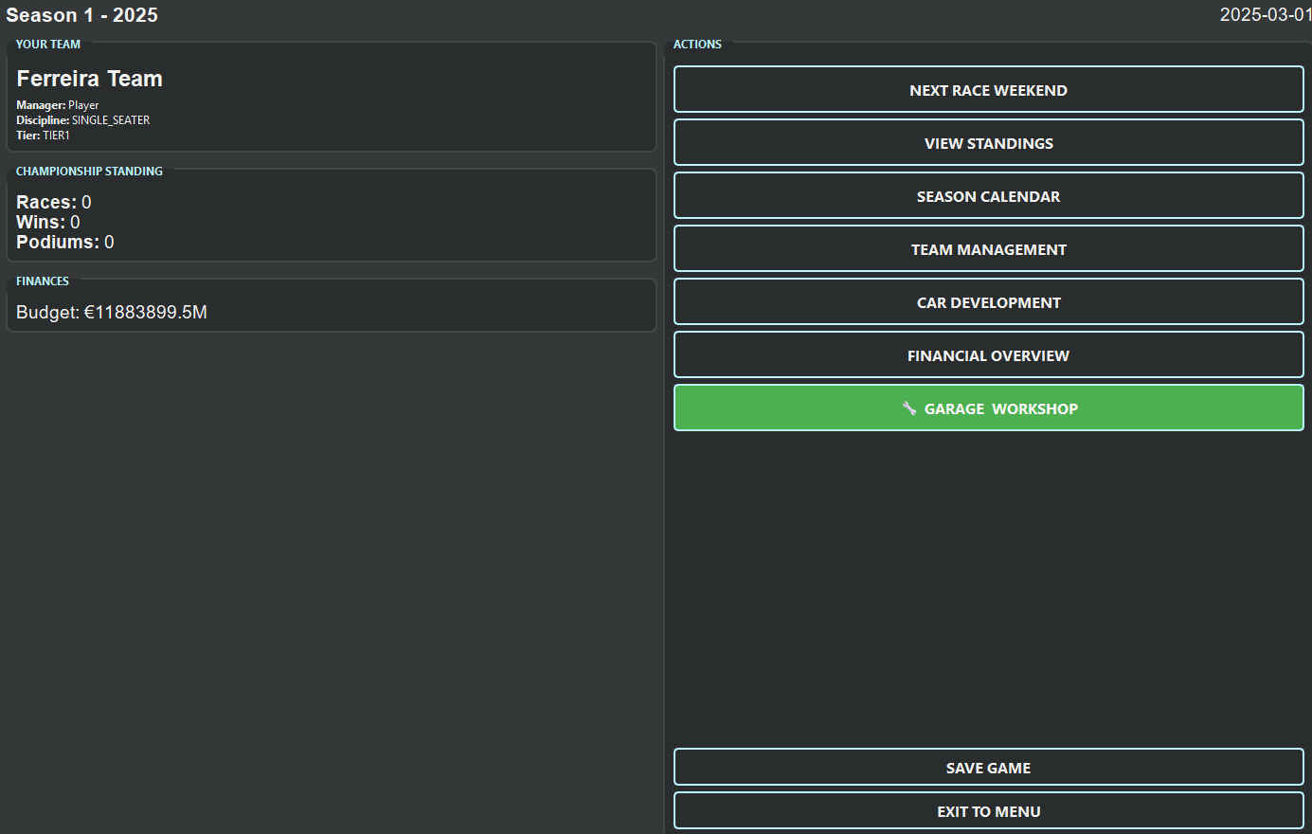
The Future – What Will Come?
Career Mode
Team management
Development
Multi-Discipline
Notes:
I will focus on building a larger game world, a persistent one that progresses and develops whether you oversee it or not. This will allow a player to move in the same game world and see how teams you were previously involved in either kick on or ruin your legacy. Drivers will be available for multiple disciplines, think the real-world triple crown or Kiki Räikkönen and Robert Kubica going into rally.
I envisage this being a large task, but I have laid a lot of groundwork with my game engines that I then will iterate on top of, each system will not have to be made from scratch.

Slide 5
Questions?
Notes:
Q: Why Python and PyQt6 for the demo?
A: Python lets me prototype quickly and reuse scientific libraries (NumPy/pandas). PyQt6 gives a straightforward, offline desktop UI that is stable for a timed, local demo.
Q: How do you ensure results are reproducible?
A: Demo runs can be seeded; RNG seeds and any demo parameters are preserved with results. The seeded persistence helper inserts a minimal track and drivers to ensure a consistent starting state.
Q: Why an agent-based realtime engine instead of only Monte Carlo?
A: Monte Carlo was useful early for exploring balance and failure modes. The agent-based engine produces emergent, watchable behaviour that’s better for an interactive demo and for modelling driver interactions like overtakes.
Q: What data do you use for drivers and tracks?
A: All data is synthetic or project-generated. Driver attributes are stored in the canonical schema; the GUI loads hydrated `Driver` objects via the `DatabaseManager`. The current demo uses a single seeded track; a larger track DB is present for future work.
Q: How are driver attributes modelled to avoid redundancy?
A: The code uses a canonical persisted attribute set and computes derived signals (bravery, aggression, vehicle control) in `services/driver_attributes.py`. This keeps stored data compact while allowing nuanced behaviour.
Q: Does the GUI persist results automatically?
A: Persistence is available via `PersistenceSQLite.save_race_results`. Scripts and service code call this when configured; the GUI flow can be wired to persistence but demo mode focuses on live visual output and returning to menu.
Q: How did you validate the simulation?
A: Small unit/validation tests live under `Momentum/Python/mvp_tests/` and targeted playtests capture DNFs, lap-time variance and incidents. Early Monte Carlo runs also helped stress-test edge cases.
Q: What are the main limitations today?
A: The prototype is single-process and optimised for demo scale. Season progression, persistent world state, and full UI polish remain future work.
Q: How would you scale performance for larger simulations?
A: Options: vectorise more logic with NumPy, move tight loops to Cython/compiled extensions, or run Monte Carlo/batch simulations across multiple worker processes or a cluster for offline analysis.
Q: Why SQLite for persistence?
A: Lightweight, zero-config, portable for examiner demos. It supports the project’s reproducible, file-backed workflows without requiring a DB server.
Q: Data ethics and privacy?
A: All driver data is synthetic (Faker/seeding). No personal data is used in the demo, and seeds or sample generation logs can be provided if required.

