Slide 1
Resampling Methods

Slide 3
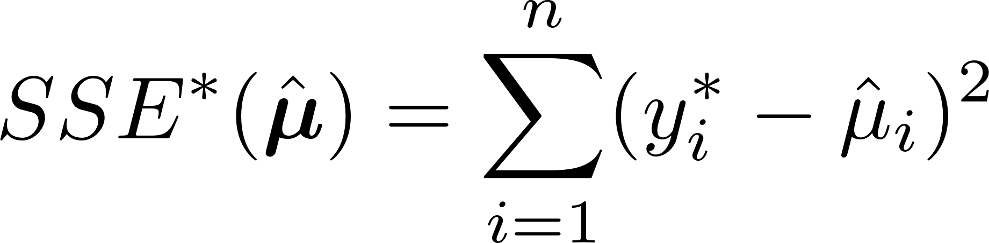
Prediction Error and AIC

Slide 4
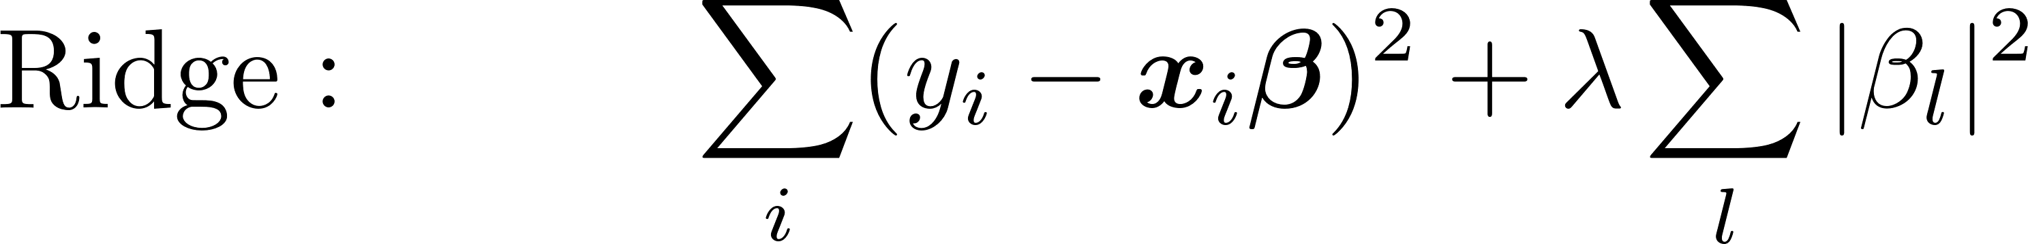

해의 최적화를 쉽게 한다
실질적인 모수의 개수를 줄여준다
모형을 단순화 한다
4. 모형의 예측성을 높여준다(?)

Slide 5
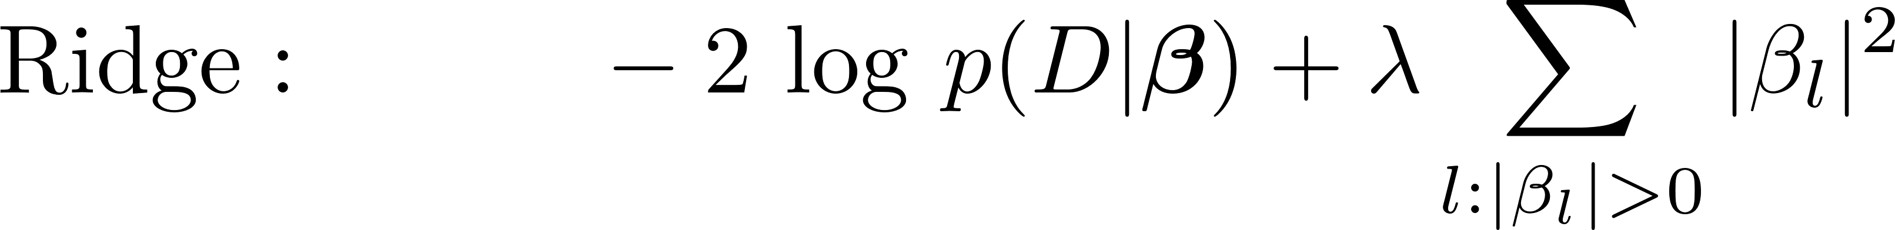
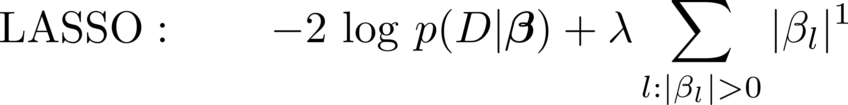
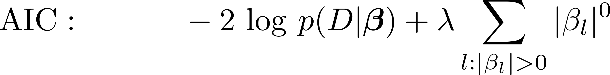
How to find the best lambda ?

Slide 6
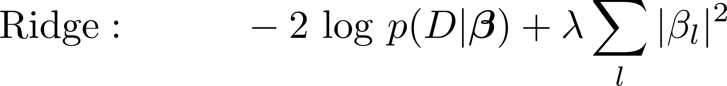
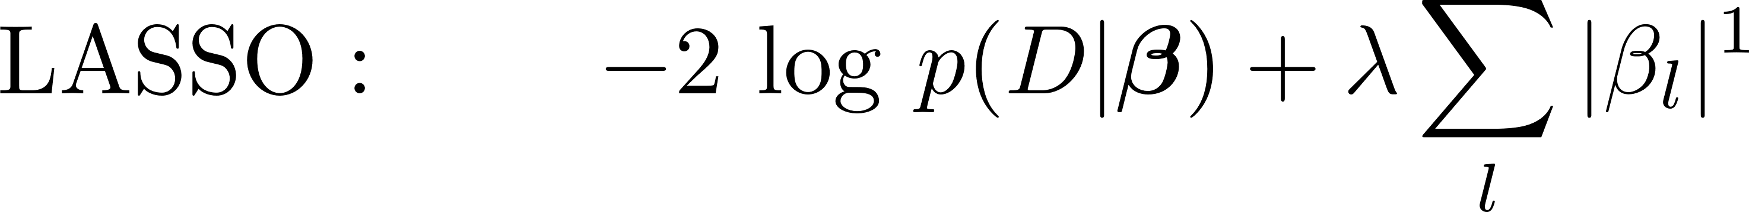
AIC/BIC for Ridge & LASSO

Slide 7
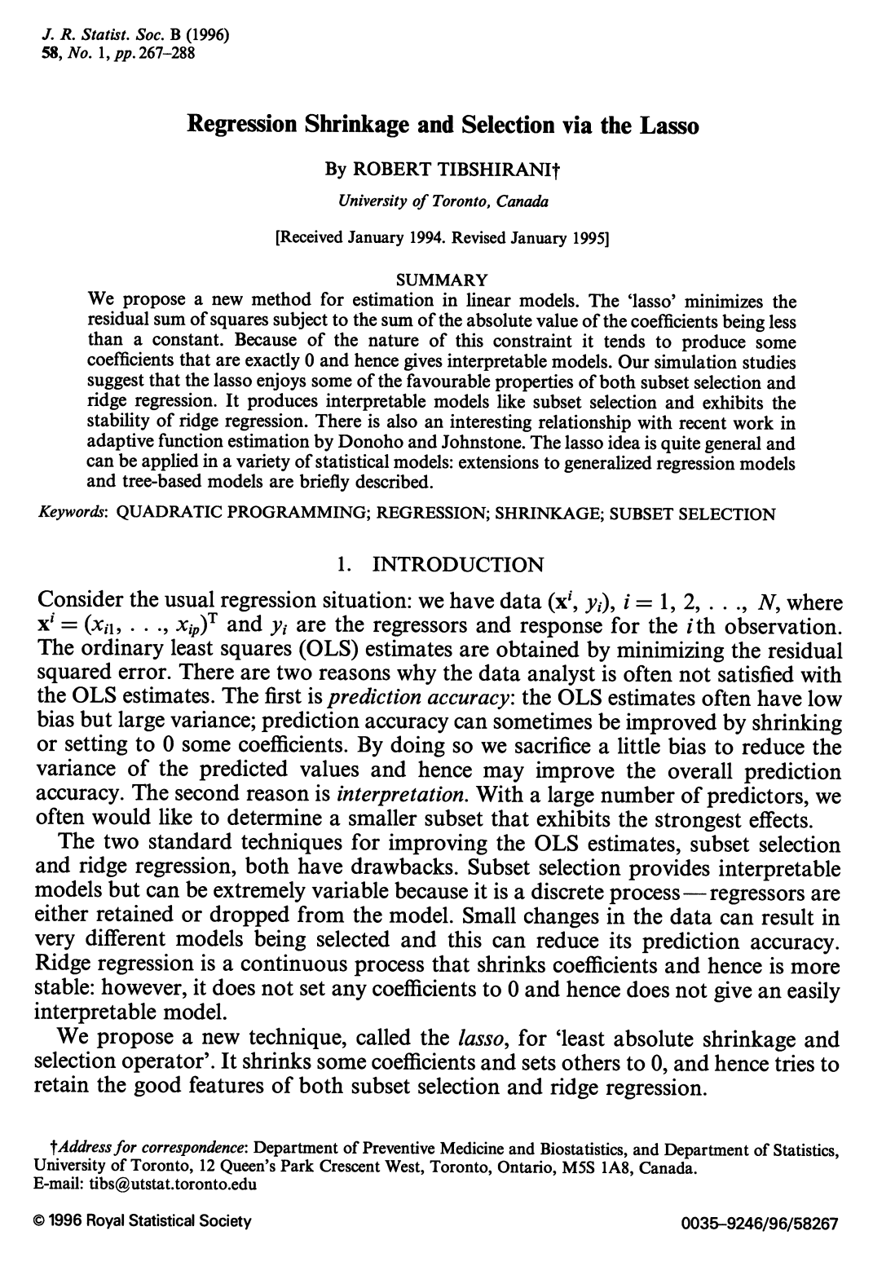
1996, JRSS-B

Slide 8
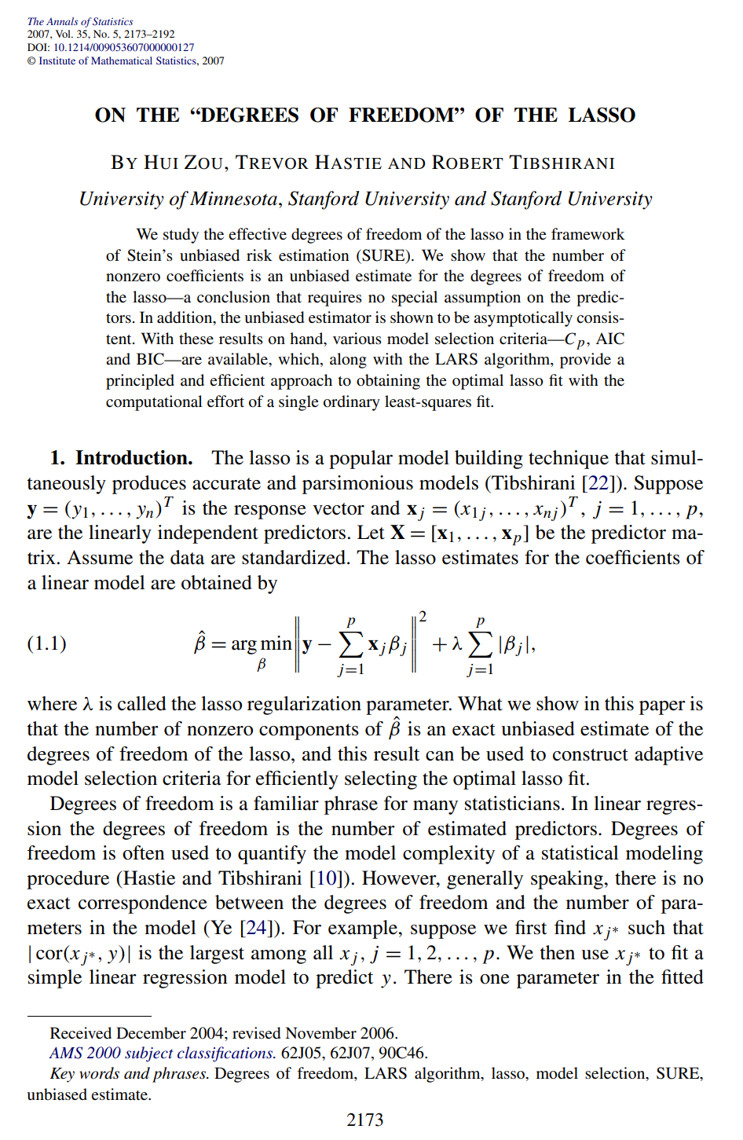
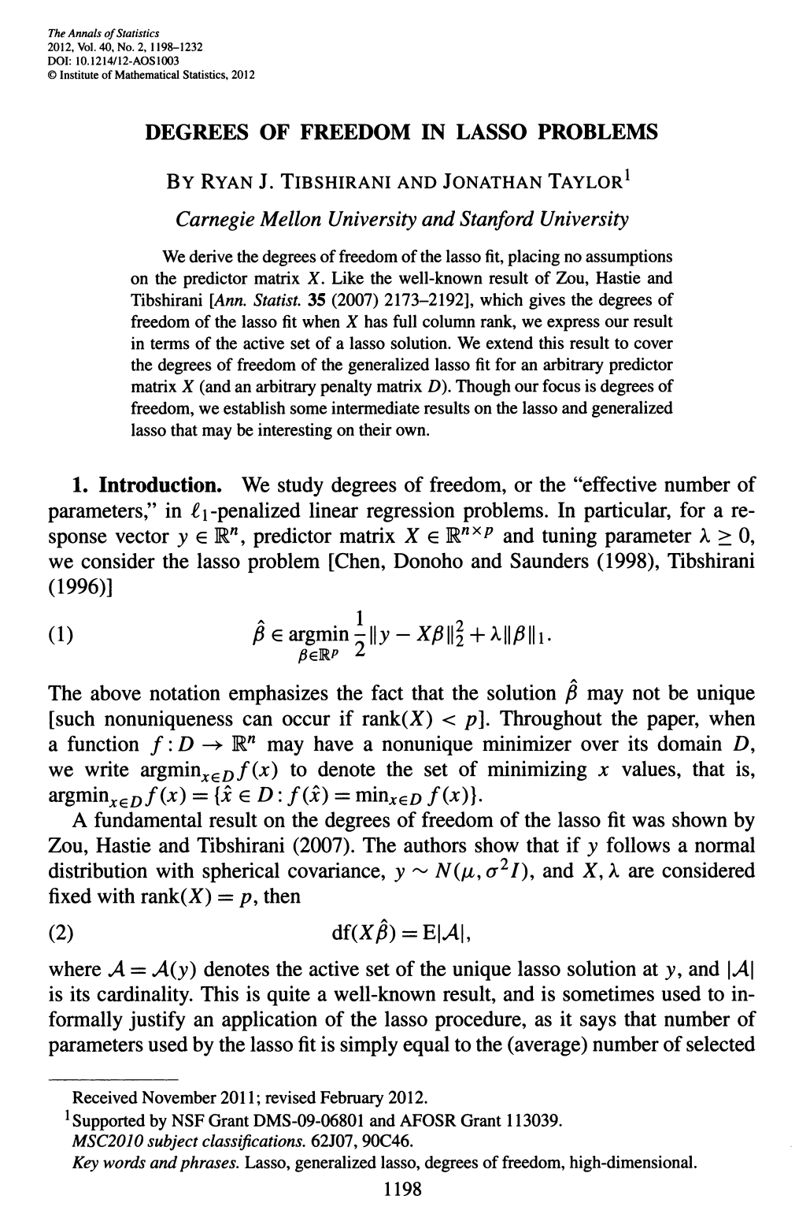
2007, AS
2012, AS

Slide 9
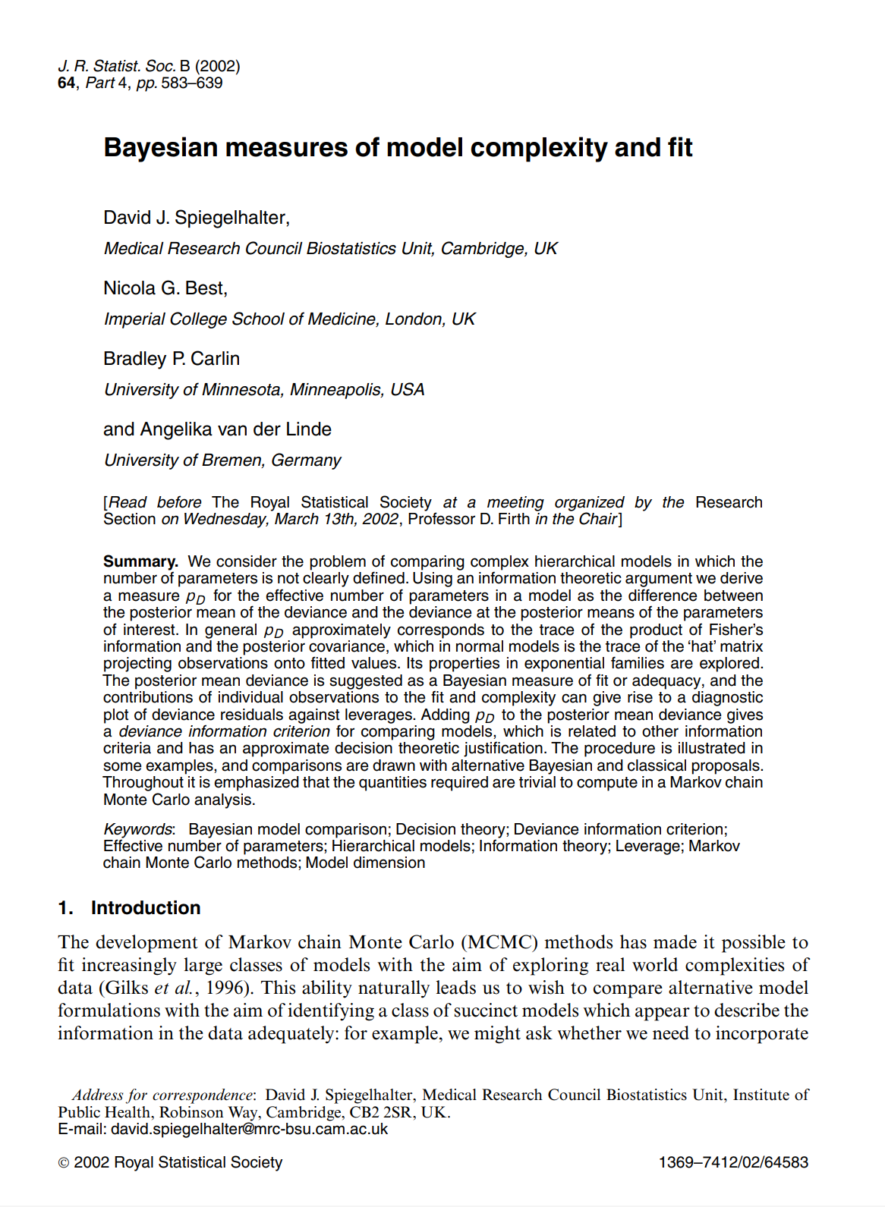
2002, JRSS-B

Slide 10

deviance, 이탈도

Slide 11
Resampling Methods
Jackknife, PRESS
Cross Validation
Bootstrap
Bagging

Slide 12
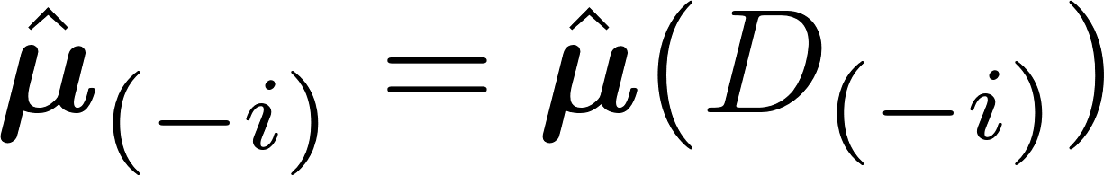
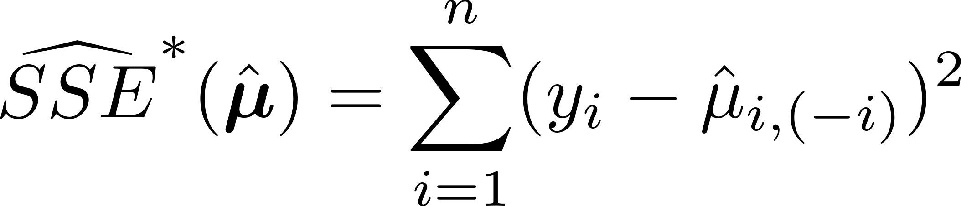
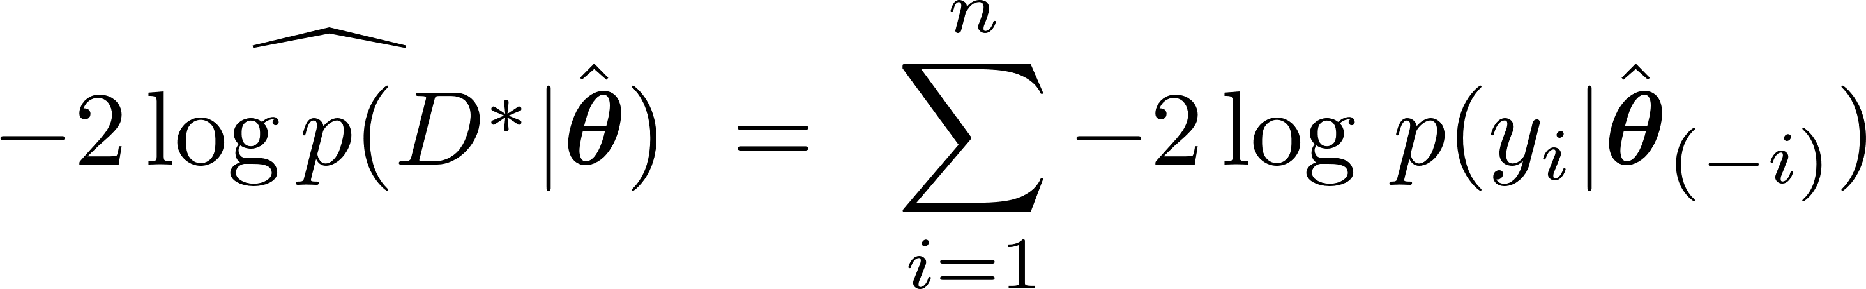
Jackknife Estimator

Slide 13
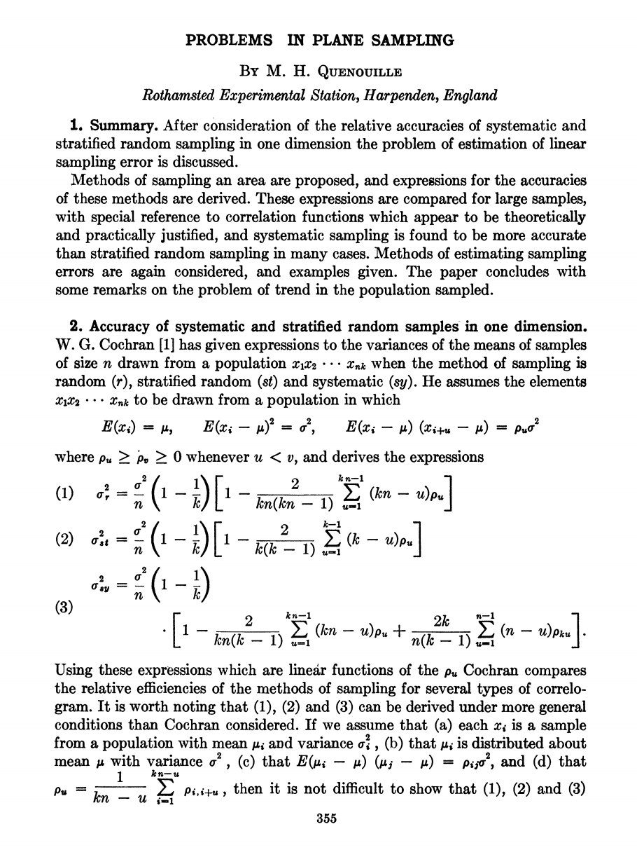
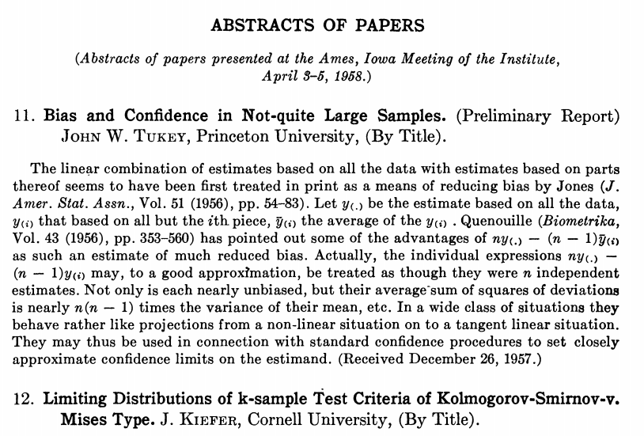
1949, AMS
1958, AMS

Slide 14
m-folding cross validation
Training data & Validation data :
fitting data
validation data
fitting data
validation data
fitting data
validation data
fitting data
validation data
fitting data
validation data
fitting data

Slide 15
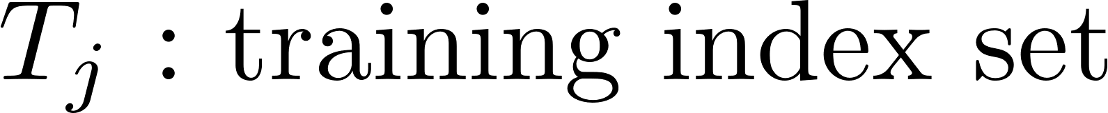
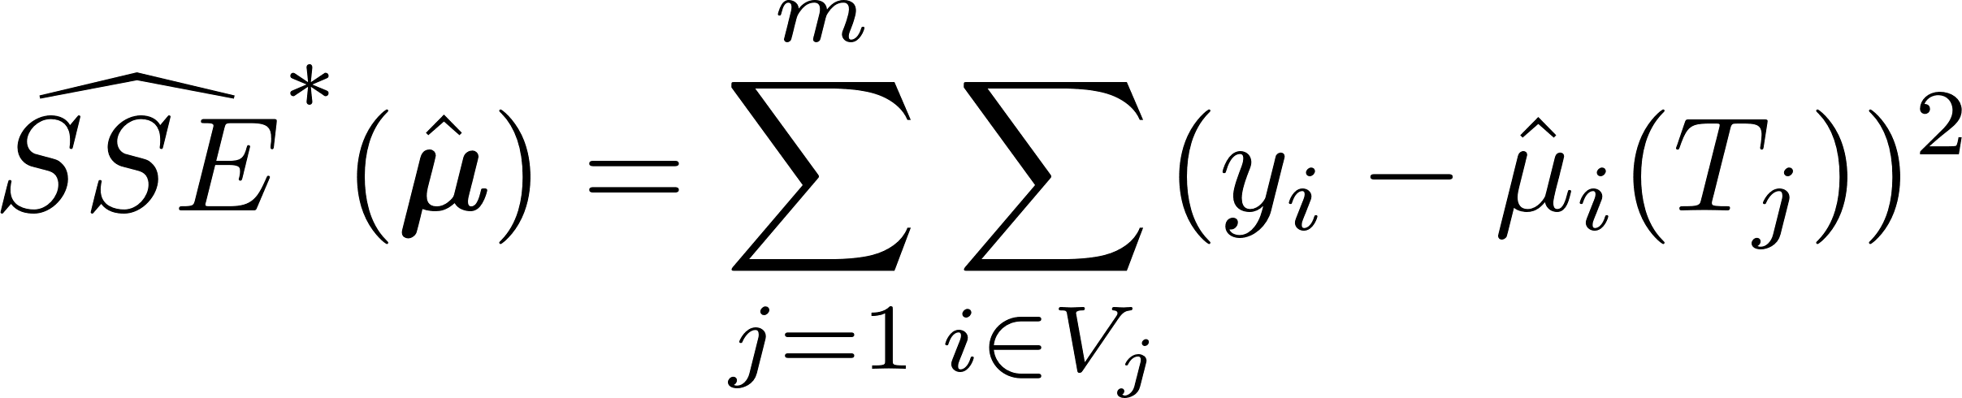
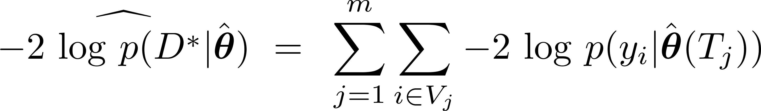
m-folfing CV Estimator

Slide 16

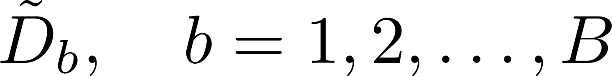

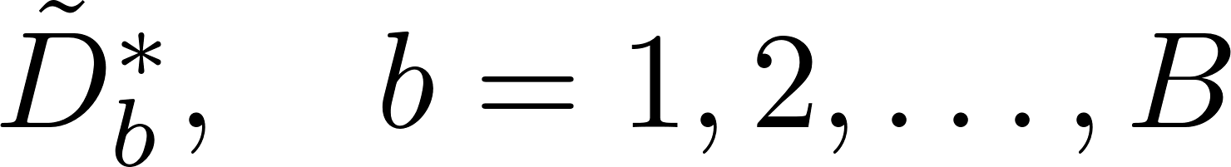

Bootstrap

Slide 17
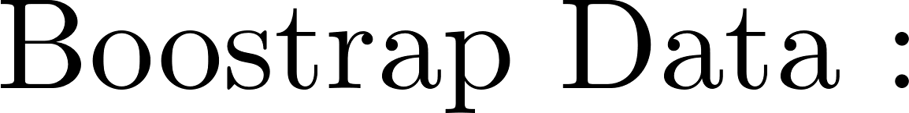
Bootstrap Sample

Slide 18
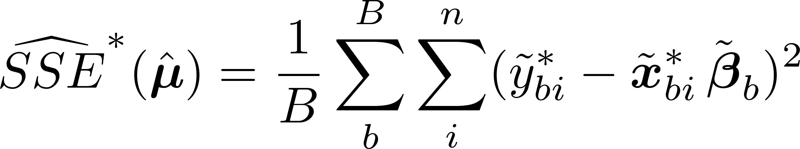
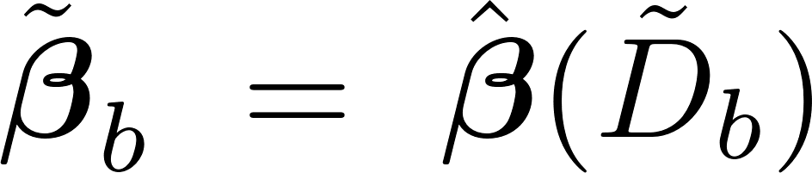
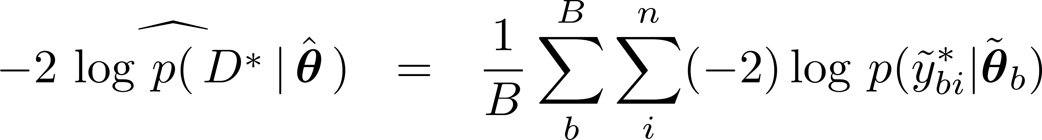
Bootstrap Estimator
Cross Entropy for Classification

Slide 19
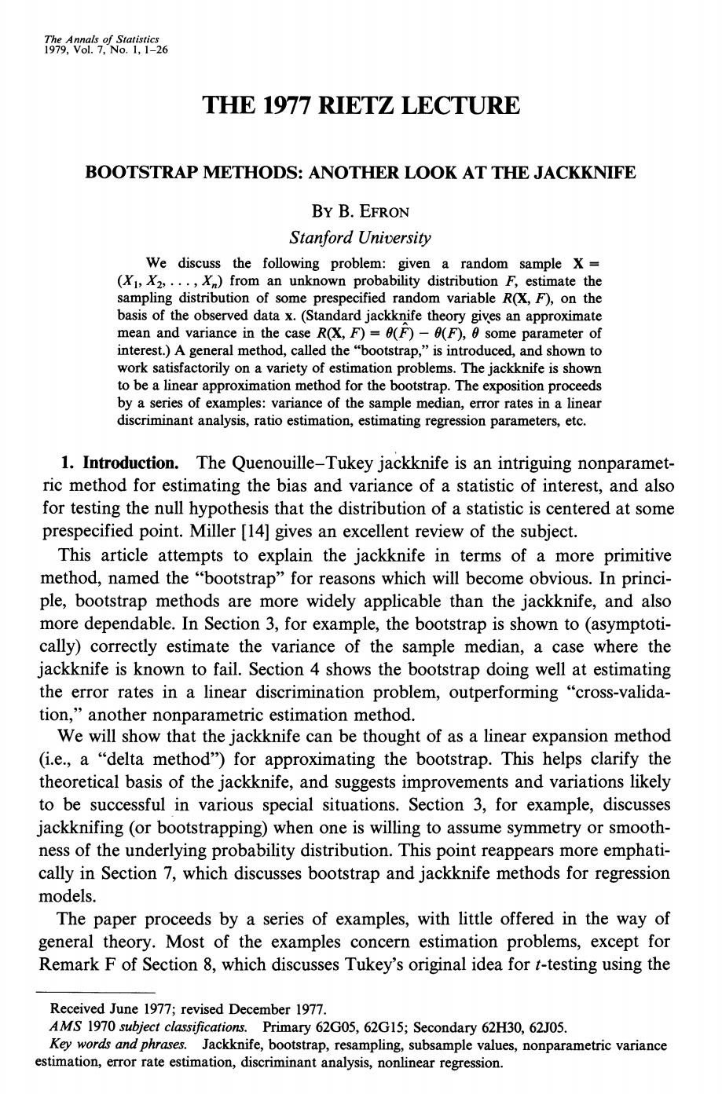
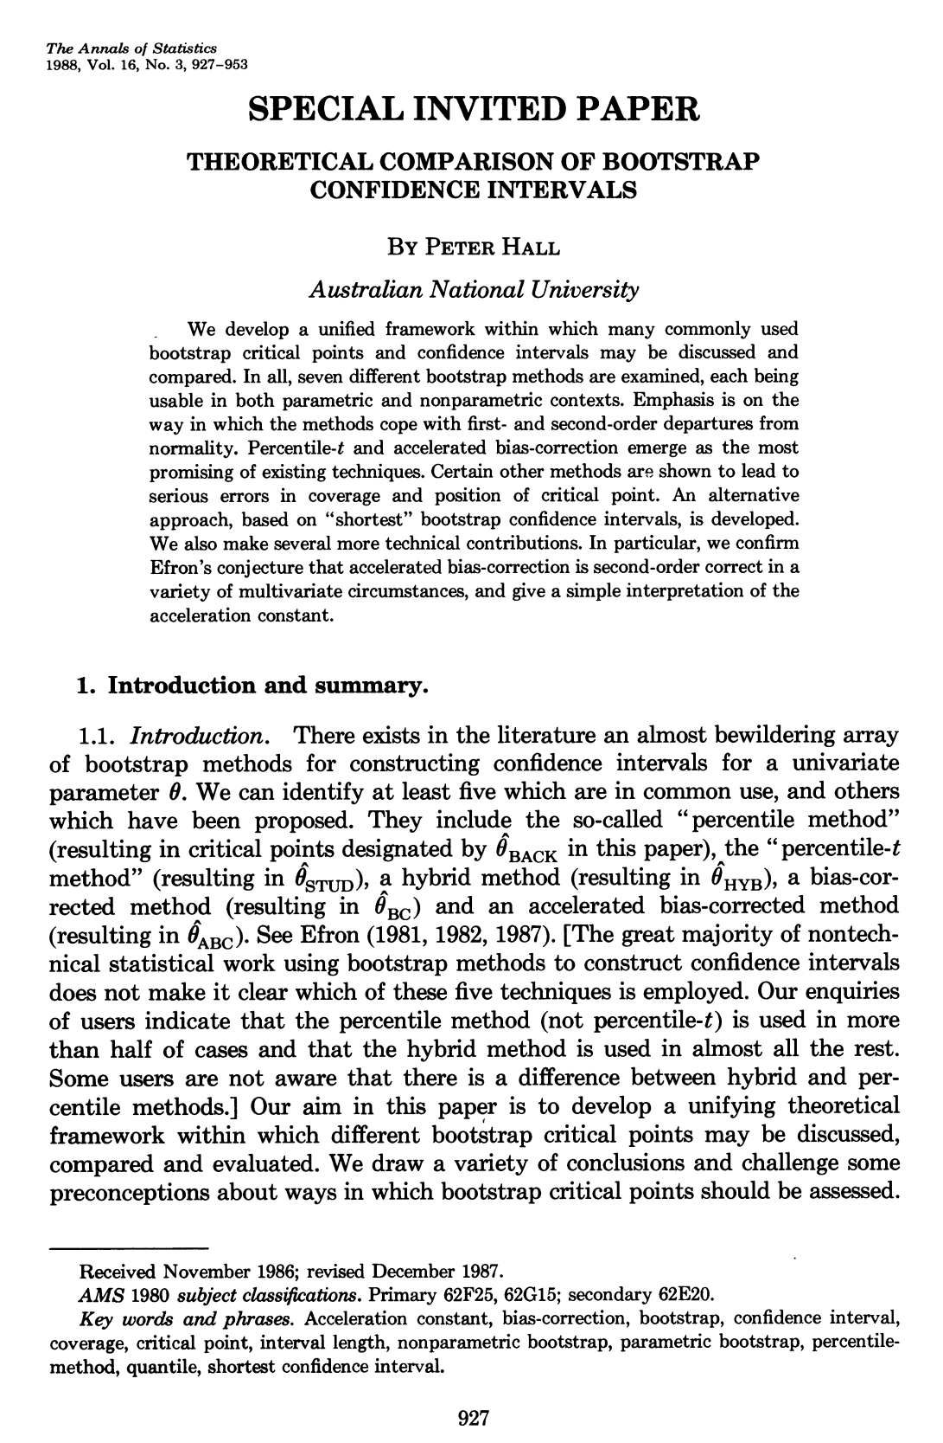
1979, AS
1988, AS

Slide 20
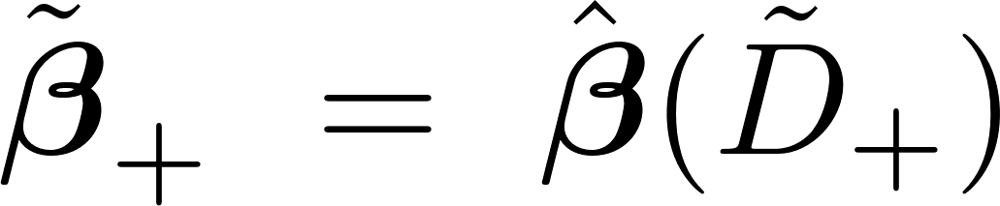
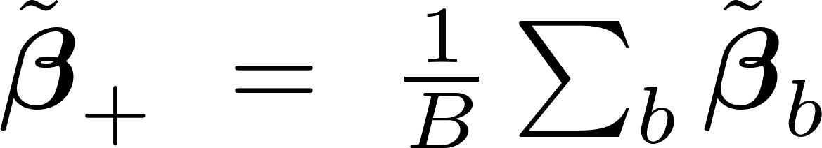
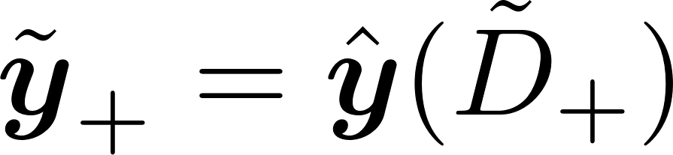
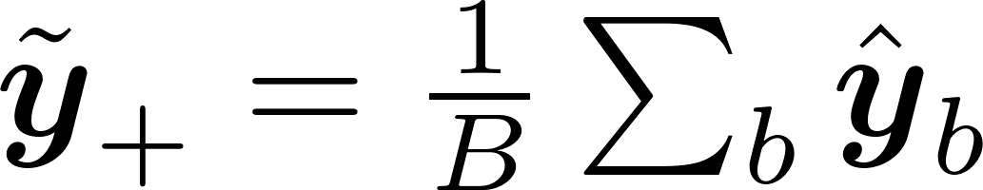
aggregating bootstrap predictor

Slide 21
Bagging ??
Is it different ?
What is better ?

Slide 22
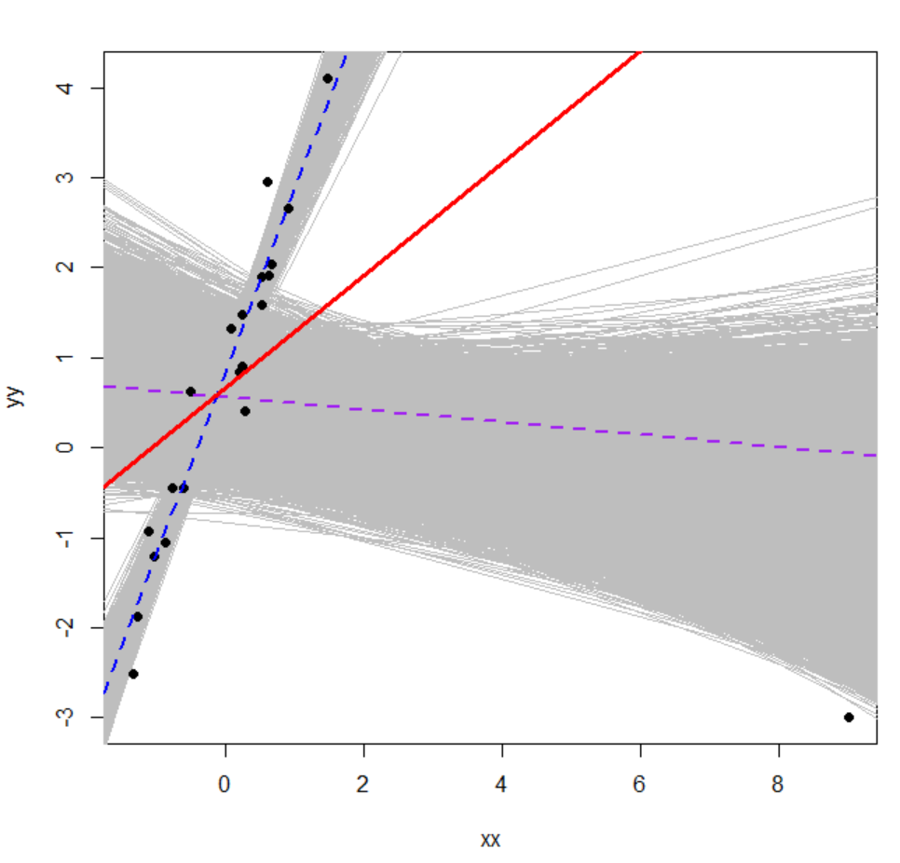
without influential data
bagging regression line
with influential data

Slide 23
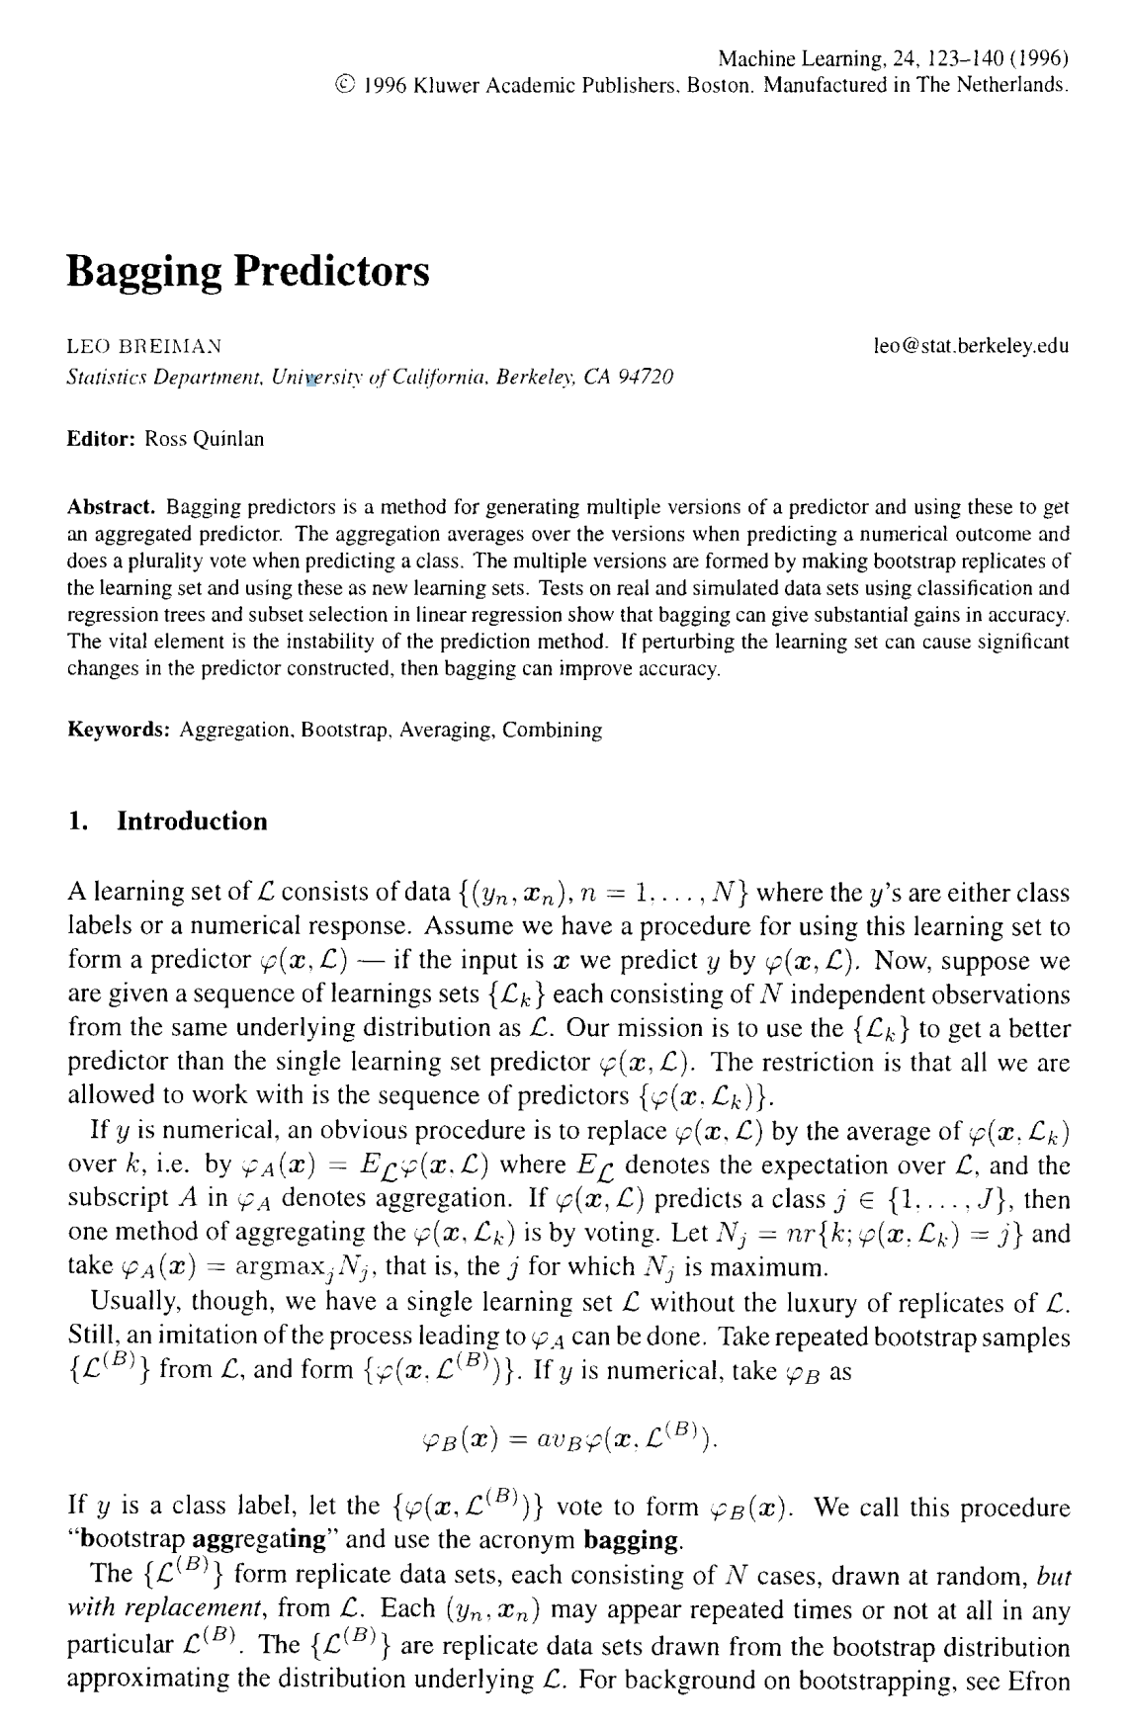
1996, ML

Slide 24

1984

Slide 25
Bagging ( L. Breiman, 1996 )
예측성을 높인다.
과적합에 대한 저항성을 부여한다
Reducing instability of predictor
벌칙항을 부과한 것과 같은 효과를 준다

Slide 26
- Bagging : Boostrap Aggregating
- Boosting : Integrating Multiple Predictors

Slide 27
Why multiple predictors :
many predictor variables
boostrap predictors

Slide 28
Boosting
(Ada)Boosting (Freund & Schapire, 1995)
Additive Logistic Regression ( HTF, 2000 )
GBM (J. Friedman, 2001)

Slide 29
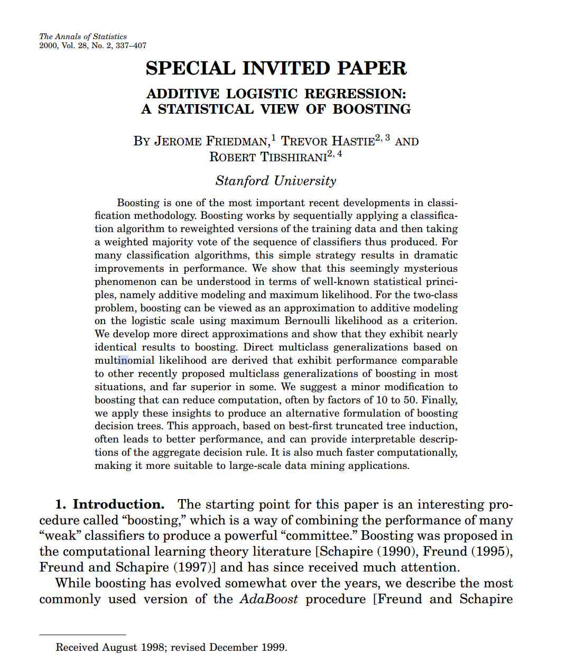

Slide 30
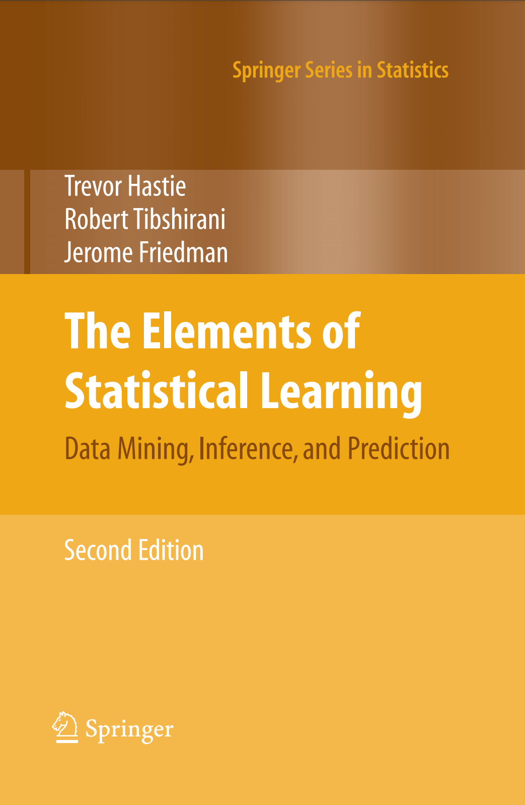
2001

Slide 31
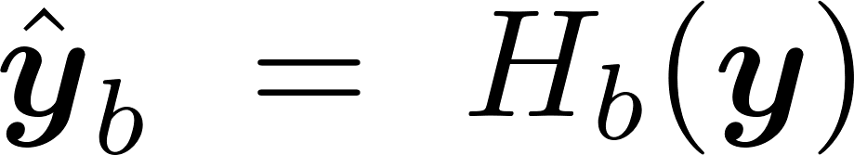
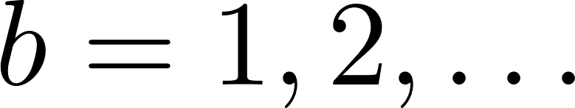
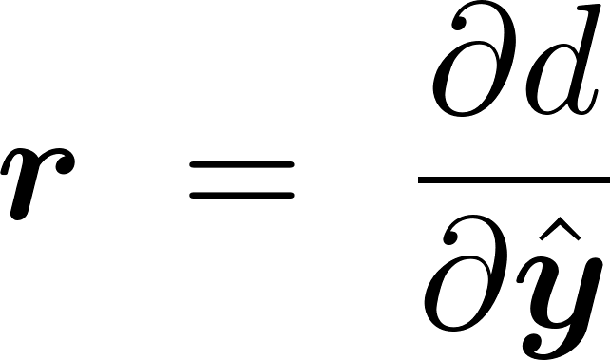
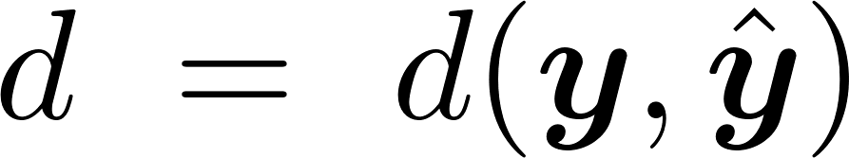
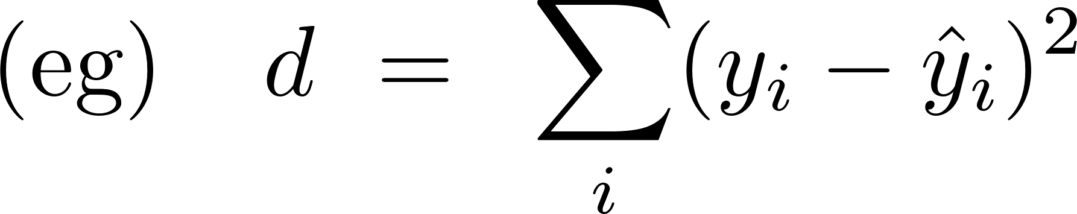

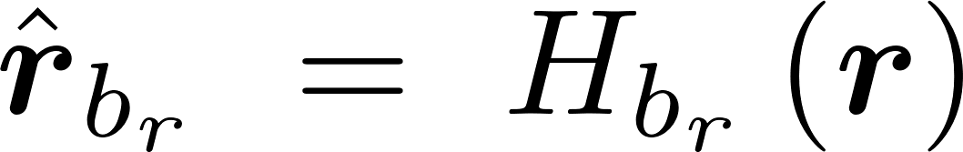
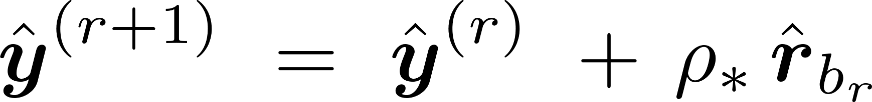
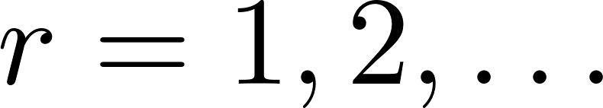
GBM, Gradient Boosting Machines
adaptable predictors
gradient, pseudo-residual
- set predictor to gradient, with each base predictor.
- use OLS to set adaptable predictors
iteratively add, optimally scale adjusted predicted gradient.

Slide 32
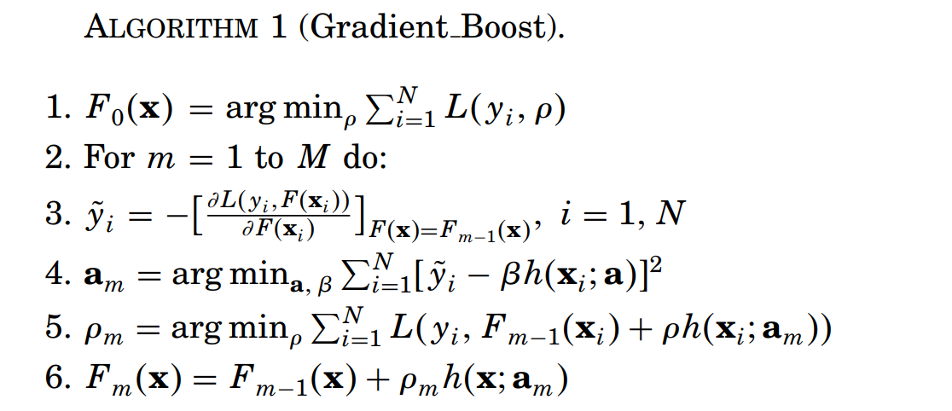

Slide 33
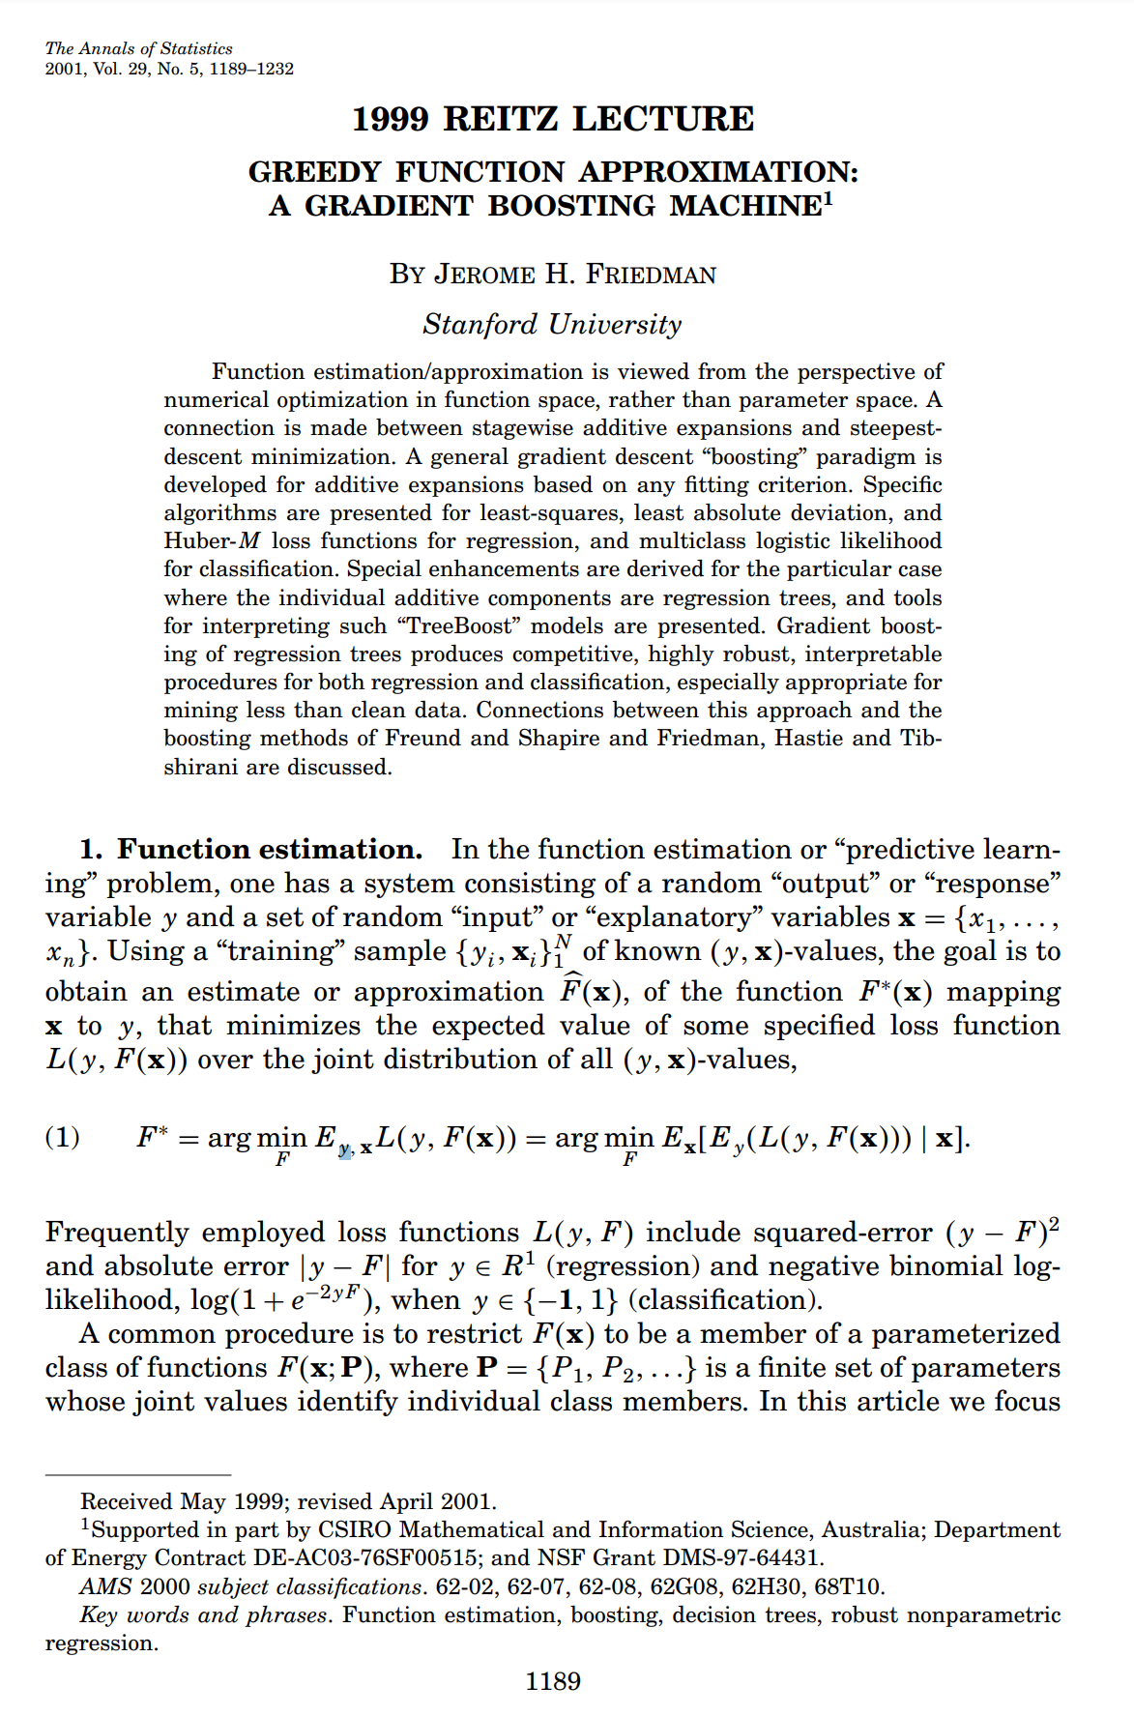
2001, AS

Slide 34
>>> quit() # Thank you !

