Slide 1
Speech Intelligibility Index
ANSI S3.5

Slide 2
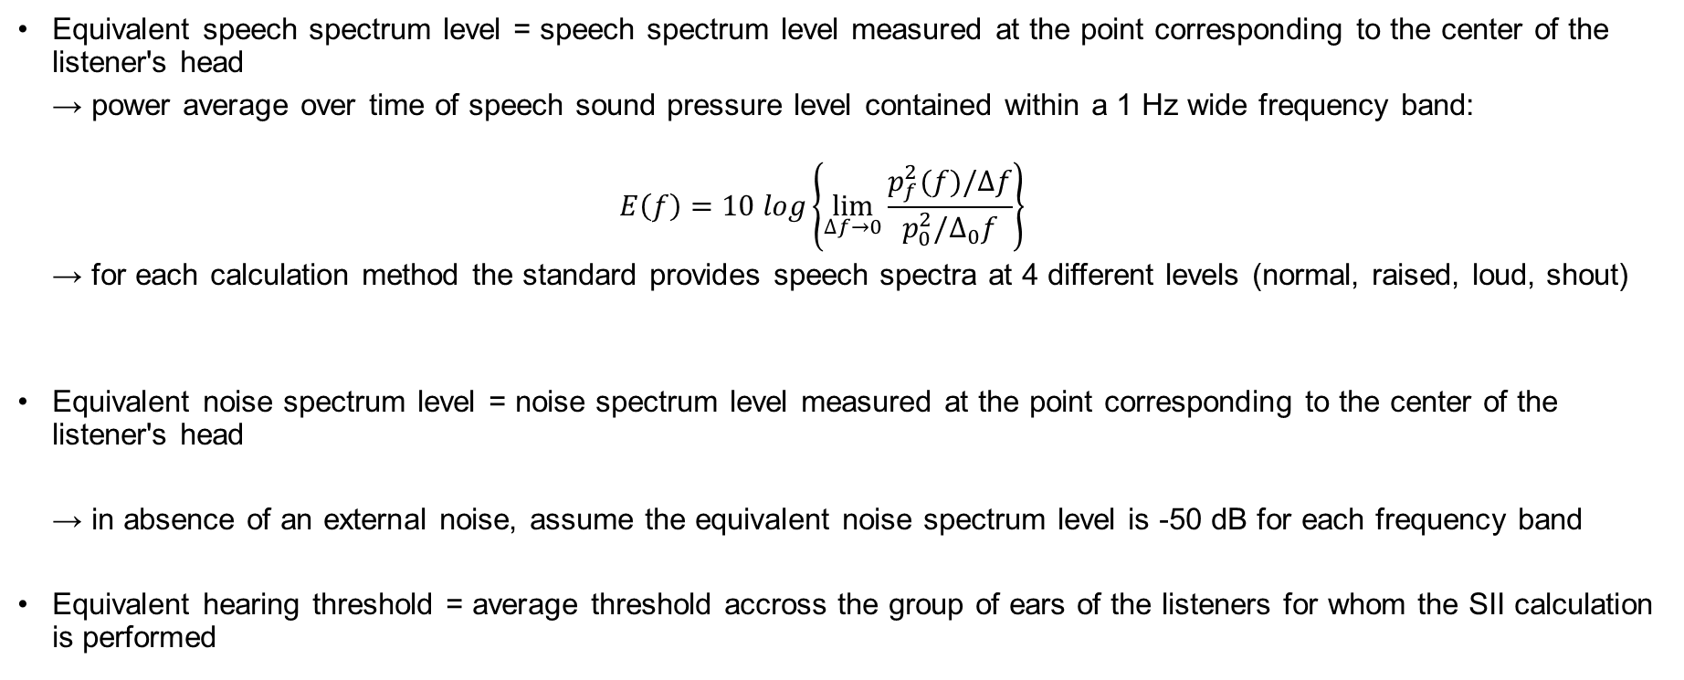
SII calculation
Input variables
Equivalent speech spectrum level = speech spectrum level measured at the point corresponding to the center of the listener's head
→ power average over time of speech sound pressure level contained within a 1 Hz wide frequency band:
$$E\left(f\right)=10 log\left\{\lim_{∆f→0}{\frac{p_{f}^{2}(f)/∆f}{p_{0}^{2}/∆_{0}f}}\right\}$$
→ for each calculation method the standard provides speech spectra at 4 different levels (normal, raised, loud, shout)
Equivalent noise spectrum level = noise spectrum level measured at the point corresponding to the center of the listener's head
→ in absence of an external noise, assume the equivalent noise spectrum level is -50 dB for each frequency band
Equivalent hearing threshold = average threshold accross the group of ears of the listeners for whom the SII calculation is performed

Slide 3
SII calculation
Python function integrated into the SQMetrics class
SQMetrics.sii_ansi(method, speech, noise, threshold)
Variables | Type | Description
method | string | Frequency band method used for the calculation. 4 choices: 'critical_bands', 'equal_critical_bands', 'third_octave_bands', 'octave_octave_bands'
speech | string / SQMetric object | Speech spectrum level as an SQMetric object if known, or a string to use the standard data: 'standard_normal_speech', 'standard_raised_speech', 'standard_loud_speech', 'standard_shout_speech'.
noise | SQMetric object / float | to be used as speech data or float. In case of a single value, it will be set on each frequency band. If None, it is set to -50 dB.
threshold | string | Hearing threshold. If 'standard', the threshold from Zwicker is used. If None, the threshold is set to 0.

Slide 4
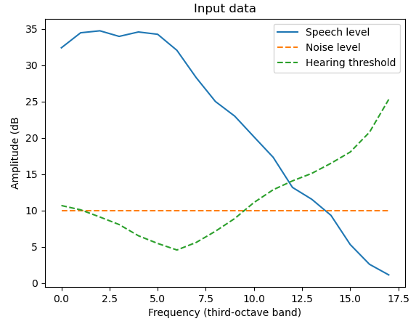
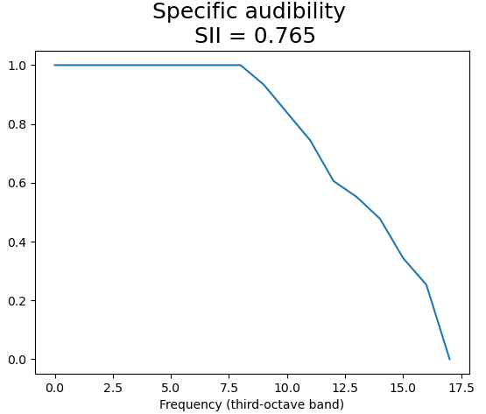
SII calculation
Compute from speech spectrum
s = SQMetrics(x_speech, y_speech, domain='freq', sii_input='speech')
s.sii(method='third_octave_bands', noise=10, speech='standard_normal_speech', threshold='standard')
→ it is also possible to give an array for the noise, if the frequency axis differs, the bands data will be computed.
Known speech
Zwicker hearing threshold
Noise set to 10dB

Slide 5
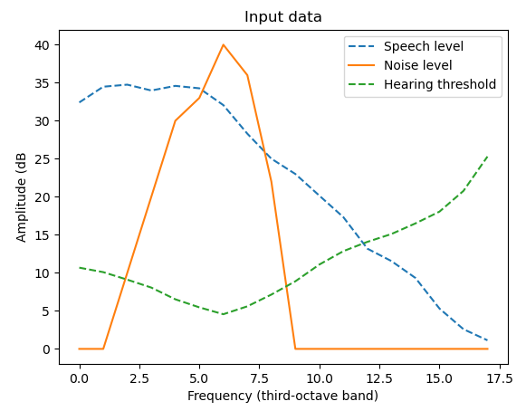
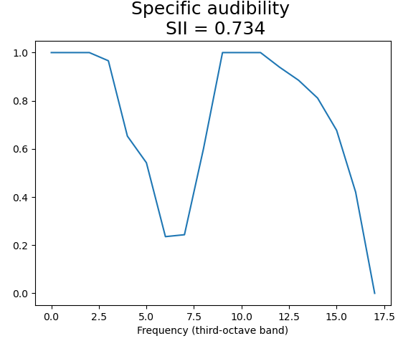
SII calculation
Compute from noise spectrum
s = SQMetrics(x_noise, y_noise, domain='freq', sii_input='noise')
s.sii(method='third_octave_bands', speech='standard_normal_speech', threshold='standard')
→ it is also possible to give an array for the speech level. If the frequency axis differs, the bands data will be computed.
Zwicker hearing threshold
Known noise
Normal speech level from the standard

