Slide 1
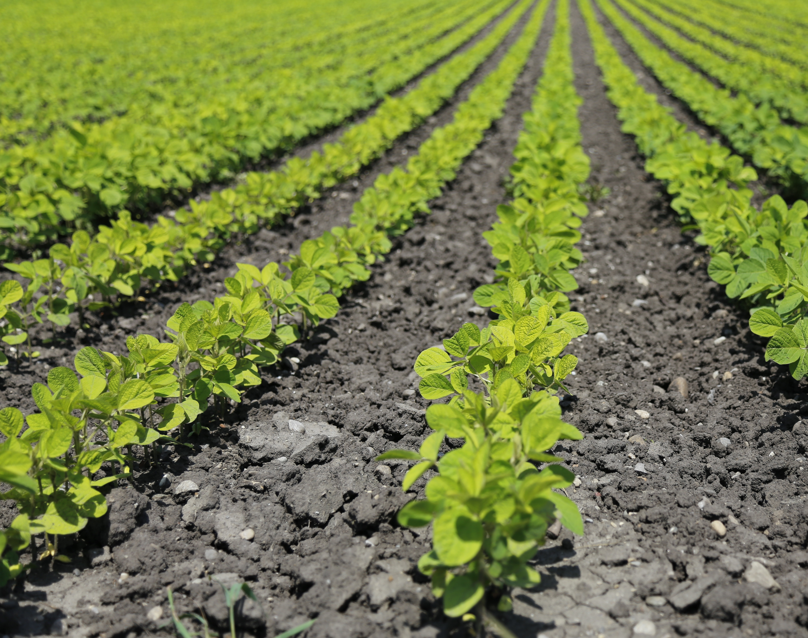
The Venus Flytrap Recording and Playback Device–
Plant Electrophysiology for Agricultural Advancement
Hector Duran, Ross Gunther, Amanda Hegadorn, Sangeon Jeon, Skylar Kennett, and Colton Walker
Faculty Advisor: Dr. William Hunt | In association with Vivent Biosignals

Slide 2
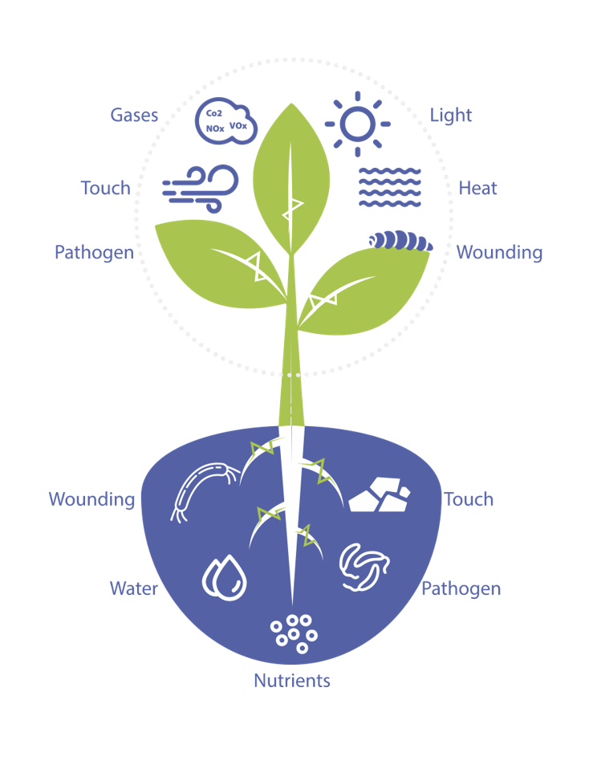


Corporate Sponsor:
Notes:
Our project is through a partnership with Vivent, a Swiss company using plant electrophysiology for agricultural aid. Currently they implement AI and Machine Learning to gather important information about crops such as if the crops are getting sufficient water, not enough sun, are being attacked by pest etc. on wide scale farms.

Slide 3
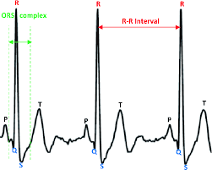
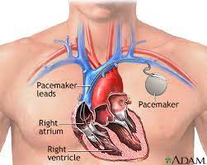
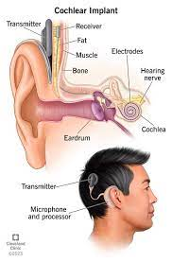
Previous Electrophysiological Advancements
ECG Signal
Pacemaker
Cochlear Implant
Notes:
Electrophysiology is the study of electrical impulses exhibited by biological processes in cells and tissues. Electrophysiological studies have been utilized since the 1700s and have led to major biotechnical advancements such as the ECGs, the pacemaker, and the cochlear implant.
In humans many of these biosignals have been characterized such as a QSR complex on an ECG signaling the contraction of the heart or an action potential across an axon signaling a neurotransmitter being released.

Slide 4
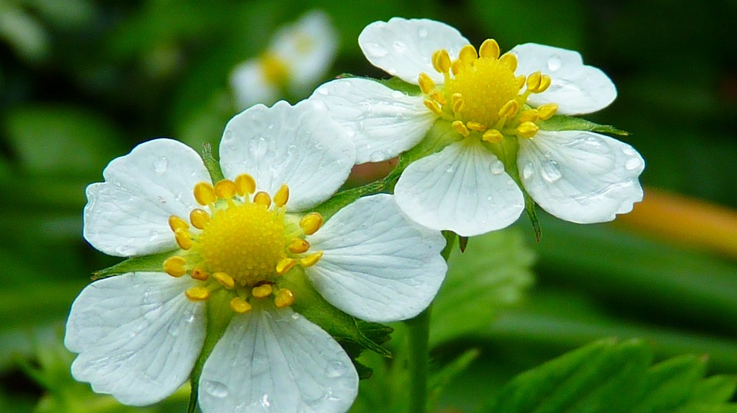
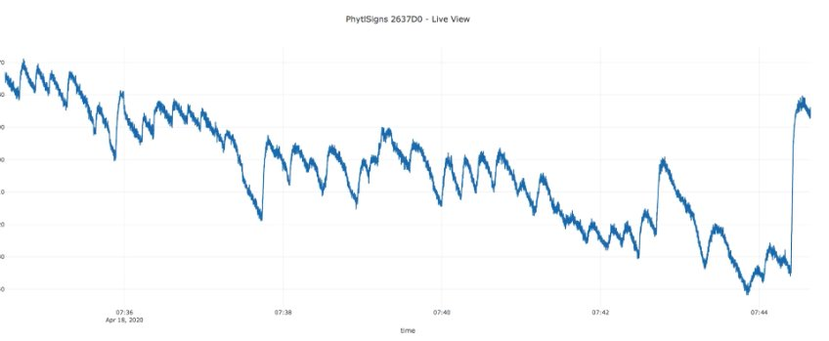
The Future of Electrophysiology: Agriculture
Notes:
Currently, electrophysiological signals in plants are less studied, but our sponsor believes by characterizing these signals instead of relying on Machine learning to interpret them, we can better understand and take advantage of cell signaling within plants. The benefits of this could yield revolutionary results from enticing plants to flower sooner or later, to biological computing.

Slide 5

Project Requirements
Signal Acquisition
Processing
Playback
Reach goal:
Close the flytrap with electrical stimulation
Low Noise Amplification
Signal in
Microcontroller
Processing
- Storage
DSP
Playback Configuration
Signal out
Attenuation, smoothing
Notes:
To lay the groundwork for characterization, Vivent asked for a portable playback device with the ability to record electrophysiological signals, store them for later use and signal analysis, and output the signal into future specimens. For our product, we experimented with Venus Flytraps because they have a physical reaction to the action potential that alerts them to close. Specifically, they want the capability to inject a similar biological signal and see if it is able to stimulate the plant into closing through our device.

Slide 6
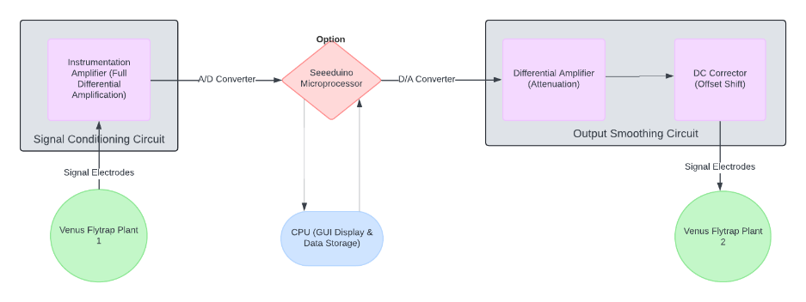
High Level Overview of Our Device
Notes:
This means that we need accurate low noise data collection of a differential signal in the range of 10mV, and a playback signal that can attenuate a recorded signal to the same degree that it was amplified for reading. We also need the ability to store and process this data for study, or for modifications prior to playback.
The signal read in from the plant is differential and of very low amplitude, our input circuit is designed around an instrumentation amplifier to keep noise at a minimum, amplify the signal and offset it for the Seeeduino’s ADC to read in the signal properly.

Slide 7
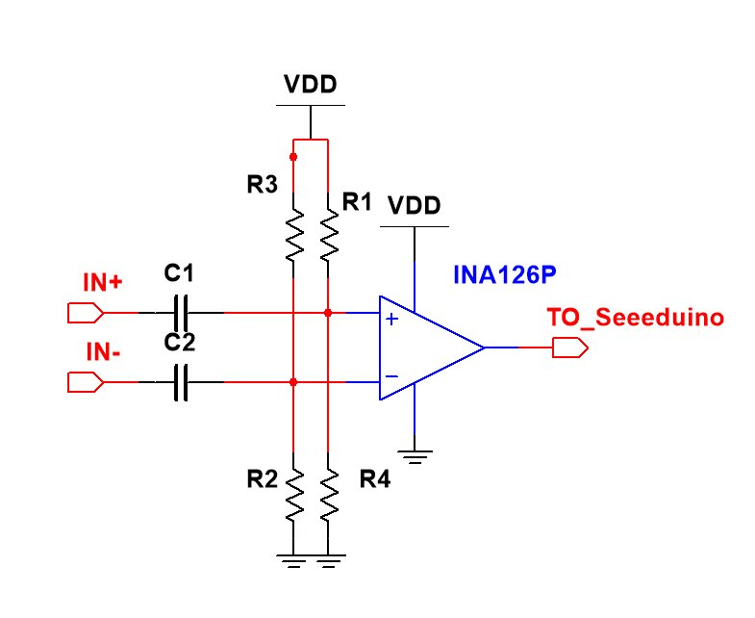
Input Analog Circuit
Instrumentation Amplifier to Remove Noise, Amplify, and Filter the VFT Action Potential for input to the 12-bit ADC on the Seeeduino Xiao
Notes:
The signal read in from the plant is differential and of very low amplitude, our input circuit is designed around an instrumentation amplifier to keep noise at a minimum, amplify the signal and offset it for the Seeeduino’s ADC to read in the signal properly.

Slide 8
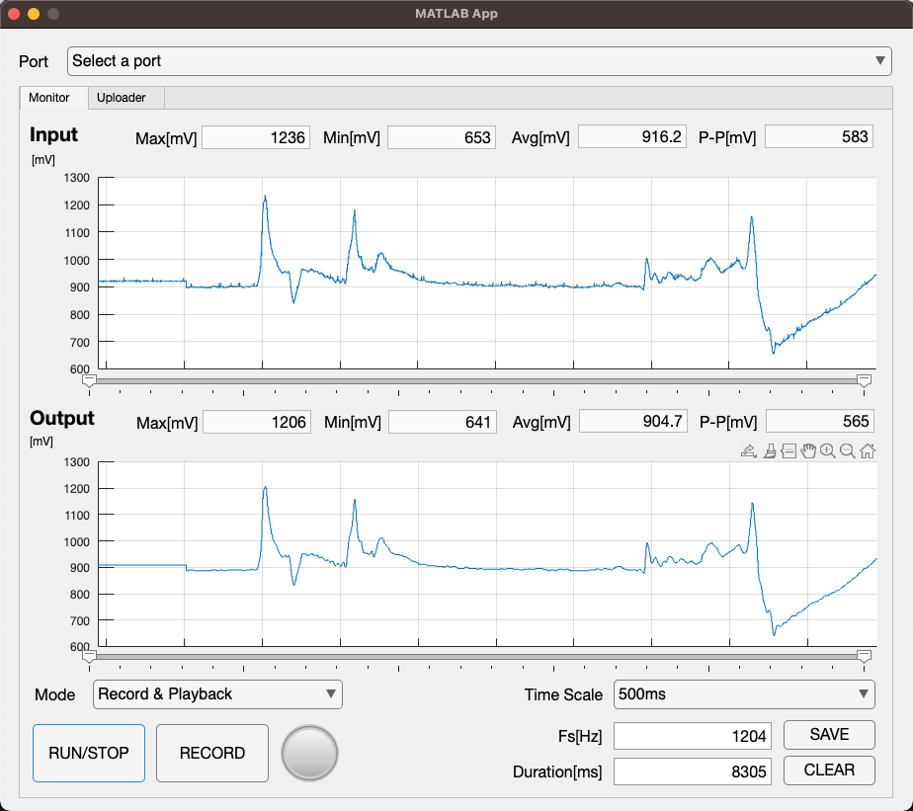
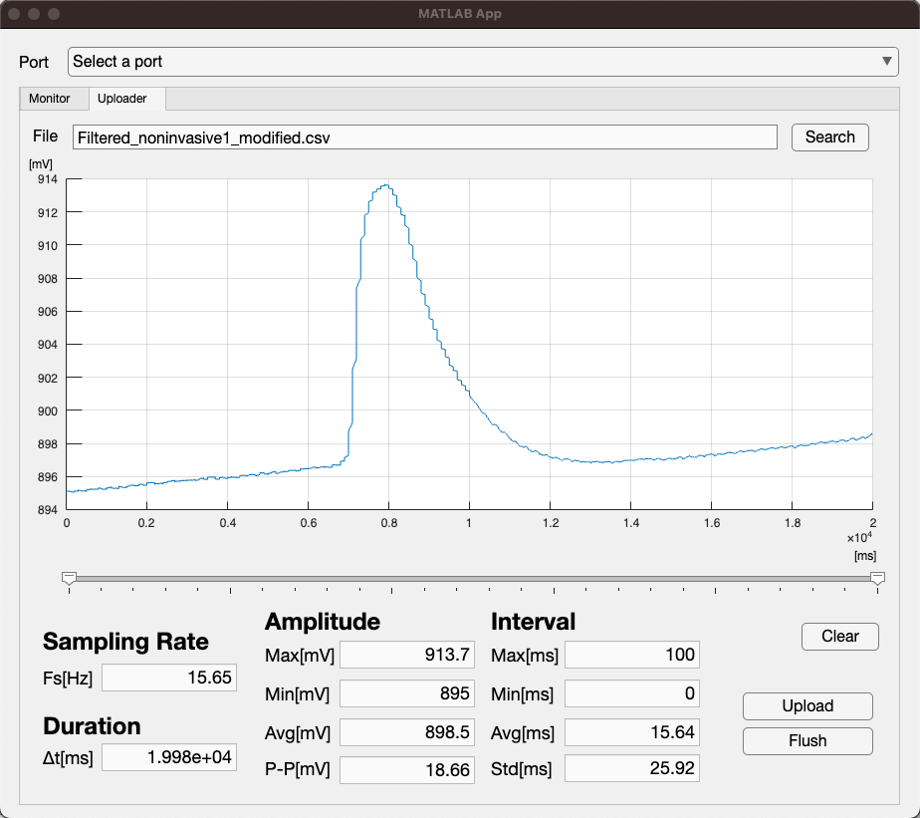
Digital System
Matlab GUI View For Signal
Recording and Playback
Matlab GUI View Uploading and Saving Recorded Signals
Notes:
The Seeeduino collects input data using a 12-bit ADC and sends output data via a 10-bit DAC. The board transmits the data over a serial connection to Matlab for storage and processing. To ensure temporal precision, all timestamps are generated by the Seeeduino, eliminating the time delay associated with communication between the board and Matlab. This approach allows the system to achieve microsecond precision. The Matlab front-end plots the signals sent to and received from the plant for further analysis. It can also select a specific portion of the recorded signal to modify and replay to the plant.

Slide 9
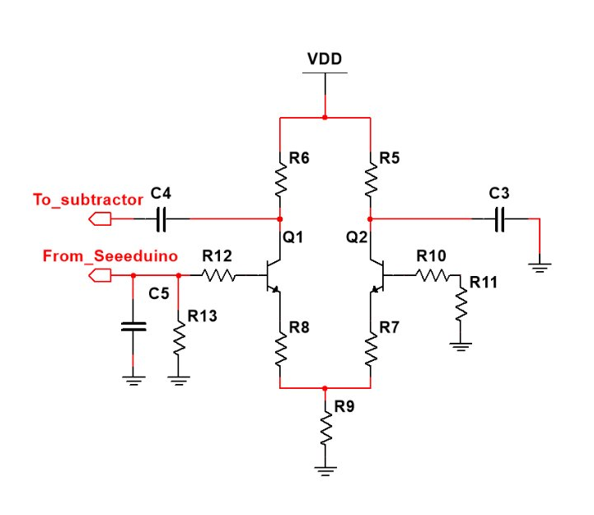
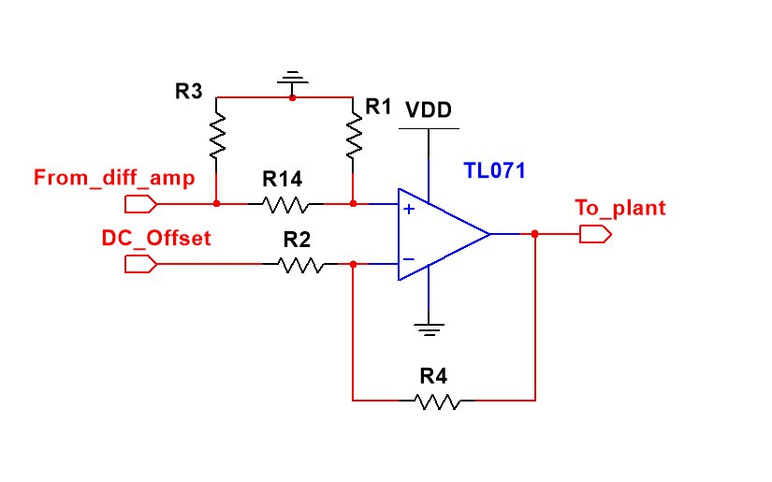
Output Analog Circuit
Differential Pair to Remove Noise
from the Seeeduino Output Signal
Subtractor Circuit to Remove DC Offset from
Seeeduino Output Signal into the VFT.
Notes:
The output circuit is the other interface between Seeeduino and plant, in a way it is the inverse of the input circuit. While keeping noise at a minimum it attenuates the signal to bring the voltage down to levels seen in plants. The output circuit also removes the initial DC offset added.

Slide 10

Recording Action Potentials
Notes:
This is an example of our recording, where we can touch the plant while held open to stimulate the trigger hairs and record an action potential.

Slide 11
Playback of Action Potentials
Notes:
This is an example of the playback, where a signal specified in Matlab is played back to see if it can entice the plant to close without any physical stimulus. We found that signals slightly larger than the recorded signal are required to close the plant, but this device allows for future study and characterization.

Slide 12
Playback of Action Potentials
Notes:
This is an example of the playback, where a signal specified in Matlab is played back to see if it can entice the plant to close without any physical stimulus. We found that signals slightly larger than the recorded signal are required to close the plant, but this device allows for future study and characterization.

Slide 13
Signal Processing of Stored Signals
Insert Demo
Notes:
This is an example of taking the plant’s unit step response, where you can see the plant’s response to a received signal. This is one example of the types of study that can be done with this device.

Slide 14
Closing Remarks
How is this creative and innovative?
Future aspirations:
  Communicating with more plants
  Predicting plant characteristics based on the impulse response
  Studying how different playback signals impact the plant and closings
Notes:
This solution is innovative because it allows for scientific study of the plants using standard engineering tools. The Matlab app used to collect data allows for playback of specific signals, and modification of the signal prior to playback.
Additionally, the ability to record and play a signal back at the same time allows for studies to be done to characterize the plant such as taking an impulse response or frequency response of the trap.
Furthermore, the device allows us to investigate the mechanisms that close the trap more specifically, analyzing the shape and magnitude of the applied wave and the plant’s response.

