Slide 1
동아리 ∙ 소모둠 1회차
경상국립대학교 정보통계학과 성언승

Slide 2


INDEX
Data Load
Drop, Rename, Add Columns
Missing Value
Filter Operation
Groupby
Simple ML Example (Linear Regression)
Pandas VS PySpark

Slide 3


Pandas VS PySpark
데이터 조작 및 분석을 위한 Python Libray
Apache Spark 기능을 Python으로 실행시키기 위한 Library
Toy Dataset (Scikit-Learn 등) 분석에 주로 사용
빅데이터 분석(GB, TB 이상)에 용이, 빠른 처리속도
SQL 문법 지원 X
SQL 문법 지원
Eager Evaluation – 호출 즉시 메모리 할당
Lazy Evaluation – 필요 시 메모리 할당

Slide 4
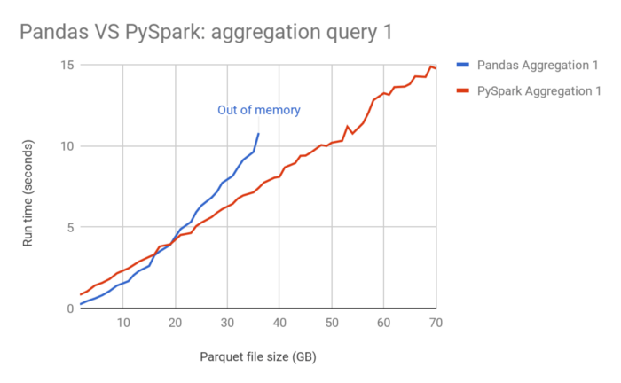
Pandas VS PySpark
Pandas와 PySpark 파일 크기에 따른 속도 비교

Slide 5
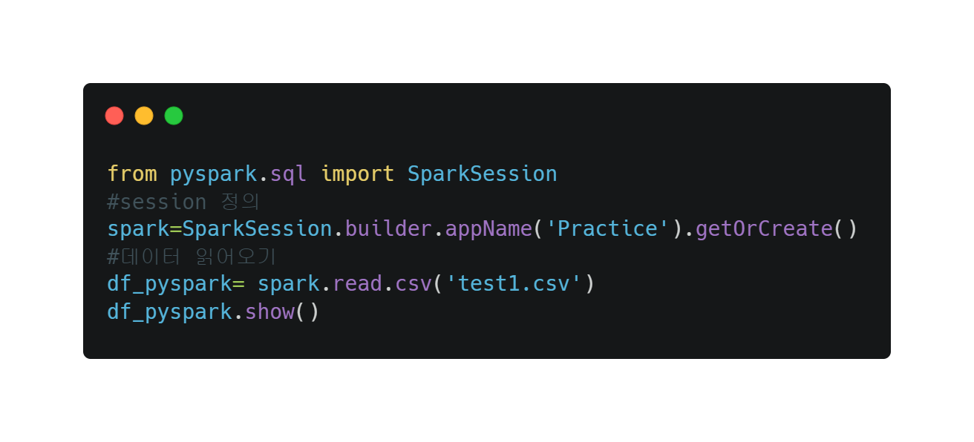
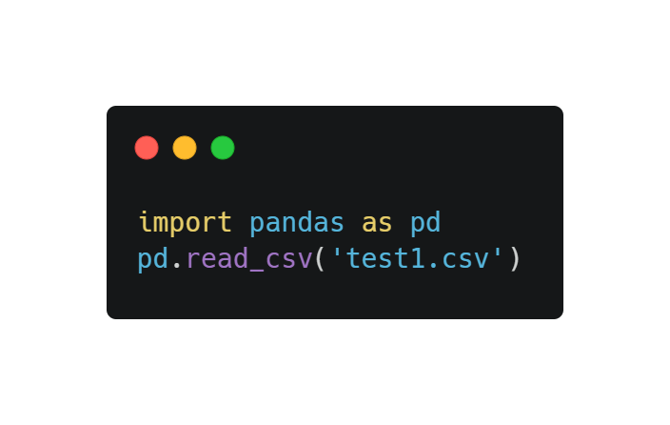
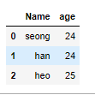
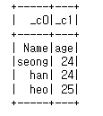
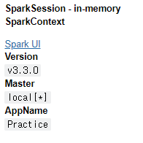
Pandas VS PySpark
1. Data Load

Slide 6
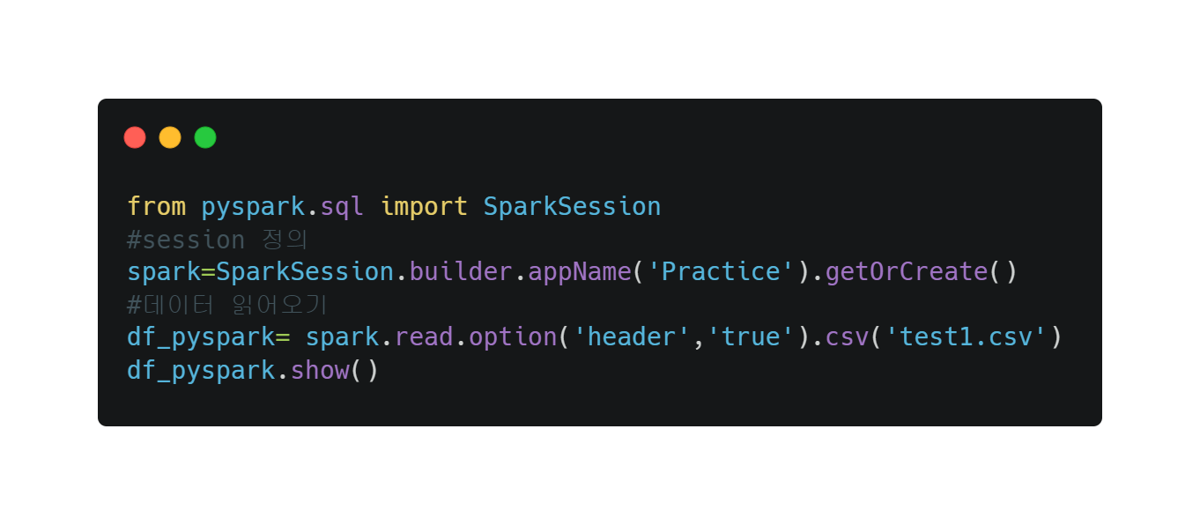
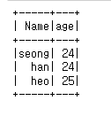
Pandas VS PySpark
Pandas VS PySpark
1. Data Load

Slide 7
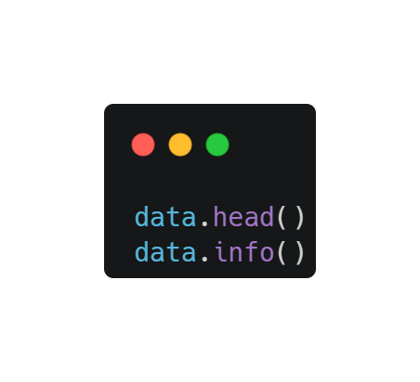
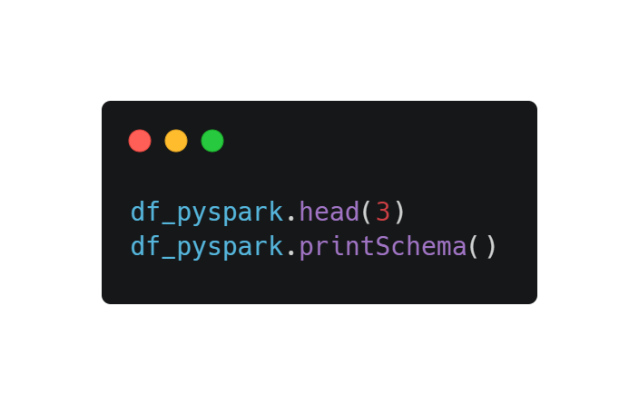
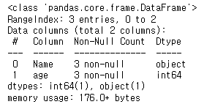


Pandas VS PySpark
Pandas VS PySpark
1. Data Load

Slide 8
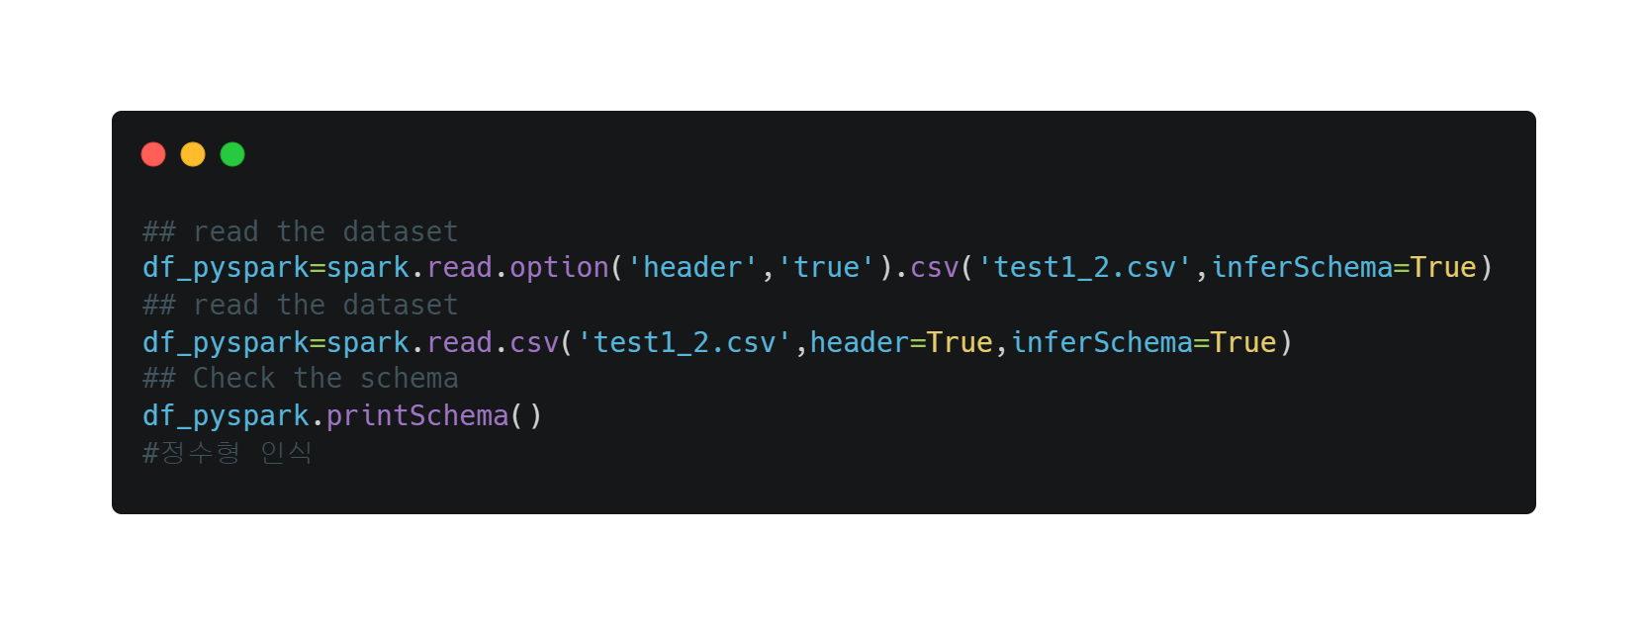

Pandas VS PySpark
Pandas VS PySpark
1. Data Load

Slide 9
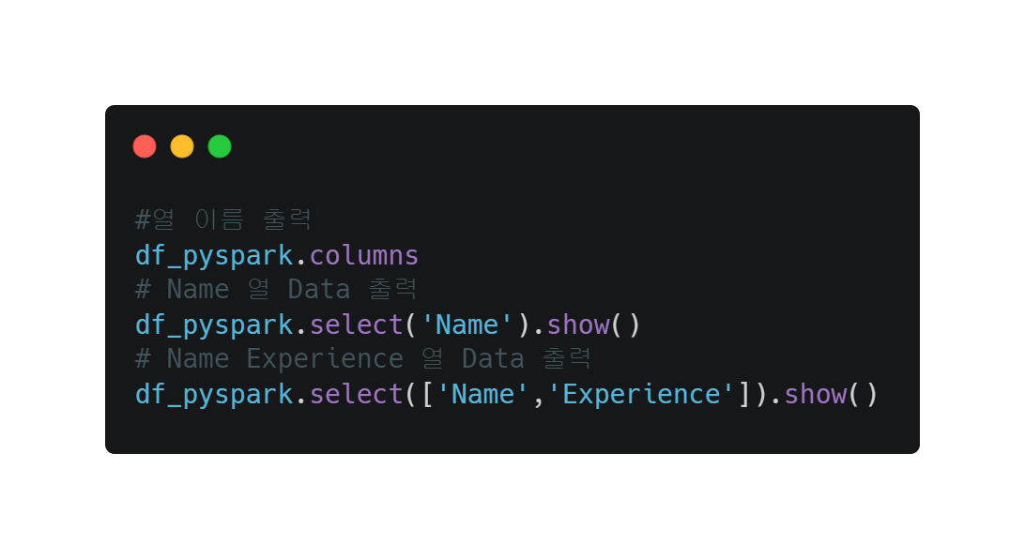
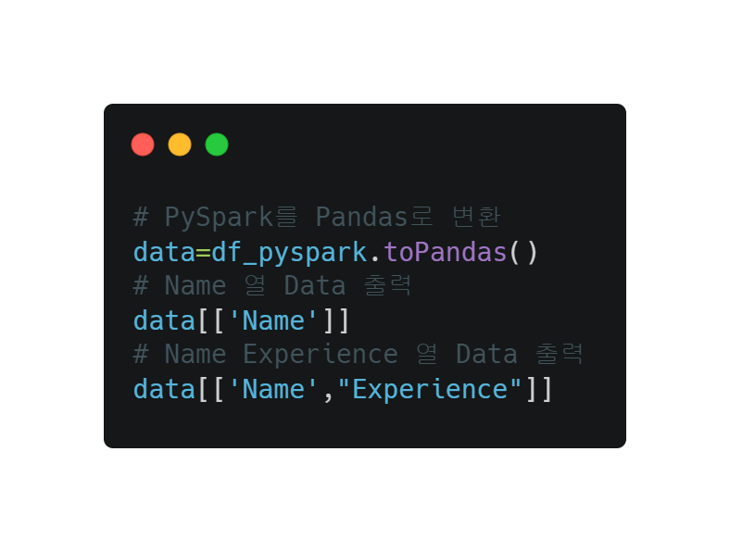

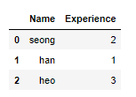

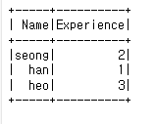
Pandas VS PySpark
Pandas VS PySpark
2. Drop, Rename, Add Columns

Slide 10
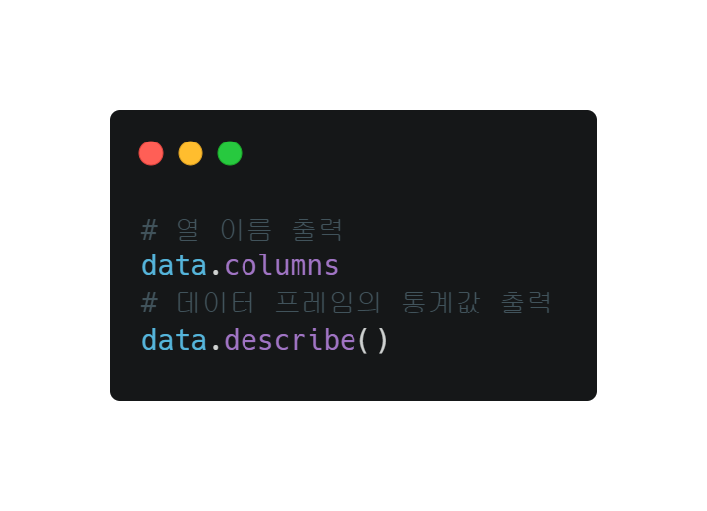
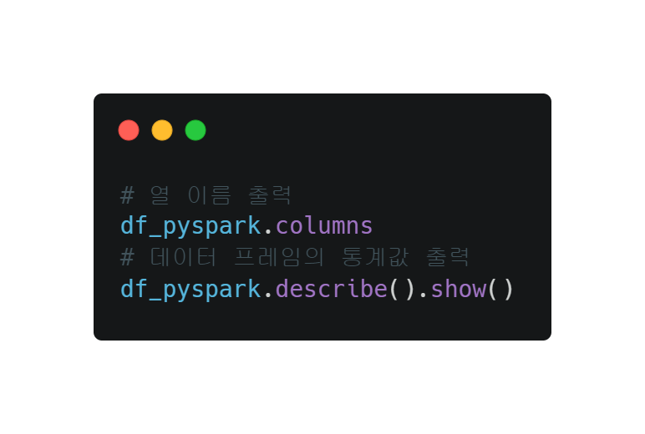

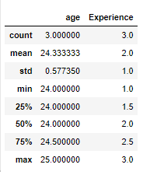
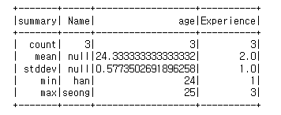
Pandas VS PySpark
Pandas VS PySpark
2. Drop, Rename, Add Columns

Slide 11
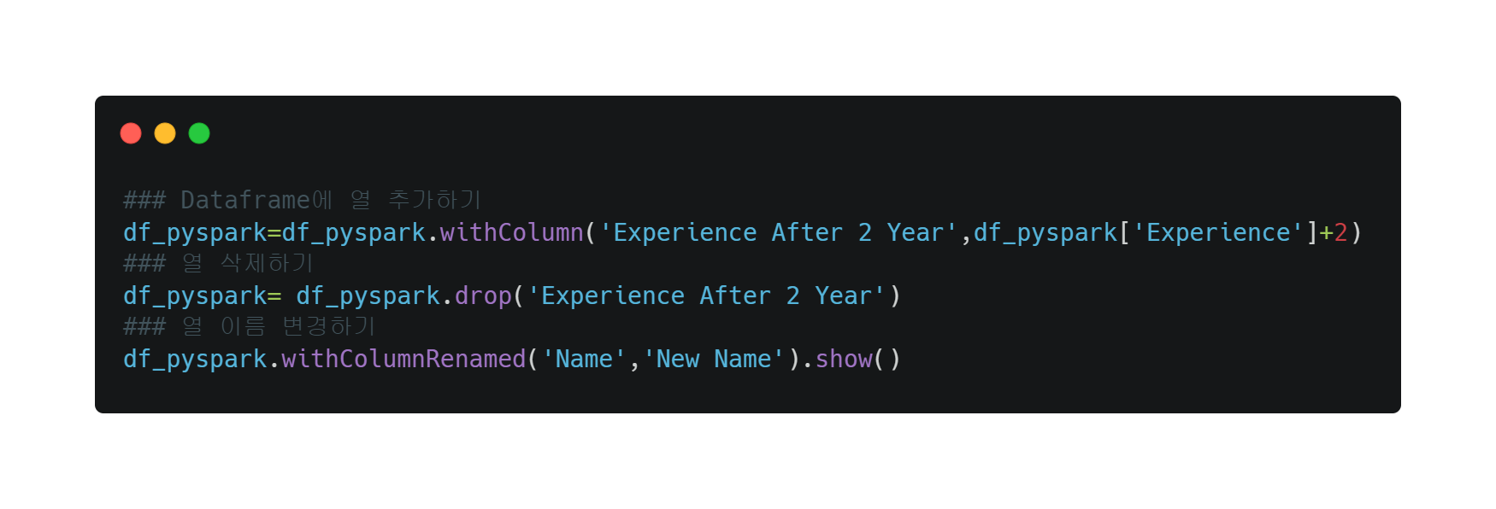
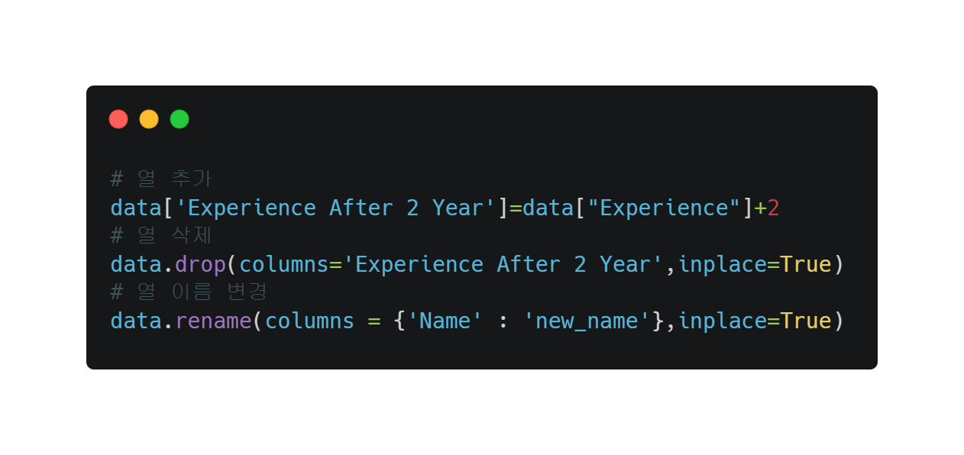
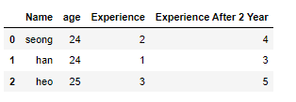
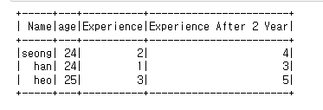
Pandas VS PySpark
Pandas VS PySpark
2. Drop, Rename, Add Columns

Slide 12
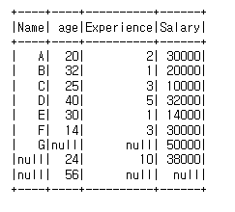
Pandas VS PySpark
Pandas VS PySpark
3. Missing Value
Data에 결측치 (Null값)가 존재

Slide 13
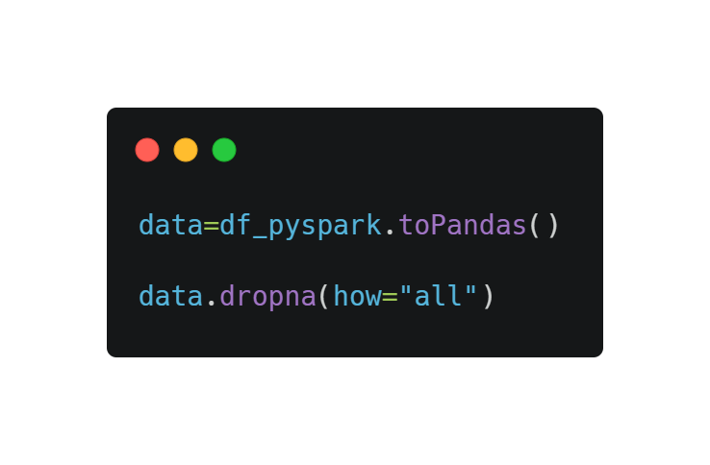
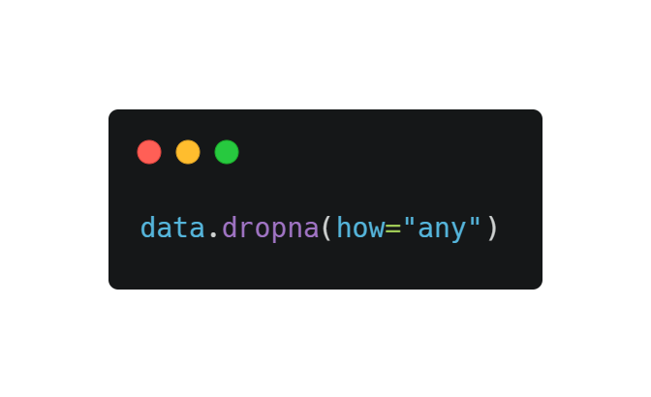
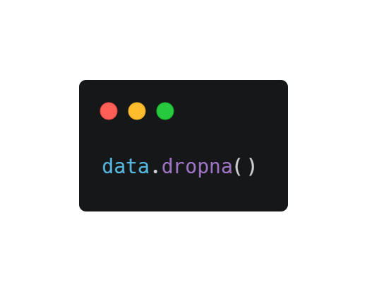
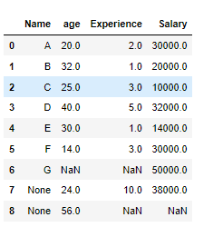
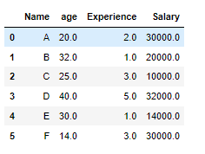
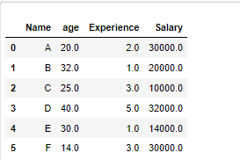
Pandas VS PySpark
Pandas VS PySpark
Pandas Ver.

Slide 14
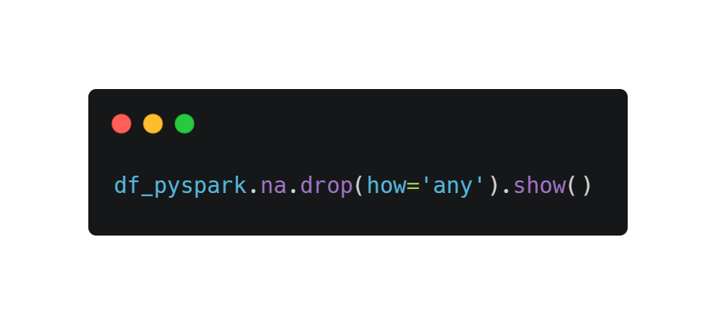
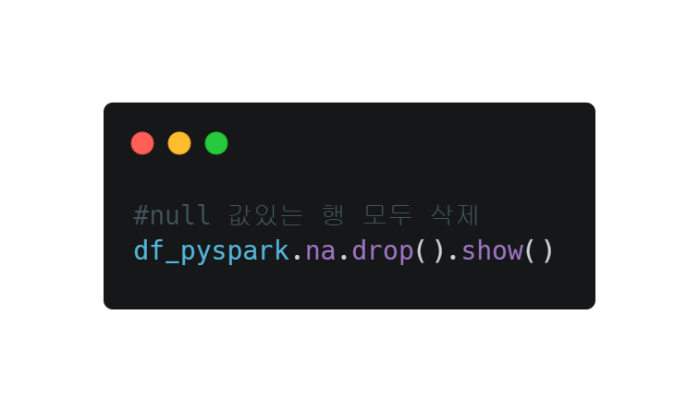
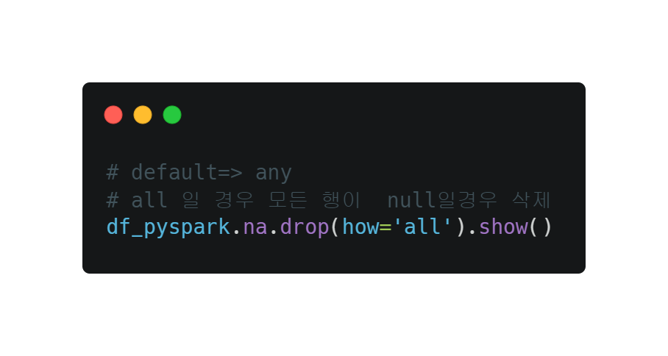
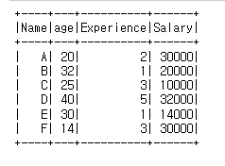
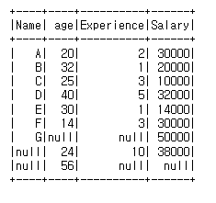
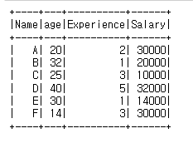
Pandas VS PySpark
Pandas VS PySpark
PySpark Ver.

Slide 15
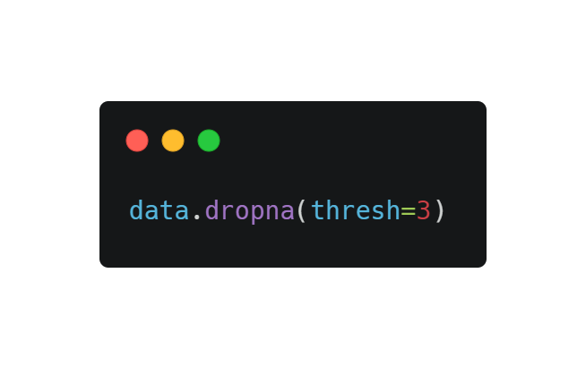
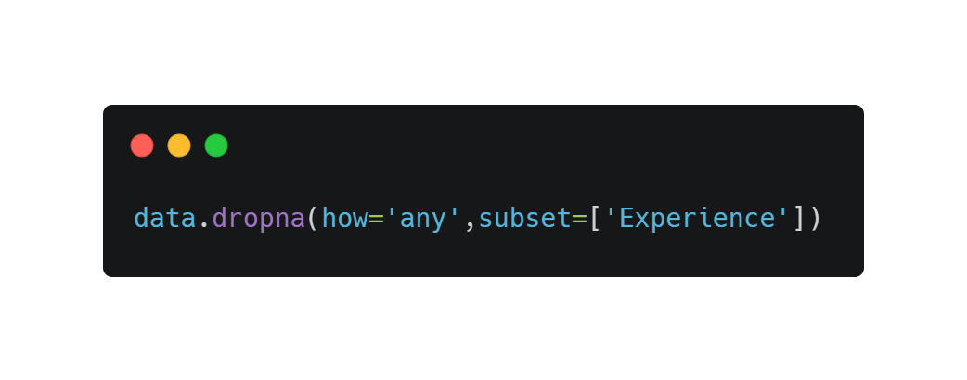

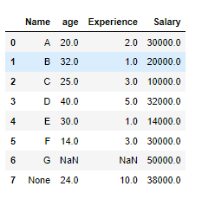
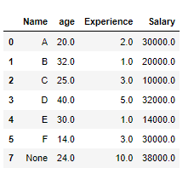
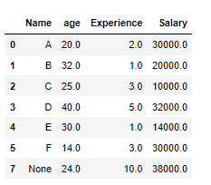
Pandas VS PySpark
Pandas VS PySpark
Pandas Ver.

Slide 16
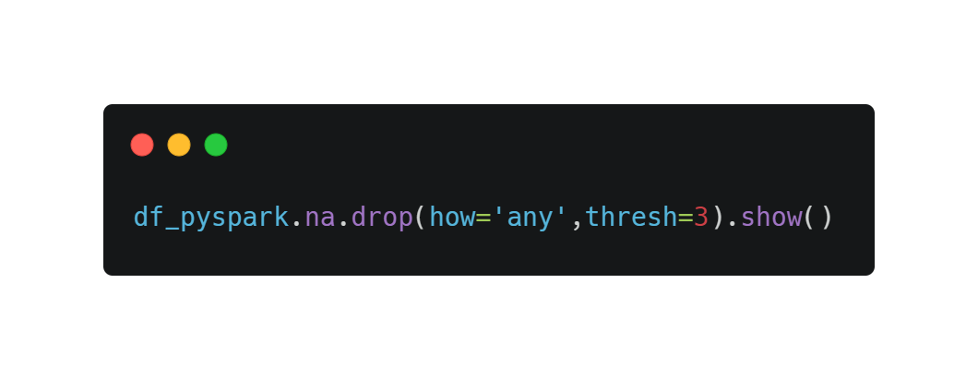
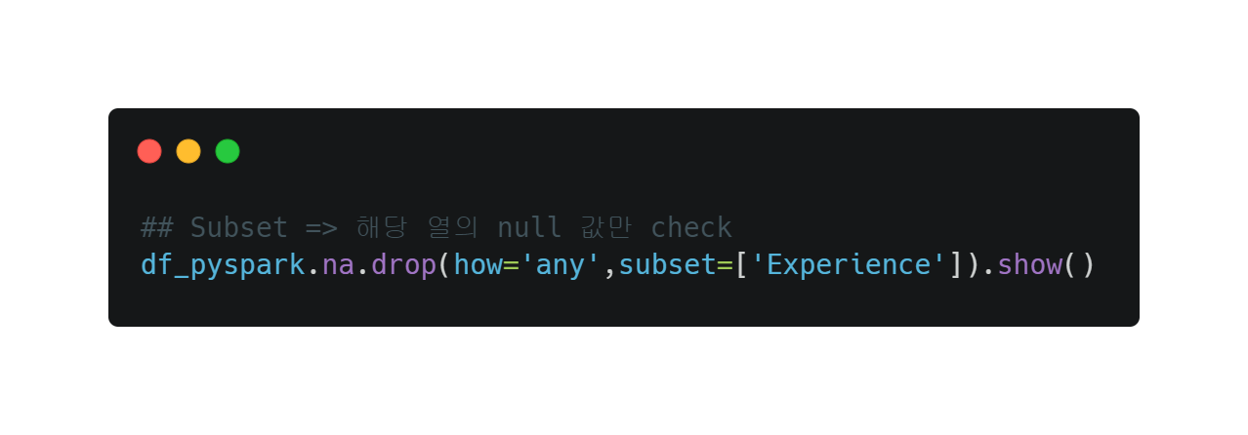
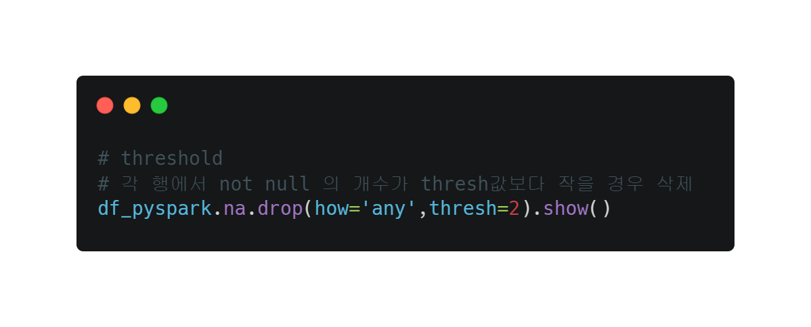
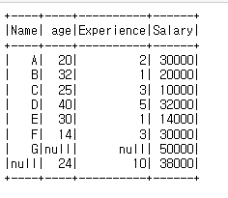
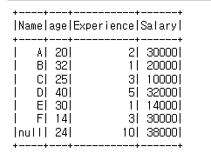
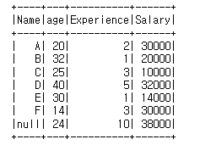
Pandas VS PySpark
Pandas VS PySpark
PySpark Ver.

Slide 17
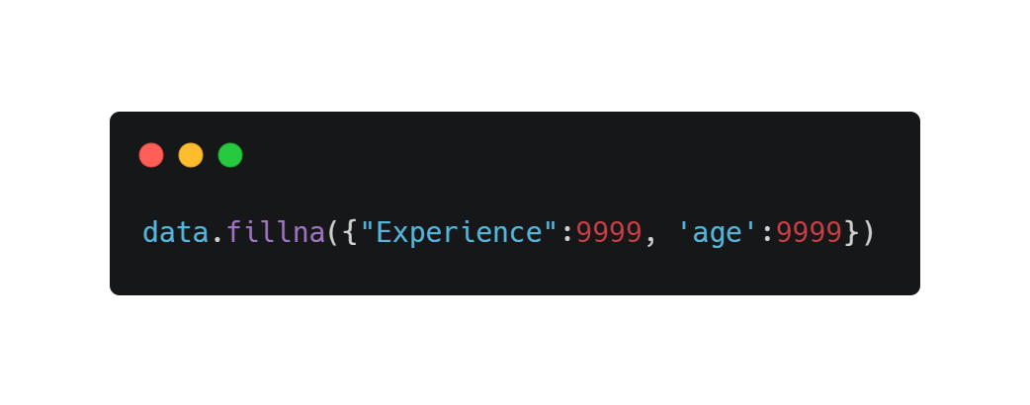
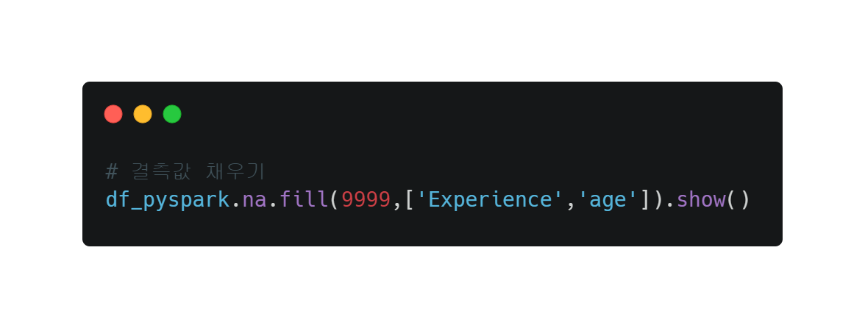


Pandas VS PySpark
Pandas VS PySpark
3. Missing Value

Slide 18




Pandas VS PySpark
Pandas VS PySpark
3. Missing Value

Slide 19


Pandas VS PySpark
Pandas VS PySpark
4. Filter Operation

Slide 20




Pandas VS PySpark
Pandas VS PySpark

Slide 21


Pandas VS PySpark
Pandas VS PySpark

Slide 22






Pandas VS PySpark
Pandas VS PySpark
AND Result
OR Result
Original Data
NOT Result

Slide 23


Pandas VS PySpark
Pandas VS PySpark
5. Groupby

Slide 24






Pandas VS PySpark
Pandas VS PySpark
5. Groupby

Slide 25
Pandas VS PySpark
Pandas VS PySpark
5. Simple ML Example (Linear Regression)
Pandas + Scikit-Learn
Data
Train / Test Split
ML
Train
Predict
PySpark
Data
Vector Assembler
Train / Test Split
ML
Train
Predict

Slide 26


Pandas VS PySpark
Pandas VS PySpark
5. Simple ML Example (Linear Regression)

Slide 27


Pandas VS PySpark
Pandas VS PySpark
5. Simple ML Example (Linear Regression)

Slide 28


Pandas VS PySpark
Pandas VS PySpark
6. Simple ML Example (Linear Regression)

Slide 29





Pandas VS PySpark
Pandas VS PySpark
6. Simple ML Example (Linear Regression)

