Slide 1
Digital Image Processing Final Project
Detection and Segmentation in Powder
Spreading Process of Magnetic Material
Additive Manufacturing

Slide 2
Outline
Background
Objective
Data
Evaluation
Other information

Slide 3
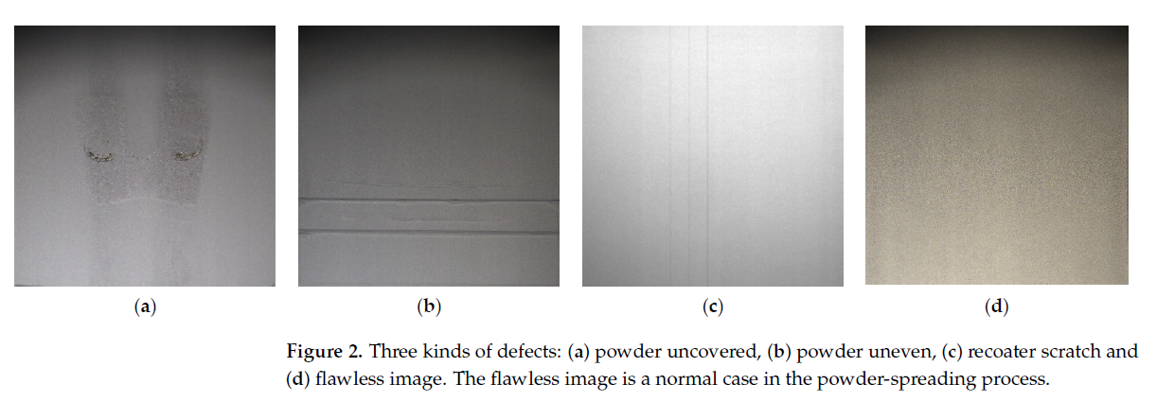
Background
Metal laser melting manufacturing (MAM) has been widely applied in the medical industry, manufacturing, aerospace and boutique industries in recent years. However, defects during the selective laser melting (SLM) manufacturing process can result from thermal stress or hardware failure during the selective laser melting (SLM) manufacturing process. To improve the product’s quality, the use of defect detection during manufacturing is necessary.

Slide 4
Objective
An accurate detection of defects is very important. There have three powder-spreading defect types: powder uneven, powder uncovered and recoater scratches.
Target :
Automatically detect and segment the defect during manufacturing.
Step 1. Detect defects from provided image.
Step 2. Segment the defective area at the meanwhile.

Slide 5
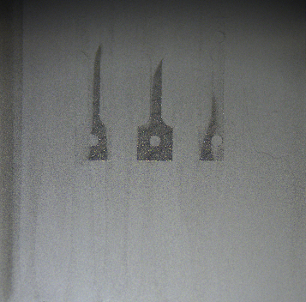
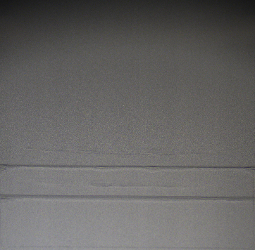

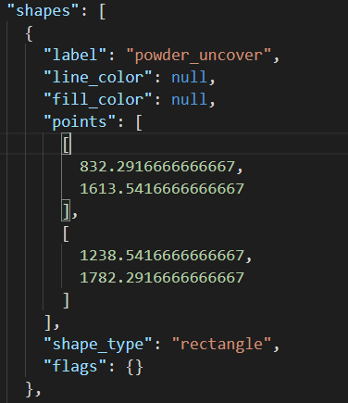



Data
150 image were captured each class.
The bounding boxes of defect was labeled by experts. The bounding box ground truth contains left-top and bottom-right coordinate (rectangle) in *.json file format.
We also provide the segmentation mask ground truth.
Defect bounding boxes format
Powder uncover
Powder uneven
Scratch

Slide 6
Project Goal
You are asked to detect and segment the defects of manufacturing from given images.
You are given with total 450 images and ground truth annotations(mask and bounding box positions).
You can use the image processing skills as well as deep learning methods for this homework.

Slide 7
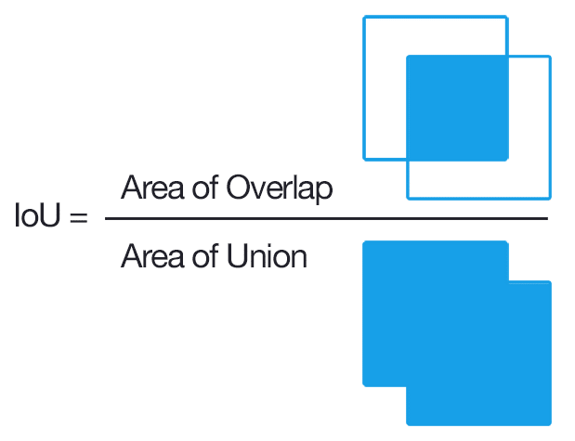

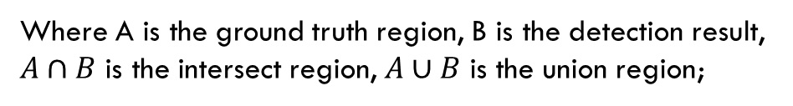
Evaluation
Use the Intersection over Union (IoU) to evaluate your detection result with the ground truth:
IoU = $\frac{A∩B}{A∪B}$
Where A is the ground truth region, B is the detection result,
$A∩B$ is the intersect region, $A∪B$ is the union region;

Slide 8
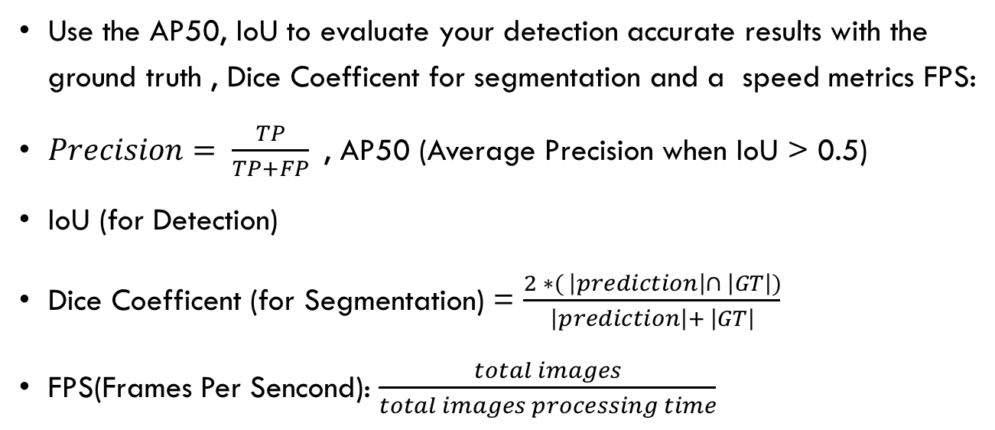
Evaluation
Use the AP50, IoU to evaluate your detection accurate results with the ground truth , Dice Coefficent for segmentation and a speed metrics FPS:
$Precision= \frac{TP}{TP+FP}$, AP50 (Average Precision when IoU > 0.5)
IoU (for Detection)
Dice Coefficent (for Segmentation) = $\frac{2 ∗( \left|prediction\right|∩ \left|GT\right|)}{\left|prediction\right|+ \left|GT\right|}$
FPS(Frames Per Sencond): $\frac{total images}{total images processing time}$

Slide 9
Requirement
1) Read a image folder and its ground truth from your program interface.
2) Run your program and let user choose any image to show the ground truth and predicted result (detection result and segmentation result) in the program interface.
3) Show the evaluation metric.
AP50 (each class)
IoU
Dice Coefficent
FPS

Slide 10
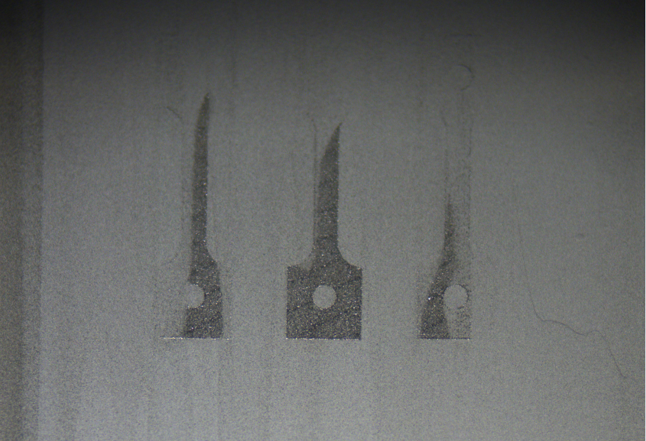
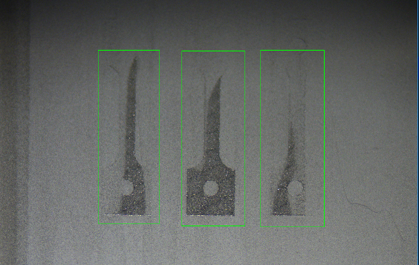

GUI LAYOUT SAMPLE
.
Original image
Detection result
Current Image : 5/20
FPS:
Type(GT):powder uncover Predict: powder uncover
IoU :
Dice Coefficient:
Select Image Folder
Folder (Mean)
Evaluation Metric
AP50(uncover):
AP50(uneven):
AP50(scratch):
Detect defects
Segment
Segmentation result

Slide 11
Evaluation
You should clearly show the number of training, validation and testing images of your evaluation.
If you are using training base methods, 4 fold cross-validation is required..
You should evaluation the detection and segmentation result of each fold and show the average of the metrics.
Round 1
f1
f2
f3
f4
Round 2
Blue: training
Yellow: testing
f1
f2
f3
f4
Round 3
f1
f2
f3
f4
Round 4
f1
f2
f3
f4

Slide 12
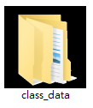
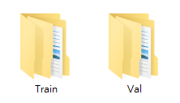
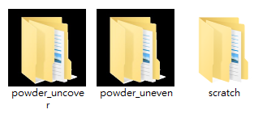
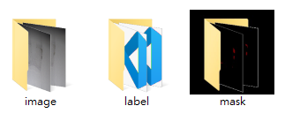
Folder Architecture

Slide 13
File Upload
Please compress the program source code, execution file(release mode) and report as a zip file and upload it to FTP “FinalProject” folder before 11:59 p.m. of 2023/01/8(Sun).
ftp://140.116.247.97 port:102
Id: imagehw
password: imagehw
The format of the zip file name :
[student id]_[version].zip
e.g. P78901234_VS.zip.
e.g. P78901234_PY.zip
Please add your version number if you have any new update
e.g. P78901234_VS_v02.zip

Slide 14
Notice
The report should be written in Chinese or English, and 4 pages at least. The report should include the questions, methods, results, discussion and conclusion. Please print it with your named on it and hand it in at the demonstration.
The demonstration will be held in Room 65702 during 2023/01/09,10. The schedule will be announced in advance on the course web side. You can bring your laptop to demonstration.
If you cannot attend the scheduled demonstration, please inform the teaching assistant one week earlier for changing demo time.
If you are not EE or CSIE student, you are allowed to use the matlab 2019 to do this project.
Environment Requirement: Python 3.7 with pytorch 1.12 should be used when you are using deep learning methods.
You could come to Room 65702 to test your environment at 2023/01/02 , 2023/01/06 .

Slide 15
Notice
For deep learning methods, if you have to use any special library or version, please contact TA in advance and write a environment requirement .txt .
It is not allowed to copy homework from other classmates, but discussions are encouraged.

Slide 16
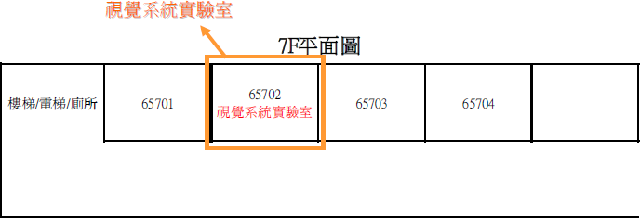
Vision System Lab (Room 65702)

Slide 17
Reference
Deep Learning Applied to Defect Detection in Powder Spreading Process of Magnetic Material Additive Manufacturing. Materials 2022, 15, 5662. https://doi.org/10.3390/ ma15165662 Chen, H.-Y.; Lin, C.-C.; Horng, M.-H.; Chang, L.-K.; Hsu, J.-H.; Chang, T.-W.; Hung, J.-C.; Lee, R.-M.; Tsai, M.-C.
Mask R-CNN. Kaiming He, Georgia Gkioxari, Piotr Dollár, and Ross Girshick. IEEE International Conference on Computer Vision (ICCV), 2017.
Faster R-CNN: Towards Real-Time Object Detection with Region Proposal Networks Shaoqing Ren, Kaiming He, Ross Girshick, and Jian Sun. Conference on Neural Information Processing Systems (NIPS), 2015.
Unet: Convolutional networks for biomedical image segmentation. In International Conference on Medical image computing and computer-assisted intervention, pages 234–241. Olaf Ronneberger, Philipp Fischer, and Thomas Brox.
Yolov4: Optimal speed and accuracy of object detection. arXiv preprint arXiv:2004.10934, 2020. Alexey Bochkovskiy, Chien-Yao Wang, and HongYuan Mark Liao.

Slide 18
Information
NCKU moodle
TA:
willy123301@gmail.com
johnson210140@gmail.com
chenxuan0511@gmail.com

