Slide 1
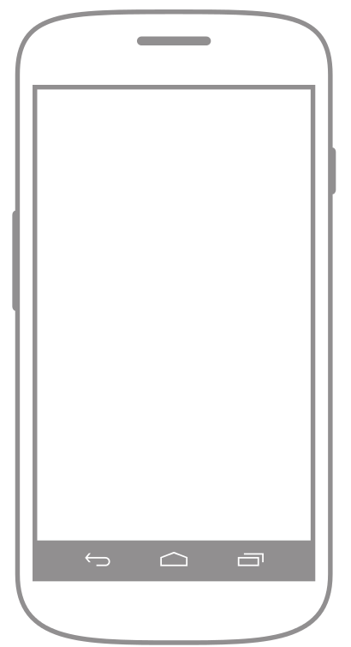
PLAY
CUSTOMIZE

Slide 2
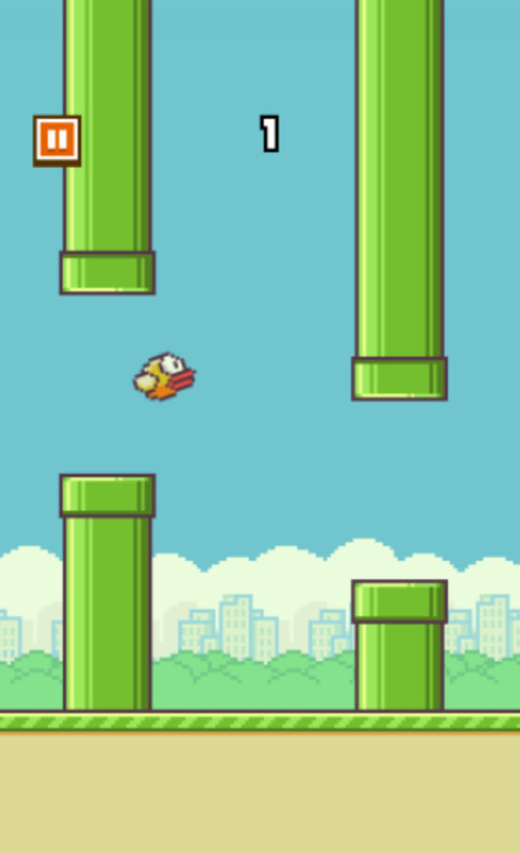

Slide 3
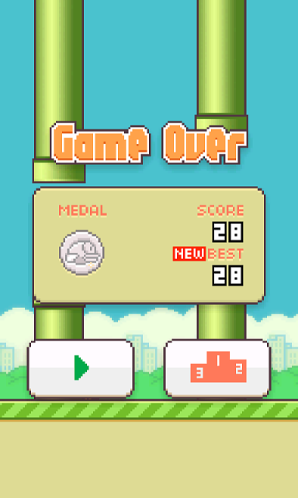
Replay
Easy Mode

Slide 4
CUSTOMIZE FLAPPY
COLOUR
PHYSICS
SIZE

Slide 5
CUSTOMIZE
Change the colour:

Slide 6
CUSTOMIZE
Change the physics:

Slide 7
CUSTOMIZE
Change the scale:

Slide 8
PLAY
CUSTOMIZE

Slide 9
PLAY
CUSTOMIZE

Slide 10
PLAY
CUSTOMIZE

Slide 11
PLAY
CUSTOMIZE

Slide 12
PLAY
CUSTOMIZE

Slide 13
PLAY
CUSTOMIZE

Slide 14
PLAY
CUSTOMIZE

