Slide 1
ARAMINA
XRD decision support for biopsy assessment
Research-draft product overview
27/07/2026
Notes:
[Sources]
Aramina/docs/modeling/aramina_t100_target_case_model_v0_1.md; intended use and model scope.

Slide 2
T100 defines the biopsy-confirmed cohort
Archive acquisitions: 14 May 2025 to 10 June 2026 | T100 preprocessing | target-breast endpoint
Combined H5
2D XRD + metadata
AgBH T100 QC
PONI + thickness
Biopsy-patient
cohort
Biopsied breast
= target case
Frozen model
0.2.12-beta
Accepted model-input cohort
Historical target cases
164
patients
314
breasts
893
measurements
175
target breasts
76
CANCER
99
BENIGN
• 150 patients have two breasts; 14 have one breast.
• NORMAL + BENIGN -> BENIGN
• ATYPICAL + PRE_CANCEROUS + CANCER -> CANCER
1
Notes:
[Sources]
Aramina/examples/outputs/preprocessing_and_training/aramina_target_breast_risk_preprocessing_and_training_20260724T125256Z_552f0758/preprocessing/cohort_summary.json; Aramina/docs/modeling/current_model_dataframe_v0_1.md.

Slide 3
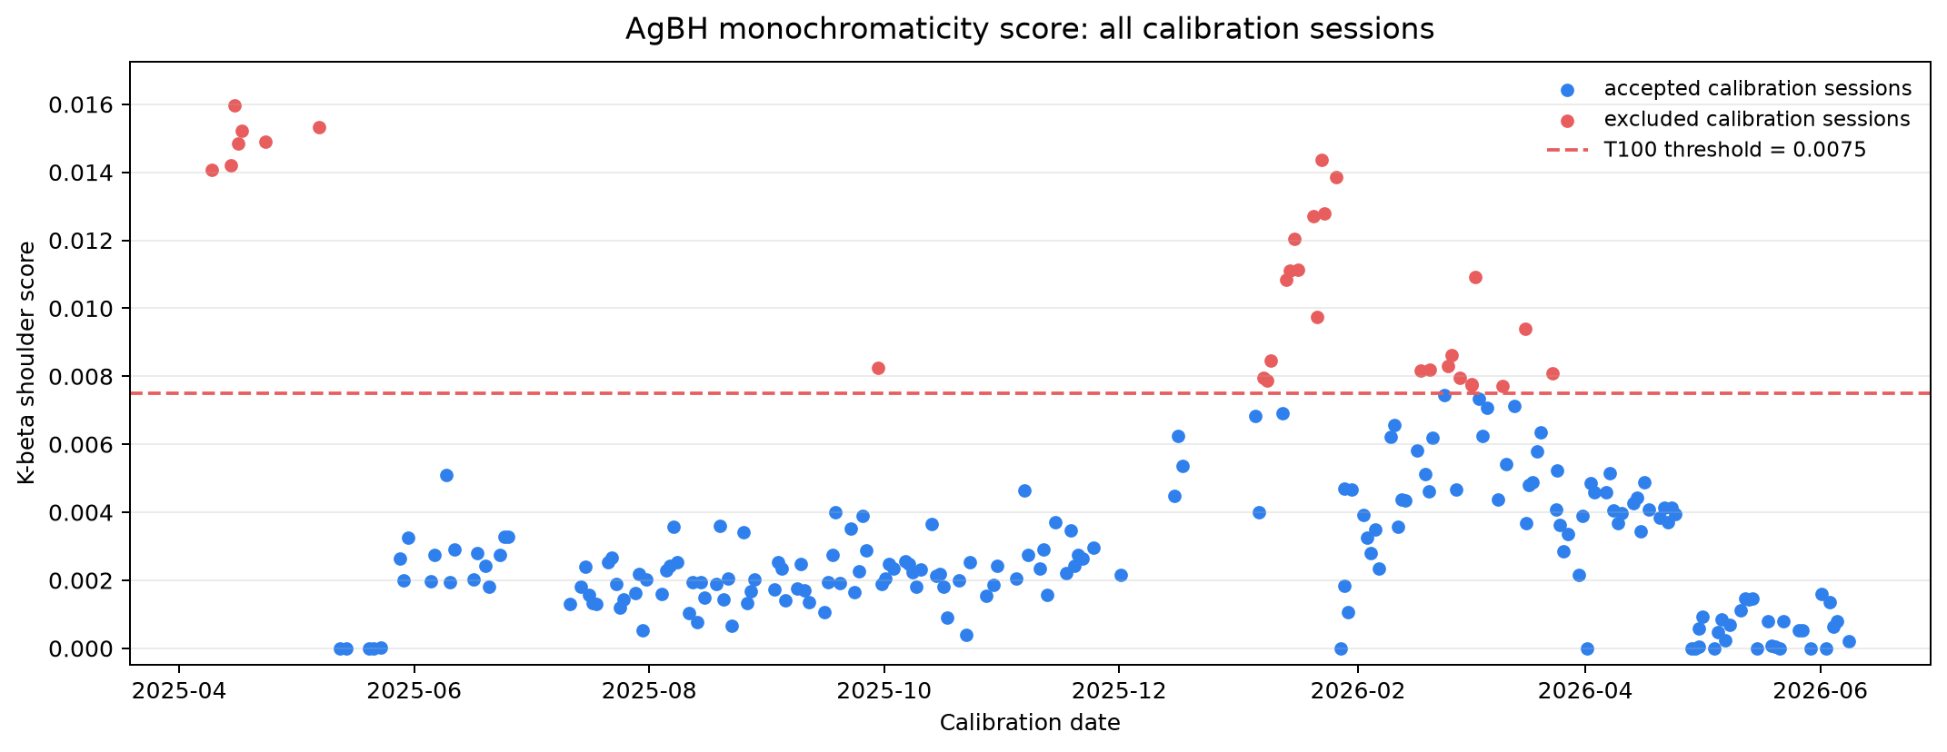
T100 removes unstable calibration sessions
K-beta shoulder contamination can distort XRD profiles before modelling
Why this matters
All calibration sessions
• Product profiles must share one stable q calibration.
• AgBH is an external calibration-quality monitor.
• T100 uses score <=0.0075; sessions above the threshold are excluded before GFRM loading.
Product decision
T100 is the frozen preprocessing route for the current Aramina model artifact.
2
Notes:
[Sources]
Clinical_trials/analysis/aramina_preprocessing_v0_1/agbh_monochromaticity_by_batch.png; Aramina/docs/agbh_quality_exclusions.md; Aramina/docs/modeling/current_model_dataframe_v0_1.md.

Slide 4
2D XRD becomes a normalized 100-point profile
All settings are frozen in the preprocessing YAML and stored with the model artifact
H5 container
raw GFRM + metadata
Quality filters
AgBH, PONI, thickness
Faulty-pixel
mask
Azimuthal
integration
Normalized 1D
radial profile
Integration and signal quality
Normalization and profile gate
2-23 nm^-1
q range
100
q points
SNR >=18 dB
Poisson model
6.7-7.1 nm^-1
median reference
q=14 nm^-1
profile gate
P1/P2/P3
293 / 303 / 297
• Calibrant thickness must be 2-40 mm; sample thickness is required.
• PONI geometry must cover q >=23 nm^-1 before integration.
3
Notes:
[Sources]
Aramina/config/preprocessing/shared/aramina_policy_v0_1.yaml; Aramina/config/preprocessing/shared/aramina_pipeline_v0_1.yaml; frozen cohort dataframe inspection.

Slide 5
Final p_cancer combines profile, age and symmetry
Two logistic-regression stages; symmetry is optional and never blocks prediction
P1
radial profile
LR2 refinement
target p_cancer + age
+ symmetry / zeros
LR1
profile model
p_cancer 1
p_cancer 2
p_cancer 3
target p_cancer
logit average
Final p_cancer
P2
radial profile
P3
radial profile
Fixed threshold
0.24666
Both breasts have
>=2 valid measurements?
Symmetry input to LR2
Yes: SK Core 4 (Wasserstein, RMS1, RMS2, peak delta)
No: zero vector; reliability: low
Biopsy action
required / not required
4
Notes:
[Sources]
Aramina/docs/modeling/aramina_t100_target_case_model_v0_1.md; Aramina/docs/modeling/sk_symmetry_features_v0_1.md; frozen model_description.yaml.

Slide 6
Validation and final fit answer different questions
The same patient never appears in both train and held-out test partitions
Patient-safe evaluation
Final train-on-all fit
• Repeated stratified 5-fold x20.
• 100 held-out patient folds.
• Threshold is derived from each training fold, then applied to its held-out fold.
• This is the honest evidence line.
• Fixed regularization: LR1 C=0.1; LR2 C=0.3.
• Fit on all 175 accepted target cases.
• Deployment threshold: p_cancer = 0.24666.
• Chosen to reach sensitivity >=0.95 in final fit.
Interpretation
Train-on-all describes the frozen artifact; it does not replace patient-safe validation or an independent clinical validation cohort.
5
Notes:
[Sources]
Aramina/docs/modeling/aramina_t100_target_case_model_v0_1.md; Aramina/examples/outputs/preprocessing_and_training/aramina_target_breast_risk_preprocessing_and_training_20260724T125256Z_552f0758/training/aramina_target_breast_risk_0_2_12-beta_20260724T125510Z_b8beddb6/evaluation.yaml.

Slide 7
Current evidence is limited by cohort size
Frozen Aramina 0.2.12-beta | T100 biopsy cohort | decision threshold p_cancer = 0.24666
Evidence | Method | ROC AUC | Sensitivity | Specificity | Interpretation
Patient-safe | 5-fold x20 | 0.645 +/- 0.069 | 0.818 +/- 0.099 | 0.376 +/- 0.133 | Held-out folds
Final fit | Train on all | 0.865 | 0.961 | 0.495 | In-sample
Cohort | 175 target cases | 76 CANCER | 99 BENIGN | 164 patients | T100 QC
Threshold | p_cancer | 0.24666 | TP 73 | TN 49 | Final fit
Errors | Final fit | FN 3 | FP 50 | NPV 0.942 | Not independent
Predictive value | Final fit | PPV 0.593 | NPV 0.942 | BA 0.728 | In-sample
Threshold policy | Final fit | Target sensitivity | >=0.95 | Reached | Fixed route
Limitation | Validation | No external cohort | Small n | Selected cohort | Research draft
• Current evidence supports research-draft decision support, not an autonomous diagnosis claim.
• Larger independent data are required before stronger performance claims.
6
Notes:
[Sources]
Frozen model_description.yaml and evaluation.yaml under Aramina/examples/outputs/preprocessing_and_training/aramina_target_breast_risk_preprocessing_and_training_20260724T125256Z_552f0758/training/aramina_target_breast_risk_0_2_12-beta_20260724T125510Z_b8beddb6/.

