Slide 1
HomeWork

Slide 2
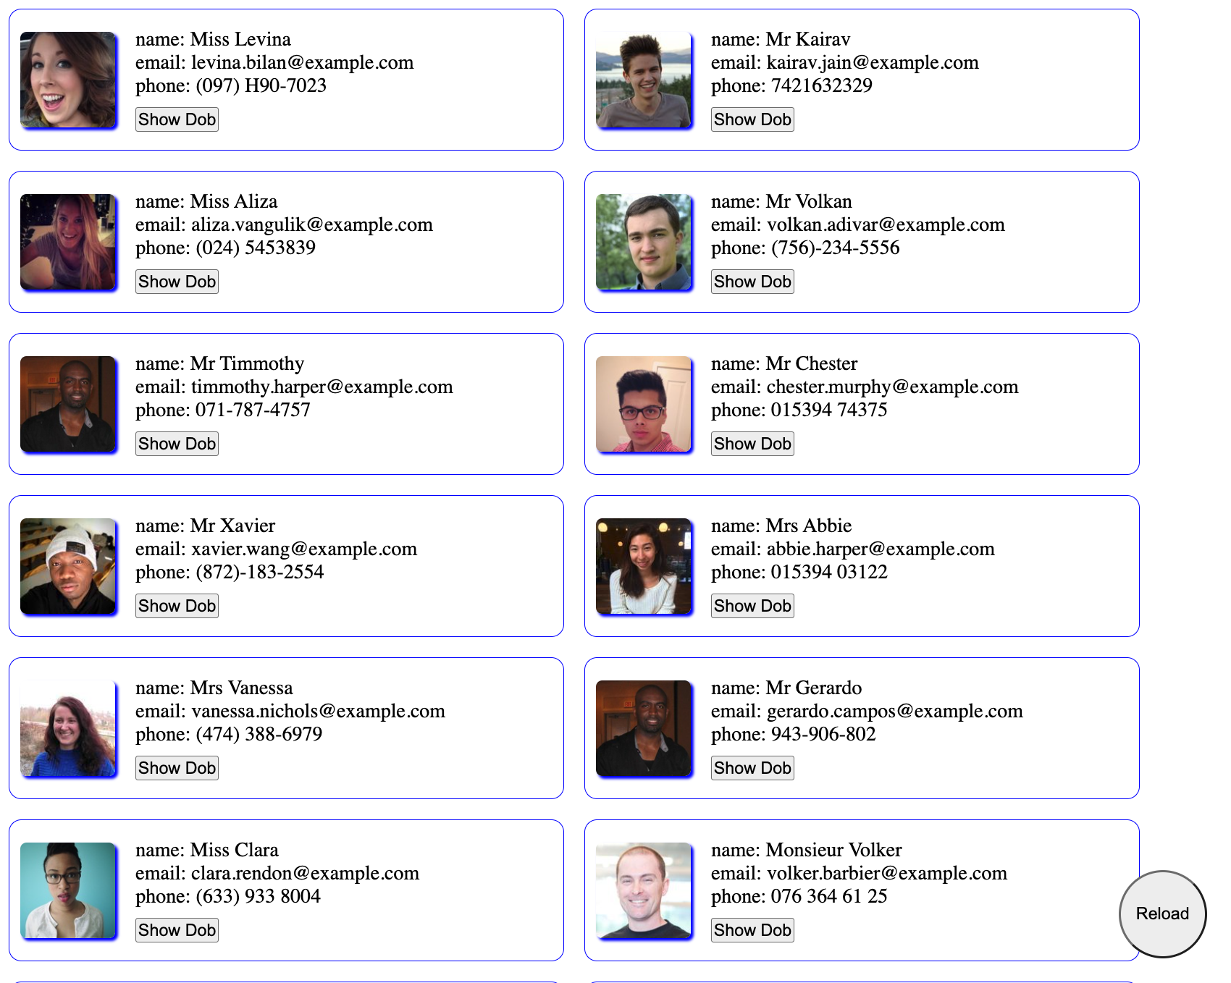
Overview:
Create a web page to list users by using only JavaScript, html, and CSS, no any other library.
You can look up syntax online, -- Google is your friend!
Please reply the Evaluation message in Slack by your link before 6pm EST, Sep 30, 2022;
Your link can be your repository or online code editor

Slide 3
Instructions:
Step 1 (Create the cards)
- Make 20 calls to the API below to get 20 Users. (This API generates random User data each call):
https://randomuser.me/api
Display 1 card per User from the API response;
Populate each card with the User’s name, email, phone number, and picture.
Step 2 (Add additional features to the cards)
Show User’s Date of Birth, but user a reveal pattern so they have to toggle something to display these values;
Fix a reload button at the right bottom corner of the page, when click it these user cards will reload.

Slide 4
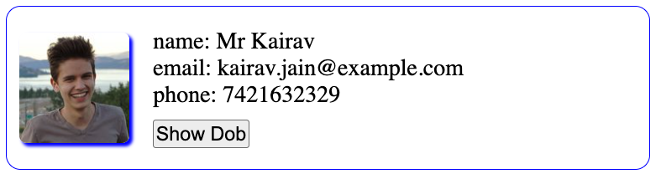

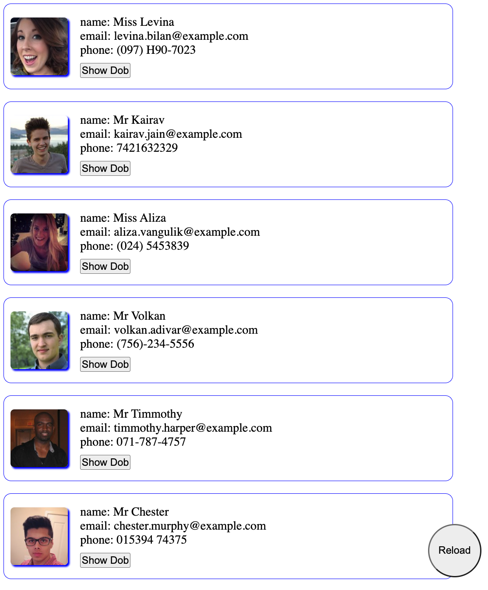
Some details:
Style your card like this,
Consider responsive page, base on viewpoint change.

Slide 5

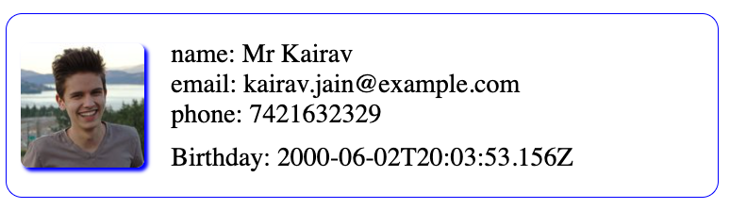
Some details:
Toggle button to hide and show users date of birth.
click
click

Slide 6
About the API: https://randomuser.me/api
Check the response first, each request only give you only one random user
In the user object, it’s ID is another object, you may overwrite it by a random ID if you need it
Here is small function can help you for the random ID:
const generateRandomId = () => {
const resouse =
"ABCDEFGHIJKLMNOPQRSTUVWXYZ0123456789abcdefghijklmnopqrstuvwxyz";
const length = 12;
let id = "";
for (let i = 0; i <= length; i++) {
const index = Math.floor(Math.random() * resouse.length);
id += resouse[index];
}
return id;
}
Feel free too add any key into the user object in your local if you need it;

